Slide 1


K A R M A
-----------------------------------------------
--------------------------------------------
Joyce
Alicia
Allen

Slide 2

---------------------------------------------------------------------------------------------------------------------
PART 1
---------------------------------------------------------------------------------------------------------------------
Inspiration

Slide 3

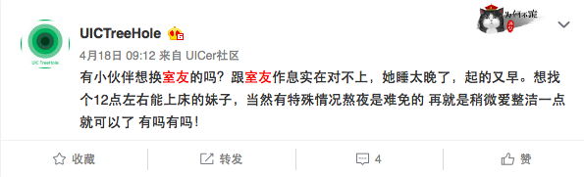
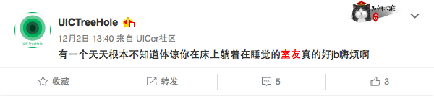
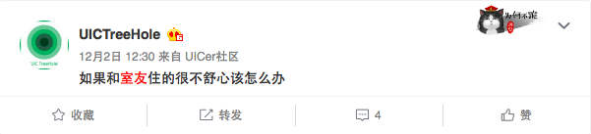
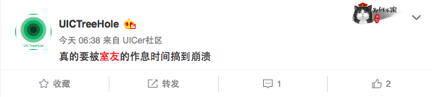
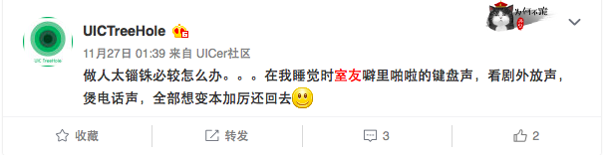
---------------------------------------------------------------------------------------------------------------------
PART 1
---------------------------------------------------------------------------------------------------------------------

Slide 4

---------------------------------------------------------------------------------------------------------------------
PART 1
---------------------------------------------------------------------------------------------------------------------
Interest
Character
Gender
Smoke
Clean
Wake Time
Bed Time

Slide 5

---------------------------------------------------------------------------------------------------------------------
PART 2
---------------------------------------------------------------------------------------------------------------------
Process

Slide 6
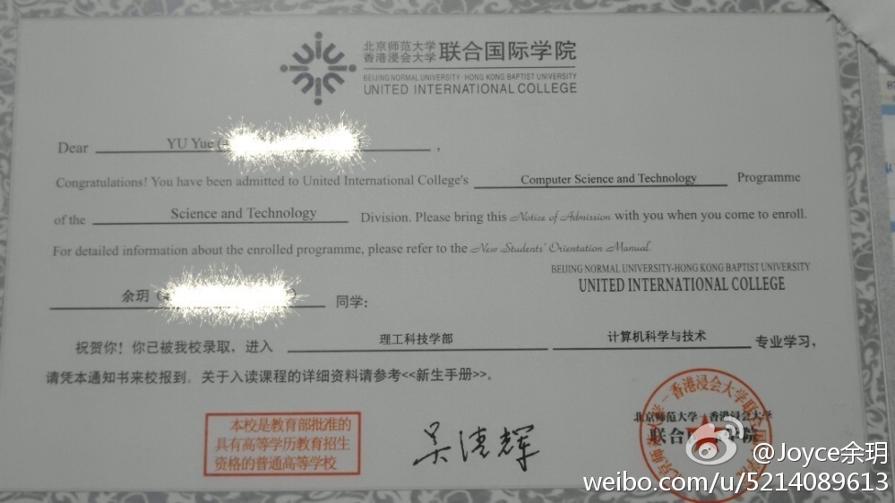
---------------------------------------------------------------------------------------------------------------------
PART 2
---------------------------------------------------------------------------------------------------------------------
Get Your basic Student information
Your Roommate
Your habit;
Your willing roommate;
Magic happens

Slide 7
---------------------------------------------------------------------------------------------------------------------
PART 2
---------------------------------------------------------------------------------------------------------------------
If you have input your information already:
  You can see your information immediately;
  You cannot change it anymore;
If it is your first time to run karma:
  You can save your habit and willing;

Slide 8
---------------------------------------------------------------------------------------------------------------------
PART 2
---------------------------------------------------------------------------------------------------------------------
Once you submit your information
  You cannot find your roommate directly;
  You need to login again and then click find button;
If administrator want to see the result:
  Input “admin” in ID Text-Box;
  One exclusive page to show the completed pairings.

Slide 9

---------------------------------------------------------------------------------------------------------------------
PART 3
---------------------------------------------------------------------------------------------------------------------
Implementation

Slide 10
---------------------------------------------------------------------------------------------------------------------
PART 3
---------------------------------------------------------------------------------------------------------------------
Find Roommates
User:
1. Match by habits and wills
2. Avoid different gender living together
3. Avoid select oneself
4. Your roommate cannot find if there no proper student you want.
Admin: 1. Find out all of couples who have been matched

Slide 11
D E M O
-----------------------------------------------
--------------------------------------------
Thank You

