Slide 1
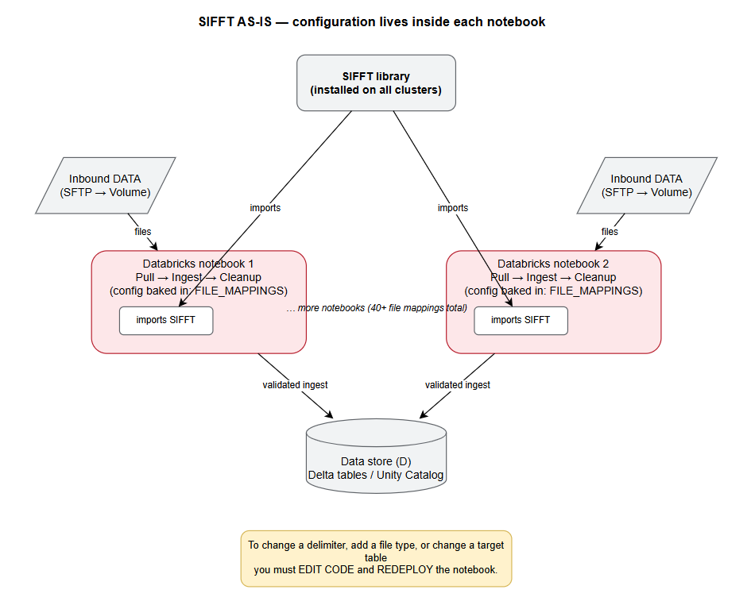
The Problem
SIFFT (https://github.com/dvla/sifft) - the tool developed by DVLA's Data Platform engineers is used to load data files into tables (loads 50+ file types a day (Drivers, Vehicles, Lookups)).
How each file is read and written is hard-coded in the pipeline.
  Any change = edit code + redeploy.
  Slow
  needs developer access
  a mistake can break the daily job

Slide 2
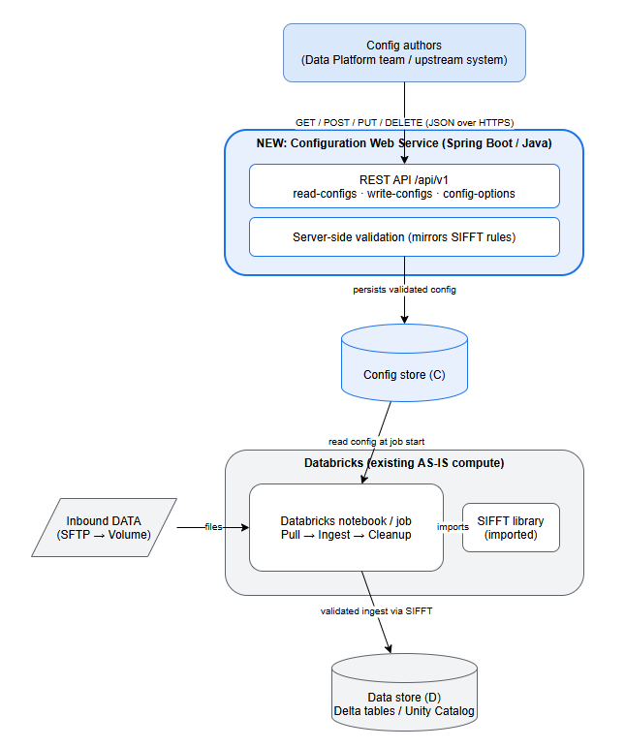
The Proposal
A web service that manages the configuration as three resources:
  read-configs - how a file is read (delimiter, columns)
  write-configs - how its table is written (format, mode)
  config-options - the allowed values (read-only)
Every change will be validated, so bad config is rejected up front.
This is scope / focus
This is not in scope for WBP

Slide 3
Scope & Ask
Scope:
  DOES: manage + validate config, return proper JSON and HTTP codes.
  DOES NOT: Running Spark / the pipeline — it manages config only, doesn't run Spark.
  DOES NOT: include the notebook "glue" change — swapping get_file_mapping() to read from the store isn't built.
  DOES NOT: have a live Java - Python integration — the two only share config data, never call each other.
Ask:
  Complex enough?
  Scope acceptable?
  Any design concerns?
  Postman to run operations on the config change sufficient?

Slide 4
• What is NOT in scope for the planned SIFFT config improvement (the sifft-config-api proof-of-concept).
The planned improvement is a Java/Spring Boot web service that externalises SIFFT's ingestion config out of hard-coded Python (FILE_MAPPINGS, TableWriteOptions) into a managed, validated REST-driven store. It manages three resources — read-configs, write-configs, config-options.
What is explicitly out of scope:
1. The service does NOT run the data pipeline / Spark. The web service only validates and stores configuration. The actual data loading (reading files, validation, writing to Delta tables) remains the existing SIFFT/Databricks job, unchanged.
2. The "glue" change to the Databricks notebook is NOT built. The one piece that is neither built nor already existing
is making the notebook read config from the new store instead of from its hard-coded FILE_MAPPINGS (i.e. swapping
get_file_mapping() to call the config store/API). The session states this is "a small change to the notebook… and it's
out of scope for your PoC." So:
complete solution = new web service + notebook change (not built) + existing SIFFT (unchanged).
3. No persistent/production datastore. The PoC will use an in-memory option. A real database or persistent config
table is out of scope (noted as "in a real deployment it'd be a persistent database").
4. No live Java↔Python integration. By design, the two systems never call each other — they only share config data.
There is no Java-calling-Python bridge or live connection in scope.
5. The report prose and deliverables are deliberately NOT produced by the tool. A kept boundary: the docs are
"structured notes and tables, not finished report prose" — the report writing, Postman screenshots, and diagram
PNG/SVG rendering are left to the user.
Separately, there's a set of "cross-cutting concerns" the session flags as necessary for any real self-hosted HTTP
exposure but which the PoC does not implement — effectively future/out-of-scope hardening:
- Freezing the mutable global registries to startup-only (they're a per-request race hazard)
- Server-side credential resolution (storage_options must not come from request bodies)
- Path/URI allow-listing to prevent traversal/SSRF on file_path inputs
- Caching/offline handling of pyld's network I/O during CSVW expansion
- Observability (request IDs, structured logs, throughput/queue metrics)
- Row-level validation results + a quarantine/rejects output (today CSVW validation reports aggregate counts only)
One caveat on sourcing: these points come from an exported chat session, not a formal scope document, so they reflect
that conversation's framing of the project. If there's a specific scope statement in the project's own docs/ (e.g.
DESIGN_SPEC.md, MEETING_BRIEF.md) you'd like me to cross-check against, those files live in
C:\WSD_WBP\sifft-config-api\docs\ and I can read them directly.

