Slide 1
Finding f(n)

Slide 2
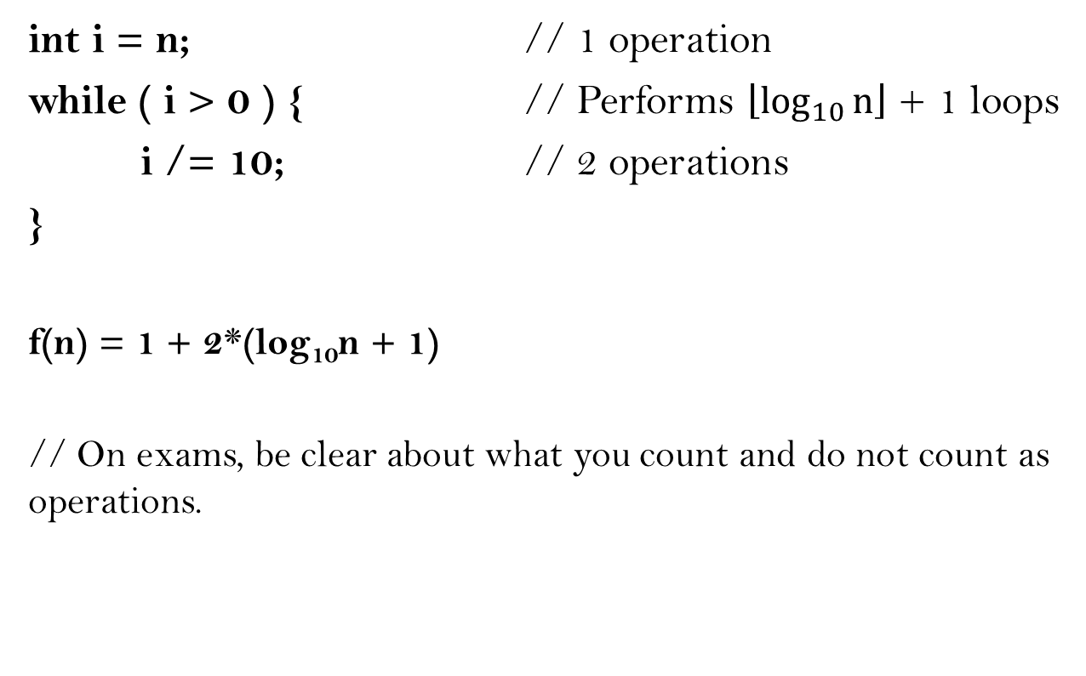
Finding f(n)
int i = n; // 1 operation
while ( i > 0 ) { // Performs $\left\lfloor \log_{10}{n}\right\rfloor$ + 1 loops
i /= 10; // 2 operations
}
f(n) = 1 + 2*(log₁₀n + 1)
// On exams, be clear about what you count and do not count as operations.

Slide 3

Finding f(n)
int i = n; // 1 operations
while ( i > 0 ) { // Performs $\left\lfloor \log_{2}{n}\right\rfloor$ + 1 loops
for ( j = 1; j <= n; ++j ) { // Performs n iterations
s++; // 2 operations.
}
i /= 2; // 2 operations.
}
f(n) = 1 + 2n(log₂n + 1) + 2*(log₂n + 1 )

Slide 4

Finding f(n)
int i = n; // 1 operation
for( j = 1; j <= n; ++j ) { // Performs 1 iteration
while ( i > 0 ) { // Performs $\left\lfloor \log_{2}{n}\right\rfloor$ + 1 loops
i /= 2; // 2 operations.
}
}
f(n) = 1 + 2*(log₂n + 1)

Slide 5
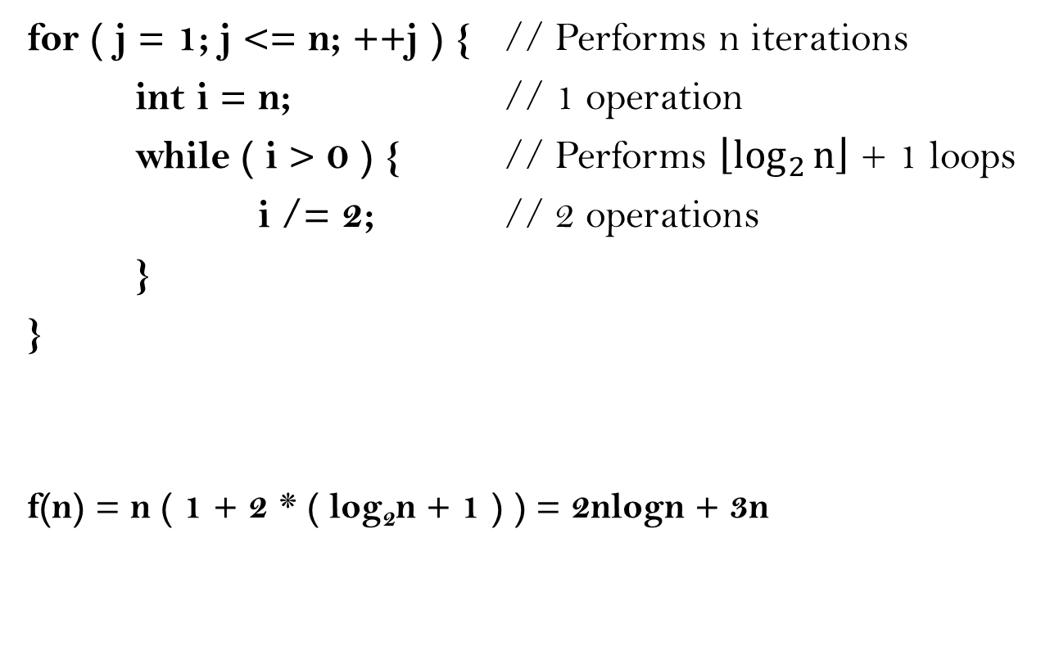
Finding f(n)
for ( j = 1; j <= n; ++j ) { // Performs n iterations
int i = n; // 1 operation
while ( i > 0 ) { // Performs $\left\lfloor \log_{2}{n}\right\rfloor$ + 1 loops
i /= 2; // 2 operations
}
}
f(n) = n ( 1 + 2 * ( log₂n + 1 ) ) = 2nlogn + 3n

Slide 6
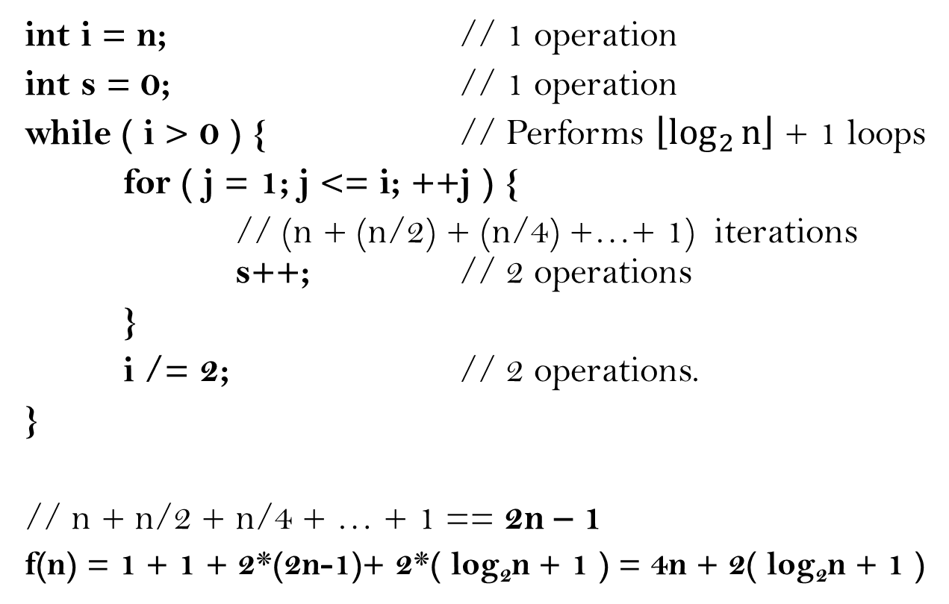
Finding f(n)
int i = n; // 1 operation
int s = 0; // 1 operation
while ( i > 0 ) { // Performs $\left\lfloor \log_{2}{n}\right\rfloor$ + 1 loops
for ( j = 1; j <= i; ++j ) {
// (n + (n/2) + (n/4) +…+ 1) iterations s++; // 2 operations
}
i /= 2; // 2 operations.
}
// n + n/2 + n/4 + … + 1 == 2n – 1
f(n) = 1 + 1 + 2*(2n-1)+ 2*( log₂n + 1 ) = 4n + 2( log₂n + 1 )

Slide 7
Classifying Algorithms

Slide 8
Classifying Algorithms
To show that f(n) is O(g(n)), show there exists a constant C such that:
f(n) ≤ C*g(n) for all n>n_{o}, where n_{o} is a constant.

Slide 9
Classifying Algorithms
This can be done by obtaining the running-time function, then picking the term with the highest order
f(n) = 3n^{n} + 2^{n} ~ O(n^{n})
f(n) = n³ + n² + 2n ~ O(n³)
f(n) = n²logn + nlogn ~ O( n²logn)
f(n) = nlogn + n ~ O( nlogn)

Slide 10
Classifying Algorithms
Justification:
f(n) = 3n^{n} + 2^{n} < 3n^{n} + n^{n} = 4n^{n}
f(n) = n³ + n² + 2n < n³ + n³ + n³ = 3n³
f(n) = n²logn + nlogn < n²logn + n²logn
= 2n²logn
f(n) = nlogn + n < nlogn + nlogn = 2nlogn

Slide 11
Classifying Algorithms
int i = n;
while ( i > 0 ) {
i /= 10;
}
f(n) = 1 + 2*(log₁₀n + 1)
~ O( log₁₀n ) ≈ O( log₂n )

Slide 12
Classifying Algorithms
int i = n;
while ( i > 0 ) {
for ( j = 1; j <= n; ++j ) {
s++;
}
i /= 2;
}
f(n) = 1 + 2n(log₂n + 1) + 2*(log₂n + 1 )
~ O( nlog₂n )

Slide 13
Classifying Algorithms
int i = n;
for( j = 1; j <= n; ++j ) {
while ( i > 0 ) {
i /= 2;
}
}
f(n) = 1 + 2*(log₂n + 1)
~O( log₂n )

Slide 14
Classifying Algorithms
for ( j = 1; j <= n; ++j ) {
int i = n;
while ( i > 0 ) {
i /= 2;
}
}
f(n) = 2nlogn + 3n
~O( nlog₂n )

Slide 15
Classifying Algorithms
int i = n;
int s = 0;
while ( i > 0 ) {
for ( j = 1; j <= i; ++j ) {
s++;
}
i /= 2;
}
f(n) = 4n + 2( log₂n + 1 )
~ O( n )

Slide 16
Writing Algorithms

Slide 17
Writing Algorithms
Find the inner product of two vectors, v1 and v2, each of size n.
int innerProduct( vector<int> v1, vector<int> v2, int n) {
int product = 0; // 1 operation
for ( int i = 0; i < n; ++i ) { // n iterations
product = product + v1[i] * v2[i] ;
// 3 operations
}
return product; // 1 operation
}
f(n) = 2 + 3n ~ O( n )

Slide 18
Writing Algorithms
Find the number of occurrences of an element t in a vector of size n
int occurs( elem t, vector<elem> v, int n) {
int count = 0; // 1 operation
for( int i = 0; i < n; ++i ) { // n iterations
if ( t == v[i] ) { // 1 comparison
++count; // 2 operations
}
}
return count; // 1 operation
}
Best case: f(n) = 2 + n // No occurrences of t
Worst case: f(n) = 2 + 3n // n occurrences of t
~ O( n )

Slide 19
Writing Algorithms
Concatenate two strings, each of size n
char* concatenate( char* s1, char* s2, int n) {
char* newString = new char[ n * 2 ]; // 1 operation
for( int i = 0; i < n; ++i ) { // n iterations
newString[i] = s1[i]; // 1 operation
newString[ i + n ] = s2[i]; // 1 operation
}
return newString; // 1 operation
}
f(n) = 2 + 2n ~ O( n )

Slide 20
Writing Algorithms
Remove the i’th element of an array
int* remove( int index, int n, int* oldArray) {
int* newArray = new int[ n -1 ]; // 1 operation
int k = 0; // 1 operation
for( int i = 0; i < n; ++i ) { // n iterations
if ( i == index ) { // 1 comparison
// Do nothing
}
else {
newArray[k] = oldArray[i]; // 1 operation
++k; // 2 operations
}
}
return newArray; // 1 operation
}
f(n) = 4n ~ O( n )

Slide 21
Writing Algorithms
Sum all elements in a vector less than 43
int sum43( vector<int> v, int n ) {
int sum = 0; // 1 operation
for ( int i = 0; i < n; ++i ) { // n iterations
if ( v[i] < 43 ) { // 1 comparison
sum = sum + v[i]; // 2 operations
}
}
return sum; // 1 operation
}
Best case: f(n) = 2 + n // No elements less than 43
Worst case: f(n) = 2 + 3n // All elements less than 43
~ O( n )

Slide 22
Writing Algorithms
Add element to the beginning of a vector
void prepend( int elem, vector<int>& v, int n ) {
vector<int> newVec; // 1 operation
newVec.push_back( elem ); // 1 operation
for ( int i = 0; i < n; ++i ) { // n iterations
newVec.push_back( v[i] ); // 1 operation
}
v = newVec; // 1 operation
}
f(n) = 3 + n ~ O( n )

Slide 23
Writing Algorithms
Add element to the end of a vector
void append( int elem, vector<int>& v ) {
v.push_back( elem ); // 1 operation
}
f(n) = 1 ~ O( 1 )

