Slide 1
Beginning: “Divide and Conquer”
How do we find the Big-O?
Recurrence Relations

Slide 2
…as opposed to solving the entire problem at once.
…and solving it by solving smaller, simpler problems first
Divide-and-Conquer is about taking a large problem…

Slide 3
5
10
15
20
25
30
35
40
40
find( 40 )
A popular example is Binary Search.
Unlike the more common Linear Search, who simply knocks at each element’s door until it finds what it is looking for…
Binary Search starts at the midpoint.
If the value it is searching for is at the midpoint, then Binary Search stops.
Otherwise, it cuts the problem in half, focusing on only the half that contains what it is looking for.

Slide 4
40
10
30
15
35
25
5
20
10
15
30
40
5
20
25
35
Another common example is Merge Sort.
Merge Sort divides the problem into two sub-problems.
Once the two sub-problems are complete, both
sub-arrays will be sorted.
Thereafter, Merge Sort simply joins the two sub-arrays back together.

Slide 5
5
4!
5!
120
*
*
4
3!
24
*
*
*
*
3
2!
6
*
*
*
*
*
*
2
1!
2
Instead of computing the answer at once, we worked our way down to the simplest problem, then built our way back up.
One last example is the Factorial (!) Algorithm…
*
*
*
*
1

Slide 6
With Merge Sort, we split the problem into two sub-problems, then joined their solutions.
With Binary Search, we sped things up by eliminating multiple choices at once.
And with Factorial, we broke the problem down to its simplest form, before building our way back up.
No matter what kind of Divide-and-Conquer you use, the premise is always the same:
In summary, there are multiple ways “Divide-and-Conquer” can be employed.
Solve the problem by solving smaller, simpler ones first.

Slide 7
That all being said, there still remains one question
we haven’t addressed.

Slide 8
Previously, when studying how to find F(n), we simply counted the operations.
But how do you count recursive statements, like Factorial(n-1)?
How is the Big-O found for a Divide-and-Conquer Algorithm?
Truth is we cannot.
To find the Big-O, we’ll need a different method.
int Factorial( int n ) {
  if ( n <= 1 )
  // 1 operation
  return 1;
  // 1 operation
else
return n * Factorial( n – 1 );
}

Slide 9
Recurrence Relations

Slide 10
Writing Recurrence Relations
Solving Recurrence Relations

Slide 11
Recurrence Relations describe Divide-and-Conquer Algorithms in a way that enables us to find F(n).
To make one, there are 5 characteristics
we must know.

Slide 12
1. How many sub-problems are formed?
40
10
30
15
35
25
5
20
Example: For Merge Sort, that answer is 2.

Slide 13
2. What portion of the input does each
sub-problem receive?
40
10
30
15
35
25
5
20
For Merge Sort, that answer is 1/2.

Slide 14
3. How long does it take to form the
sub-problems?
40
40
10
10
30
30
15
15
35
35
25
25
5
5
20
20
If we assume the sub-arrays are formed by copying each element, then the process is O(n).

Slide 15
4. When does the algorithm stop splitting the problem?
40
10
30
15
35
25
5
20
Merge Sort stops splitting the problem when the input size for each sub-problem is 1. From there, Merge Sort begins combining the sub-arrays back together.

Slide 16
5. How long does it take to combine the solutions together?
10
15
30
40
5
20
25
35
For Merge Sort, this is O(n).

Slide 17

T(n) =
T(n/2) + T(n/2)
T(n) + T(n)
+ O(n)
+ O(n)
= 2 * T(n/2) + O(n)
T(1) =
1
Once these characteristics are known, we can form our Recurrence Relation.
1st: Refer to the problem as T(n), where n
is the input size.
Merge Sort forms two sub-problems.
Both sub-problems receive
1/2 of the input.
It takes O(n) time to set up these two sub-problems.
And it takes O(n) time to combine their solutions.
This simplifies to…
Lastly, Merge Sort stops splitting when
n == 1…
…and the running time in this case is simply 1, since Merge Sort just returns in this case.

Slide 18
T(n) =
T(n)
T(n/2)
+ O(1)
+ O(1)
= T(n/2) + O(1)
T(1) =
1
This can also be applied to Binary Search.
Unlike Merge Sort, Binary Search forms
one sub-problem.
This sub-problem focuses on
half of the input.
Unlike the Merge Sort we illustrated, Binary Search does not need to create a new array.
It just makes a recursive call on the left or right half
of the input.
(This is called working in-place. Merge Sort can be done this way as well)
Once the solution is found, the algorithm simply returns. Hence, the combining phase is O(1) as well.
This simplifies to…
Binary Search stops dividing the input when n == 1.
Either way, Binary Search simply returns. Hence, the running time for T(1) is 1.
At this point, the element is either found,
or does not exist in the array.

Slide 19
T(n) =
T(n)
T(n-1)
+ O(1)
+ O(1)
= T(n-1) + O(1)
T(1) =
1
We’ll do this once more for Factorial.
Factorial forms just one sub-problem.
The input size gets decreased by
just one.
This is done with a simple recursive call.
Once the recursive call returns, Factorial performs one multiplication, which is also O(1).
Factorial stops making recursive calls when n == 1.
At this point, it simply returns 1, which is one operation.

Slide 20
T(n) = 4 * T(n/4) + O(n)
T(1) =
1
It also helps, when given a recurrence relation, to be able to interpret it. For example…
This states that the algorithm creates 4 sub-problems, and each of them receive 1/4 of the input
…and that the combined time it takes to set up these
sub-problems and combine their solutions is
O(n).
And lastly, the running-time upon reaching the base case, T(1), equals 1.

Slide 21
T(n) = T(n/4) + T(3n/4) + O(n²)
T(1) =
3
Similarly…
This states that the algorithm forms 2
sub-problems.
One of them receives 1/4 of the input, while the other receives 3/4 of it.
The combined time it takes to set up these sub-problems and combine their solutions is O(n²).
And its running-time upon reaching the
base-case, T(1), equals 3.

Slide 22
There are 4 ways this can be done.
This first way is Substitution.
Finding the Big-O for a Recurrence Relation

Slide 23
Substitution
Iterative Method
Tree Method
The Master Theorem

Slide 24
T(n) = 2 * T(n/2) + n
= 2 * c * n/2 + n
= 2 * c * n/2 * log(n/2) + n
= c * n + n
= c * n * log(n/2) + n
= (c + 1) * n
= c * n * (logn – log2) + n
≤ c * n ???
= c * n * (logn – 1) + n
1st step: Guess what the Big-O is.
First guess:
O(n)
Substitute c * n for T(n).
If your guess is accurate, then the function you come up with should be less than or equal to your original guess.
FALSE.
Hence, our guess was inaccurate.
Second guess:
O(nlogn)
Substitute c * nlogn for T(n)
…when c ≥ 1
= c * n logn - c * n + n
Hence, T(n) is O(nlogn)
≤ c * nlogn???

Slide 25
The next way is the Iterative Method.

Slide 26
T(n) = 2 * T(n/2) + n
= 2 * ( 2 * T(n/4) + n/2 ) + n
= n * c + nlogn
= 2 * ( 2 * ( 2 * T(n/8) + n/4 ) + n/2 ) + n
T(n) is O(nlogn)
= 2 * ( 2 * ( 2 * ( 2* T(n/16) + n/8 ) + n/4 ) + n/2 ) + n
…
= 2^{i} * T(n/2^{i}) + i * n
Repeatedly plug in the formula for T(n).
If the base case is T(1), then the max value for i is logn.
T(1) == c.
The base case always equals a constant.
= 2^{logn} * T(n/2^{logn}) + logn * n
= n * T(1) + nlogn

Slide 27
The third way is the Tree Method.

Slide 28
The next step is finding the time spent at each level.
Level 1:
n
Level 2:
n/2 + n/2 = n
Level 3:
4 * n/4 = n
Level logn:
n * 1 = n
Once the total time spent at each level is found, sum them to get F(n).
Since there are logn levels, and the time spent at each level equals n…
The running time equals:
n * logn
= O(nlogn)
T(n/2)
T(n/2)
T(n)
T(n) = 2 * T(n/2) + n
T(1) = 1
T(n/4)
T(n/4)
T(n/4)
T(n/4)
Merge Sort
…
T(n) creates two sub-problems.
Each with input-size n/2.
T(n/2) creates two sub-problems.
Each with input size n/4.
This process continues until the base-case, T(1), is reached.
…
T(1)
T(1)
T(1)
T(1)
T(1)
T(1)
…

Slide 29
The time spent at each level is O(1).
Since there are logn levels total…
The running time equals
logn * O(1)
= O(logn)
T(n/2)
T(n)
T(n) = T(n/2) + O(1)
T(1) = 1
T(n/4)
Binary Search
T(n) creates one sub-problem,
with input size n/2.
T(n/2) creates one sub-problem as well,
with input size n/4.
This process continues until the base-case, T(1), is reached.
…
T(1)

Slide 30
The time spent at each level is O(1).
Since there are n levels total…
The running time equals
n * O(1)
= O(n)
T(n-1)
T(n)
T(n) = T(n-1) + O(1)
T(1) = 1
T(n-2)
Factorial
T(n) creates one sub-problem,
with input size n-1.
T(n-1) creates one sub-problem as well,
with input size n-2.
…
T(1)

Slide 31
The final method is The Master Theorem.

Slide 32
The Master Theorem tests an algorithm
against 3 different cases.
The case that returns TRUE indicates
the running time of the algorithm.

Slide 33
T(n) = * T(n/ ) + f(n)
a
b
When a < b, part of the input gets left out during the recursive call.
Example: Binary Search
To understand how Master Theorem gets its solution, we must understand two key influences
…the first one being how a relates to b (whether a < b, a > b, or a == b).

Slide 34
T(n) = T(n/2) + O(1)
T(n/2)
T(n)
Binary Search throws half of its input away during each recursive call.
As a result, the size of the problem decreases as we move down the tree.
The rate at which the size decreases will effect the running time of the algorithm.
T(n/4)
…

Slide 35
When a == b, the input gets evenly distributed amongst the sub-problems.
Example: Merge Sort

Slide 36
Because a == b, the input gets evenly distributed. Hence the size is identical at each level of the tree.
T(n) = 2 * T(n/2) + O(n)
T(n/2)
T(n/2)
T(n)
T(n/4)
T(n/4)
T(n/4)
T(n/4)
…
…

Slide 37
And lastly, when a > b, the original input gets expanded.

Slide 38
Because a > b, the input gets expanded, causing the size of the problem to increase as we go down the tree
T(n) = 4 * T(n/2) + O(n)
T(n/2)
T(n/2)
T(n/2)
T(n/2)
T(n)
T(n/4)
T(n/4)
T(n/4)
T(n/4)
T(n/4)
T(n/4)
T(n/4)
T(n/4)
T(n/4)
T(n/4)
T(n/4)
T(n/4)
T(n/4)
T(n/4)
T(n/4)
T(n/4)
…
…
…
…
…

Slide 39
In summary, how a relates to b controls the rate of growth (or shrinkage) of the problem as we go down the tree.
We refer to this rate of growth as
n^{c}, where c = log_{b}a.

Slide 40
T(n) = a * T(n/b) + f(n)
The Master Theorem finds its solution by comparing the rate of growth, n^{c}, to f(n).
The one that is asymptotically larger (greater as n approaches infinity) is the one that has more influence on the running time, F(n).
While a and b influence the size of the problem at each level of the tree,
f(n) influences the time spent at each level.
The 2nd key influence on the running time is f(n).

Slide 41
Case 1:
IF: f(n) is O(n^{c})
THEN: T(n) is O(n^{c})
where c = log_{b}a.
Example: 4*T(n/2) + n

Slide 42
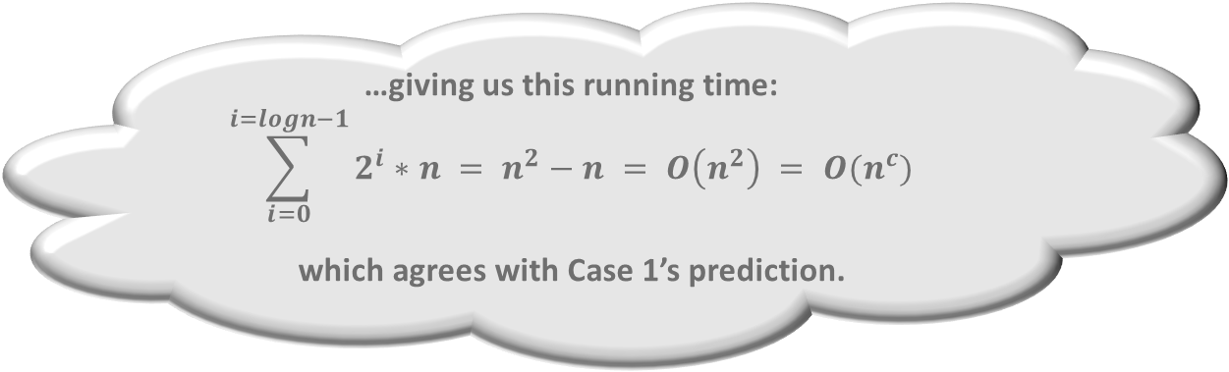
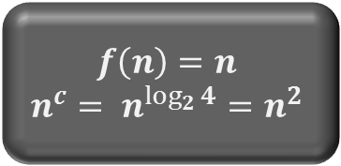
$$f\left(n\right)=n$$
$$n^{c}= n^{\log_{2}{4}}=n^{2}$$
T(n) = 4 * T(n/2) + n
n / 2
n / 2
n / 2
n / 2
n
The time spent at the top level is always f(n).
n / 4
n / 4
n / 4
n / 4
n / 4
n / 4
n / 4
n / 4
n / 4
n / 4
n / 4
n / 4
n / 4
n / 4
n / 4
n / 4
The time spent at the second level is:
4 * n/2 = 2n
…giving us this running time:
$$\sum_{i=0}^{i=logn−1}{2^{i}∗n = n^{2}−n = O\left(n^{2}\right) = O(n^{c})}$$
which agrees with Case 1’s prediction.
Clearly, the time we spend at each level increases as we move down the tree.
Since the input is repeatedly split in half, the total number of levels will be log₂n...
The time spent at the third level equals:
16 * n/4 = 4n

Slide 43
Case 2:
IF: f(n) is Θ(n^{c})
THEN: T(n) is O(n^{c} logn)
where c = log_{b}a.
Example: 2*T(n/2) + n

Slide 44
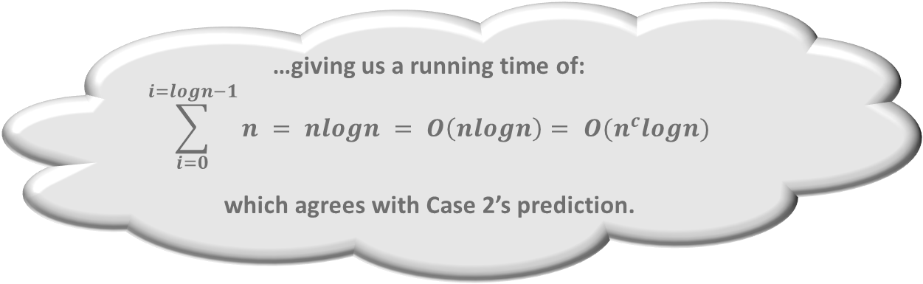
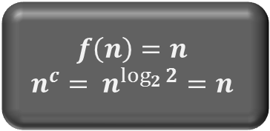
$$f\left(n\right)=n$$
$$n^{c}= n^{\log_{2}{2}}=n$$
T(n) = 2 * T(n/2) + n
n
n / 2
n / 2
n / 4
n / 4
n / 4
n / 4
…giving us a running time of:
$$\sum_{i=0}^{i=logn−1}{n = nlogn = O\left(nlogn\right)= O(n^{c}logn)}$$
which agrees with Case 2’s prediction.
The time spent at each level
equals n, and there are log₂n levels
…
…

Slide 45
Case 3:
IF: f(n) is Ω(n^{c})
AND: a*f(n/b) < d*f(n)
where d < 1
THEN: T(n) is O( f(n) )
where c = log_{b}a.
Example: 2*T(n/2) + n²

Slide 46

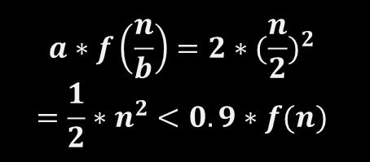
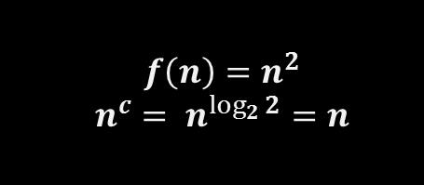
$$f\left(n\right)=n^{2}$$
$$n^{c}= n^{\log_{2}{2}}=n$$
$$a∗f\left(\frac{n}{b}\right)=2∗{(\frac{n}{2})}^{2}$$
$$=\frac{1}{2}∗n^{2}<0.9∗f(n)$$
T(n) = 2 * T(n/2) + n²
n²
n² / 4
n² / 4
n² / 16
n² / 16
n² / 16
n² / 16
In total, the running time is:
$$\sum_{i=0}^{i=logn−1}{\frac{n^{2}}{2^{i}} = 2n^{2}−2n=O\left(n^{2}\right)=O( f\left(n\right) )}$$
which agrees with Case 3’s prediction.
The time spent at the top level equals:
n²
And the time spent at the third level equals:
4 * n²/16 = n²/4
The time spent at the second level equals:
2 * n²/4 = n²/2
…
…

Slide 47
In summary, the 3 cases for Master Theorem are as follows (where c = log_{b}a):
Case 1: If f(n) is O(n^{c}), then T(n) is O(n^{c})
Case 2: If f(n) is Θ(n^{c}), then T(n) is O(n^{c}logn)
Case 3: If f(n) is Ω(n^{c}), and a * f(n/b) < d * f(n) for some constant d < 1, then T(n) is O( f(n) )

