Slide 2
Insert( e, x )
Min()
RemoveMin()

Slide 3
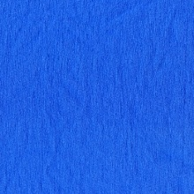
6
1
3
7
8
5
4
9
2

Slide 4
Summary
Unsorted Array
  Min O(n)
  RemoveMin O(n)
  Insert(e,x) O(1)
Sorted Array
  Min O(1)
  RemoveMin O(1)
  Insert(e,x) O(n)
Binary Heap
  Min O(1)
  RemoveMin O(log₂n)
  Insert(e,x) O(log₂n)
6
1
1
2
3
3
7
4
8
5
5
6
4
7
9
8
2
9

Slide 5
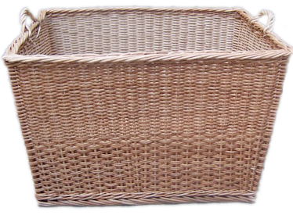
6
3
8
1
4
2
7
5
PQ

Slide 6
8
7
6
5
4
3
2
1
PQ

Slide 7
Sorted Array
n insertions:
n removemin:
Total:
Unsorted Array
n insertions:
n removemin:
Total:
n * O(1)
= O(n)
n * O(n)
= O(n²)
O(n + n²)
Selection Sort
= O(n²)

Slide 8
Sorted Array
n insertions:
n removemin:
Total:
Binary Heap
n insertions:
n removemin:
Total:
n * O(n)
= O(n²)
n * O(1)
= O(n)
O(n² + n)
Insertion Sort
= O(n²)

Slide 9
Binary Heap
n insertions:
n removemin:
Total:
n * O(log₂n)
= O(nlog₂n)
n * O(log₂n)
= O(nlog₂n)
O(2*nlog₂n)
Heap Sort
=O(nlog₂n)

Slide 10
“Thanks and gig’em Ags!”

Slide 11
c
‘a’
‘A’
‘d’
‘e’
‘g’
‘h’
‘i’
f(c)
2
1
1
1
3
1
1
‘k’
‘m’
‘n’
‘s’
‘T’
‘
!
1
1
2
2
1
1
1

Slide 12
PQ:
1 / A
1 / d
1 / e
1 / h
1 / i
1 / k
1 / m
1 / T
1 / ‘
1 / !
2 / a
2 / n
2 / s
3 / g

Slide 13
while PQ.size() > 1
T₁ = PQ.removeMin()
T₂ = PQ.removeMin()
Create a new node T
T.val = T₁.val + T₂.val
T.left = T₁
T.right = T₂
PQ.insert( T )

Slide 14
PQ:
1 / A
1 / A
1 / d
1 / d
1 / e
1 / h
1 / i
1 / k
1 / m
1 / T
1 / ‘
1 / !
2 / a
2 / n
2 / s
3 / g

Slide 15
T_{a} / 2
‘A’ / 1
‘d’ / 1

Slide 16
PQ:
1 / e
1 / e
1 / h
1 / h
1 / i
1 / k
1 / m
1 / T
1 / ‘
1 / !
2 / a
2 / n
2 / s
2 / T_{a}
3 / g
2 / T_{a}

Slide 17
T_{a} / 2
T_{b} / 2
‘A’ / 1
‘d’ / 1
‘e’ / 1
‘h’ / 1

Slide 18
PQ:
1 / i
1 / i
1 / k
1 / k
1 / m
1 / T
1 / ‘
1 / !
2 / a
2 / n
2 / s
2 / T_{a}
2 / T_{b}
3 / g
2 / T_{b}

Slide 19
T_{a} / 2
T_{b} / 2
T_{c} / 2
‘A’ / 1
‘d’ / 1
‘e’ / 1
‘h’ / 1
‘i’ / 1
‘k’ / 1

Slide 20
PQ:
1 / m
1 / m
1 / T
1 / T
1 / ‘
1 / !
2 / a
2 / n
2 / s
2 / T_{a}
2 / T_{b}
2 / T_{c}
3 / g
2 / T_{c}

Slide 21
T_{a} / 2
T_{b} / 2
T_{c} / 2
T_{d} / 2
‘A’ / 1
‘d’ / 1
‘e’ / 1
‘h’ / 1
‘i’ / 1
‘m’ / 1
‘k’ / 1
‘T’ / 1

Slide 22
PQ:
1 / ‘
1 / ‘
1 / !
1 / !
2 / a
2 / n
2 / s
2 / T_{a}
2 / T_{b}
2 / T_{c}
2 / T_{d}
3 / g
2 / T_{d}

Slide 23
T_{a} / 2
T_{b} / 2
T_{c} / 2
T_{d} / 2
T_{e} / 2
‘A’ / 1
‘d’ / 1
‘e’ / 1
‘h’ / 1
‘i’ / 1
‘k’ / 1
‘m’ / 1
‘ / 1
‘T’ / 1
‘!’ / 1

Slide 24
PQ:
2 / a
2 / a
2 / n
2 / n
2 / s
2 / T_{a}
2 / T_{b}
2 / T_{c}
2 / T_{d}
2 / T_{e}
3 / g
2 / T_{e}

Slide 25
T_{f} / 4
‘a’ / 2
‘n’ / 2
T_{a} / 2
T_{b} / 2
T_{c} / 2
T_{d} / 2
T_{e} / 2
‘A’ / 1
‘d’ / 1
‘e’ / 1
‘h’ / 1
‘i’ / 1
‘k’ / 1
‘m’ / 1
‘T’ / 1
‘ / 1
‘!’ / 1

Slide 26
PQ:
2 / s
2 / s
2 / T_{a}
2 / T_{a}
2 / T_{b}
2 / T_{c}
2 / T_{d}
2 / T_{e}
3 / g
4 / T_{f}
4 / T_{f}

Slide 27
T_{f} / 4
‘a’ / 2
‘n’ / 2
T_{g} / 4
T_{a} / 2
T_{a} / 2
‘s’ / 2
T_{b} / 2
T_{c} / 2
T_{d} / 2
T_{e} / 2
‘A’ / 1
‘d’ / 1
‘e’ / 1
‘h’ / 1
‘i’ / 1
‘k’ / 1
‘m’ / 1
‘T’ / 1
‘ / 1
‘!’ / 1

Slide 28
PQ:
2 / T_{b}
2 / T_{b}
2 / T_{c}
2 / T_{c}
2 / T_{d}
2 / T_{e}
3 / g
4 / T_{f}
4 / T_{g}
4 / T_{g}

Slide 29
T_{f} / 4
T_{g} / 4
‘a’ / 2
‘n’ / 2
T_{h} / 4
T_{a} / 2
‘s’ / 2
T_{b} / 2
T_{b} / 2
T_{c} / 2
T_{c} / 2
T_{d} / 2
T_{e} / 2
‘A’ / 1
‘d’ / 1
‘e’ / 1
‘h’ / 1
‘i’ / 1
‘k’ / 1
‘m’ / 1
‘T’ / 1
‘ / 1
‘!’ / 1

Slide 30
PQ:
2 / T_{d}
2 / T_{d}
2 / T_{e}
2 / T_{e}
3 / g
4 / T_{f}
4 / T_{g}
4 / T_{h}
4 / T_{h}

Slide 31
T_{f} / 4
T_{g} / 4
T_{h} / 4
‘a’ / 2
‘n’ / 2
T_{i} / 4
T_{a} / 2
‘s’ / 2
T_{b} / 2
T_{c} / 2
T_{d} / 2
T_{d} / 2
T_{e} / 2
T_{e} / 2
‘A’ / 1
‘d’ / 1
‘e’ / 1
‘h’ / 1
‘i’ / 1
‘k’ / 1
‘m’ / 1
‘T’ / 1
‘ / 1
‘!’ / 1

Slide 32
PQ:
3 / g
3 / g
4 / T_{f}
4 / T_{f}
4 / T_{g}
4 / T_{h}
4 / T_{i}
4 / T_{i}

Slide 33
T_{j} / 7
T_{f} / 4
T_{f} / 4
‘g’ / 3
T_{g} / 4
T_{h} / 4
‘a’ / 2
‘n’ / 2
T_{i} / 4
T_{a} / 2
‘s’ / 2
T_{b} / 2
T_{c} / 2
T_{d} / 2
T_{e} / 2
‘A’ / 1
‘d’ / 1
‘e’ / 1
‘h’ / 1
‘i’ / 1
‘k’ / 1
‘m’ / 1
‘T’ / 1
‘ / 1
‘!’ / 1

Slide 34
PQ:
4 / T_{g}
4 / T_{g}
4 / T_{h}
4 / T_{h}
4 / T_{i}
7 / T_{j}
7 / T_{j}

Slide 35
T_{j} / 7
T_{f} / 4
T_{k} / 8
T_{f} / 4
‘g’ / 3
T_{g} / 4
‘a’ / 2
‘n’ / 2
T_{g} / 4
T_{h} / 4
T_{h} / 4
T_{i} / 4
T_{a} / 2
‘s’ / 2
T_{b} / 2
T_{c} / 2
T_{d} / 2
T_{e} / 2
‘A’ / 1
‘d’ / 1
‘e’ / 1
‘h’ / 1
‘i’ / 1
‘k’ / 1
‘m’ / 1
‘T’ / 1
‘ / 1
‘!’ / 1

Slide 36
PQ:
4 / T_{i}
4 / T_{i}
7 / T_{j}
7 / T_{j}
8 / T_{k}
8 / T_{k}

Slide 37
T_{l} / 11
T_{j} / 7
T_{i} / 4
T_{j} / 7
T_{f} / 4
T_{k} / 8
T_{f} / 4
‘g’ / 3
T_{g} / 4
T_{h} / 4
‘a’ / 2
‘n’ / 2
T_{i} / 4
T_{a} / 2
‘s’ / 2
T_{b} / 2
T_{c} / 2
T_{d} / 2
T_{e} / 2
‘A’ / 1
‘d’ / 1
‘e’ / 1
‘h’ / 1
‘i’ / 1
‘k’ / 1
‘m’ / 1
‘T’ / 1
‘ / 1
‘!’ / 1

Slide 38
PQ:
8 / T_{k}
8 / T_{k}
11 / T_{l}
11 / T_{l}
11 / T_{l}

Slide 39
T_{m} / 19
T_{m} / 19
T_{k} / 8
T_{k} / 8
T_{l} / 11
T_{l} / 11
T_{l} / 11
T_{j} / 7
T_{i} / 4
T_{j} / 7
T_{f} / 4
T_{k} / 8
T_{f} / 4
‘g’ / 3
T_{g} / 4
T_{h} / 4
‘a’ / 2
‘n’ / 2
T_{a} / 2
‘s’ / 2
T_{b} / 2
T_{c} / 2
T_{d} / 2
T_{e} / 2
‘A’ / 1
‘d’ / 1
‘e’ / 1
‘h’ / 1
‘i’ / 1
‘k’ / 1
‘m’ / 1
‘T’ / 1
‘ / 1
‘!’ / 1

Slide 40
0
1
0
1
T_{m} / 19
0
1
T_{k} / 8
T_{l} / 11
T_{l} / 11
0
1
T_{j} / 7
T_{i} / 4
T_{j} / 7
0
1
0
1
T_{f} / 4
T_{f} / 4
‘g’ / 3
0
1
T_{g} / 4
T_{h} / 4
‘a’ / 2
‘n’ / 2
0
1
0
1
0
1
T_{a} / 2
‘s’ / 2
T_{b} / 2
T_{c} / 2
T_{d} / 2
T_{e} / 2
0
1
0
1
0
1
0
1
0
1
‘A’ / 1
‘d’ / 1
‘e’ / 1
‘h’ / 1
‘h’ / 1
‘i’ / 1
‘k’ / 1
‘m’ / 1
‘T’ / 1
‘ / 1
‘!’ / 1

Slide 41
Running Time
Each vertex and edge gets visited once.
Thus, the total running time is O( n + m ) for a graph with n vertices and m edges.
(Assuming each visit takes O(1) time)

Slide 42
L₀
L₁
L₁
L₂
L₂
L₃
L₃
L₄
L₄
L₅
L₅
L₁
L₁
L₄
L₄
L₁
Running Time
Each vertex and edge gets visited once.
Thus, the total running time is O( n + m ) for a graph with n vertices and m edges.
(Assuming each visit takes O(1) time)
L₁
L₂
L₂
L₂
L₂
L₃
L₃
L₃
L₃
L₃
L₃
L₄
L₃
L₄
L₃
I
I
I
V
I
I
V
I
I
L₄
L₄

Slide 43
b
b / ∞
a
b / 50
a / 0
50
98
121
88
129
g
g / ∞
g / 171
g / 140
c
c / ∞
77
c / 214
11
f
f / ∞
f / 129
64
47
31
38
e / ∞
e
e / 167
d / 268
d
d / ∞
d / 245
101
0 + 50 < ∞
0 + 129 < ∞
50 + 121 < ∞
129 + 11 < 171
129 + 38 < ∞
140 + 98 > 0
140 + 64 > 167
167 + 47 < ∞
167 + 101 < ∞
214 + 88 > 50
214 + 77 > 140
214 + 31 < 268

Slide 44
Running Time
If we use:
a Heap-based Priority Queue to store all n vertices
removeMin() to finalize the vertices
decreaseKey() (with locators) to update vertices after relaxing their edges
then we spend:
O(nlogn) time building the Priority Queue
O(nlogn) time making n calls to removeMin()
O(mlogn) time making O(m) calls to decreaseKey
to give us a total running that is:
O((n+m)logn )

Slide 45
Sparse:
Dense:
Sparse: O((n+n)logn)
Dense: O((n+n²)logn)
F(n) = O((n+m)logn )
= O(nlogn)
= O(n²logn)

Slide 46
0 + 10 < ∞
10 + 125 < ∞
135 + 100 < ∞
235 + 75 < ∞
I
b
b / ∞
b / 10
b / 10
c
c / ∞
c / 135
c / 35
c / 35
d
d / ∞
d / 235
d / 65
d / 65
e
e / ∞
e / 310
e / 110
e / 110
125
125
100
100
75
75
10
10
a
a / 0
a / 0
30
30
35
35
40
40
45
20
45
20
25
25
15
15
f
f / ∞
f / 15
f / 15
g
g / ∞
g / 140
g / 35
g / 35
h
h / ∞
h / 240
h / 70
h / 70
i
i / ∞
i / 315
i / 110
i / 110
125
125
100
100
75
75
II
III
IV
V
VI
VII
VIII
VIV
0 + 15 < ∞
15 + 125 < ∞
140 + 100 < ∞
240 + 75 < ∞
15 + 20 < 135
10 + 25 < 140
35 + 30 < 235
35 + 35 < 240
70 + 40 < 310
65 + 45 < 315

Slide 47
-685 + 100 < -435
-85 + 100 < 235
10 + 125 > -685
0 + 10 = 10
0 + 10 < ∞
10 + 125 < ∞
135 + 100 < ∞
235 + 75 < ∞
0 + 10 = 10
10 + 125 > -85
15 + 75 < 310
I
II
X
b / ∞
b / 10
b / 10
b / 10
c / ∞
c / 135
c / -85
c / -685
c / -685
d / ∞
d / 235
d / 15
d / -435
d / -435
d / -585
e / ∞
e / 310
e / 90
e /
-360
e /
-360
125
125
100
100
75
75
10
10
a / 0
a / 0
a / 0
-50
-50
-50
-50
15
15
f / ∞
f / 15
f / -135
f / -585
f / -585
g / ∞
g / -35
g / -635
g / -635
h / ∞
h / 65
h / -535
h / -535
i / ∞
i / 140
i /
-460
i /
-460
-50
-50
100
100
75
75
III
IV
V
VI
VII
VIII
VIV
0 + 15 < ∞
15 - 50 < ∞
-35 + 100 < ∞
65 + 75 < ∞
135 - 50 > 15
-35 - 50 < 135
0 + 15 = 15
15 - 50 = -35
-35 + 100 = 65
65 + 75 = 140
-85 - 50 < 15
-35 - 50 = -85

Slide 48
Running Time
If we:
Store all m edges in a Vector or List
Relax all m edges by iterating through the Vector/List with a for-loop or while-loop.
  Repeat n times.
Then running time would be:
O(n*m)

Slide 49
Sparse:
Dense:
O(n*n)
O(n*n²)
F(n) = O(n*m)
= O(n²)
= O(n³)

Slide 50
120
50
90
30
100
40
-10
a
b
b / ∞
c
e
f
g
a / 0
d
g / 110
a / 0
b / ∞
b / 50
b / 50
c / ∞
c / 140
c / 140
d / ∞
d / ∞
d / 170
d / 170
e / ∞
e / ∞
e / 270
e / 270
f / ∞
f / ∞
f / 120
f / 120
f / 120
g / ∞
g /
∞
g / 171
g / 171
g / 143
c /
∞
g / 143
3
121

Slide 51
Running Time
Each vertex and edge is visited once in O(1) time, giving us a running time that is:
O(n + m)

Slide 52
Sparse:
Dense:
O(n + n)
O(n + n²)
F(n) = O(n + m)
= O(n)
= O(n²)

Slide 53
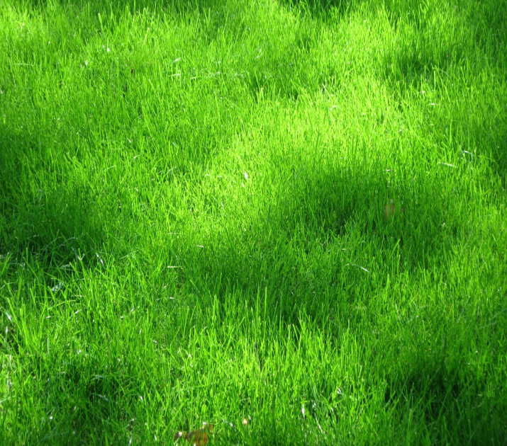

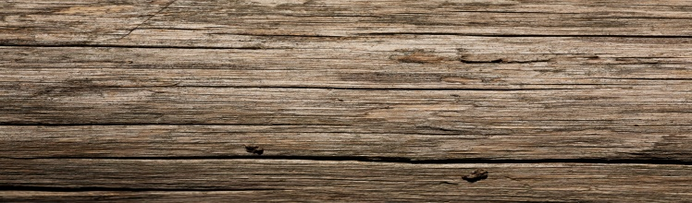
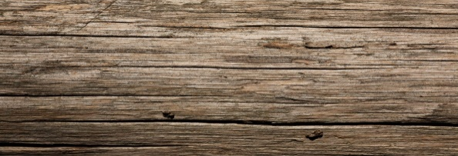
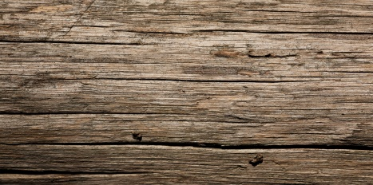
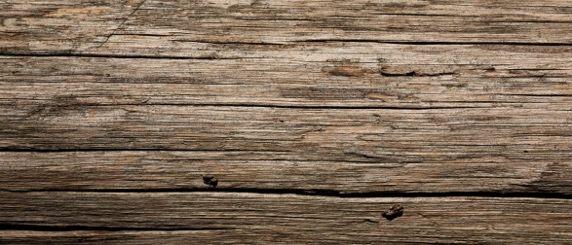
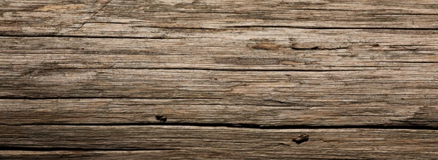
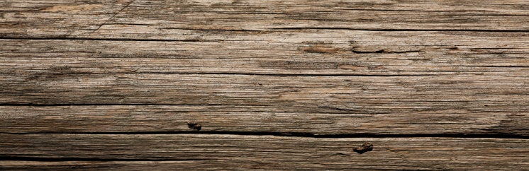

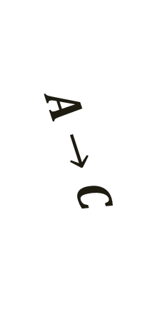

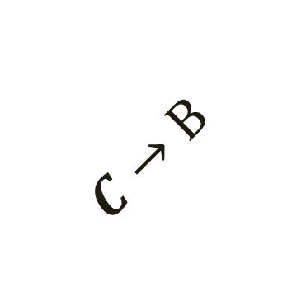

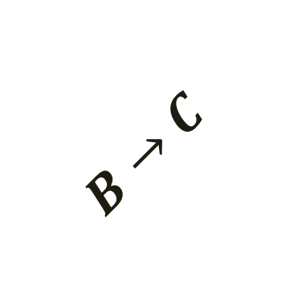
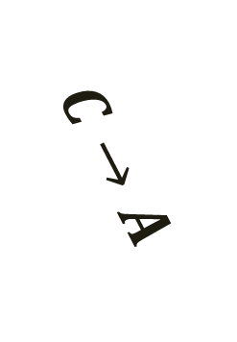
A
B
$$B→A$$
$$A→B$$
$$A→C$$
$$C→A$$
$$B→C$$
$$C→B$$
C

Slide 54
E
B
A
151
98
251
125
211
D
C
10
34
I
236
F
40
175
H
171
45
G

Slide 55
E/∞
E/∞
E
E/251
E/251
E/10
B/151
B/∞
B
B/∞
A/0
151
A
98
251
125
211
D/∞
D
D/∞
D/236
D/236
D/98
C/125
C/∞
C
C/∞
10
34
I /211
I /∞
I
I /∞
I /211
I /34
236
F/∞
F
F/∞
F/175
F/175
F/171
40
175
H/∞
H
H/∞
H/40
171
45
G/∞
G
G/∞
G/45

Slide 56
Running Time
If we use:
a Heap-based Priority Queue to store all n vertices
removeMin() to add vertices to the cloud
decreaseKey() (with locators) to update vertices after relaxing their edges
then we spend:
O(nlogn) time building the Priority Queue
O(nlogn) time making n calls to removeMin()
O(mlogn) time making O(m) calls to decreaseKey
to give us a total running that is:
O((n+m)logn )

Slide 57
Sparse:
Dense:
Sparse: O((n+n)logn)
Dense: O((n+n²)logn)
F(n) = O((n+m)logn )
= O(nlogn)
= O(n²logn)

Slide 58
E
B
A
151
98
251
125
211
D
C
10
34
I
236
F
40
175
H
171
45
G

Slide 59
r1 = find(E)
union(r1,r2)
r2 = find(F)
C
I
E
34
F
10
A
B
C
D
E
F
G
H
I

Slide 60
H
G
I
45
H
40
C
E
A
B
I
F
G
H
D

Slide 61
H
G
B
45
D
98
C
E
A
H
I
F
G
B
D

Slide 62
A
C
A
125
B
151
C
E
B
A
H
I
G
F
D

Slide 63
G
A
F
171
B
151
C
E
B
A
G
H
I
F
D

Slide 64
G
171
F
C
A
B
E
H
G
D
F
I

Slide 65
Running Time
If we use:
a Heap-based Priority Queue to store all m edges
removeMin() to obtain the smallest edges
find() and union() to combine clouds after an edge is relaxed
then we spend:
O(mlogm) time building the Priority Queue
O(mlogm) time making m calls to removeMin()
O(mlog*m) time making multiple calls to find() & union()
to give us a total running that is:
O(mlogm)

Slide 66
Sparse:
Dense:
O(nlogn)
O(n²logn²)
F(n) = O(mlogm)
= O(n²*2logn)
= O(n²logn)

Slide 67

N = 10
Hashcodes: { 2, 4, 6, 8, 10 }
H(c) = c mod N
10
2
4
6
8
0
1
2
3
4
5
6
7
8
9
H(2) == 2
H(4) == 4
H(6) == 6
H(8) == 8
H(10) == 0

Slide 68
There’s also the MAD method
(“Multiply, Add & Divide”):
H(c) = (a*c + b) mod N
where a and b are constants.
0
1
2
3
4
5
6
7
8
9

Slide 69
N = 10, a = 2, b = 2
Hashcodes: { 2, 4, 6, 8, 10 }
H(c) = (a*c + b) mod N
4
10
6
2
8
0
1
2
3
4
5
6
7
8
9
H(2) == 6
H(4) == 0
H(6) == 4
H(8) == 8
H(10) == 2

Slide 70
Collision
When two values map to the same index.
0
1
2
3
4
5
6
7
8
9

Slide 71
Chaining Method
Hashcodes: { 1, 2, 4, 6, 7, 8, 10, 11, 12, 15 }
H(c) = c mod 5
0
1
2
3
4

Slide 72
11
12
15
6
7
10
1
2
8
4
0
1
2
3
4
H(2) == 2
H(1) == 1
H(4) == 4
H(6) == 1
H(7) == 2
H(8) == 3
H(10) == 0
H(11) == 1
H(12) == 2
H(15) == 0

Slide 73
Linear Probing Method
Hashcodes: { 1, 6, 4, 0, 9 }
H(c) = c mod 5
0
1
6
9
4
0
1
2
3
4
H(1) == 1
H(6) == 1
H(4) == 4
H(0) == 0
H(9) == 4

Slide 74
Double-Hashing Method
0
1
2
3
4

Slide 75
Hashcodes: { 15, 8, 5, 11, 18, 1, 13,
25 }
H(c) = c mod 10
H’(c) = 7 – (c mod 7)
25
11
1
18
15
13
5
8
0
1
2
3
4
5
6
7
8
9
H(15) == 5
H(8) == 8
H(5) == 5
H’(5) == 2
H(11) == 1
H(18) == 8
H’(18) == 3
H(1) == 1
H’(1) == 6
H(13) == 3
H’(13) == 1
H(25) == 5
H’(25) == 3

Slide 76
Chaining
Have each index in the Hash Table reference a Linked List. H[i] will store all elements that map to index i

Slide 77
Linear Probing
If the location is already taken, check the next
one. If the next is taken, check the one after
that. Repeat until an empty location is found, or
the entire Hash Table has been probed.

Slide 78
Double-Hashing
If the location is already taken, find H’(c) to
determine how far to the right to check for the
next element. Repeat until an empty location is
found or every possible location has been probed.

Slide 79
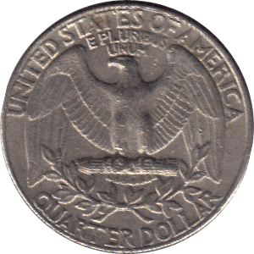
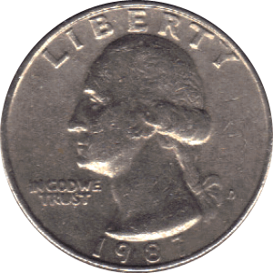
insert( 8 );
-∞
8
∞
p
<
-∞
-∞
8
∞
<
-∞
-∞
-∞
8
∞
∞
Complete

Slide 80
insert( 1 );
p
<
-∞
-∞
∞
<
-∞
-∞
8
∞
<
-∞
-∞
8
∞
<
-∞
-∞
1
8
∞
Complete

Slide 81
insert( 41 );
p
<
-∞
-∞
∞
>
<
-∞
-∞
8
8
41
∞
<
-∞
8
8
41
∞
<
-∞
1
8
8
41
∞
Complete

Slide 82
insert( 12 );
p
<
-∞
-∞
∞
>
<
-∞
-∞
8
8
41
∞
<
-∞
8
8
12
41
∞
<
-∞
1
8
8
12
41
∞
Complete

Slide 83
insert( 25 );
p
<
-∞
-∞
-∞
25
∞
∞
>
<
-∞
-∞
8
8
25
41
∞
>
<
-∞
8
8
12
12
25
41
∞
<
-∞
1
8
12
12
25
41
∞
Complete

Slide 84
p
find( 20 );
<
-∞
-∞
∞
<
-∞
-∞
-∞
25
∞
∞
>
<
-∞
-∞
8
8
25
41
∞
>
<
-∞
8
8
12
12
25
41
∞
<
-∞
1
8
12
12
25
41
∞

Slide 85
remove( 25 )
-∞
∞
-∞
-∞
25
∞
∞
-∞
8
25
41
∞
-∞
8
12
25
41
∞
p
-∞
1
8
12
25
41
∞
Complete

Slide 87
4
4
1
1
>
>
2
6
6
2
2
>
>
3
1
3
5
7
3
7
7
>
4
4
>
5
5
>
6
6
>
7
7
7

Slide 88
I
a
5
b
10
c
15
insert( 15 );

Slide 89
II
c
15
b
10
a
5
insert( 5 );

Slide 90
III
a
5
c
15
b
10
insert( 10 );

Slide 91
IV
c
15
a
5
b
10
insert( 10 );

Slide 92
V
a
10
b
5
20
c
15
25
remove( 5 );

Slide 93
VI
c
20
b
10
25
a
5
15
remove( 25 );

Slide 94
0 --------------------
20
1 --------------
10
25
2 ---------
5

Slide 95
0 ----------------------------
1 ---------------
2 ---------
3 -----
4 ---

Slide 96
0 --------------------
15
1 --------------
10
2 --------
5

Slide 97
Overflow
15
5
10
20
25
30
35

Slide 98
Overflow
15
5
10
20
25
30
35
Split
Complete

Slide 99
Underflow
15
15
30
5
10
35
20
25

Slide 100
Underflow
15
30
5
10
20
25
Transfer
Complete

Slide 101
15
25
5
10
30
20
Fusion
Complete

Slide 102
R
30
30
20
1
25
25
35
35
25
1
1

Slide 103
20
20
20
25
or
20 25
25
20
30
25 30 35
25
35

Slide 104
a
10
a
t
b
5
15
t
b
c
20
c
25
Case 1: t is red
Paint b and t black, and a red (unless a is the root).
Case 2: t is black
Perform trinode restructuring.
Paint a and c red (if not already), and b black.
Double-Red Violation
Label the red nodes ‘b’ and ‘c’, b’s parent as ‘a’, and b’s sibling as ‘t’.
insert( 10 );
insert( 5 );
insert( 15 );
insert( 20 );
Violation
insert( 25 );
Violation
Complete

Slide 105
The root is still black
All external nodes are still black
All external nodes still have the same black-depth
All red nodes still have black children

Slide 106
10
5
15
20
remove( 15 );
Complete

Slide 107
20
r
10
25
5
Case 1: Black with red child
Perform trinode restructuring.
Label the black node as ‘r’.
remove( 25 );

Slide 108
c
20
b
r
10
a
5
Paint a and c black, and b the color of the original root (red in this case).
Complete

Slide 109
10
5
20
r
15
25
Case 2: Black with black childlren
Color r’s parent black, and r’s sibling red.
remove( 25 );
Complete

Slide 110
c
20
r
b
10
25
b
a
5
15
Case 3: Red
Paint r’s grandparent black, and r’s parent red.
remove( 25 );

