Slide 1

Proposition 7.10

Slide 2
First: Extended Binary Trees.

Slide 3
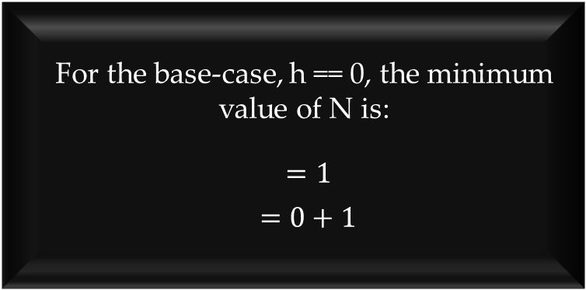

$h+1≤ N ≤2^{h+1}−1$
For the base-case, h == 0, the minimum value of N is:
$=1$
$=0+1$

Slide 4
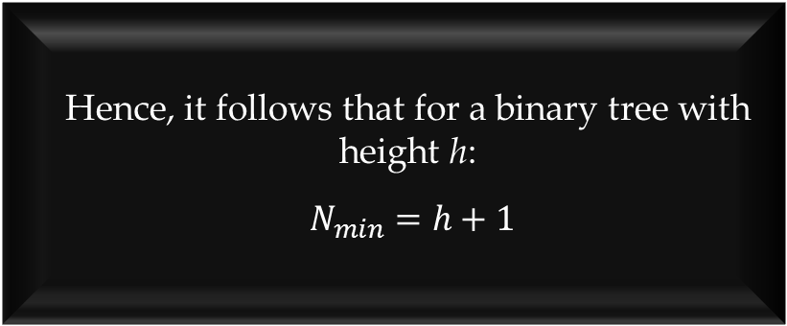
$h+1≤ N ≤2^{h+1}−1$
Hence, it follows that for a binary tree with height h:
$N_{min}=h+1$
To increase the height by 1, at least 1 node must be added.
This fact is true for any height h.

Slide 5
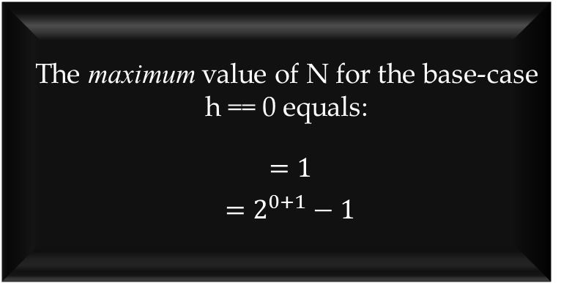
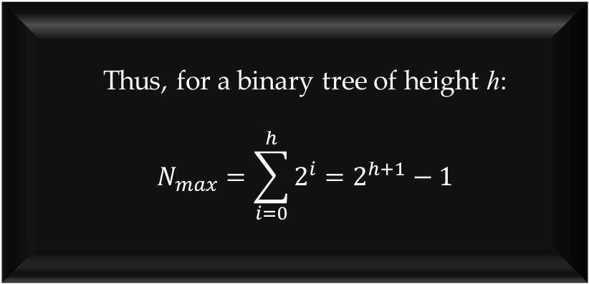

$h+1≤ N ≤2^{h+1}−1$
Thus, for a binary tree of height h:
$$N_{max}=\sum_{i=0}^{h}{2^{i}}=2^{h+1}−1$$
The maximum value of N for the base-case h == 0 equals:
$=1$
$=2^{0+1}−1$
The maximum number of nodes that may be added to level 1 is:
$2^{1}=2$
The maximum number of nodes that may be added to any level i is 2^{i}.

Slide 6
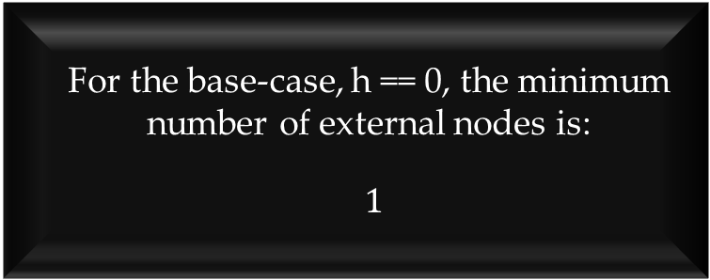

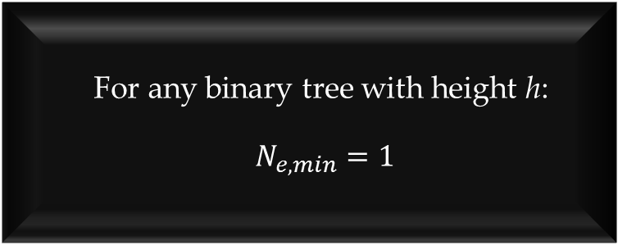
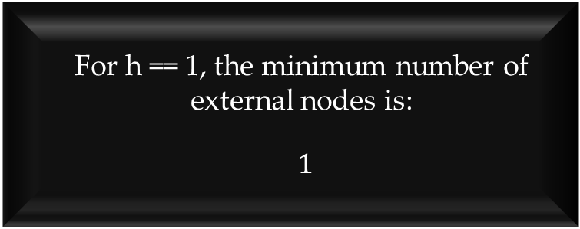
$1≤ N_{e} ≤2^{h}$
For the base-case, h == 0, the minimum number of external nodes is:
$1$
For h == 1, the minimum number of external nodes is:
$1$
For any binary tree with height h:
$N_{e,min}=1$

Slide 7
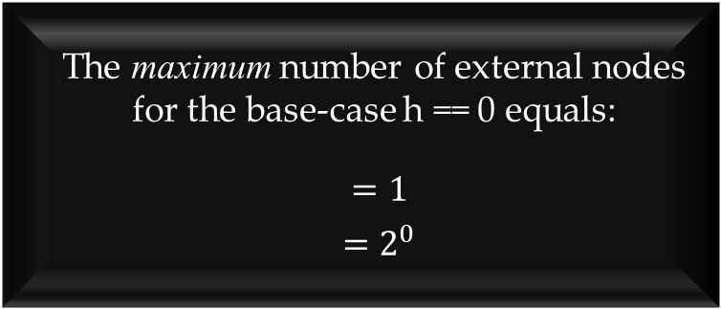
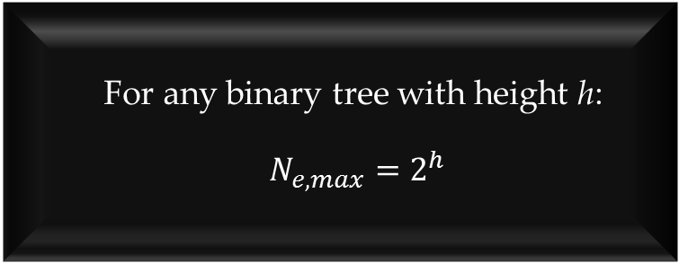
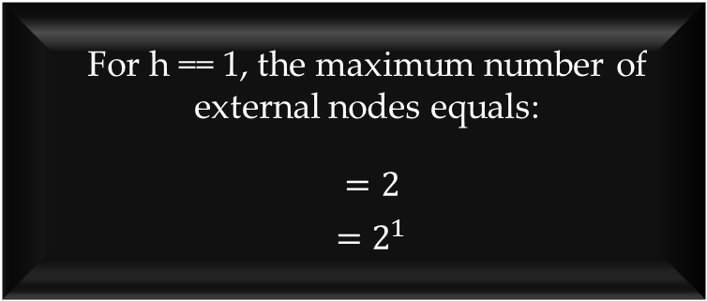
$1≤ N_{e} ≤2^{h}$
For any binary tree with height h:
$N_{e,max}=2^{h}$
The maximum number of external nodes for the base-case h == 0 equals:
$=1$
$=2^{0}$
For h == 1, the maximum number of external nodes equals:
$=2$
$=2^{1}$

Slide 8
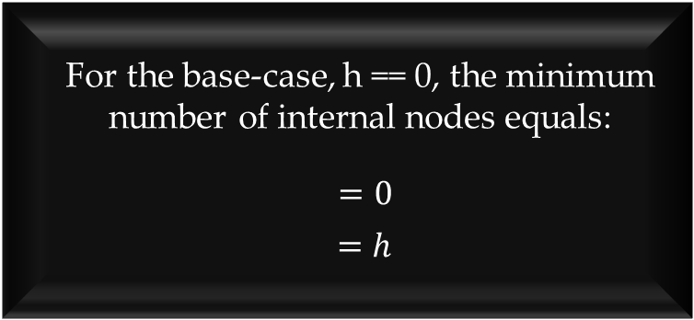

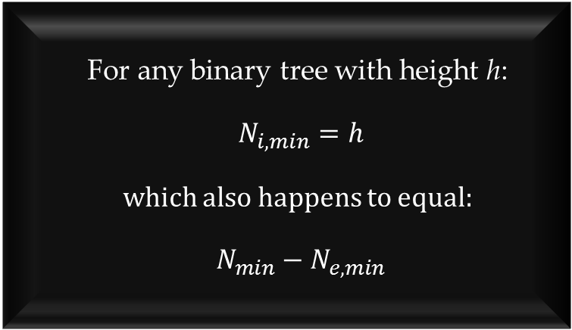
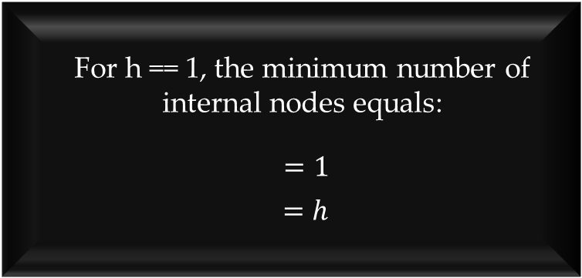
$h≤ N_{i} ≤2^{h}$- 1
For the base-case, h == 0, the minimum number of internal nodes equals:
$=0$
$=h$
For h == 1, the minimum number of internal nodes equals:
$=1$
$=h$
For any binary tree with height h:
$N_{i,min}=h$
which also happens to equal:
$N_{min}−N_{e,min}$

Slide 9
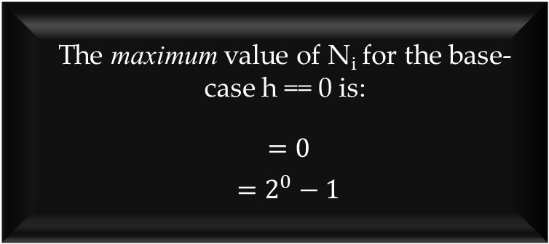
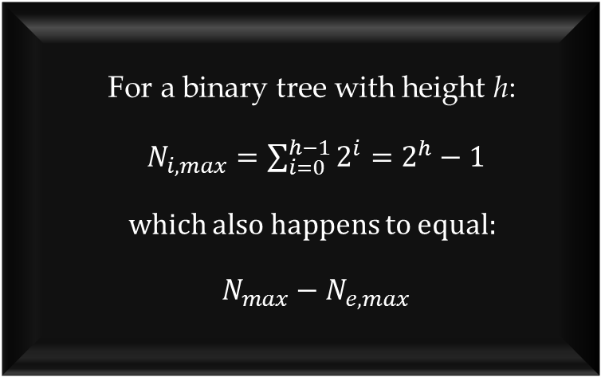
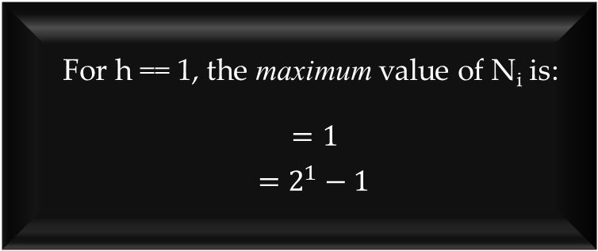
$h≤ N_{i} ≤2^{h}$- 1
For a binary tree with height h:
$N_{i,max}=\sum_{i=0}^{h−1}{2^{i}}=2^{h}−1$
which also happens to equal:
$N_{max}−N_{e, max}$
The maximum value of N_{i} for the base-case h == 0 is:
$=0$
$=2^{0}−1$
For h == 1, the maximum value of N_{i} is:
$=1$
$=2^{1}−1$

Slide 10
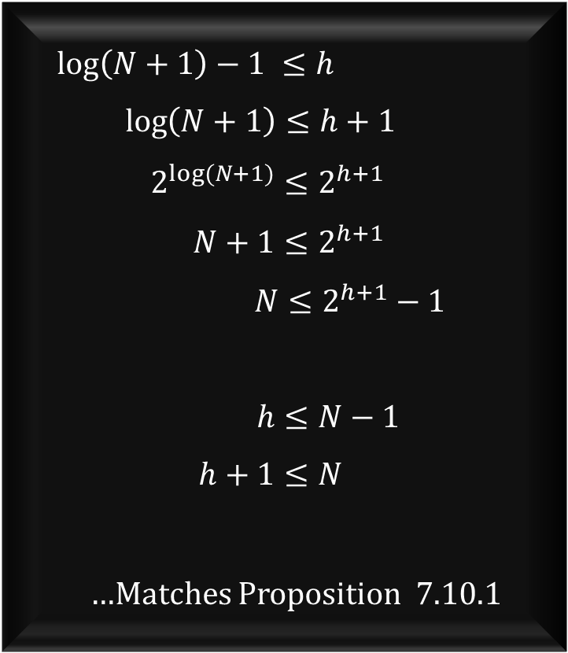

$log\left(N+1\right)−1≤ h ≤N−1$
$$\log\left(N+1\right)−1 ≤h$$
$\log\left(N+1\right)≤h+1$
$2^{log⁡(N+1)}≤2^{h+1}$
$N+1≤2^{h+1}$
$N≤2^{h+1}−1$
$$h≤N−1$$
$h+1≤N$
…Matches Proposition 7.10.1
This is easily proven by re-arranging the equation into one we’ve already proved.

Slide 11
Next: Proper Binary Trees.

