Slide 1

Proposition 7.10

Slide 2
Now: Proper Binary Trees.

Slide 3
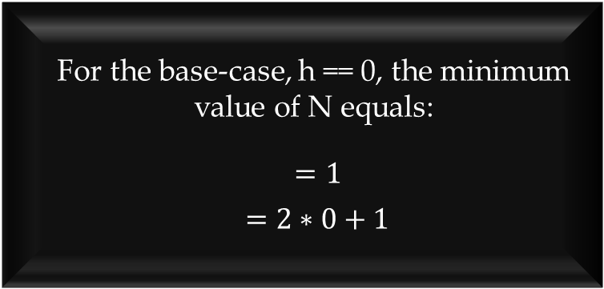

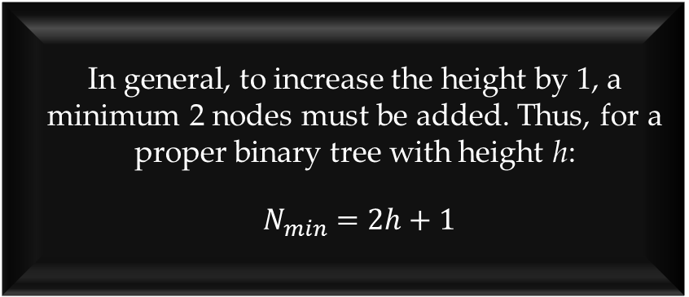
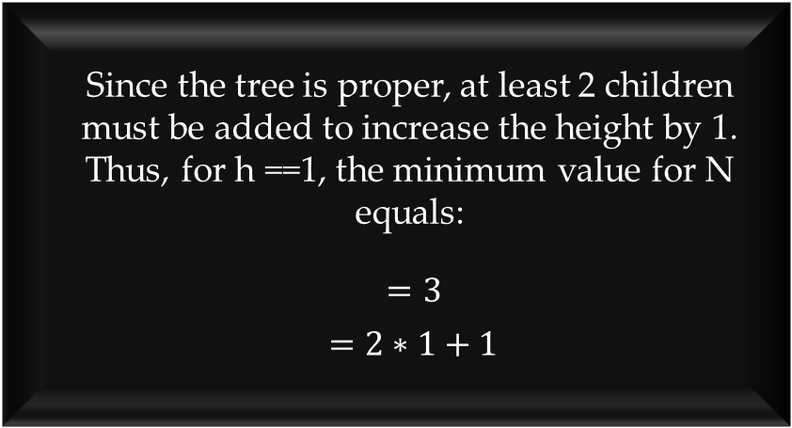
$2h+1≤ N ≤2^{h+1}−1$
For the base-case, h == 0, the minimum value of N equals:
$=1$
$=2∗0+1$
Since the tree is proper, at least 2 children must be added to increase the height by 1. Thus, for h ==1, the minimum value for N equals:
$=3$
$=2∗1+1$
In general, to increase the height by 1, a minimum 2 nodes must be added. Thus, for a proper binary tree with height h:
$N_{min}=2h+1$

Slide 4
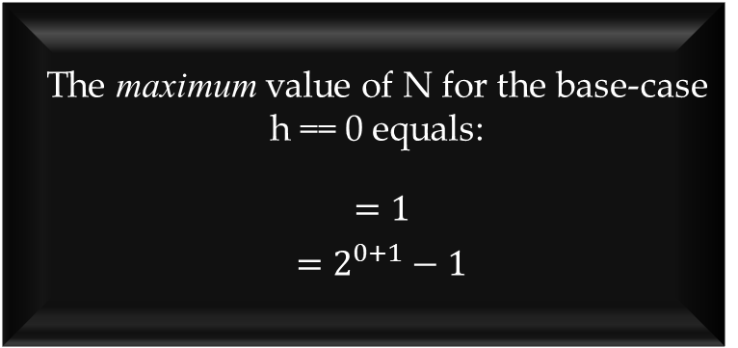
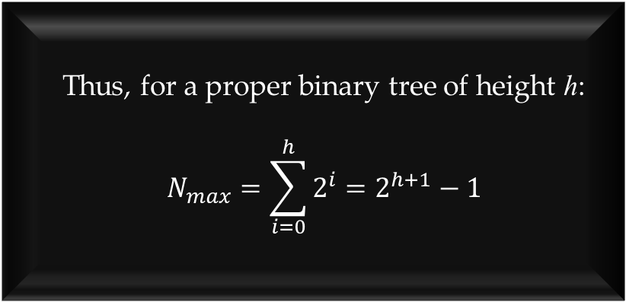

$2h+1≤ N ≤2^{h+1}−1$
Thus, for a proper binary tree of height h:
$$N_{max}=\sum_{i=0}^{h}{2^{i}}=2^{h+1}−1$$
The maximum value of N for the base-case h == 0 equals:
$=1$
$=2^{0+1}−1$
The maximum number of nodes that may be added to level 1 equals:
$2^{1}=2$
The maximum number of nodes that may be added to any level i is 2^{i}.

Slide 5
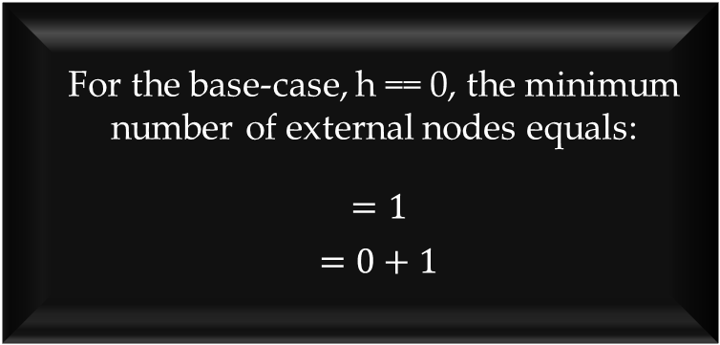

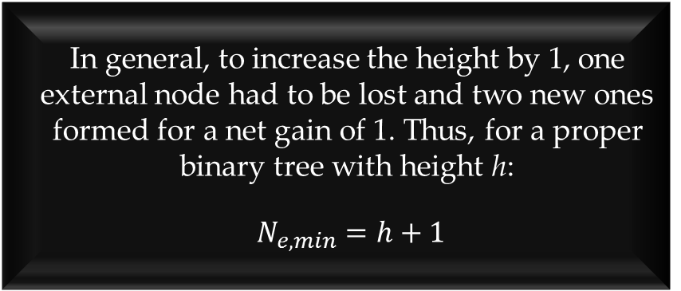
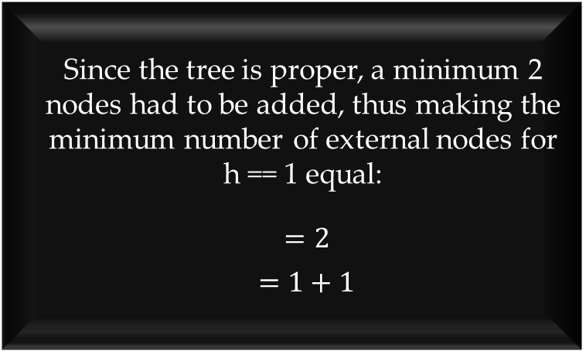
$h+1≤ N_{e} ≤2^{h}$
For the base-case, h == 0, the minimum number of external nodes equals:
$=1$
$=0+1$
Since the tree is proper, a minimum 2 nodes had to be added, thus making the minimum number of external nodes for
h == 1 equal:
$=2$
$=1+1$
In general, to increase the height by 1, one external node had to be lost and two new ones formed for a net gain of 1. Thus, for a proper binary tree with height h:
$N_{e,min}=h+1$

Slide 6
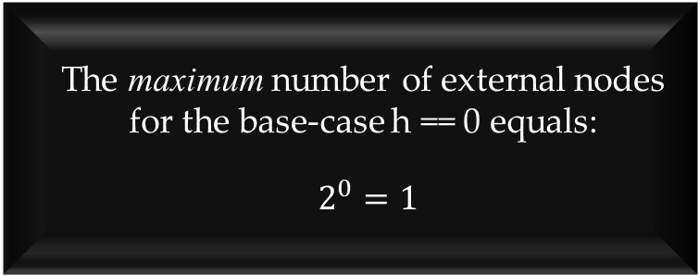

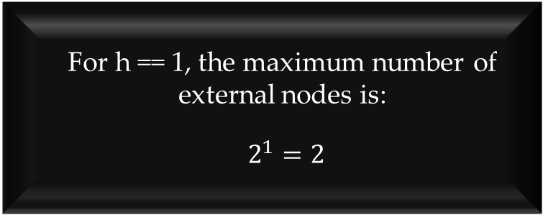
$h+1≤ N_{e} ≤2^{h}$
For any proper binary tree with height h:
$N_{e,max}=2^{h}$
The maximum number of external nodes for the base-case h == 0 equals:
$2^{0}=1$
For h == 1, the maximum number of external nodes is:
$2^{1}=2$

Slide 7
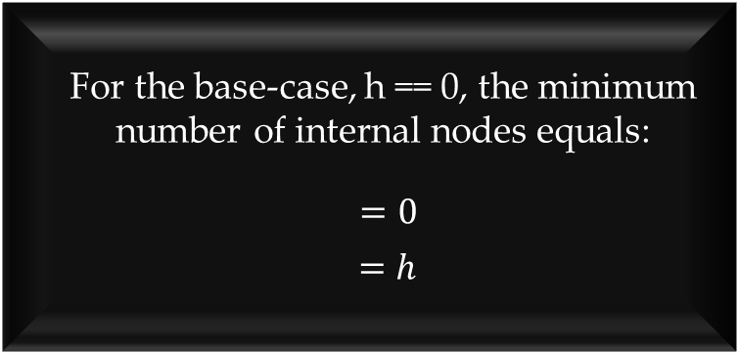

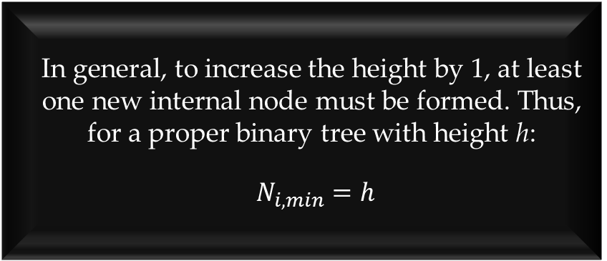
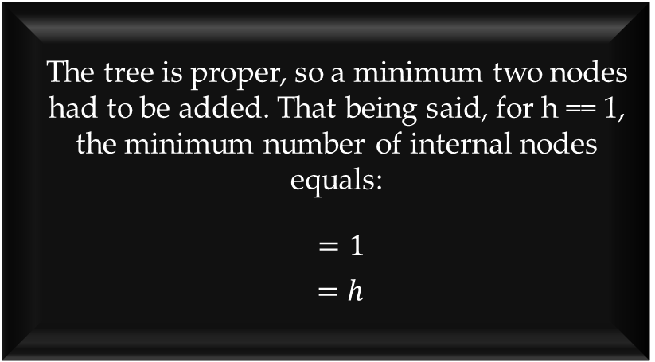
$h≤ N_{i} ≤2^{h}$- 1
For the base-case, h == 0, the minimum number of internal nodes equals:
$=0$
$=h$
The tree is proper, so a minimum two nodes had to be added. That being said, for h == 1, the minimum number of internal nodes equals:
$=1$
$=h$
In general, to increase the height by 1, at least one new internal node must be formed. Thus, for a proper binary tree with height h:
$N_{i,min}=h$

Slide 8
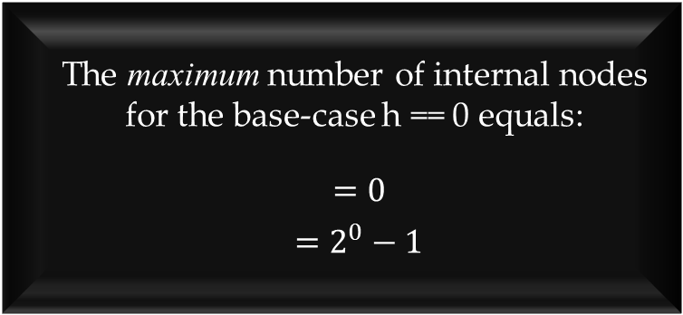
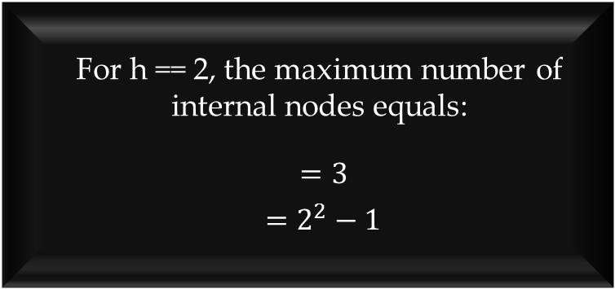
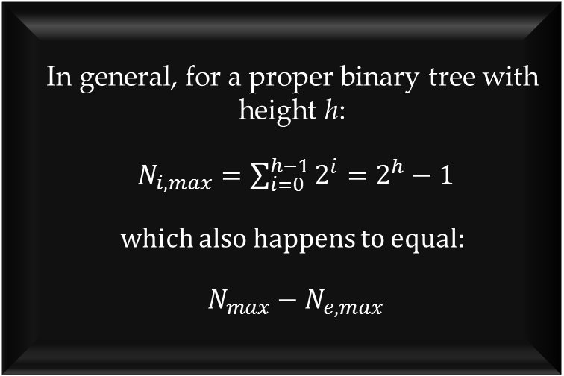
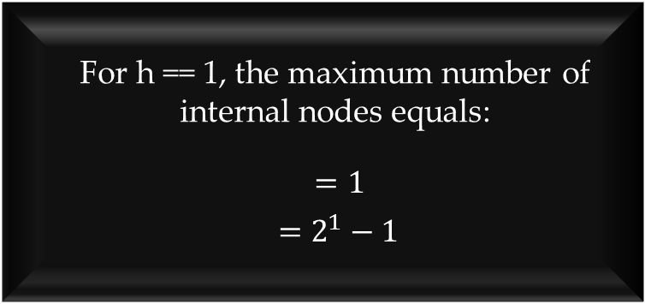
$h≤ N_{i} ≤2^{h}$- 1
In general, for a proper binary tree with height h:
$N_{i,max}=\sum_{i=0}^{h−1}{2^{i}}=2^{h}−1$
which also happens to equal:
$N_{max}−N_{e, max}$
The maximum number of internal nodes for the base-case h == 0 equals:
$=0$
$=2^{0}−1$
For h == 1, the maximum number of internal nodes equals:
$=1$
$=2^{1}−1$
For h == 2, the maximum number of internal nodes equals:
$=3$
$=2^{2}−1$

Slide 9
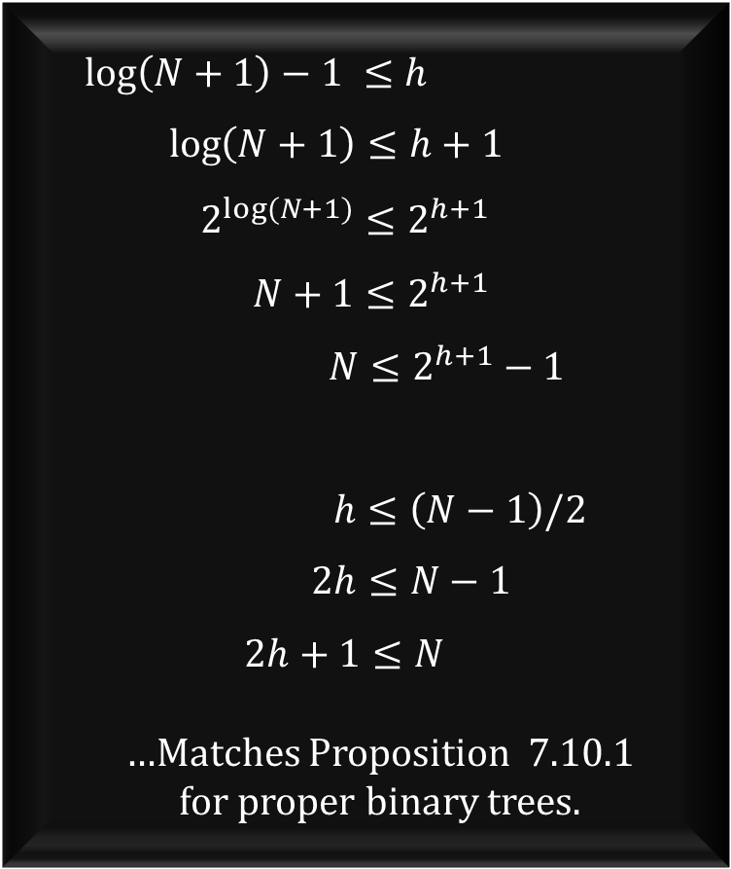

$log\left(N+1\right)−1≤ h ≤(N−1)/2$
$$\log\left(N+1\right)−1 ≤h$$
$\log\left(N+1\right)≤h+1$
$2^{log⁡(N+1)}≤2^{h+1}$
$N+1≤2^{h+1}$
$N≤2^{h+1}−1$
$$h≤\left(N−1\right)/2$$
$2h≤N−1$
$2h+1≤N$
…Matches Proposition 7.10.1
for proper binary trees.
This is easily proven by re-arranging the equation into one we’ve already proved.

