Slide 1
Shell Sort

Slide 2
500
400
300
200
100
1
500
400
300
200
100
1
Shell Sort was created to improve a
weakness of Insertion Sort.
The weakness was that small numbers who start near the back of the array must be swapped often in order to reach the front.
This is not ideal because swapping requires writing values to memory, a relatively slow operation.
Shell Sort improves on this by dividing the array into sub-groups.
This way, if a small number starts near the back, it won’t have to be swapped as often to reach the front.
Shell Sort then performs Insertion Sort on each
sub-group individually.

Slide 3
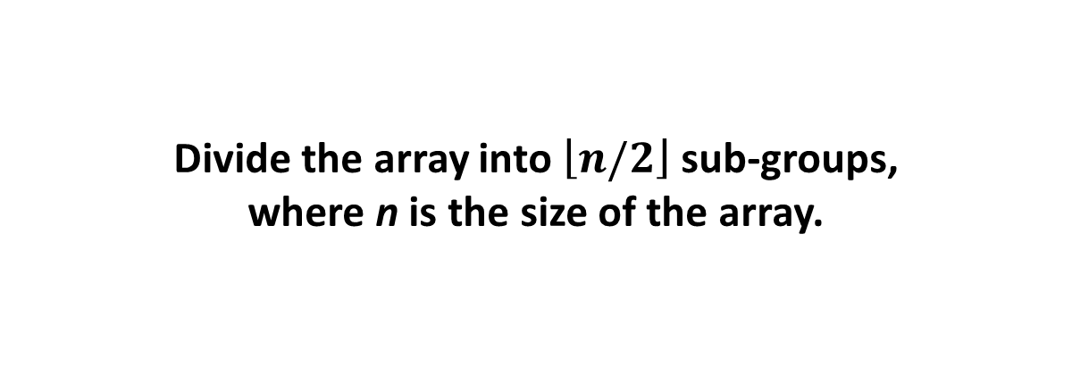
<
900
250
900
400
400
68
125
125
600
600
100
100
40
250
250
250
200
200
300
300
500
500
450
450
Divide the array into $\left\lfloor n/2\right\rfloor$ sub-groups,
where n is the size of the array.
Most implementations of Shell Sort do not divide precisely by 2, but we will for simplicity.

Slide 4
<
250
200
400
125
600
100
900
200
200
300
500
450

Slide 5
>
250
200
125
600
100
900
400
300
300
500
450

Slide 6
<
250
200
125
500
600
100
900
400
300
500
500
450

Slide 7
>
250
200
125
500
100
900
400
300
600
450
450

Slide 8
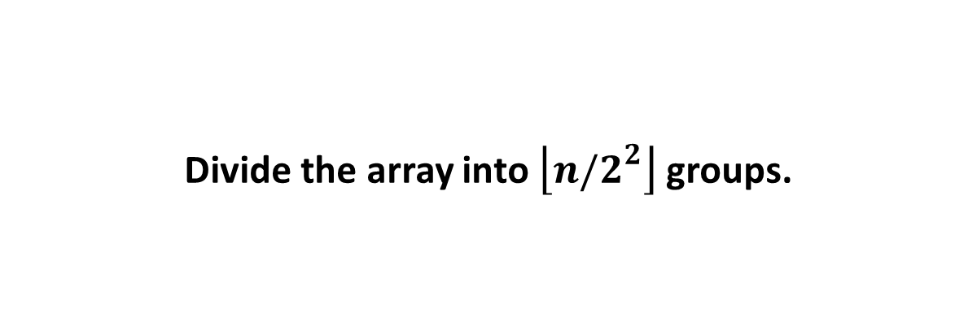
<
<
>
>
250
125
100
200
200
125
125
500
500
100
100
900
900
400
400
300
300
600
600
450
450
Divide the array into $\left\lfloor n/2^{2}\right\rfloor$ groups.

Slide 9
>
>
<
<
<
100
200
125
500
500
300
250
900
900
450
400
300
300
600
450
450

Slide 10
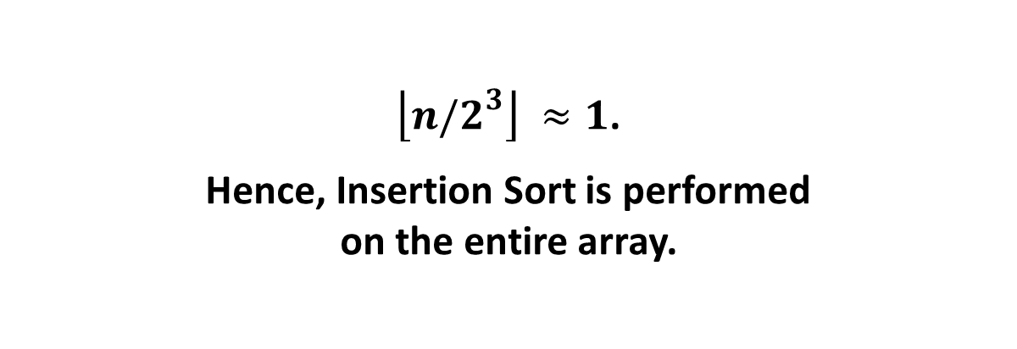
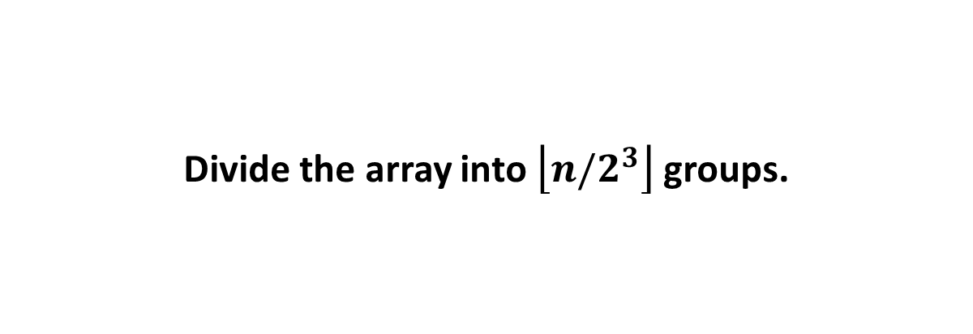
>
>
<
>
>
<
>
>
<
>
>
>
100
100
200
200
125
125
125
125
200
300
300
250
250
250
250
300
450
450
400
400
400
400
450
500
500
500
600
600
600
900
900
900
Divide the array into $\left\lfloor n/2^{3}\right\rfloor$groups.
$\left\lfloor n/2^{3}\right\rfloor ≈1$.
Hence, Insertion Sort is performed
on the entire array.

