Slide 1
Selection Sort

Slide 2
1st step:
Locate the smallest element – store it in the first slot

Slide 3
38
5
8
42
111
79
3
66
211

Slide 4
Assume the 1st element is the smallest.
Current minimum = 38
38
5
8
42
111
79
3
66
211

Slide 5
Current minimum = 38
38
5
8
42
111
79
3
66
211

Slide 6
Current minimum =
5
38
5
8
42
111
79
3
66
211

Slide 7
Current minimum =
5
38
5
8
42
111
79
3
66
211

Slide 8
Current minimum =
5
38
5
8
42
111
79
3
66
211

Slide 9
Current minimum =
5
38
5
8
42
111
79
3
66
211

Slide 10
Current minimum =
5
38
5
8
42
111
79
3
66
211

Slide 11
Current minimum =
5
38
5
8
42
111
79
3
66
211

Slide 12
Current minimum =
3
38
5
8
42
111
79
3
66
211

Slide 13
Current minimum =
3
38
5
8
42
111
79
3
66
211

Slide 14
Current minimum =
3
38
5
8
42
111
79
3
66
211

Slide 15
All comparisons have been made.
Store the final min in front.
38
5
8
42
111
79
3
66
211

Slide 16
All comparisons have been made.
Store the final min in front.
38
5
8
42
111
79
66
211
3

Slide 17
Repeat this for the remaining elements.
38
5
8
42
111
79
66
211
3

Slide 18
Current minimum =
38
38
5
8
42
111
79
66
211
3

Slide 19
Current minimum =
38
38
5
8
42
111
79
66
211
3

Slide 20
Current minimum =
5
38
5
8
42
111
79
66
211
3

Slide 21
Current minimum =
5
38
5
8
42
111
79
66
211
3

Slide 22
Current minimum =
5
38
5
8
42
111
79
66
211
3

Slide 23
Current minimum =
5
38
5
8
42
111
79
66
211
3

Slide 24
Current minimum =
5
38
5
8
42
111
79
66
211
3

Slide 25
Current minimum =
5
38
5
8
42
111
79
66
211
3

Slide 26
Current minimum =
5
38
5
8
42
111
79
66
211
3

Slide 27
Current minimum =
5
38
8
42
111
79
66
211
3
5

Slide 28
A total of n-1 iterations are performed.
38
8
42
111
79
66
211
3
5

Slide 29
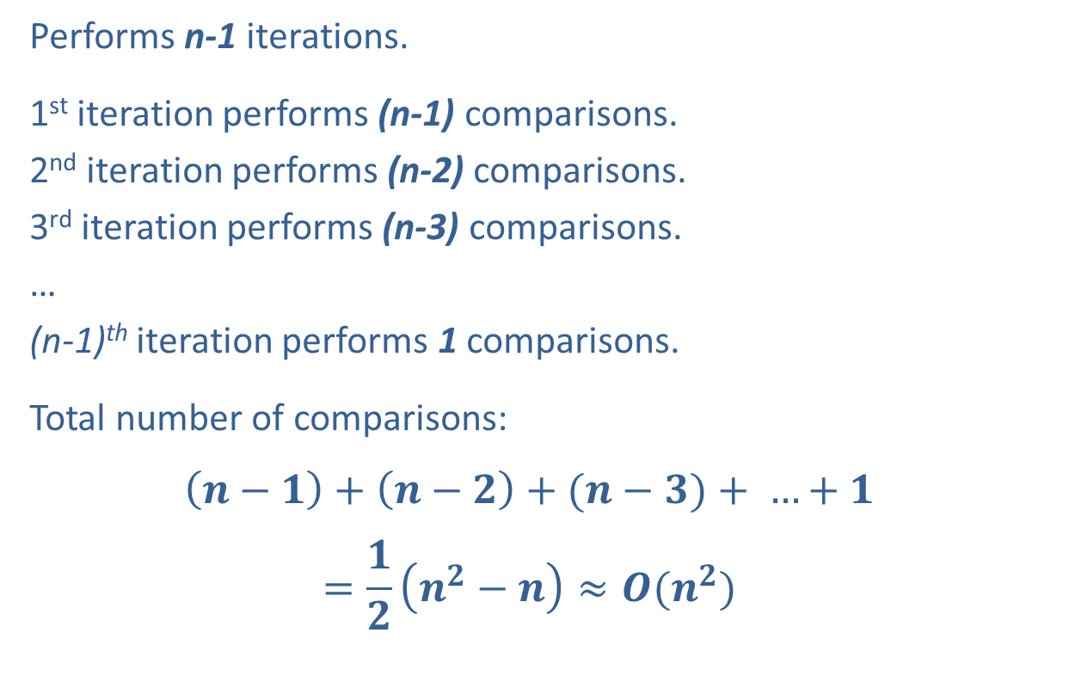
Selection Sort (Analysis)
Performs n-1 iterations.
1st iteration performs (n-1) comparisons.
2nd iteration performs (n-2) comparisons.
3rd iteration performs (n-3) comparisons.
…
(n-1)^{th} iteration performs 1 comparisons.
Total number of comparisons:
$$\left(n−1\right)+\left(n−2\right)+(n−3)+ …+1$$
$$=\frac{1}{2}\left(n^{2}−n\right)≈O(n^{2})$$

Slide 30
Selection Sort (Analysis)
The best and worst-case is O(n²) since the number of operations is always the same, no matter how the input is arranged.

Slide 31
Insertion Sort

Slide 32
1st step:
Compare the second element with the first element. If the second is smaller, then swap.

Slide 33
1st iteration
43
11
4
28
23
89
33
50
41

Slide 34
1st iteration
11
43
4
28
23
89
33
50
41
Iteration ends here

Slide 35
Repeat with the third and second element.

Slide 36
2nd iteration
11
43
4
28
23
89
33
50
41

Slide 37
2nd iteration
11
4
43
28
23
89
33
50
41
Move it forward as much as possible.

Slide 38
2nd iteration
11
4
43
28
23
89
33
50
41

Slide 39
2nd iteration
4
11
43
28
23
89
33
50
41
Iteration ends here

Slide 40
2nd iteration
4
11
43
28
23
89
33
50
41
Repeat for the fourth, fifth, … , and n^{th} elements.

Slide 41
3rd iteration
4
11
43
28
23
89
33
50
41

Slide 42
3rd iteration
4
11
28
43
23
89
33
50
41

Slide 43
3rd iteration
4
11
28
43
23
89
33
50
41
Iteration ends here

Slide 44
4th iteration
4
11
28
43
23
89
33
50
41

Slide 45
4th iteration
4
11
28
23
43
89
33
50
41

Slide 46
4th iteration
4
11
28
23
43
89
33
50
41

Slide 47
4th iteration
4
11
23
28
43
89
33
50
41

Slide 48
4th iteration
4
11
23
28
43
89
33
50
41
Iteration ends here

Slide 49
5th iteration
4
11
23
28
43
89
33
50
41
Iteration ends here

Slide 50
6th iteration
4
11
23
28
43
89
33
50
41

Slide 51
6th iteration
4
11
23
28
43
33
89
50
41

Slide 52
6th iteration
4
11
23
28
43
33
89
50
41

Slide 53
6th iteration
4
11
23
28
33
43
89
50
41

Slide 54
6th iteration
4
11
23
28
33
43
89
50
41
Iteration ends here

Slide 55
7th iteration
4
11
23
28
33
43
89
50
41

Slide 56
7th iteration
4
11
23
28
33
43
50
89
41

Slide 57
7th iteration
4
11
23
28
33
43
50
89
41
Iteration ends here

Slide 58
8th iteration
4
11
23
28
33
43
50
89
41

Slide 59
8th iteration
4
11
23
28
33
43
50
41
89

Slide 60
8th iteration
4
11
23
28
33
43
50
41
89

Slide 61
8th iteration
4
11
23
28
33
43
41
50
89

Slide 62
8th iteration
4
11
23
28
33
43
41
50
89

Slide 63
8th iteration
4
11
23
28
33
41
43
50
89

Slide 64
8th iteration
4
11
23
28
33
41
43
50
89
Iteration ends here

Slide 65
4
11
23
28
33
41
43
50
89
The End

Slide 66
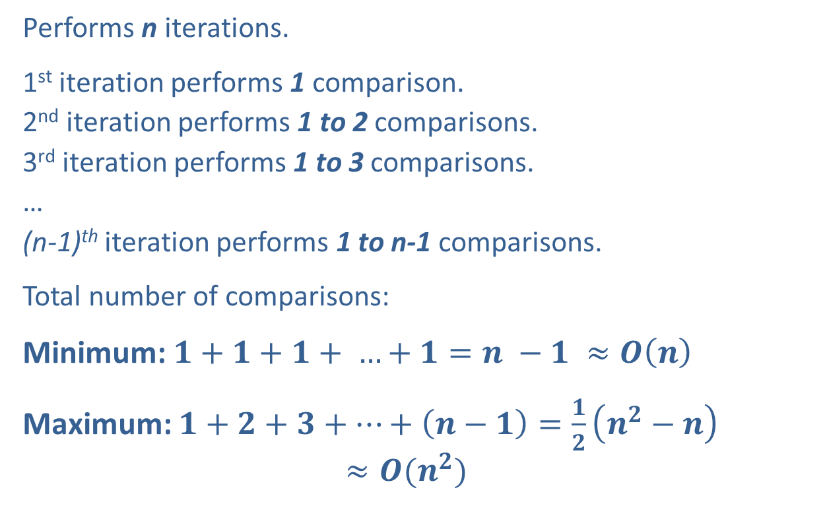
Insertion Sort (Analysis)
Performs n iterations.
1st iteration performs 1 comparison.
2nd iteration performs 1 to 2 comparisons.
3rd iteration performs 1 to 3 comparisons.
…
(n-1)^{th} iteration performs 1 to n-1 comparisons.
Total number of comparisons:
Minimum: $1+1+1+ …+1=n −1 ≈O\left(n\right)$
Maximum: $1+2+3+…+\left(n−1\right)=\frac{1}{2}\left(n^{2}−n\right)$
$$≈O(n^{2})$$

Slide 67
Insertion Sort (Analysis)
The minimum (best) case occurs when the list is already sorted. When this occurs, 1 comparison is performed each iteration.
The maximum (worst) case occurs when the list is sorted in reverse-order, thus causing each element to be moved forward the maximum possible distance.

Slide 68
Bubble Sort

Slide 69
Bubble Sort
Similar to Selection Sort.
Bubble Sort searches for the largest element and places it in the back.

Slide 70
1st iteration
43
11
4
28
23
89
33
50
41

Slide 71
1st iteration
11
43
4
28
23
89
33
50
41

Slide 72
1st iteration
11
43
4
28
23
89
33
50
41

Slide 73
1st iteration
11
4
43
28
23
89
33
50
41

Slide 74
1st iteration
11
4
43
28
23
89
33
50
41

Slide 75
1st iteration
11
4
28
43
23
89
33
50
41

Slide 76
1st iteration
11
4
28
43
23
89
33
50
41

Slide 77
1st iteration
11
4
28
23
43
89
33
50
41

Slide 78
1st iteration
11
4
28
23
43
89
33
50
41

Slide 79
1st iteration
11
4
28
23
43
89
33
50
41

Slide 80
1st iteration
11
4
28
23
43
33
89
50
41

Slide 81
1st iteration
11
4
28
23
43
33
89
50
41

Slide 82
1st iteration
11
4
28
23
43
33
50
89
41

Slide 83
1st iteration
11
4
28
23
43
33
50
89
41

Slide 84
1st iteration
11
4
28
23
43
33
50
41
89
Iteration ends here

Slide 85
2nd iteration
11
4
28
23
43
33
50
41
89

Slide 86
2nd iteration
4
11
28
23
43
33
50
41
89

Slide 87
2nd iteration
4
11
28
23
43
33
50
41
89

Slide 88
2nd iteration
4
11
28
23
43
33
50
41
89

Slide 89
2nd iteration
4
11
23
28
43
33
50
41
89

Slide 90
2nd iteration
4
11
23
28
43
33
50
41
89

Slide 91
2nd iteration
4
11
23
28
43
33
50
41
89

Slide 92
2nd iteration
4
11
23
28
33
43
50
41
89

Slide 93
2nd iteration
4
11
23
28
33
43
50
41
89

Slide 94
2nd iteration
4
11
23
28
33
43
50
41
89

Slide 95
2nd iteration
4
11
23
28
33
43
41
50
Iteration ends here
89

Slide 96
3rd iteration
4
11
23
28
33
43
41
50
89

Slide 97
3rd iteration
4
11
23
28
33
43
41
50
89

Slide 98
3rd iteration
4
11
23
28
33
43
41
50
89

Slide 99
3rd iteration
4
11
23
28
33
43
41
50
89

Slide 100
3rd iteration
4
11
23
28
33
43
41
50
89

Slide 101
3rd iteration
4
11
23
28
33
43
41
50
89

Slide 102
3rd iteration
4
11
23
28
33
41
43
Iteration ends here
50
89

Slide 103
Watch what happens this iteration
4th iteration
4
11
23
28
33
41
43
50
89

Slide 104
Watch what happens this iteration
4th iteration
4
11
23
28
33
41
43
50
89

Slide 105
Watch what happens this iteration
4th iteration
4
11
23
28
33
41
43
50
89

Slide 106
Watch what happens this iteration
4th iteration
4
11
23
28
33
41
43
50
89

Slide 107
Watch what happens this iteration
4th iteration
4
11
23
28
33
41
43
50
89

Slide 108
Watch what happens this iteration
4
11
23
28
33
41
Iteration ends here
43
50
89

Slide 109
Watch what happens this iteration
4
11
23
28
33
41
43
50
89

Slide 110
Not a single swap was made that iteration.
This signals that the remaining elements are sorted. Thus, Bubble Sort finishes early.
4
11
23
28
33
41
43
50
89

Slide 111
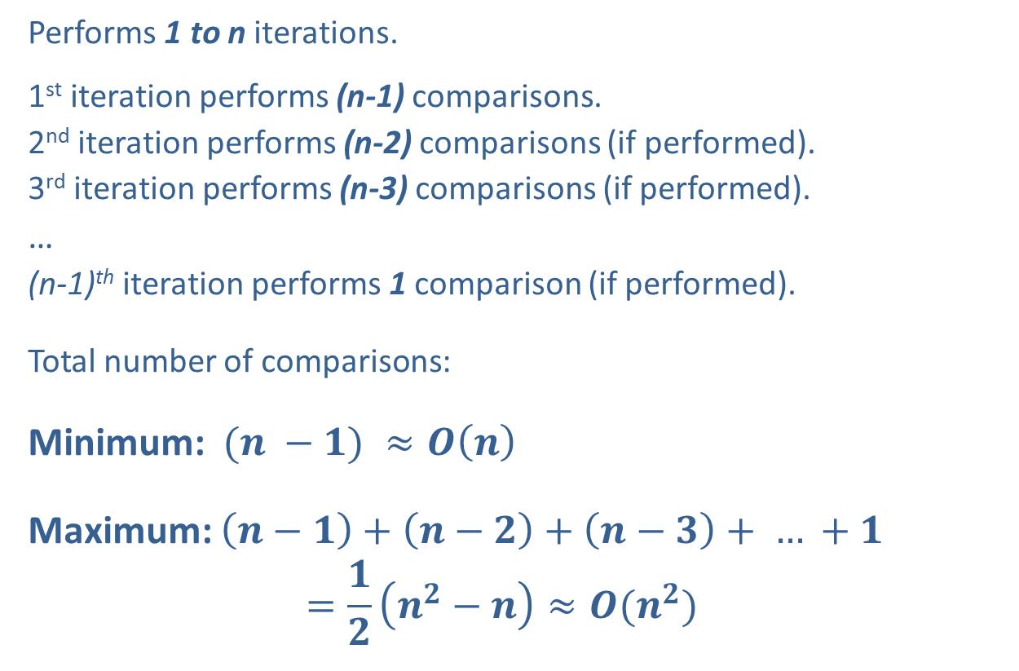
Bubble Sort (Analysis)
Performs 1 to n iterations.
1st iteration performs (n-1) comparisons.
2nd iteration performs (n-2) comparisons (if performed).
3rd iteration performs (n-3) comparisons (if performed).
…
(n-1)^{th} iteration performs 1 comparison (if performed).
Total number of comparisons:
Minimum: $(n −1) ≈O\left(n\right)$
Maximum: $\left(n−1\right)+\left(n−2\right)+\left(n−3\right)+ … +1$
$$=\frac{1}{2}\left(n^{2}−n\right)≈O(n^{2})$$

Slide 112
Bubble Sort (Analysis)
The minimum (best) case occurs when the list is already sorted, causing Bubble Sort to need one iteration.
The maximum (worst) case occurs when the list is sorted in reverse-order, causing Bubble Sort to need all n-1 iterations.

Slide 113
Lower Bound Theorem
All comparison-based sorting algorithms are at least O(nlogn) in the worst case, where n is the size of the input.

Slide 114
Tractable Algorithms
Polynomial Expression – An expression of the form (n^{k}), where k is some constant.
Tractable Algorithm – An algorithm whose running time is bounded by a polynomial expression.
Intractable Algorithm – An algorithm whose running time cannot be bounded by a polynomial expression (also known as an exponential algorithm).

