Slide 1

What Makes a Good Game?
A Steam Analysis by Jeffrey Emmons JR
DA10 Capstone
Notes:
Breath and chill out guy

Slide 2
Overview
Utilizes API for Steam and Steam Spy
Game List from February 3rd, 2024
Game Data from February 16th, 2024
Reviews price, concurrent players, average play time, and review scores
Notes:
SteamSpy is a 3rd party website that record addition Steam Information

Slide 3

Steam
Digital distribution platform developed by Valve
Videogame store with a vast library(96k applications)
User accounts to track transactions
Multiplayer, social networking, automatic updates and cloud saves
Notes:
Developed in 2003

Slide 4
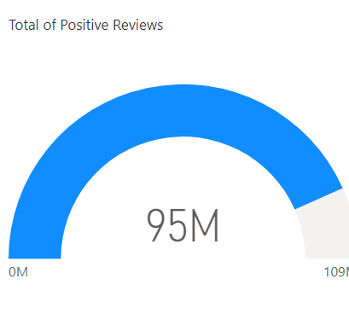
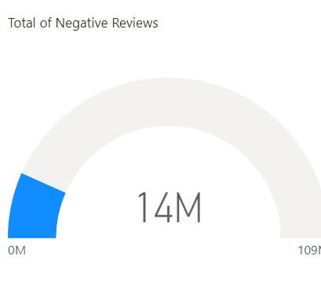
Gamers are easy to please.

Slide 5
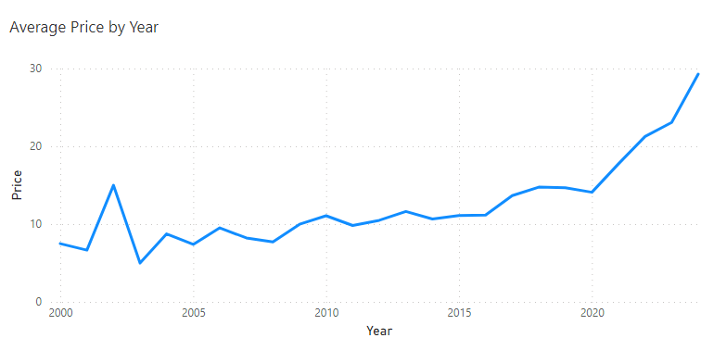
Prices raises over time.

Slide 6
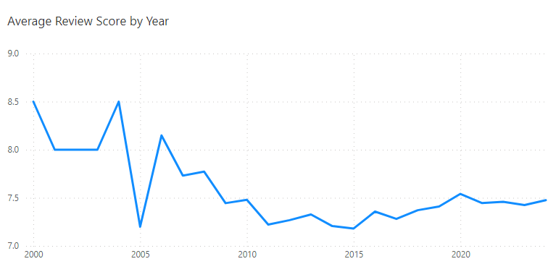
Review Scores lowers over time.

Slide 7
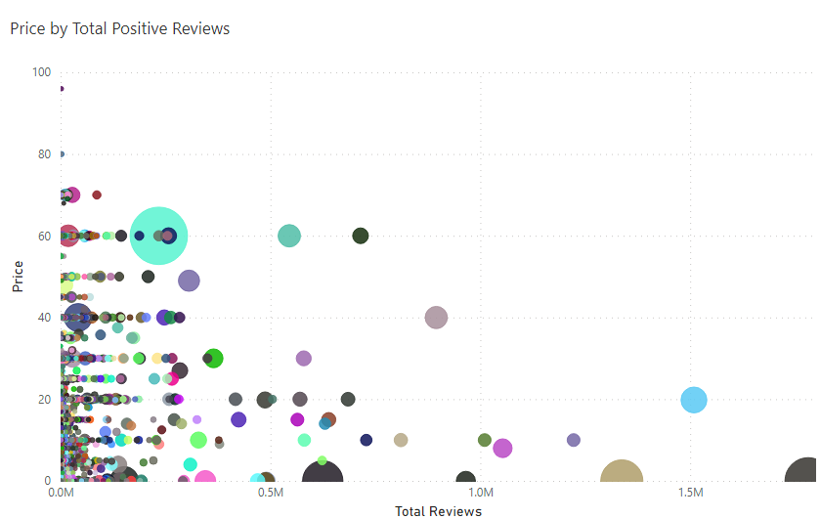
Gamers like cheaper games.
Notes:
Does not include CS2

Slide 8
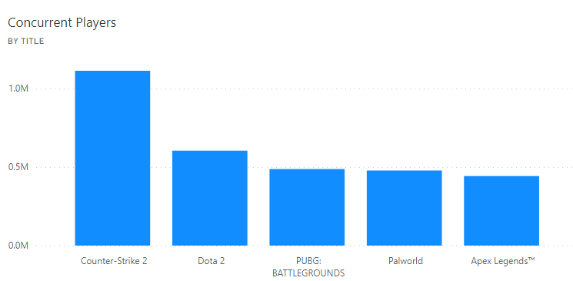
Top 5 played games

Slide 9
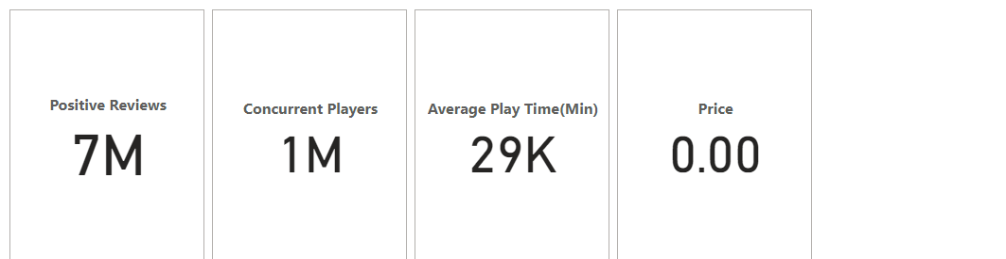
Counter-Strike 2
Multiplayer First-person Shooter
Successor of popular franchise
Esports
Free-to-play
The most positive reviews

Slide 10
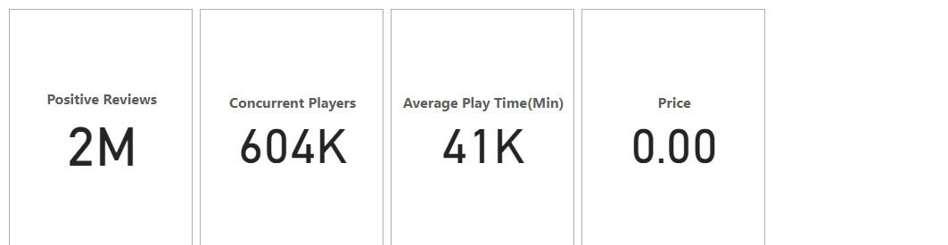
Dota 2
Multiplayer Online Battle Arena(MOBA)
Sequel to community made mod
Esports
Free-to-play
Most played game 2014-2017

Slide 11
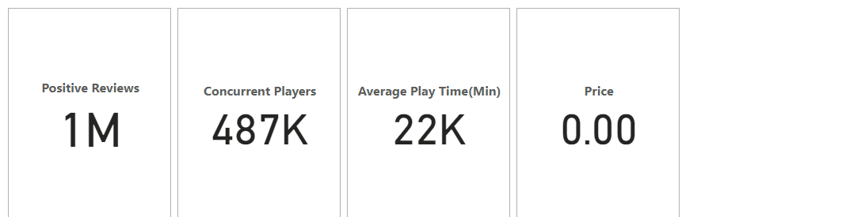
PUBG: BATTLEGROUNDS
Battle Royal
Popularized Genre
Esports
Free-to-play
Most played game of all time

Slide 12
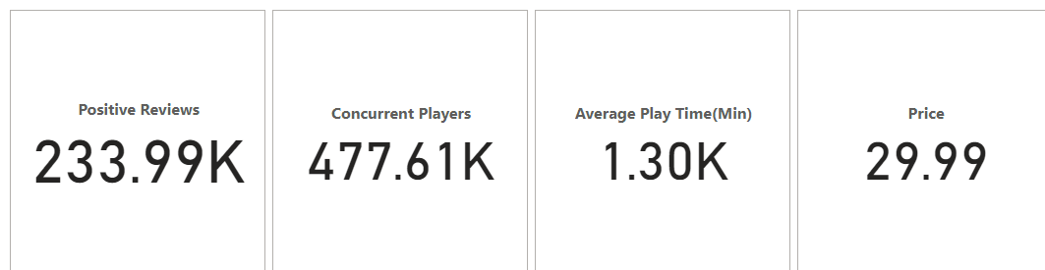
Palworld
Monster Tamer Survivor
Refreshed Genre
Open World
Sold 8 million copies in 6 days
2nd most played game of all time

Slide 13
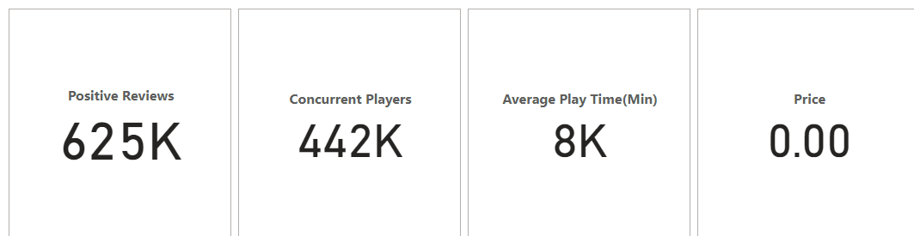
Apex Legends
Battle Royal-Hero Shooter
Combines two popular genres
Esports
Free-to-play
Implemented ‘ping’ system

Slide 14
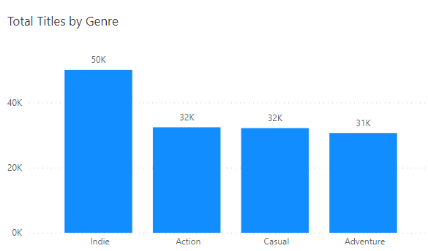
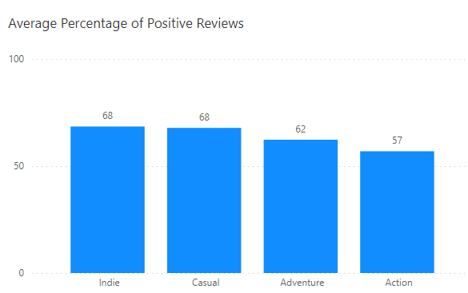
Top Genres by Total Titles

Slide 15
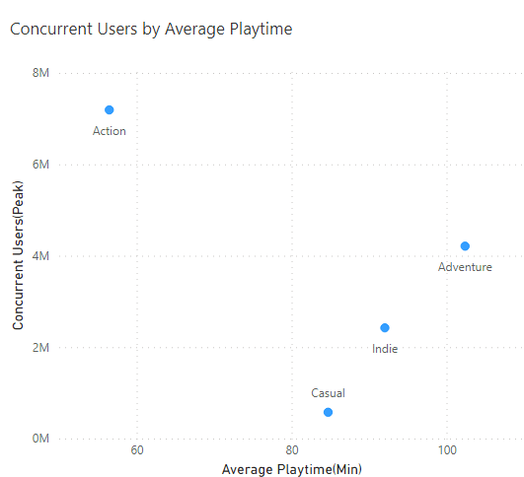
How Are Gamers Playing?

Slide 16
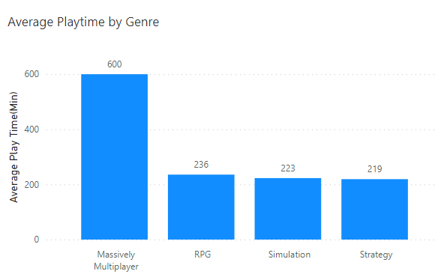
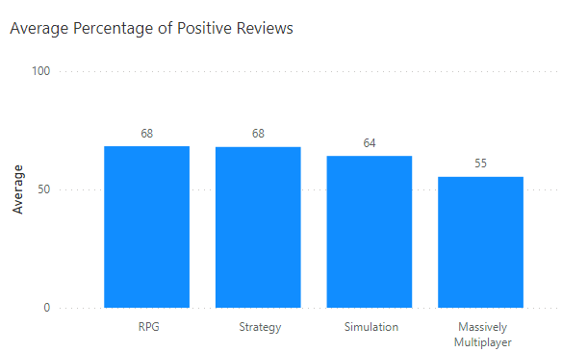
Top Genres by Average Playtime

Slide 17
Key Take Aways
Cheaper games are played by more people
More people play short game styles
People spend more time with slower styled genres
Esports games are popular

Slide 18

What makes a good game?
A game that shorter game modes
A game that is cheaper for the consumer
A game that is easy to watch
A game that shakes up its genre
Essentially a game that is accessible to the most amount of people while being innovative in its space

Slide 19
Thank you!

