Slide 1

What Makes a Good Game?
A Steam Analysis by Jeffrey Emmons JR
DA10 Capstone
Notes:
Breath and chill out guy

Slide 2
Overview
Utilizes API for Steam and Steam Spy
Game List from February 3rd, 2024
Game Data from February 16th, 2024
Reviews price, concurrent players, average play time, and review scores
Notes:
SteamSpy is a 3rd party website that record addition Steam Information

Slide 3

Steam
Digital distribution platform developed by Valve
Videogame store with a vast library(96k applications)
User accounts to track transactions
Multiplayer, social networking, automatic updates and cloud saves
Notes:
Developed in 2003

Slide 4
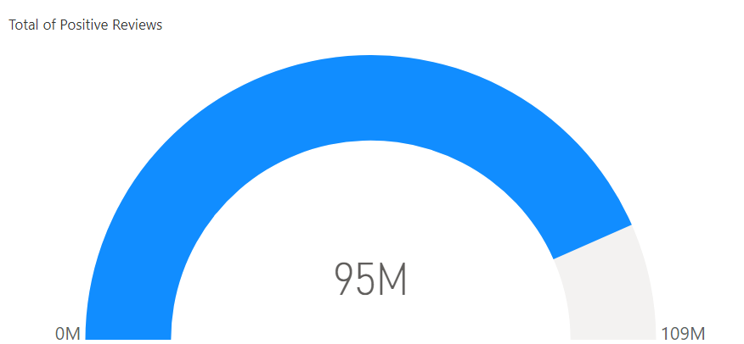
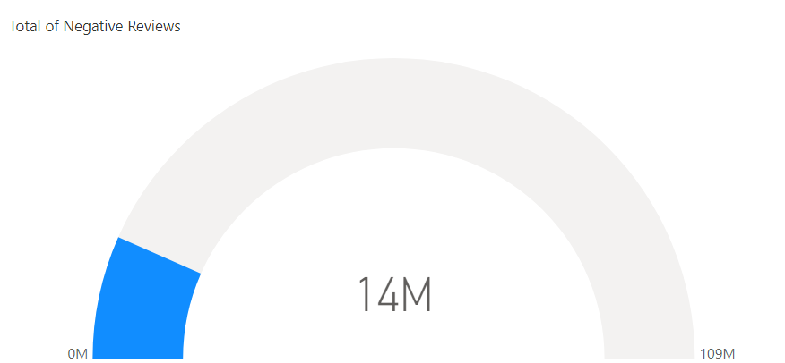
Gamers are easy to please.
Open in Power BI visuals Data as of 2/29/24, 1:56 AM Filtered by total_reviews (is greater than 1000)

Slide 5
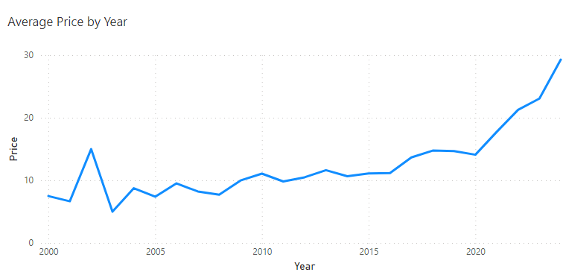
Prices over time.
Notes:
Please Note these are current prices in relation to a games release date.
, so older games are more likely to be sold at a cheaper price than their original price. 2020 also saw the AAA price increase to $69.99 to cover increasing developmental costs post pandemic

Slide 6
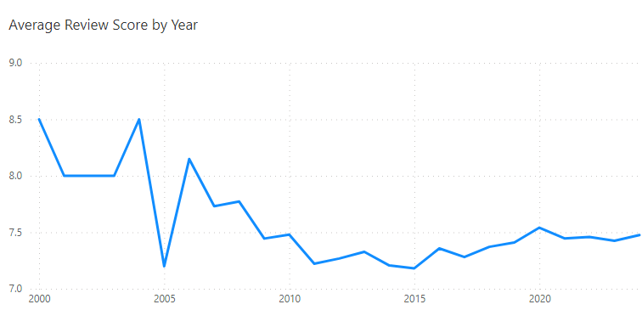
Review Scores lowers over time.

Slide 7
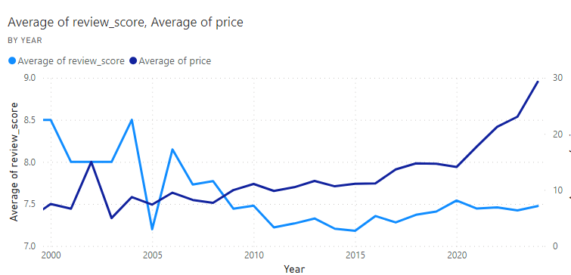
Prices Against Reviews

Slide 8
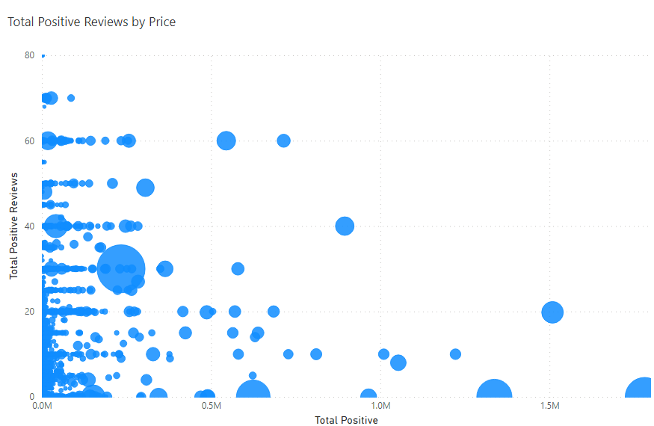
Gamers like cheaper games.
Notes:
Does not include CS2

Slide 9
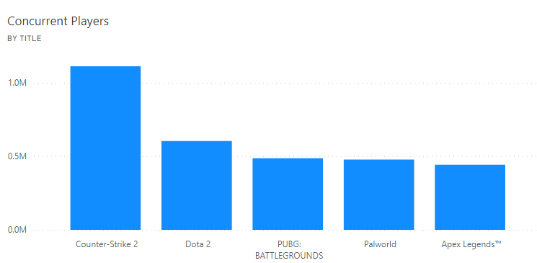
Top 5 played games

Slide 10
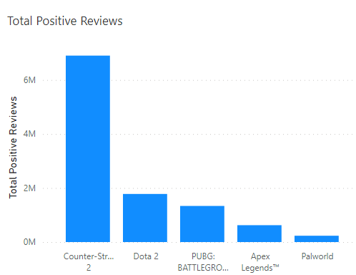
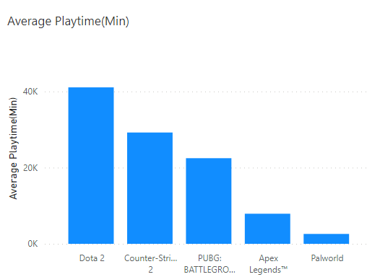
Top 5 games Overview
Notes:
4 of the games are free and are considered Esports
All five games are genre staples: PUBG led Battle Royals, Apex first to implement ‘ping’ system, Palworld shook up Pokemon’s space

Slide 11
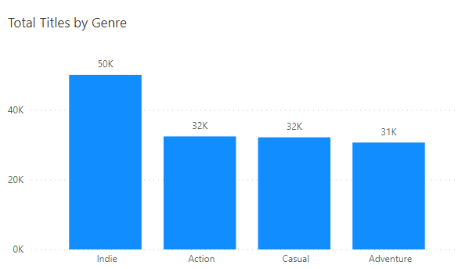
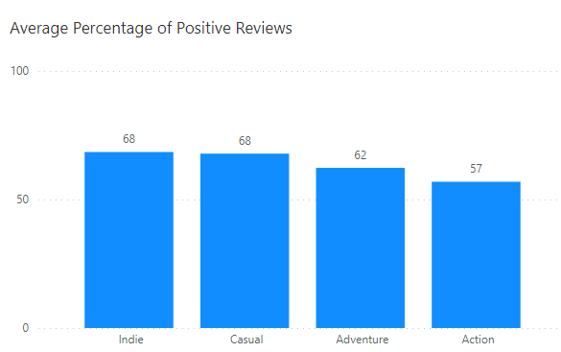
Top Genres by Total Titles

Slide 12
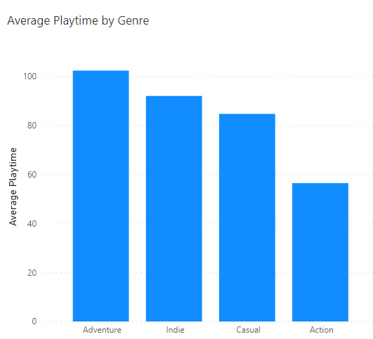
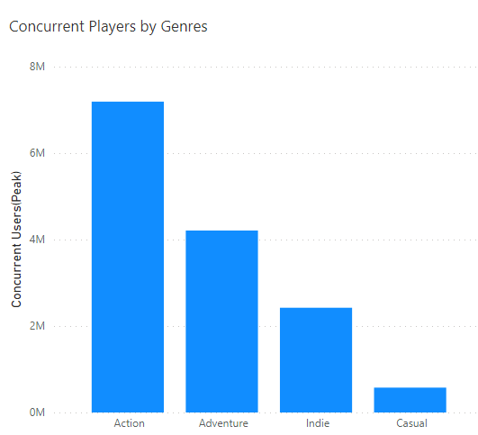
How Are Gamers Playing?

Slide 13
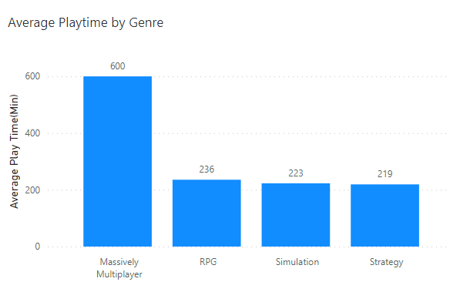
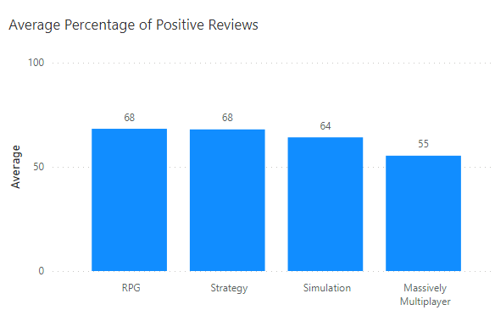
Top Genres by Average Playtime

Slide 14
Key Take Aways
Cheaper games are played by more people
More people play short game styles
People spend more time with slower styled genres
Esports games are popular

Slide 15

What makes a good game?
A game that shorter game modes
A game that is cheaper for the consumer
A game that is easy to watch
A game that shakes up its genre
Essentially a game that is accessible to the most amount of people while being innovative in its space

Slide 16
Thank you!

