Slide 1
AntennaForge
Synthetic Antenna Pattern Generation
Jude Eschete

Slide 2
Executive Summary
What is it? A tool to generate, visualize, analyze, and report idealized antenna radiation patterns.
Target Audience: Engineers needing rapid prototyping of parameterized antenna patterns.
Core Philosophy: Generates synthetic patterns from analytical models (math), not physical geometry simulations.
Key Stats:
  Python 3.10+
  7 Built-in Antenna Types

Slide 3
The Problem & The Solution
The Problem: Requirements sometimes need fast iteration on patterns that ask for specific antenna pattern behaviors.
The Gap: Sometimes the intel is incomplete, and assumptions must be made.
  This takes time for the antenna SMEs to build a system in FEKO.
  If the analyst knows what the target gains and beamwidths are, time can be saved.
The AntennaForge Solution:
  Fast: Generates multi-frequency sweeps in milliseconds.
  Realistic: Adds physics-based imperfections (sidelobes, noise, breakup).
  Portable: Written completely in Python.

Slide 4
System Architecture
Tech Stack:
  Core: Python (Standard Library + NumPy/SciPy)
  GUI: customtkinter
  Plotting: matplotlib (Embedded in GUI + Report generation)
Design Pattern:
  Separation of Concerns: core/ engine decoupled from gui/
  Data Flow: Config Dict -> Engine -> CSV Files -> Analysis/Plotting
Input/Output:
  Input: JSON Configuration for batch processing or GUI Widgets
  Output: Standard CSV format for antenna cuts, PDF/LaTeX Reports for frequency ranges

Slide 5
The Math Engine
Implementation:
  Scalar Path: Pure Python fallback (slow, highly portable)
  Vectorized Path: NumPy implementation (fast)
Performance:
  Grid Size: 361 x 181 points (1 deg step)
  Time per slice: ~11ms (NumPy) vs ~500ms (Scalar)

Slide 6
Antenna Models (Analytical Approaches)
Aperture Models:
  Dish: Jinc² (Airy Pattern) — Uses Bessel functions
  Panel/Horn: Sinc² (Rectangular aperture) x Cosine Taper
Wire Models:
  Dipole/Monopole: Classical thin-wire formula
Array Theory:
  Phased Array: Element Pattern x Array Factor
  Features: Beam steering, Grating lobe prediction, Taylor weighting
LPDA: Elliptical Gaussian main beam + Radial sidelobe envelope

Slide 7
Physics Features
Frequency-Dependent Beamwidth:
  Models aperture physics: BW proportional to 1/f
  Modes: Exponent decay, Percentage per octave, or 3-Point interpolation
Sidelobes (Taylor):
  Replaces mathematical nulls with realistic sidelobe floors
  Configurable decay rate and first sidelobe level (e.g., -25 dB)

Slide 8
Physics Features
The +/- 90 deg Discontinuity Fix:
  Problem: Analytical models often clip hard at the horizon
  Solution: Implements a Sigmoid Blend function to smoothly transition
Pattern Breakup:
  Adds deterministic ripple at high off-axis angles
VSWR Rolloff:
  Simulates impedance mismatch at band edges (gain drop-off)

Slide 9
Environmental & System Effects
Ground Reflection:
  Implements a 2-Ray Model
  Interference between direct and reflected paths based on height
Cross-Polarization:
  Generates secondary _xpol.csv files
  Models polarization leakage peaking at 45 deg diagonals
Gain-Beamwidth Coupling:
  Links gain calculations to beamwidth changes

Slide 10
The GUI (Graphical User Interface)
Framework: customtkinter Key UX Features:
  Lazy Loading: Pages load only when clicked
  Threading: Generation/Plotting run on background threads
  Cooperative Cancellation: Long-running jobs can be stopped

Slide 11
RF Calculations & Operations
Pattern Arithmetic:
  Add, Subtract, Multiply, Max Envelope
Geometric Transformations:
  3-Axis Rotation (Yaw/Pitch/Roll) using Bicubic Interpolation
Link Budget:
  Full angular map (Tx Az vs Rx Az) link margin calculation
  EIRP and Power Density

Slide 12
Reporting Engine
Philosophy: 'Production-ready outputs'
Formats:
  PDF: Direct generation via Matplotlib backend
  LaTeX: Generates .tex source + image folder structure
  PPTX: Native PowerPoint slide generation
Content:
  Auto-generated Cover Page, TOC, Summary Tables
  Heatmaps, Polar Plots, and 3D Surfaces

Slide 13
Conclusion & Roadmap
Summary: AntennaForge bridges gap between parameterized patterns and full FEKO simulation.
Deployment: Fully portable
Future Work:
  Output ODESSA “*.tbl” files.
  2D View that updates as you adjust parameters. (Heatmap, Polar, Az/El cut)
  Additional Antenna Plots.

Slide 14
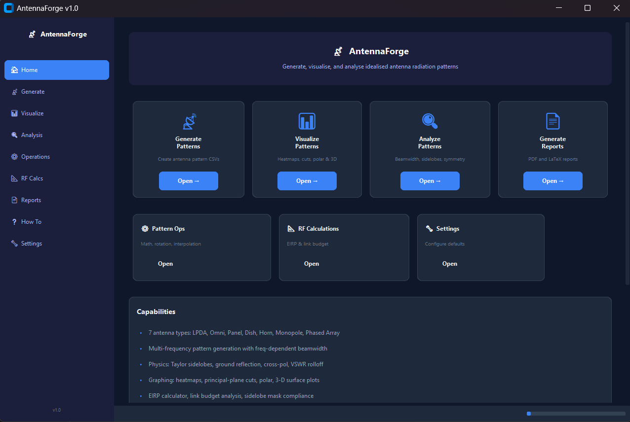
Home Page

Slide 15
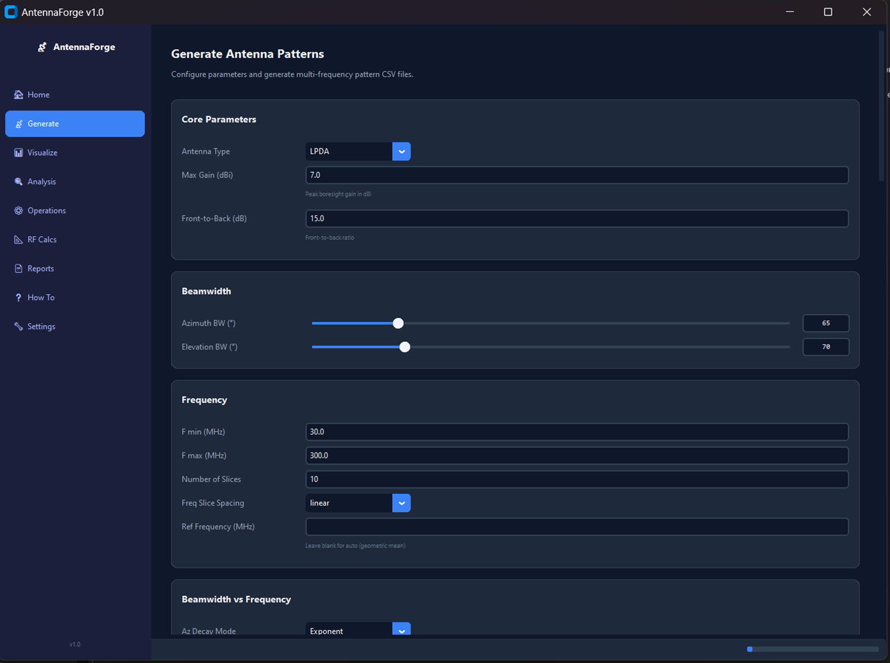
Generation Tab

Slide 16
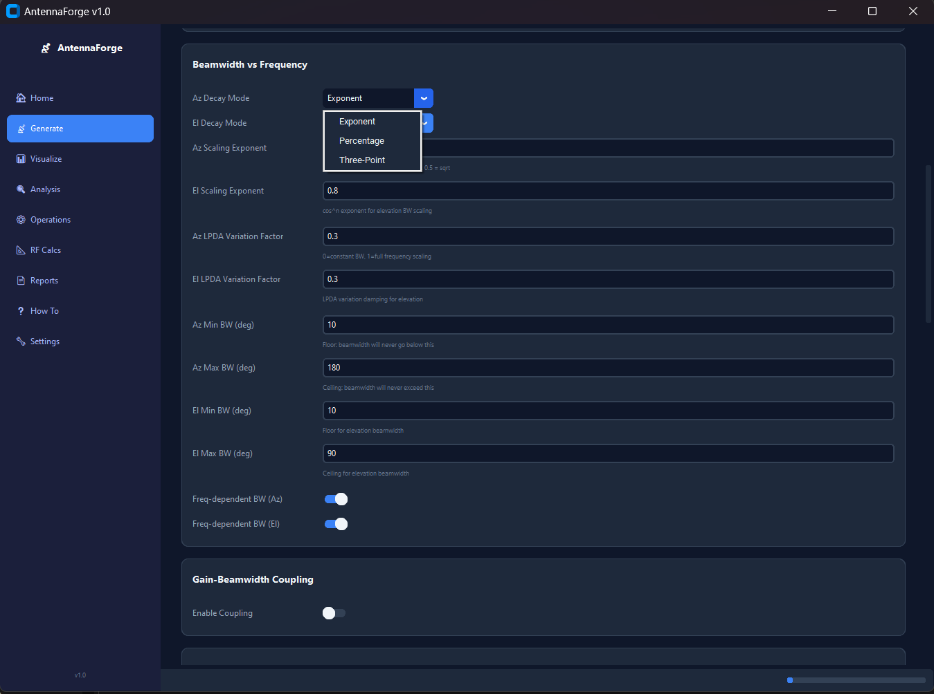
Generation Tab Cont’d

Slide 17
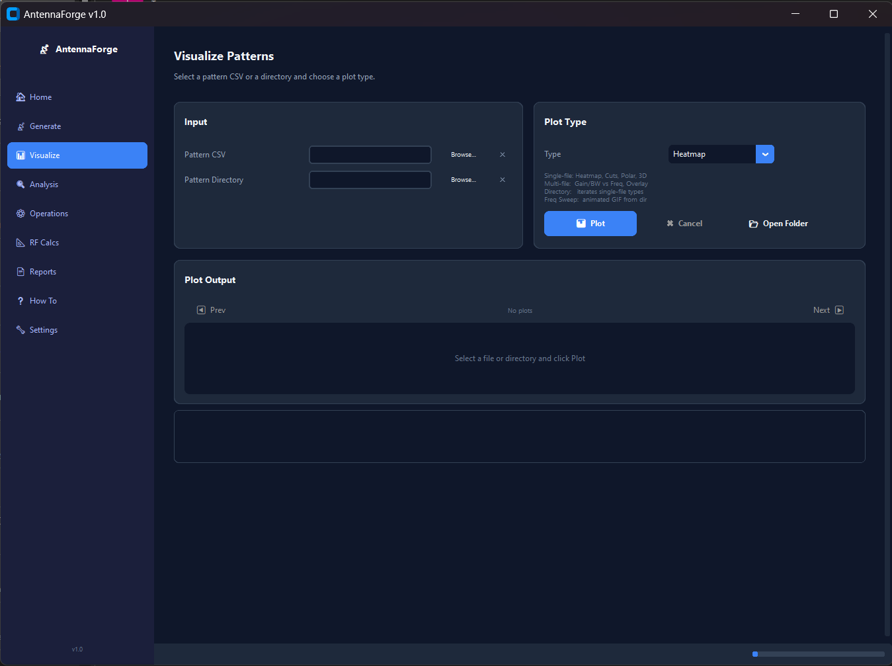
Visualization Tab

