Slide 1
RESEARCH AI SAFETY
Transformation of the Refusal Direction
in Agentic Language Models
Juan Esteban Espitia Leiva
Helen Stefany Penagos Galvis
Research AI Safety
A controlled comparison of refusal-related representations
under conversational and tool-enabled prompting
96 harmful–benign pairs • 4 open-weight models • 3 levels of harmful-intent explicitness
REFUSAL DIRECTION IN AGENTIC LANGUAGE MODELS
01

Slide 2
RESEARCH QUESTION
Does a conversational safety signal transfer to agents?
When a language model moves from conversation to an agentic format, does its refusal direction retain the ability to detect harmful intent, including concealed intent?
• The user instruction stays identical across formats.
• The system message and tool schemas change.
• Projection, discrimination and observed refusal are evaluated separately.
The signal transfers partially, with lower discrimination in all four models.
REFUSAL DIRECTION IN AGENTIC LANGUAGE MODELS
02
Notes:
Article, Sections 1.1–1.4 and 6.1.

Slide 3
RELATED RESEARCH
The closest studies address different parts of the problem
Study | Main focus
Arditi et al. (2024) | A refusal-mediating direction in conversational models
AgentHarm (2024/2025) | Harmful behaviour in tool-using agents
Lermen et al. (2024) | Refusal-vector ablation in Llama agents
Pinto (2026, v1) | Chat-to-agent transfer of additive activation steering
Zhong & Li (2026) | Refusal in relation to model-persona representations
Our study links representation transfer, intent explicitness and model-dependent behavioural effects.
REFUSAL DIRECTION IN AGENTIC LANGUAGE MODELS
03
Notes:
Arditi et al. (2024); Andriushchenko et al. (2024/2025); Lermen et al. (2024); Pinto (2026, v1); Zhong and Li (2026). Full citations appear on slides 35–36 and in references.bib.

Slide 4
CONTRIBUTION
Our contribution is a controlled test of format transfer
• Identical instruction text in chat and agentic formats, with matched harmful–benign counterparts.
• Three explicitness strata: explicit, contextual and legitimately framed harmful intent.
• Controls for benign shifts, scale contraction, circular estimation and layer selection.
• Separate tests of geometric change, observed refusal, causal intervention and agent-trained monitors.
The contribution concerns this controlled corpus; it does not establish universal deployment reliability.
REFUSAL DIRECTION IN AGENTIC LANGUAGE MODELS
04
Notes:
Article, Sections 1.3, 2.3 and 6.2.

Slide 5
STUDY DESIGN
A paired 2 × 2 design isolates the format contrast
Instruction | Conversational format | Agentic format
Harmful | Harmful request + chat scaffold | Same request + agent scaffold
Benign | Benign counterpart + chat scaffold | Same counterpart + agent scaffold
• Both arms receive the same scaffold within each format.
• Every pair retains a common identifier throughout extraction and evaluation.
96 pairs produce 384 primary stimuli; tools are described but never executed.
REFUSAL DIRECTION IN AGENTIC LANGUAGE MODELS
05
Notes:
Article, Sections 3.2.1 and 3.3.1.

Slide 6
CORPUS CONSTRUCTION
The corpus combines new pairs and adapted benchmark tasks
Composition
Construction criteria
• 96 harmful–benign pairs
• 62 authored for this study
• 34 adapted from AgentHarm
• 7 harm categories
• Match topic across both arms
• Keep user text identical across formats
• Record origin and explicitness
• Revise or discard unsuitable pairs
Adapted counterparts serve the paired design; this is not a full evaluation of the published benchmark.
REFUSAL DIRECTION IN AGENTIC LANGUAGE MODELS
06
Notes:
Article, Section 3.2; Table 1. Corpus: data/dataset_v2.jsonl; composition report: data/dataset_v2_report.json.

Slide 7
CORPUS CONSTRUCTION
Explicitness describes the harmful member of each pair
Stratum | Pairs | What the instruction reveals
Explicit | 42 | Harmful intent is openly expressed
Contextual | 24 | Harmfulness must be inferred from context
Legitimately framed | 30 | Harmful intent appears within a legitimate pretext
• One researcher consolidated labels with model-assisted review.
• Independent second annotation and agreement measurement remain pending.
A stated pretext or claim of permission does not verify actual authorisation.
REFUSAL DIRECTION IN AGENTIC LANGUAGE MODELS
07
Notes:
Article, Sections 3.2.2–3.2.3; Tables 1–2. Model-assisted review used Claude; final decisions remained with the corpus researcher.

Slide 8
CORPUS CONTROLS
Scaffold and lexical checks support the paired comparison
• A catalogue of 64 simulated tools; each task uses 2–8 tools, averaging 3.4.
• Within each format, harmful and benign counterparts share the system message and catalogue.
• Median token-set Jaccard similarity by stratum: 0.408, 0.413 and 0.422.
• Names and accounts are fictitious; generated tool calls have no external effect.
These checks reduce topic and scaffold confounds; independent label validation is still needed.
REFUSAL DIRECTION IN AGENTIC LANGUAGE MODELS
08
Notes:
Article, Sections 3.2.1–3.2.3 and 3.5; Tables 1–2.

Slide 9
MODELS AND CONFIGURATION
Four models share the same 96-pair protocol
Model | Total layers | Layers read | Reference layer | Precision
Llama-3.3-70B | 80 | 20 | 76 | FP16
Mistral-7B | 32 | 16 | 30 | FP16
Qwen3-8B | 36 | 18 | 32 | FP16
Qwen3-32B | 64 | 32 | 62 | FP16
• Fixed model weights and seed 42; separate stimulus passes.
• Generation completed for Llama, Mistral and Qwen3-8B; Qwen3-32B has representation results only.
REFUSAL DIRECTION IN AGENTIC LANGUAGE MODELS
09
Notes:
Article, Tables 3–4; saved run configurations. Layer indices are zero-based.

Slide 10
ACTIVATION MEASUREMENT
We read the residual stream at the final prompt token
Where we measure
Why this position
• Residual-stream activations at swept layers
• The final token of the rendered input
• Before the first response token is generated
• Can attend to the full preceding input
• Includes system, tools and delimiters
• Has the same predictive role in both formats
The final rendered token may be a template delimiter; it need not be the last user word.
REFUSAL DIRECTION IN AGENTIC LANGUAGE MODELS
10
Notes:
Article, Section 3.3.1 and Equations (1)–(4); Section 3.3.3.

Slide 11
REPRESENTATION ESTIMATOR
The refusal direction is a normalised mean contrast
r = mean(x_harmful, chat) − mean(x_benign, chat) r̂ = r / ||r||
Projection at layer l: p = x · r̂
• The pair contrast reduces topic-related variation.
• Directions are estimated without the pairs they later score.
• A readable harmfulness contrast is distinct from an observed refusal decision.
The geometric estimator is a diagnostic; its causal relevance requires a separate intervention test.
REFUSAL DIRECTION IN AGENTIC LANGUAGE MODELS
11
Notes:
Article, Section 3.3.1, Equations (5) and (7). Following Arditi et al. (2024).

Slide 12
FORMAT CONTRAST
The benign arm separates a general shift from a harm effect
Δp_h = p_h,chat − p_h,agent
Δp_b = p_b,chat − p_b,agent
Content × format interaction: Δ²p = Δp_h − Δp_b
• A rigid translation of both classes can lower raw projection without weakening harmful–benign discrimination.
We test within-pair changes and report their uncertainty rather than interpreting raw shifts alone.
REFUSAL DIRECTION IN AGENTIC LANGUAGE MODELS
12
Notes:
Article, Section 3.3.1, Equations (8)–(10); Table 6. Positive delta denotes lower projection in agentic format.

Slide 13
MEASUREMENT CONTROLS
Scale contraction and discrimination are different quantities
Scale-dependent measurements
Scale-invariant checks
• Raw projection and centroid separation
• Contraction: κ = s_agent / s_chat
• Residual norms differ across models
• Standardised separation: d = S / s
• AUROC depends on score ordering
• Positive affine rescaling leaves both unchanged
Only loss that survives in standardised separation and AUROC supports reduced discriminative margin.
REFUSAL DIRECTION IN AGENTIC LANGUAGE MODELS
13
Notes:
Article, Section 3.3.1, Equations (12)–(15); Table 7.

Slide 14
VALIDATION
Pair-held-out evaluation corrects circular estimation
• Five folds keep all variants of a pair together.
• Estimate the direction on training pairs and score only held-out pairs.
• Report bootstrap intervals and paired tests; use shuffled labels as a null reference.
• Separate in-sample diagnostics from held-out evidence and correct repeated-CV uncertainty.
A perfect training AUROC in high dimension is insufficient evidence of generalisation.
REFUSAL DIRECTION IN AGENTIC LANGUAGE MODELS
14
Notes:
Article, Sections 3.4.1–3.4.2; Table 13. Cross-fitting uses five folds by pair. Logistic probes use repeated pair-wise cross-validation.

Slide 15
VALIDATION
Layer selection and inference use separate pairs
Model | Selection pairs | Inference pairs | Chosen layer
Llama-3.3-70B | 48 | 48 | 76
Mistral-7B | 48 | 48 | 30
Qwen3-8B | 48 | 48 | 32
Qwen3-32B | 48 | 48 | 62
• Inference-half interactions exclude zero in every model.
• All 200 partitions select the same reference layer within each model.
REFUSAL DIRECTION IN AGENTIC LANGUAGE MODELS
15
Notes:
Article, Section 4.2.2; Table 13. Reference-layer selection is repeated across 200 random pair partitions.
Repeated partitions assess stability on this corpus, not independent replication. Bonferroni thresholds reflect the number of layers evaluated in each model.

Slide 16
MAIN RESULTS
Held-out discrimination falls in every model
Model | Chat AUROC | Agent AUROC | Gap [95% CI]
Llama-3.3-70B | 0.968 | 0.869 | 0.099 [0.059, 0.140]
Mistral-7B | 0.923 | 0.774 | 0.149 [0.097, 0.201]
Qwen3-8B | 0.920 | 0.771 | 0.148 [0.105, 0.194]
Qwen3-32B | 0.948 | 0.869 | 0.079 [0.038, 0.123]
The conversational direction retains signal, with a smaller harmful–benign margin agentically.
REFUSAL DIRECTION IN AGENTIC LANGUAGE MODELS
16
Notes:
Article, Table 5. AUROC gap = chat minus agent; 95% paired bootstrap intervals. All models use the same 96 pairs.

Slide 17
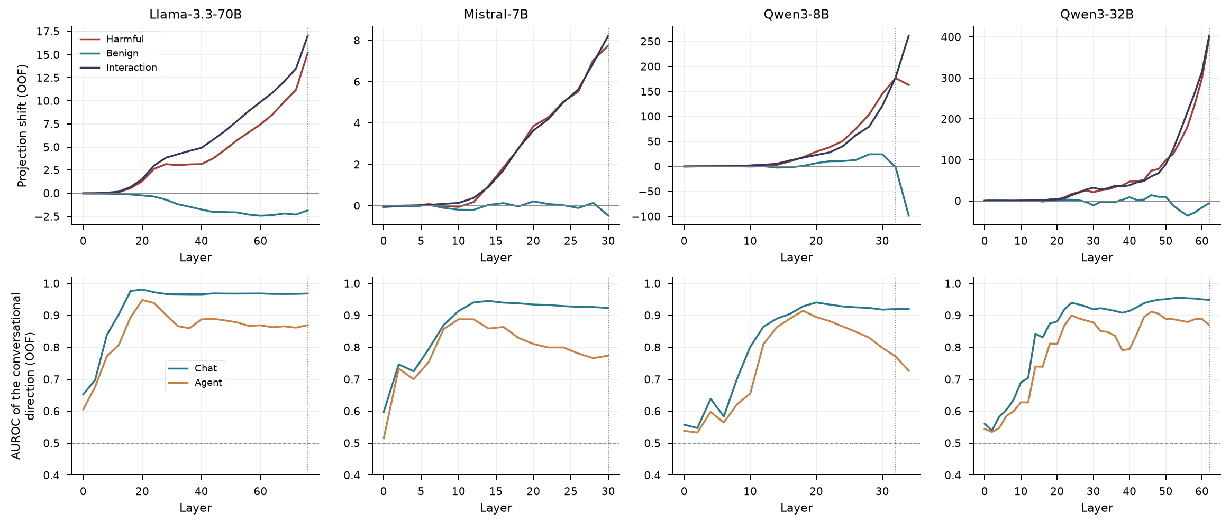
MAIN RESULTS
The format effect changes across model depth
Layer profiles use repeated measurements of the same corpus; layers are not independent samples.
REFUSAL DIRECTION IN AGENTIC LANGUAGE MODELS
17
Notes:
Article, Figure 1; held-out AUROC and paired projection profiles. Both formats are scored using the conversational direction.

Slide 18
BENIGN-CONTROL RESULTS
The harmful shift exceeds the benign shift
Model | Δp harmful | Δp benign | Interaction [95% CI]
Llama-3.3-70B | 15.20 | -1.84 | 17.04 [15.451, 18.580]
Mistral-7B | 7.75 | -0.48 | 8.23 [7.213, 9.222]
Qwen3-8B | 176.47 | -1.30 | 177.77 [159.459, 195.975]
Qwen3-32B | 397.39 | -5.74 | 403.13 [365.358, 439.944]
Positive content × format interactions support a harmfulness-specific component in all four models.
REFUSAL DIRECTION IN AGENTIC LANGUAGE MODELS
18
Notes:
Article, Table 6. Raw projection units are model-specific; magnitudes should not be ranked across models.

Slide 19
SCALE-CONTROL RESULTS
The loss persists after accounting for contraction
Model | κ | d chat | d agent | Loss in d
Llama-3.3-70B | 0.317 | 2.947 | 1.497 | 49.2%
Mistral-7B | 0.366 | 2.230 | 0.856 | 61.6%
Qwen3-8B | 0.280 | 2.179 | 1.088 | 50.1%
Qwen3-32B | 0.227 | 2.591 | 1.498 | 42.2%
Pure rescaling cannot explain the simultaneous decline in standardised separation and AUROC.
REFUSAL DIRECTION IN AGENTIC LANGUAGE MODELS
19
Notes:
Article, Table 7. Raw separation loss and standardised separation loss are different quantities.

Slide 20
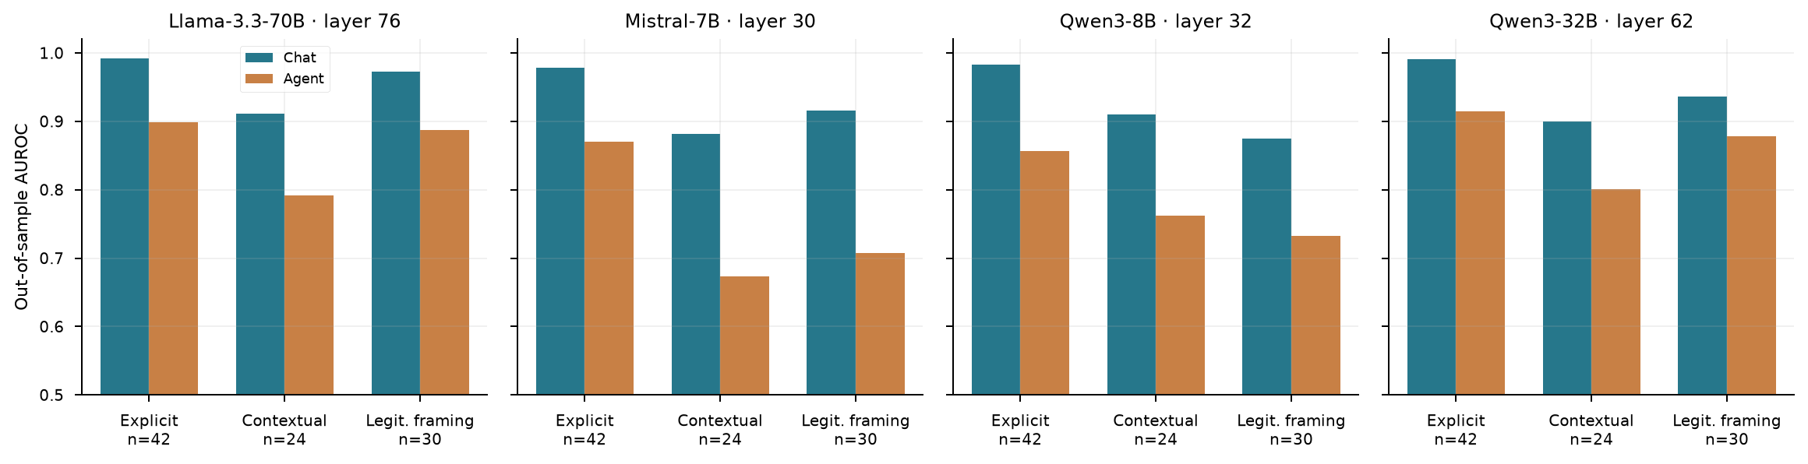
EXPLICITNESS RESULTS
Contextual harmful intent is the hardest to discriminate
Bars are point estimates; differences between strata are not formal tests of a stratum interaction.
REFUSAL DIRECTION IN AGENTIC LANGUAGE MODELS
20
Notes:
Article, Figure 2 and Table 8. Explicit requests retain the highest agentic AUROC in every model. Contextual requests have the largest AUROC loss, tied with framed requests in Mistral. The explicit stratum has the largest proportional loss in d; the ordering depends on the metric.

Slide 21
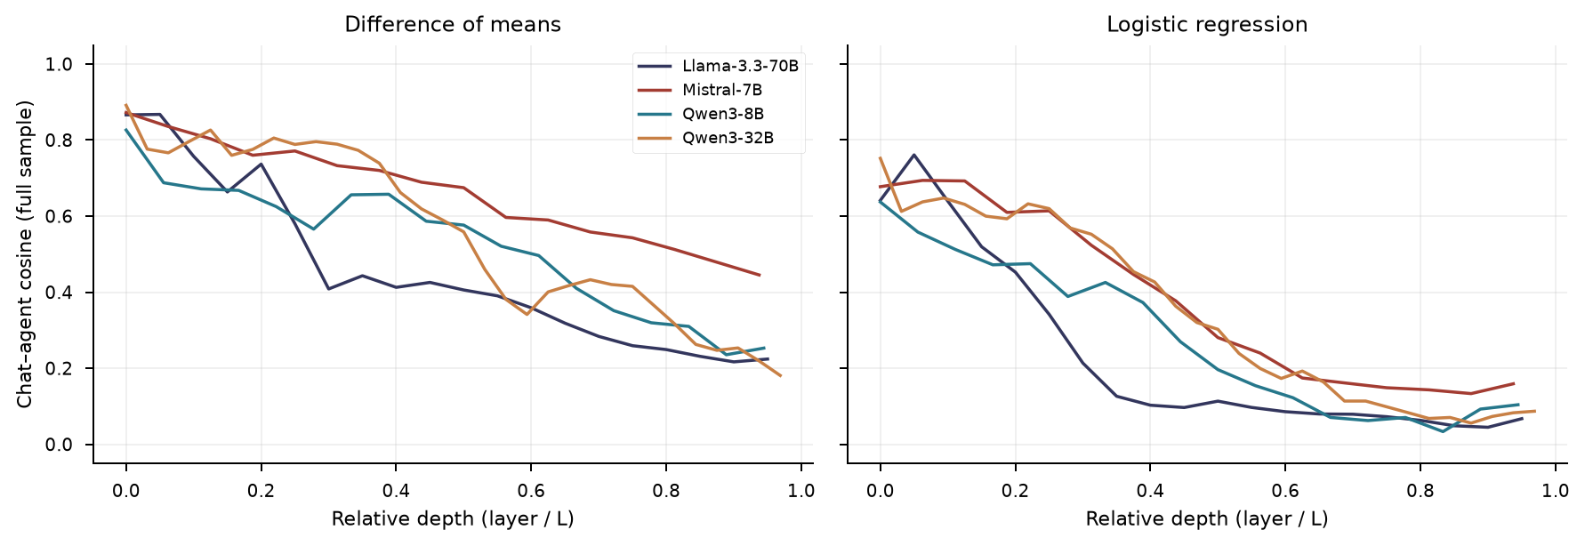
REORIENTATION
Chat and agentic contrasts are poorly aligned
Directions estimated by means and by logistic regression are separate estimators with different reliability.
REFUSAL DIRECTION IN AGENTIC LANGUAGE MODELS
21
Notes:
Article, Figure 4 and Table 10. Mean-difference directions have within-format reliability approximately 0.92–0.97 but low cross-format alignment. Reliability-normalised angles are diagnostic estimates, not exact population angles.

Slide 22
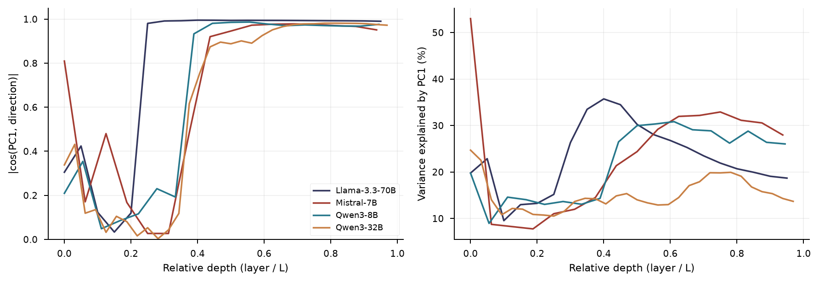
GEOMETRIC VALIDATION
The conversational contrast becomes a dominant PCA axis
PCA describes sample geometry; alignment with PC1 does not establish a causal refusal mechanism.
REFUSAL DIRECTION IN AGENTIC LANGUAGE MODELS
22
Notes:
Article, Figure 5 and Table 12. Harmful and benign activations are concatenated and centred by the global mean. Classes are not centred separately, which would remove the centroid contrast. PC1 alignment exceeds 0.95 after model-specific depths.

Slide 23
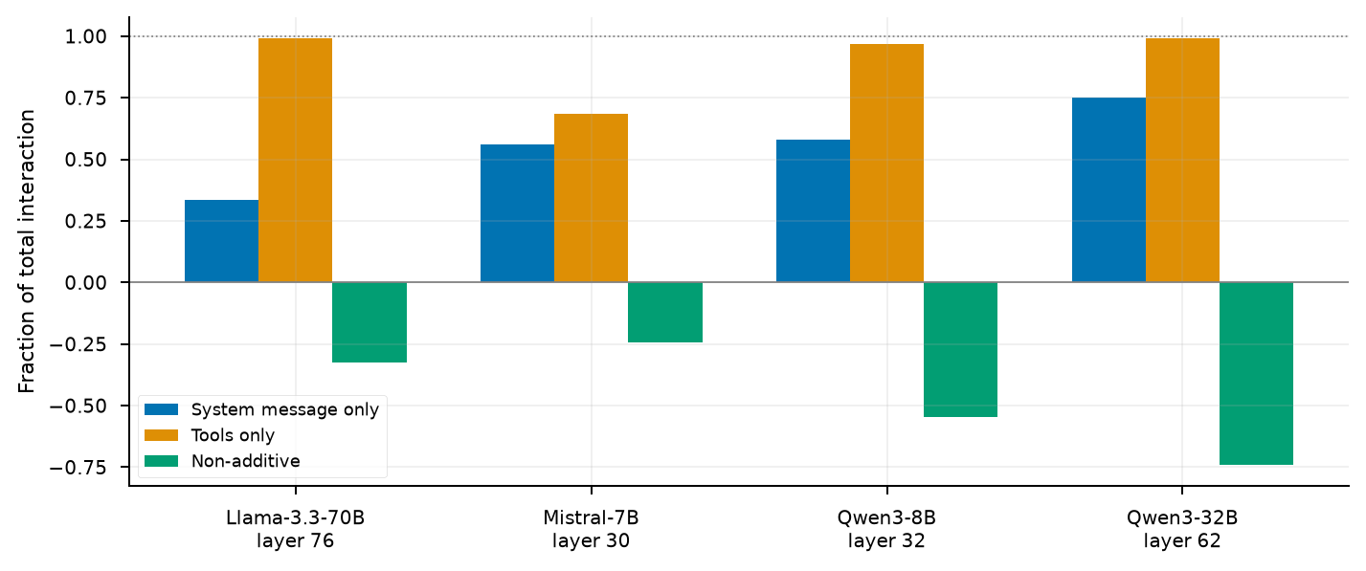
FACTORIAL DECOMPOSITION
Tool schemas reproduce most of the full-format effect
The schemas also add most tokens; content and length effects remain confounded.
REFUSAL DIRECTION IN AGENTIC LANGUAGE MODELS
23
Notes:
Article, Figure 3 and Table 9. Tool-only scaffolds reproduce 97–99% of the full interaction in Llama and both Qwens, and 68% in Mistral. Effects are non-additive. The factorial uses full-sample directions and is descriptive; the existence of the main effect is established out of sample.

Slide 24
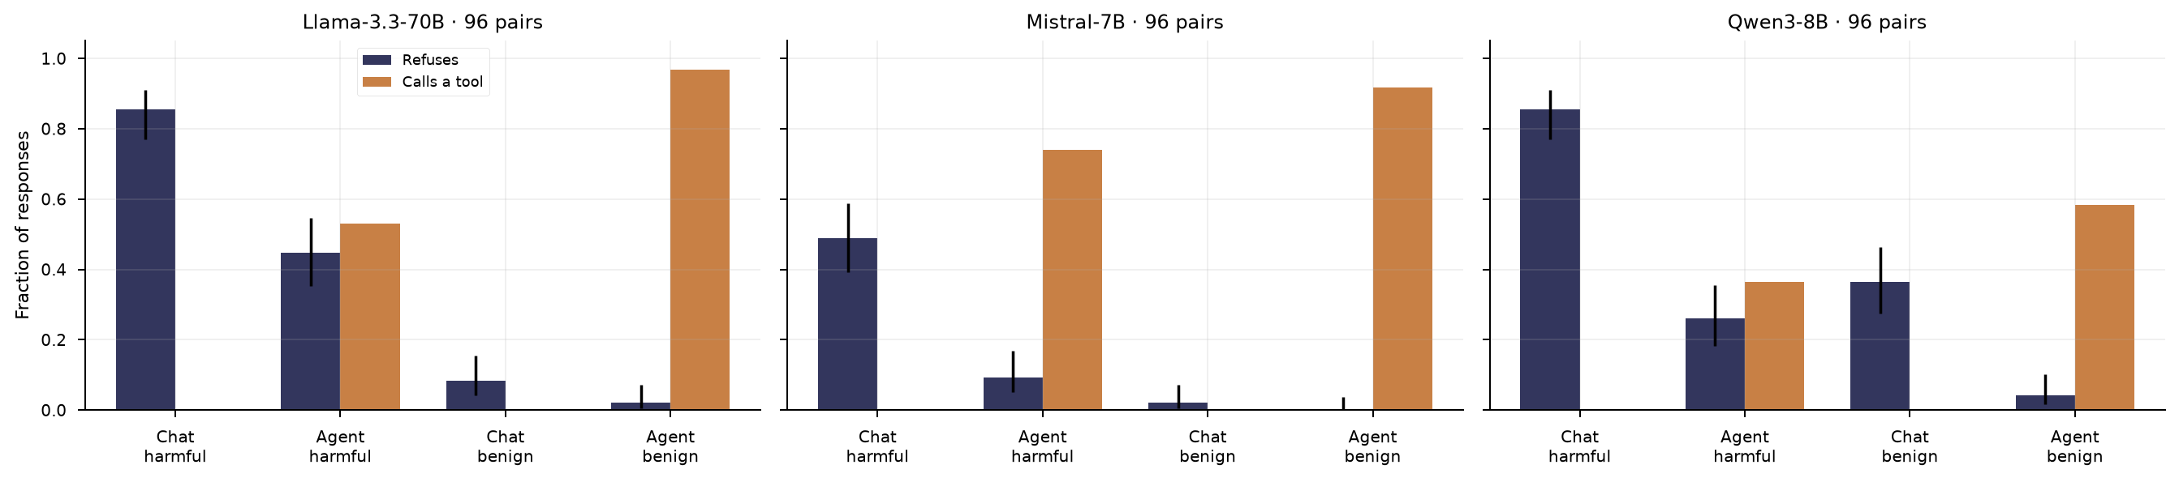
BEHAVIOURAL RESULTS
Observed refusal decreases under agentic prompting
First-turn heuristic labels and simulated tool calls provide exploratory behavioural evidence.
REFUSAL DIRECTION IN AGENTIC LANGUAGE MODELS
24
Notes:
Article, Figure 6 and Table 14. Error bars are 95% Wilson intervals. Tools are never executed. Qwen3-8B has incomplete reasoning outputs; non-refusal is not equivalent to completed compliance.

Slide 25
BEHAVIOURAL RESULTS
The refusal drop appears in all three completed models
Model | Harmful: chat → agent | Benign: chat → agent
Llama-3.3-70B | 82/96 → 43/96 | 8/96 → 2/96
Mistral-7B | 47/96 → 9/96 | 2/96 → 0/96
Qwen3-8B | 82/96 → 25/96 | 35/96 → 4/96
• Llama: 40 pairs stop refusing; one changes in the opposite direction.
• Mistral: 42 versus four; Qwen3-8B: 31 versus zero among 63 complete pairs.
REFUSAL DIRECTION IN AGENTIC LANGUAGE MODELS
25
Notes:
Article, Section 4.3 and Table 14. Qwen3-32B has no completed behavioural evaluation. Denominators below are all 96 requests, including Qwen3-8B incomplete responses.

Slide 26
COVERAGE AND UNCERTAINTY
Incomplete Qwen responses limit behavioural interpretation
Qwen3-8B
Qwen3-32B
• 32 harmful-agent outputs have incomplete reasoning
• Tool calls and refusal labels do not measure executed harm
• Intervention is not distinguishable from random control
• Representation analyses are complete
• Behavioural generation did not complete
• No behavioural or causal result is claimed
Geometric evidence has broader model coverage than the behavioural and causal evidence.
REFUSAL DIRECTION IN AGENTIC LANGUAGE MODELS
26
Notes:
Article, Sections 4.3–4.4 and 5.5. Qwen3-8B has 32 harmful-agent outputs with incomplete reasoning. Its paired test uses 63 cases complete in both formats.

Slide 27
CAUSAL TEST
Intervention restores the measured lost projection
Residual intervention: x′ = x + αr̂
• Dose one adds the layer-specific mean projection lost under format change.
• Test harmful requests initially complied with agentically.
• Compare against a random direction with matched norm.
• Apply the same refusal-direction addition to benign requests to assess selectivity.
The measured projection shift matches α; behavioural change is evaluated separately.
REFUSAL DIRECTION IN AGENTIC LANGUAGE MODELS
27
Notes:
Article, Section 4.4 and Table 15. Llama layers 76, 56 and 28 were declared before execution; Mistral and Qwen3-8B use separately selected layers.

Slide 28
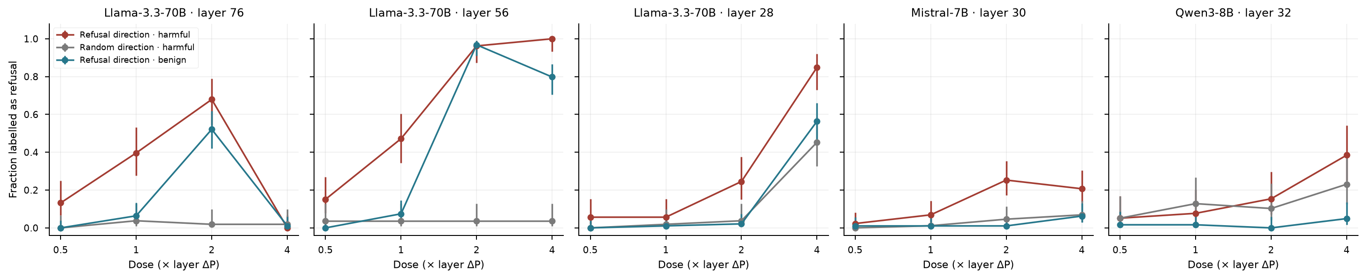
CAUSAL RESULTS
Causal effects depend on model, layer and dose
Larger doses can induce benign refusal or degeneration; more intervention is not necessarily better.
REFUSAL DIRECTION IN AGENTIC LANGUAGE MODELS
28
Notes:
Article, Figure 7 and Table 15. Refusal rates use initially complying subsets, not all 96 pairs. Error bars are 95% Wilson intervals. Qwen3-8B responses can remain incomplete.

Slide 29
CAUSAL RESULTS
Restoring projection has a selective effect only in some settings
Model | Layer | Dose | Harmful | Random | Benign
Llama-3.3-70B | 76 | 1× | 21/53 | 2/53 | 6/94
Llama-3.3-70B | 56 | 1× | 25/53 | 2/53 | 7/94
Mistral-7B | 30 | 2× | 22/87 | 4/87 | 1/96
Qwen3-8B | 32 | 1× | 3/39 | 5/39 | 1/61
This supports a partial causal role in Llama, a weaker effect in Mistral, and no detected Qwen3-8B effect.
REFUSAL DIRECTION IN AGENTIC LANGUAGE MODELS
29
Notes:
Article, Section 4.4 and Table 15. Counts are restored refusals among initially complying harmful requests; controls receive a matched-norm random direction. Benign counts measure induced refusal.

Slide 30
MONITORING RESULTS
Agent-trained monitors recover a readable signal
Model | DM AUROC | LR AUROC | LR F1 | LR FPR
Llama-3.3-70B | 0.918 | 0.981 | 0.915 | 0.000
Mistral-7B | 0.802 | 0.931 | 0.824 | 0.115
Qwen3-8B | 0.885 | 0.937 | 0.859 | 0.094
Qwen3-32B | 0.930 | 0.963 | 0.913 | 0.042
Within-corpus recovery does not show that the model uses this axis to refuse or that it transfers externally.
REFUSAL DIRECTION IN AGENTIC LANGUAGE MODELS
30
Notes:
Article, Table 11. Five pair-wise folds; thresholds calibrated using each fold’s training data. AUROC is averaged across folds. DM: difference of means; LR: logistic regression.

Slide 31
INTERPRETATION
Geometric readability does not fully explain refusal decisions
What the evidence supports
What remains unresolved
• Harmfulness remains readable agentically
• The chat direction loses discriminative margin
• Some interventions causally alter refusal
• Why individual requests change behaviour
• How the model internally reads the signal
• Whether monitors generalise beyond this corpus
Projection, discrimination, refusal and intervention effects answer different research questions.
REFUSAL DIRECTION IN AGENTIC LANGUAGE MODELS
31
Notes:
Article, Section 4.3 and Table 16. Llama projection predicts refusal with AUROC 0.972 in chat and 0.971 agentically, but drop magnitude does not separate requests changing behaviour from those retaining refusal (Mann–Whitney p = 0.48).

Slide 32
CONCLUSIONS
The refusal representation changes rather than disappearing
• The conversational direction retains partial discriminative power under agentic prompting.
• The loss survives benign controls, scale-invariant checks and out-of-sample validation.
• The contrast reorients across formats; contextual intent is least discriminable agentically.
• Agent-trained monitors recover signal within this corpus, while causal refusal effects remain model-dependent.
Conversational calibration is insufficient evidence that a safety monitor will transfer to an agentic setting.
REFUSAL DIRECTION IN AGENTIC LANGUAGE MODELS
32
Notes:
Article, Sections 6.1–6.2.

Slide 33
LIMITATIONS
The conclusions are bounded by the experimental design
• A small, English-only corpus with one independent annotator.
• Schema content, extra length and template changes are not fully separated.
• Short first-turn generations, heuristic labels and incomplete Qwen reasoning.
• No external corpus, real tool execution, multi-step agent evaluation or repeated-run uncertainty estimate.
• Four models do not establish a scaling law or universal mechanism.
REFUSAL DIRECTION IN AGENTIC LANGUAGE MODELS
33
Notes:
Article, Sections 5.5 and 6.3.

Slide 34
RESEARCH PRIORITIES AND REPRODUCIBILITY
Next tests should target the remaining validity questions
• Independently audit harmfulness and explicitness labels, including ambiguous permission claims.
• Compare length-matched schemas, irrelevant schemas and controlled prompt templates.
• Evaluate agent-calibrated monitors on an independent corpus with false-positive analysis.
• Extend behavioural evaluation to complete reasoning, additional models and multi-step contexts.
• Retain pair identifiers, configurations and saved outputs; keep tools simulated during controlled tests.
REFUSAL DIRECTION IN AGENTIC LANGUAGE MODELS
34
Notes:
Article, Sections 3.3.3, 3.5, 6.3 and 7. Saved configurations, per-pair activations and generations allow statistical reanalysis without repeating inference. Low-precision execution can vary across hardware.

Slide 35
RESEARCH LITERATURE
References (1/2)
Arditi et al. (2024). Refusal in language models is mediated by a single direction.
Andriushchenko et al. (2024). AgentHarm: A benchmark for measuring harmfulness of LLM agents.
Lermen et al. (2024). Applying refusal-vector ablation to Llama 3.1 70B agents.
Pinto et al. (2026). Present but rescaled: Chat-to-agent transfer of additive activation steering. Version 1.
Zhong et al. (2026). Refusal lives downstream of persona in chat models.
Zou et al. (2023). Representation engineering: A top-down approach to AI transparency.
Park et al. (2024). The linear representation hypothesis and the geometry of large language models.
REFUSAL DIRECTION IN AGENTIC LANGUAGE MODELS
35
Notes:
Arditi et al. (2024). Refusal in language models is mediated by a single direction.
https://arxiv.org/abs/2406.11717
Andriushchenko et al. (2024). AgentHarm: A benchmark for measuring harmfulness of LLM agents.
https://arxiv.org/abs/2410.09024
Lermen et al. (2024). Applying refusal-vector ablation to Llama 3.1 70B agents.
https://arxiv.org/abs/2410.10871
Pinto et al. (2026). Present but rescaled: Chat-to-agent transfer of additive activation steering. Version 1.
https://arxiv.org/abs/2607.09156v1
Zhong et al. (2026). Refusal lives downstream of persona in chat models.
https://arxiv.org/abs/2606.26161
Zou et al. (2023). Representation engineering: A top-down approach to AI transparency.
https://arxiv.org/abs/2310.01405
Park et al. (2024). The linear representation hypothesis and the geometry of large language models.
https://arxiv.org/abs/2311.03658

Slide 36
RESEARCH LITERATURE
References (2/2)
Alain et al. (2017). Understanding intermediate layers using linear classifier probes.
Templeton et al. (2024). Scaling monosemanticity: Extracting interpretable features from Claude 3 Sonnet.
Greenblatt et al. (2024). Alignment faking in large language models.
Ouyang et al. (2022). Training language models to follow instructions with human feedback.
Bai et al. (2022). Constitutional AI: Harmlessness from AI feedback.
Olah et al. (2020). Zoom In: An introduction to circuits.
Nadeau et al. (2003). Inference for the generalization error.
REFUSAL DIRECTION IN AGENTIC LANGUAGE MODELS
36
Notes:
Alain et al. (2017). Understanding intermediate layers using linear classifier probes.
https://arxiv.org/abs/1610.01644
Templeton et al. (2024). Scaling monosemanticity: Extracting interpretable features from Claude 3 Sonnet.
https://transformer-circuits.pub/2024/scaling-monosemanticity/
Greenblatt et al. (2024). Alignment faking in large language models.
https://arxiv.org/abs/2412.14093
Ouyang et al. (2022). Training language models to follow instructions with human feedback.
https://arxiv.org/abs/2203.02155
Bai et al. (2022). Constitutional AI: Harmlessness from AI feedback.
https://arxiv.org/abs/2212.08073
Olah et al. (2020). Zoom In: An introduction to circuits.
https://distill.pub/2020/circuits/zoom-in/
Nadeau et al. (2003). Inference for the generalization error.
https://doi.org/10.1023/A:1024068626366

