Slide 1

P5-Oniroco

Slide 2
<numéro>
Sommaire
Instructions for use
Cahier des charges
Le résultat sous GitHub Pages
Validation du code
Réalisation / Evolution / Problèmes
Accessibilté
SEO
Images
Questions
<numéro>

Slide 3
<numéro>
1 – Cahier des charges
Le projet consiste à créer
Des applications thématiques ne vendant qu’un type de produit pour se démarquer du géant Amazon
On crée un MVP * pour convaincre les investisseurs
On utilisera JavaScript :
Entre autre le localStorage pour le panier
Les paramètres de requête URL (fetch?)
On crée également un plan de tests
*Minimum Value Product : Produit Minimum Viable

Slide 4
<numéro>
Plan de test
1

Slide 5
<numéro>
Un plan de test est :
Un fichier dans lequel on liste les différentes fonctions, leurs rôles, quels sont les résultats attendus et les erreurs prévisibles.

Slide 6
<numéro>
This is a slide title
Here you have a list of items
And some text
But remember not to overload your slides with content
Your audience will listen to you or read the content, but won’t do both.

Slide 7
<numéro>
BIG CONCEPT
Bring the attention of your audience over a key concept using icons or illustrations

Slide 8
<numéro>
You can also split your content
White
Is the color of milk and fresh snow, the color produced by the combination of all the colors of the visible spectrum.
Black
Is the color of ebony and of outer space. It has been the symbolic color of elegance, solemnity and authority.

Slide 9
<numéro>
In two or three columns
Yellow
Is the color of gold, butter and ripe lemons. In the spectrum of visible light, yellow is found between green and orange.
Blue
Is the colour of the clear sky and the deep sea. It is located between violet and green on the optical spectrum.
Red
Is the color of blood, and because of this it has historically been associated with sacrifice, danger and courage.

Slide 10

<numéro>
A picture is worth a thousand words
A complex idea can be conveyed with just a single still image, namely making it possible to absorb large amounts of data quickly.

Slide 11
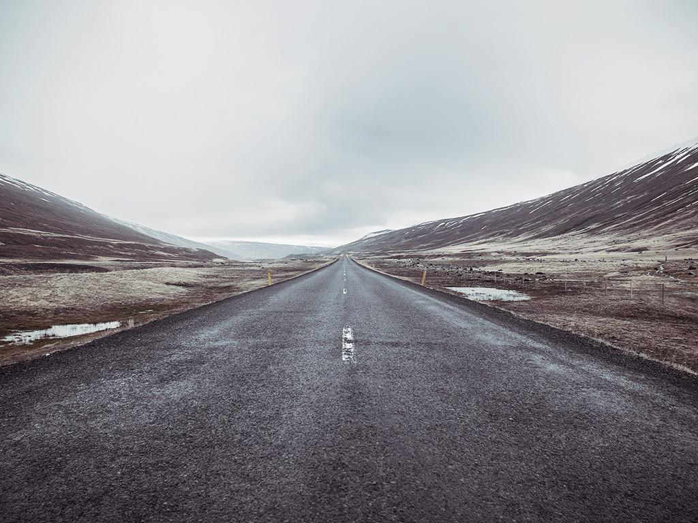
<numéro>
want big impact?
USE BIG IMAGE

Slide 12
<numéro>
Use charts to explain your ideas
White
Gray
Black

Slide 13
<numéro>
And tables to compare data
 | A | B | C
Yellow | 10 | 20 | 7
Blue | 30 | 15 | 10
Orange | 5 | 24 | 16

Slide 14

<numéro>
Maps
our office

Slide 15
<numéro>
89,526,124
Whoa! That’s a big number, aren’t you proud?

Slide 16
<numéro>
89,526,124$
That’s a lot of money
185,244 users
And a lot of users
100%
Total success!

Slide 17
<numéro>
SlidesCarnival icons are editable shapes.
This means that you can:
Resize them without losing quality.
Change fill color and opacity.
Change line color, width and style.
Isn’t that nice? :)
Examples:

Slide 18
<numéro>
Diagrams and infographics

Slide 19
<numéro>
You can also use any emoji as an icon!
And of course it resizes without losing quality.
How? Follow Google instructions https://twitter.com/googledocs/status/730087240156643328
✋👆👉👍👤👦👧👨👩👪💃🏃💑❤😂😉😋😒😭👶😸🐟🍒🍔💣📌📖🔨🎃🎈🎨🏈🏰🌏🔌🔑 and many more...

Slide 20

Free templates for all your presentation needs
For PowerPoint and Google Slides
100% free for personal or commercial use
Ready to use, professional and customizable
Blow your audience away with attractive visuals

