Slide 1
Split
Node 0
<>
<>
<>

Slide 2
Split
Insert 41.70
Node 0
41.70
<a>
<>
<>

Slide 3
Split
Insert 99.71
Node 0
41.70
99.71
<a>
<b>
<>

Slide 4
Split
Insert 72.03
Node 0
41.70
99.71
72.03
<a>
<b>
<c>

Slide 5
Split
Insert 93.25
// its full
Node 0
93.25
41.70
99.71
72.03
<d>
<a>
<b>
<c>

Slide 6
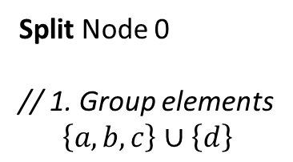
Split
Split Node 0
// 1. Group elements
$$\left\{a, b, c\right\}∪\left\{d\right\}$$
Node 0
41.70
99.71
72.03
<a>
<b>
<c>
41.70
99.71
72.03
93.25
<a>
<b>
<c>
<d>

Slide 7
Split
Split Node 0
// 2. Create new node
// The type of node created (leaf in this case) is the same of the node that called split
Node 0
41.70
99.71
72.03
<a>
<b>
<c>
41.70
99.71
72.03
93.25
<a>
<b>
<c>
<d>
Node 1
<>
<>
<>

Slide 8
Split
Split Node 0
// 3. Promote two objects to become the routing objects on the level above
Node 0
41.70
99.71
72.03
41.70
99.71
<a>
<b>
<c>
promotion
<r1>
<r2>
41.70
99.71
72.03
93.25
<a>
<b>
<c>
<d>
Node 1
<>
<>
<>

Slide 9
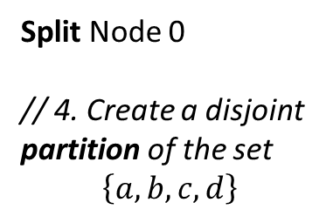
Split
Split Node 0
// 4. Create a disjoint partition of the set
$$\left\{a,b,c,d\right\}$$
Node 0
41.70
99.71
72.03
41.70
99.71
<a>
<b>
<c>
partition
<r1>
<r2>
41.70
99.71
72.03
93.25
<a>
<b>
<c>
<d>
Node 1
<>
<>
<>

Slide 10
Split
Split Node 0
// 5. Distribute partition into nodes
Before: Clear the node that called split
Node 0
41.70
99.71
41.70
99.71
<a>
<b>
<>
<r1>
<r2>
Node 1
72.03
93.25
<c>
<d>
<>

Slide 11
Split
Split Node 0
// ... Each object update the internal state currentNode.
41.70
99.71
<r1>
<r2>
Node 0
Node 1
41.70
99.71
72.03
93.25
<a>
<b>
<>
<c>
<d>
<>

Slide 12
Split
Split Node 0
// 6. As the splitted node was the root, create a new node to become the new root
It’s an internal Node, because the entries are routing objects (instead of leaf objects)
Node 2
41.70
99.71
<>
<>
<>
<r1>
<r2>
Node 0
Node 1
41.70
99.71
72.03
93.25
<a>
<b>
<>
<c>
<d>
<>

Slide 13
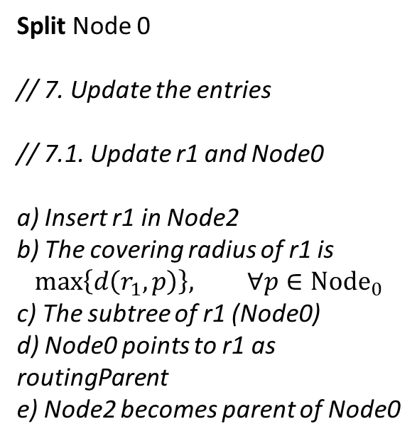
Split
Split Node 0
// 7. Update the entries
// 7.1. Update r1 and Node0
a) Insert r1 in Node2
b) The covering radius of r1 is
$$\max\left\{d\left(r_{1},p\right)\right\}, ∀p∈{Node}_{0}$$
c) The subtree of r1 (Node0)
d) Node0 points to r1 as routingParent
e) Node2 becomes parent of Node0
Node 2
99.71
41.70
<r2>
<r1>
<>
<>
58.03
Node 0
Node 1
41.70
99.71
72.03
93.25
<a>
<b>
<>
<c>
<d>
<>

Slide 14
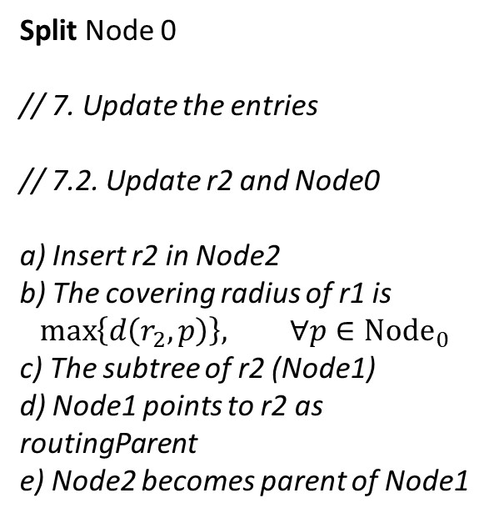
Split
Split Node 0
// 7. Update the entries
// 7.2. Update r2 and Node0
a) Insert r2 in Node2
b) The covering radius of r1 is
$$\max\left\{d\left(r_{2},p\right)\right\}, ∀p∈{Node}_{0}$$
c) The subtree of r2 (Node1)
d) Node1 points to r2 as routingParent
e) Node2 becomes parent of Node1
Node 2
41.70
99.71
<r1>
<r2>
<>
58.03
27.68
Node 0
Node 1
41.70
99.71
72.03
93.25
<a>
<b>
<>
<c>
<d>
<>

Slide 15
Split
Insert 00.01
// The insertion criteria is:
// i. Minimize distance if it’s inside the radius
// ii. Minimize de radii incremente if it’s outside
// In this case it’s inside the radius of r1
Node 2
41.70
99.71
<r1>
<r2>
<>
58.03
27.68
Node 0
Node 1
41.70
99.71
00.01
72.03
93.25
<a>
<b>
<e>
<c>
<d>
<>

Slide 16
Split
Insert 12.81
// Node0 is full
Node 2
41.70
99.71
<r1>
<r2>
<>
58.03
27.68
Node 0
Node 1
12.81
41.70
99.71
00.01
72.03
93.25
<f>
<a>
<b>
<e>
<c>
<d>
<>

Slide 17
Split
Split Node0
// 1. Group
Node 2
41.70
99.71
<r1>
<r2>
<>
58.03
27.68
Node 0
Node 1
41.70
99.71
00.01
72.03
93.25
<a>
<b>
<e>
<c>
<d>
<>
41.70
99.71
00.01
12.81
<a>
<b>
<e>
<f>

Slide 18
Split
Split Node0
// 2. New Node
Node 2
41.70
99.71
<r1>
<r2>
<>
58.03
27.68
Node 0
Node 1
41.70
99.71
00.01
72.03
93.25
<a>
<b>
<e>
<c>
<d>
<>
Node 3
41.70
99.71
00.01
12.81
<a>
<b>
<e>
<f>
<>
<>
<>

Slide 19
Split
Split Node0
// 3. Promote
Node 2
41.70
99.71
<r1>
<r2>
<>
58.03
27.68
Node 0
Node 1
41.70
99.71
00.01
72.03
93.25
41.70
99.71
<a>
<b>
<e>
<c>
<d>
<>
<r3>
<r4>
Node 3
41.70
99.71
00.01
12.81
<a>
<b>
<e>
<f>
<>
<>
<>

Slide 20
Split
Split Node0
// 4. Partition
Node 2
41.70
99.71
<r1>
<r2>
<>
58.03
27.68
Node 0
Node 1
41.70
99.71
00.01
72.03
93.25
41.70
99.71
<a>
<b>
<e>
<c>
<d>
<>
<r3>
<r4>
Node 3
41.70
99.71
00.01
12.81
<a>
<b>
<e>
<f>
<>
<>
<>

Slide 21
Split
Split Node0
// 5. Clear Node0 and distribute
Node 2
41.70
99.71
<r1>
<r2>
<>
58.03
27.68
Node 0
Node 1
41.70
99.71
72.03
93.25
41.70
99.71
<a>
<b>
<>
<c>
<d>
<>
<r3>
<r4>
Node 3
00.01
12.81
<e>
<f>
<>

Slide 22
Split
Split Node0
// 6. Swap r3 and r1
Node 2
41.70
99.71
<r3>
<r2>
<>
27.68
Node 0
Node 1
41.70
99.71
72.03
93.25
99.71
<a>
<b>
<>
<c>
<d>
<>
<r4>
Node 3
00.01
12.81
<e>
<f>
<>

Slide 23
Split
Split Node0
// 7. Update r3
Node 2
41.70
99.71
<r3>
<r2>
<>
58.0
27.68
Node 0
Node 1
41.70
99.71
72.03
93.25
99.71
<a>
<b>
<>
<c>
<d>
<>
<r4>
Node 3
00.01
12.81
<e>
<f>
<>

Slide 24
Split
Split Node0
// 8. If the parente node (Node2) has capacity, insert the routing obj.
Node 2
41.70
99.71
99.71
<r3>
<r2>
<r4>
58.0
27.68
Node 0
Node 1
Node 3
41.70
99.71
72.03
93.25
00.01
12.81
<a>
<b>
<>
<c>
<d>
<>
<e>
<f>
<>

Slide 25
Split
Split Node0
// 9. Update r4
Node 2
41.70
99.71
99.71
<r3>
<r2>
<r4>
58.0
27.68
99.7
Node 0
Node 1
Node 3
41.70
99.71
72.03
93.25
00.01
12.81
<a>
<b>
<>
<c>
<d>
<>
<e>
<f>
<>

Slide 26
Split
Insert 30.23
Node 2
41.70
99.71
99.71
<r3>
<r2>
<r4>
58.0
27.68
99.7
Node 0
Node 1
Node 3
41.70
99.71
30.23
72.03
93.25
00.01
12.81
<a>
<b>
<g>
<c>
<d>
<>
<e>
<f>
<>

Slide 27
Split
Insert 99.90
Node 2
41.70
99.71
99.71
<r3>
<r2>
<r4>
58.0
27.68
99.7
Node 0
Node 1
Node 3
41.70
99.71
30.23
72.03
93.25
99.90
00.01
12.81
<a>
<b>
<g>
<c>
<d>
<h>
<e>
<f>
<>

Slide 28
Split
Insert 14.67
// its full
Node 2
41.70
99.71
99.71
<r3>
<r2>
<r4>
58.0
27.68
99.7
Node 0
Node 1
Node 3
14.67
41.70
99.71
30.23
72.03
93.25
99.90
00.01
12.81
<i>
<a>
<b>
<g>
<c>
<d>
<h>
<e>
<f>
<>

Slide 29
Split
Split Node0
// 1. Group
// 2. New Node
// 3. Promote
// 4. Partition
Node 2
41.70
99.71
99.71
41.70
99.71
<r3>
<r2>
<r4>
<r5>
<r6>
58.0
27.68
99.7
Node 0
Node 1
Node 3
41.70
99.71
30.23
72.03
93.25
99.90
00.01
12.81
<a>
<b>
<g>
<c>
<d>
<h>
<e>
<f>
<>
41.70
99.71
30.23
14.67
Node 4
<a>
<b>
<g>
<i>
<>
<>
<>

Slide 30
Split
Split Node0
// 5. Distribute
Node 2
41.70
99.71
99.71
41.70
99.71
<r3>
<r2>
<r4>
<r5>
<r6>
58.0
27.68
99.7
Node 0
Node 1
Node 3
Node 4
41.70
99.71
72.03
93.25
99.90
00.01
12.81
30.23
14.67
<a>
<b>
<>
<c>
<d>
<h>
<e>
<f>
<>
<g>
<h>
<>

Slide 31
Split
Split Node0
// 6. Swap r3 and r5
Node 2
41.70
99.71
99.71
99.71
<r5>
<r2>
<r4>
<r6>
27.68
99.7
Node 0
Node 1
Node 3
Node 4
41.70
99.71
72.03
93.25
99.90
00.01
12.81
30.23
14.67
<a>
<b>
<>
<c>
<d>
<h>
<e>
<f>
<>
<g>
<h>
<>

Slide 32
Split
Split Node0
// 7. Update r5
Node 2
41.70
99.71
99.71
99.71
<r5>
<r2>
<r4>
<r6>
58.0
27.68
99.7
Node 0
Node 1
Node 3
Node 4
41.70
99.71
72.03
93.25
99.90
00.01
12.81
30.23
14.67
<a>
<b>
<>
<c>
<d>
<h>
<e>
<f>
<>
<g>
<i>
<>

Slide 33
Split
Split Node0
// 8. Link r6 to new node (Node4), node tbd
Node 2
41.70
99.71
99.71
99.71
<r5>
<r2>
<r4>
<r6>
58.0
27.68
99.7
85.04
Node 0
Node 1
Node 3
Node 4
41.70
99.71
72.03
93.25
99.90
00.01
12.81
30.23
14.67
<a>
<b>
<>
<c>
<d>
<h>
<e>
<f>
<>
<g>
<i>
<>

Slide 34
Split
Split Node0
// 9. r6 doesn’t fit in Node2
Node 2
41.70
99.71
99.71
99.71
<r5>
<r2>
<r4>
<r6>
58.0
27.68
99.7
85.04
Node 0
Node 1
Node 3
Node 4
41.70
99.71
72.03
93.25
99.90
00.01
12.81
30.23
14.67
<a>
<b>
<>
<c>
<d>
<h>
<e>
<f>
<>
<g>
<i>
<>

Slide 35
Split
Split Node2
// 1. Group
// 2. New Node
// 3. Promote
// 4. Partition
99.71
99.71
promote
<r7>
<r8>
partition
Node 5
99.71
99.71
41.70
99.71
<r2>
<r4>
<r5>
<r6>
<>
<>
<>
// this is the order of entries
Node 2
41.70
99.71
99.71
99.71
<r5>
<r2>
<r4>
<r6>
58.0
27.68
99.7
85.04
Node 0
Node 1
Node 3
Node 4
41.70
99.71
72.03
93.25
99.90
00.01
12.81
30.23
14.67
<a>
<b>
<>
<c>
<d>
<h>
<e>
<f>
<>
<g>
<i>
<>

Slide 36
Split
Split Node2
// 5. Distribute
99.71
99.71
<r7>
<r8>
Node 2
Node 5
99.71
99.71
41.70
99.71
<r2>
<r4>
<r5>
<r6>
<>
27.68
99.7
58.0
85.04
Node 1
Node 3
Node 0
Node 4
72.03
93.25
99.90
00.01
12.81
41.70
99.71
30.23
14.67
<c>
<d>
<h>
<e>
<f>
<>
<a>
<b>
<>
<g>
<i>
<>

Slide 37
Split
Split Node2
// 5. Distribute
99.71
99.71
<r7>
<r8>
Node 2
Node 5
99.71
99.71
41.70
99.71
<r2>
<r4>
<r5>
<r6>
<>
27.68
99.7
58.0
85.04
Node 1
Node 3
Node 0
Node 4
72.03
93.25
99.90
00.01
12.81
41.70
99.71
30.23
14.67
<c>
<d>
<h>
<e>
<f>
<>
<a>
<b>
<>
<g>
<i>
<>

Slide 38
Split
Split Node2
// 8. Create new root
Node 6
99.71
99.71
<r7>
<r8>
Node 2
Node 5
99.71
99.71
41.70
99.71
<r2>
<r4>
<r5>
<r6>
<>
27.68
99.7
58.0
85.04
Node 1
Node 3
Node 0
Node 4
72.03
93.25
99.90
00.01
12.81
41.70
99.71
30.23
14.67
<c>
<d>
<h>
<e>
<f>
<>
<a>
<b>
<>
<g>
<i>
<>

Slide 39
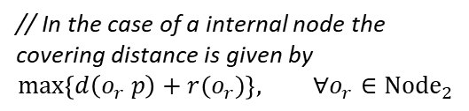
Split
Split Node2
// 9. Update r7 e r8
Node 6
// In the case of a internal node the covering distance is given by
$$\max\left\{d\left(o_{r} p\right)+r(o_{r})\right\}, ∀o_{r}∈{Node}_{2}$$
99.71
99.71
<r7>
<r8>
99.7
58+58=116
Node 2
Node 5
99.71
99.71
41.70
99.71
<r2>
<r4>
<r5>
<r6>
<>
27.68
99.7
58.0
85.04
Node 1
Node 3
Node 0
Node 4
72.03
93.25
99.90
00.01
12.81
41.70
99.71
30.23
14.67
<c>
<d>
<h>
<e>
<f>
<>
<a>
<b>
<>
<g>
<i>
<>

Slide 40
Split
Split Node0
// Returning from recursive split...
// Now I need to parent the old nodes to the recursively created one (Node5)
Node 6
99.71
99.71
<r7>
<r8>
99.7
58+58=116
Node 2
Node 5
99.71
99.71
41.70
99.71
<r2>
<r4>
<r5>
<r6>
<>
27.68
99.7
58.0
85.04
Node 1
Node 3
Node 0
Node 4
72.03
93.25
99.90
00.01
12.81
41.70
99.71
30.23
14.67
<c>
<d>
<h>
<e>
<f>
<>
<a>
<b>
<>
<g>
<i>
<>

Slide 41
Split
Insert 23.60
Node 6
99.71
99.71
<r7>
<r8>
99.7
58+58=116
Node 2
Node 5
99.71
99.71
41.70
99.71
<r2>
<r4>
<r5>
<r6>
<>
27.68
99.7
58.0
85.04
Node 1
Node 3
Node 0
Node 4
72.03
93.25
99.90
00.01
12.81
23.60
41.70
99.71
30.23
14.67
<c>
<d>
<h>
<e>
<f>
<j>
<a>
<b>
<>
<g>
<i>
<>

Slide 42
Split
Insert 9.23
Node 6
99.71
99.71
<r7>
<r8>
99.7
58+58=116
Node 2
Node 5
99.71
99.71
41.70
99.71
<r2>
<r4>
<r5>
<r6>
<>
27.68
99.7
58.0
85.04
Node 1
Node 3
Node 0
Node 4
72.03
93.25
99.90
00.01
12.81
23.60
41.70
99.71
30.23
14.67
<c>
<d>
<h>
<e>
<f>
<j>
<a>
<b>
<>
<g>
<i>
<>
9.23
<k>

Slide 43
Split
Split Node 3
Node 6
99.71
99.71
<r7>
<r8>
99.7
58+58=116
Node 2
Node 5
99.71
00.01
12.81
41.70
99.71
<r2>
<r9>
<r10>
<r5>
<r6>
<>
27.68
12.8
10.8
58.0
85.04
Node 1
Node 3
Node 7
Node 0
Node 4
72.03
93.25
99.90
00.01
12.81
23.60
9.23
41.70
99.71
30.23
14.67
<c>
<d>
<h>
<e>
<f>
<>
<j>
<k>
<>
<a>
<b>
<>
<g>
<i>
<>

Slide 44
KNN
Query: 0.5
Node 6
50.54
43.26
32.36
<r7>
<r8>
118.89
Node 2
Node 5
50.54
24.45
18.18
65.03
87.86
90.83
32.36
<r2>
<r9>
<r10>
<r5>
<r6>
<>
89.68
56.82
57.43
2.97
6.27
Node 4
Node 7
Node 1
Node 3
Node 8
Node 0
87.86
90.83
20.39
1.15
50.54
43.26
24.45
18.18
75.01
66.61
65.03
7.60
85.22
<c>
<d>
<h>
<e>
<f>
<>
<j>
<k>
<>
<a>
<b>
<>
<g>
<i>
<>
<g>
<i>
<>

Slide 45
KNN
Query: 0.5
Node 6
50.54
43.26
32.36
<r7>
<r8>
118.89
Node 2
Node 5
50.54
24.45
18.18
65.03
87.86
90.83
32.36
<r2>
<r9>
<r10>
<r5>
<r6>
<>
89.68
56.82
57.43
2.97
6.27
Node 4
Node 7
Node 1
Node 3
Node 8
Node 0
87.86
90.83
20.39
1.15
50.54
43.26
24.45
18.18
75.01
66.61
65.03
7.60
85.22
<c>
<d>
<h>
<e>
<f>
<>
<j>
<k>
<>
<a>
<b>
<>
<g>
<i>
<>
<g>
<i>
<>

Slide 46
KNN
Node 6
50.54
43.26
32.36
<r7>
<r8>
118.89
Node 2
Node 5
Query: 0.5
50.54
24.45
18.18
65.03
87.86
90.83
32.36
<r2>
<r9>
<r10>
<r5>
<r6>
<>
89.68
56.82
57.43
2.97
6.27
Node 4
Node 7
Node 1
Node 3
Node 8
Node 0
87.86
90.83
20.39
1.15
50.54
43.26
24.45
18.18
75.01
66.61
65.03
7.60
85.22
<c>
<d>
<h>
<e>
<f>
<>
<j>
<k>
<>
<a>
<b>
<>
<g>
<i>
<>
<g>
<i>
<>

Slide 47
KNN
Node 6
50.54
43.26
32.36
<r7>
<r8>
118.89
Node 2
Node 5
50.54
24.45
18.18
65.03
87.86
90.83
Query: 0.5
32.36
<r2>
<r9>
<r10>
<r5>
<r6>
<>
89.68
56.82
57.43
2.97
6.27
Node 4
Node 7
Node 1
Node 3
Node 8
Node 0
87.86
90.83
20.39
1.15
50.54
43.26
24.45
18.18
75.01
66.61
65.03
7.60
85.22
<c>
<d>
<h>
<e>
<f>
<>
<j>
<k>
<>
<a>
<b>
<>
<g>
<i>
<>
<g>
<i>
<>

Slide 48
KNN
Node 6
50.54
43.26
Query: 0.5
32.36
<r7>
<r8>
118.89
Node 2
Node 5
50.54
24.45
18.18
65.03
87.86
90.83
32.36
<r2>
<r9>
<r10>
<r5>
<r6>
<>
89.68
56.82
57.43
2.97
6.27
Node 4
Node 7
Node 1
Node 3
Node 8
Node 0
87.86
90.83
20.39
1.15
50.54
43.26
24.45
18.18
75.01
66.61
65.03
7.60
85.22
<c>
<d>
<h>
<e>
<f>
<>
<j>
<k>
<>
<a>
<b>
<>
<g>
<i>
<>
<g>
<i>
<>

Slide 49
KNN
Node 6
50.54
43.26
32.36
<r7>
<r8>
118.89
Node 2
Node 5
50.54
24.45
18.18
Query: 0.5
65.03
87.86
90.83
<r2>
<r9>
<r10>
<r5>
<r6>
<>
89.68
7.28
56.82
57.43
2.97
6.27
Node 4
Node 7
Node 1
Node 3
Node 8
Node 0
87.86
90.83
20.39
1.15
50.54
43.26
24.45
18.18
75.01
66.61
65.03
7.60
85.22
<c>
<d>
<h>
<e>
<f>
<>
<j>
<k>
<>
<a>
<b>
<>
<g>
<i>
<>
<g>
<i>
<>

Slide 50
KNN
15
6
14
2
9
13
5
1
7
3
8
11
4
10
0
12

Slide 51
KNN
15
75.78
95.79
2
75.78
95.79
4.1
73.93
7
73.23
52.16
67.19
14
91.69
22.56
21.82
d(Q) = 91
d(Q) = 22
d(Q) = 21.3
13
57.32
23.88
17.00
23.28
12

