Slide 1

Reactive Programming with F#
Tomáš Petříček
Microsoft C# MVP
http://tomasp.net/blog

Slide 2
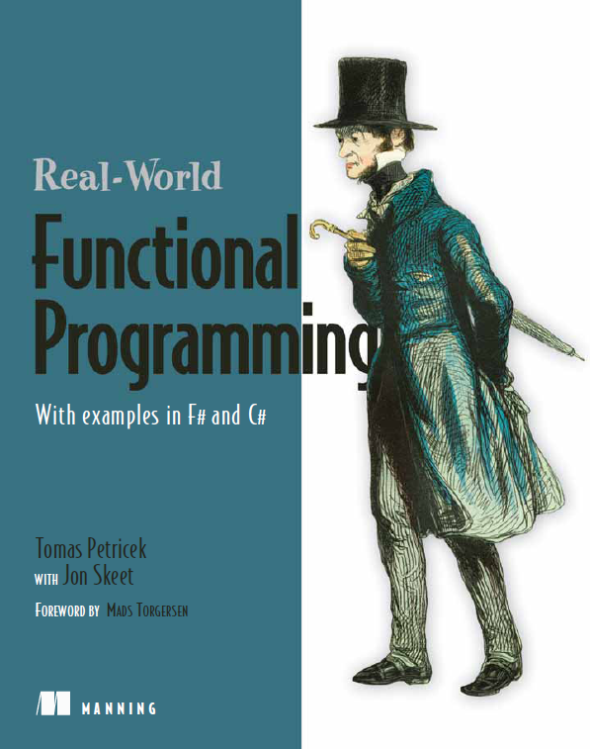
A little bit about me…
Real-World Functional Programming
with Jon Skeet
Today’s talk based on some ideas from Chapter 16
Worked on F# at MSR
Internships with Don Syme
Web programming and reactive programming in F#
Some Visual Studio 2010 IntelliSense

Slide 3
What is this talk about?
It is not about concurrent programming
Multiple threads, various programming models
Immutable data using Tasks or Parallel LINQ
We have full control over the control flow
Message passing using F# MailboxProcessor
Processors react to received messages
It is about reactive programming
Components that react to events in general
MailboxProcessor is one possible implementation
Can be single-threaded – running on GUI thread

Slide 4
Single-threaded reactive programming
Single-threading makes GUI simple (possible!)
Reactive part of the application reacts quickly
Expensive work should be done in background
Declarative – what to do with received data
Define data-flow using event combinators
⊕ Simple & elegant ⊝ Limited expressivity
Imperative – how to react to received data
Define control-flow using asynchronous workflows
⊝ Write more code ⊕ Easy for difficult tasks

Slide 5

Talk outline
Writing reactive GUIs declaratively
Declarative GUI programming in WPF
Using F# event combinators
Writing reactive GUIs imperatively
Using the AwaitObservable primitive
Understanding threading
Asynchronous programming with events
Asynchronous HTTP web requests

Slide 6
Everybody loves declarative style!
Used by numerous .NET libraries
LINQ for specifying queries in C#
Specifying layout of user interface in WPF/Silverlight
Can be used for specifying reactive aspects too!
Declarative
<Button Content="Click me!">
<i:Interaction.Triggers>
<i:EventTrigger EventName="Click">
<ei:CallMethodAction MethodName="Process" (...) />
</i:EventTrigger>
</i:Interaction.Triggers>
</Button>
Triggered when this event occurs
This action calls specified method

Slide 7
Everybody loves declarative style! (2.)
Specifying more complex behaviors
We can write new Triggers and Actions…
For example Silverlight Experimental Hacks Library
We can specify conditions for triggers
Triggered only when chkAllow.Enabled == true
<Button Content="Click me!"><i:Interaction.Triggers>
<ex:EventTrigger EventName="Click">
<ex:EventTrigger.Conditions><ex:InvokingConditions>
<ex:InvokingCondition ElementName="chkAllow"
Property="Enabled" Value="True" />
</ex:InvokingConditions></ex:EventTrigger.Conditions>
<ex:PropertyAction PropertyName="Visible" Value="True" />
</ex:EventTrigger>
</i:Interaction.Triggers></Button>
Displays some control

Slide 8
Digression: Declarative list processing
Essentially the same thing as LINQ queries
Declarative – specify what results we want
Create list of points
> let points = [ (0.0, 50.0); (100.0, 0.0); (300.0, 100.0) ]
;;
> List.map (fun (x, y) -> x+25.0, y+25.0) points
;;
val it : (float * float) list =
[(25.0, 75.0); (125.0, 25.0); (325.0, 125.0)]
> points
|> List.map (fun (x, y) -> x+25.0, y+25.0)
|> List.filter (fun (x, y) -> x < 200.0 && y < 100.0)
|> List.iter (fun (x, y) -> printf "[%f, %f] " x y)
;;
[25.000000, 75.000000] [125.000000, 25.000000]
Add 25 to X and Y coordinates
* First add 25
* Limit range
* Print points

Slide 9
DEMO
Introducing F# event combinators

Slide 10
Digression: Dynamic invoke in F#
Access members not known at compile-time
Simple version of dynamic keyword in C#
We can easily define behavior of the operator
How does it work?
When we write…
…the compiler treats it as:
let (?) (this : Control) (prop : string) : 'T =
this.FindName(prop) :?> 'T
let ball : Ellipse = this?Ball
let ball : Ellipse = (?) this "Ball"

Slide 11
More about F# events
Events in F# are first-class values
Implement interface type IEvent<'T>
Events carry values 'T such as MouseEventArgs
Can be passed as arguments, returned as results
We use functions for working with event values
Create new event that carries different type of value and is triggered only in some cases
Event.add registers handler to the final event
Event.map : ('T -> 'R) -> IEvent<'T> -> IEvent<'R>
Event.filter : ('T -> bool) -> IEvent<'T> -> IEvent<'T>

Slide 12
Two interesting event combinators
Merging events with Event.merge
Triggered whenever first or second event occurs
Note that the carried values must have same type
Creating stateful events with Event.scan
State is recalculated each time event occurs
Triggered with new state after recalculation
IEvent<'T> -> IEvent<'T> -> IEvent<'T>
('St -> 'T -> 'St) -> 'St -> IEvent<'T> -> IEvent<'St>

Slide 13

Creating ColorSelector control
Three sliders for changing color components
Box shows current color
Data-flow diagram describes the activity
Diagrams

Slide 14
DEMO
Writing ColorSelector control with F# events

Slide 15
Accessing F# events from C#
Events in F# are values of type IEvent<'T>
Enables F# way of working with events
Attribute instructs F# to generate .NET event
IEvent<'T> vs. IObservable<'T> in .NET 4.0
You can work with both of them from F#
Using combinators such as Observable.map etc.
Observable keeps separate state for each handler
Can be confusing if you add/remove handlers
[<CLIEvent>]
member x.ColorChanged = colorChanged

Slide 16
Talk outline
Writing reactive GUIs declaratively
Declarative GUI programming in WPF
Using F# event combinators
Writing reactive GUIs imperatively
Using the AwaitObservable primitive
Understanding threading
Asynchronous programming with events
Asynchronous HTTP web requests

Slide 17
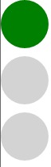
Creating SemaphoreLight control
Typical approach – store state as int or enum
Imperative code uses mutable fields
With event combinators, we use Event.scan
Difficult to read – what does state represent?
It is hard to see what the transitions are!
Better approach – write workflow that loops between states (points in code)
Asynchronous waiting on events causes transitions
Diagrams

Slide 18
DEMO
Writing SemaphoreLight with workflows

Slide 19
Workflows for GUI programming
Async.AwaitObservable operation
Creates workflow that waits for the first occurrence
Currently not part of F# libraries / PowerPack
Sometimes, using IObservable<'T> is better
Works because IEvent<'T> : IObservable<'T>
Async.StartImmediate operation
Starts the workflow on the current (e.g. GUI) thread
Callbacks always return to original kind of thread
All code in the demo runs on GUI thread as required!
AwaitObservable : IObservable<'T> -> Async<'T>

Slide 20
Writing loops using workflows
Using looping constructs like while and for
Functional style – using recursion
let semaphoreStates2() = async {
while true do
for current in [ green; orange; red ] do
let! md = Async.AwaitObservable(this.MouseLeftButtonDown)
display(current) }
“Infinite” loop
let rec semaphoreStates() = async {
for current in [ green; orange; red ] do
let! md = Async.AwaitObservable(this.MouseLeftButtonDown)
display(current)
return! semaphoreStates() }
Recursive call written using “do!”

Slide 21

Break: Time for a bit of Art…

Slide 22
Application for drawing rectangles
Choosing between multiple transitions?
AwaitObservable taking two events
Resume when the first event fires
complex diagrams

Slide 23
DEMO
Drawing rectangles in Silverlight

Slide 24
Waiting for multiple events
Choosing between two (or more) events
Specify two different transitions from single state
Overloads for more events available too
AwaitObservable : IObservable<'T> * IObservable<'U>
-> Async<Choice<'T, 'U>>
Overload taking two events as parameters
let! evt = Async.AwaitObservable
(main.MouseLeftButtonDown, main.MouseMove)
match evt with
| Choice1Of2(up) ->
// Left button was clicked
| Choice2Of2(move) ->
// Mouse cursor moved }
Returns Choice<'T1,'T2>

Slide 25
Talk outline
Writing reactive GUIs declaratively
Declarative GUI programming in WPF
Using F# event combinators
Writing reactive GUIs imperatively
Using the AwaitObservable primitive
Understanding threading
Asynchronous programming with events
Asynchronous HTTP web requests

Slide 26
Patterns for asynchronous programming
Begin/End pattern used by standard libraries
Event-based pattern used more recently
Can we write this using AwaitObservable?
Little tricky – need to attach handler first!
let hr = HttpWebRequest.Create("http://...")
let! resp = hr.AsyncGetResponse()
let sr = resp.GetResponseStream()
Created from Begin/EndGetResponse
let wc = new WebClient()
wc.DownloadStringCompleted.Add(fun res ->
let string = res.Result )
wc.DownloadStringAsync("http://...")
Register handler and then start

Slide 27
Performing asynchronous calls correctly
Introducing GuardedAwaitObservable primitive
Calls a function after attaching event handler
We cannot accidentally lose event occurrence
Mixing asynchronous I/O and GUI code
If started from GUI thread, will return to GUI thread
We can safely access controls after HTTP request
async {
let wc = new WebClient()
let! res =
Async.GuardedAwaitObservable wc.DownloadStringCompleted
(fun () -> wc.DownloadStringAsync(new Uri(uri)))
// (...) }

Slide 28
DEMO
Social rectangle drawing application
web 2.0 inside!!

Slide 29

Brief summary of the talk
Reactive code can run on the GUI thread!
Two programming styles in F#
Declarative or data-flow style
Using Event.scan combinators
Imperative or control-flow style
Using AwaitEvent primitive
In both cases, we can use diagrams
Web requests from workflows
Both common patterns work

Slide 30
Thanks!
Questions?

Slide 31
References & Links
What do you need to run samples?
Samples will be on my blog (below)
Get F# and F# PowerPack (http://www.fsharp.net)
Get Silverlight Developer tools (F# included!)
http://www.silverlight.net/getstarted
Blog & contacts
“Real-World Functional Programming”
http://functional-programming.net
My blog: http://tomasp.net/blog
Contact: tomas@tomasp.net

