Slide 1
Sketch2Code

Slide 2
What is Sketch2Code？
Sketch2Code is a solution that uses AI to transform a handwritten user interface design from a picture to valid HTML markup code.

Slide 3
The Process Flow Of Sketch2Code
The process of transformation of a handwritten image to HTML this solution implements is detailed as follows:
The user uploads an image through the website.
A custom vision model predicts what HTML elements are present in the image and their location.
A handwritten text recognition service reads the text inside the predicted elements.
A layout algorithm uses the spatial information from all the bounding boxes of the predicted elements to generate a grid structure that accommodates all.
An HTML generation engine uses all these pieces of information to generate an HTML markup code reflecting the result.

Slide 4
Architecture Of Sketch2Code
The Sketch2Code solution uses the following elements:
A Microsoft Custom Vision Model: This model has been trained with images of different handwritten designs tagging the information of most common HTML elements like Buttons, TextBox and Image.
A Microsoft Computer Vision Service: To identify the text written into a design element a Computer Vision Service is used.
An Azure Blob Storage: All steps involved in the HTML generation process are stored, including original image, prediction results and layout grouping information.
An Azure Function: Serves as the backend entry point that coordinates the generation process by interacting with all the services.
An Azure Web App: User front-end to enable uploading a new design and see the generated HTML results. These elements form the architecture as follows:

Slide 5
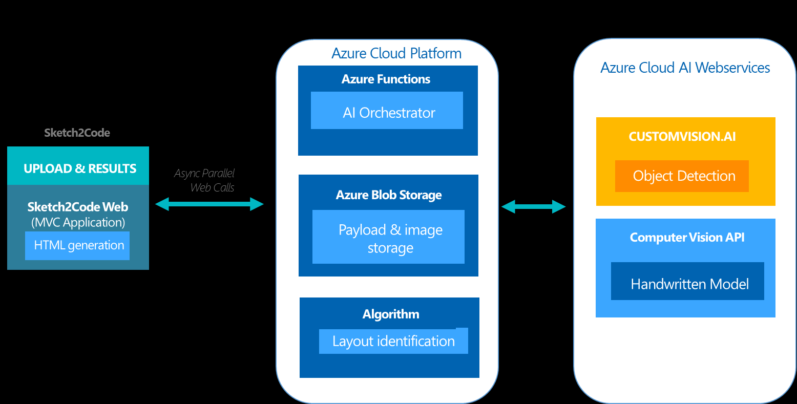

Slide 6
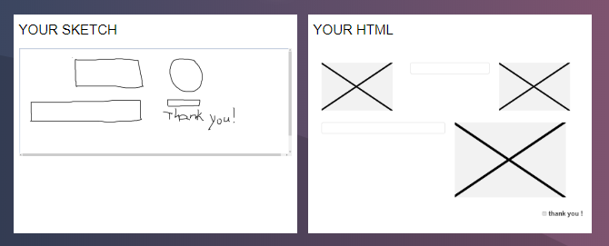
My Tests

Slide 7
