Slide 1
Markdown in GitHub

Slide 2
What is Markdown?
Markdown is a lightweight and easy-to-use syntax for styling all forms of writing on the GitHub platform.
Markdown is a way to style text on the web. We control the display of the document; formatting words as bold or italic, adding images, and creating lists are just a few of the things we can do with Markdown. Mostly, Markdown is just regular text with a few non-alphabetic characters thrown in, like # or *.

Slide 3
We can use Markdown most places around GitHub:
Gists
Comments in Issues and Pull Requests
Files with the .md or .markdown extension

Slide 4
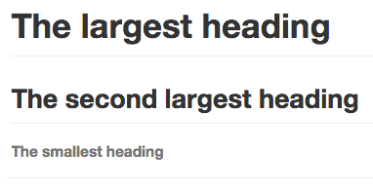
1.Headings
To create a heading, add one to six # symbols before your heading text. The number of # we use will determine the size of the heading.
e.g. # The largest heading
## The second largest heading
###### The smallest heading

Slide 5
2.Styling text
Style | Syntax | Keyboard shortcut | Example | Output
Bold | ** ** or __ __ | command/control + b | **This is bold text** | This is bold text
Italic | * * or _ _ | command/control + i | *This text is italicized* | This text is italicized
Strikethrough | ~~ ~~ | (none) | ~~This was mistaken text~~ | This was mistaken text
Bold and italic | ** ** and _ _ | (none) | **This text is _extremely_ important** | This text is extremely important

Slide 6

3.Quoting text
We can quote text with a >.
e.g.
In the words of Abraham Lincoln:
> Pardon my French

Slide 7
4.Quoting code
We can call out code or a command within a sentence with single backticks. The text within the backticks will not be formatted.
e.g. Use `git status` to list all new or modified files that haven't yet been committed.

Slide 8
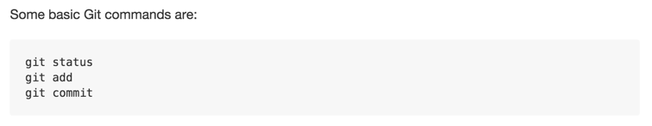
To format code or text into its own distinct block, use triple backticks.
e.g. Some basic Git commands are:
```
git status
git add
git commit
```

Slide 9
5.Links
We can create an inline link by wrapping link text in brackets [ ], and then wrapping the URL in parentheses ( ). We can also use the keyboard shortcut command + k to create a link.

Slide 10
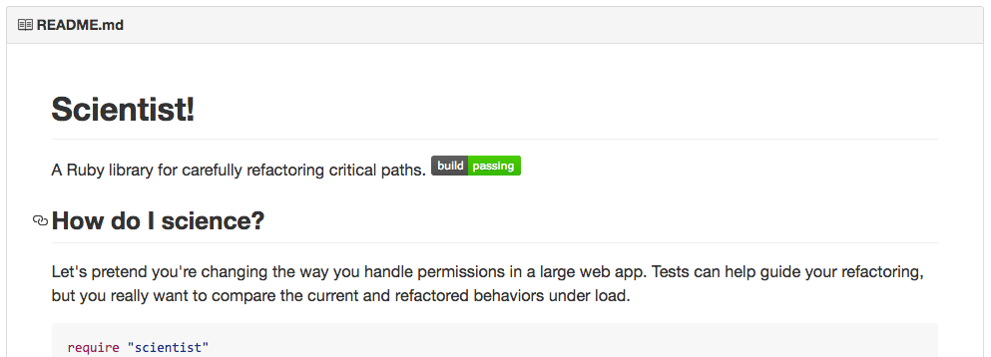
6.Section links
We can link directly to a section in a rendered file by hovering over the section heading to expose the link:

Slide 11
7.Relative links
We can define relative links and image paths in our rendered files to help readers navigate to other files in our repository.
A relative link is a link that is relative to the current file. For example, if you have a README file in root of your repository, and you have another file in docs/CONTRIBUTING.md, the relative link to CONTRIBUTING.md in your README might look like this:
[Contribution guidelines for this project](docs/CONTRIBUTING.md)

Slide 12
GitHub will automatically transform our relative link or image path based on whatever branch we're currently on, so that the link or path always works. We can use all relative link operands, such as ./ and ../.
Relative links are easier for users who clone our repository. Absolute links may not work in clones of our repository - we recommend using relative links to refer to other files within our repository.

Slide 13

8.Lists
We can make an unordered list by preceding one or more lines of text with - or *.
e.g. - George Washington
- John Adams
- Thomas Jefferson

Slide 14

To order our list, precede each line with a number.
e.g. 1. James Madison
2. James Monroe
3. John Quincy Adams

Slide 15
9.Nested Lists
We can create a nested list by indenting one or more list items below another item.
To create a nested list using the web editor on GitHub or a text editor that uses a monospaced font, like Atom, we can align your list visually. Type space characters in front of your nested list item, until the list marker character (- or *) lies directly below the first character of the text in the item above it.

Slide 16

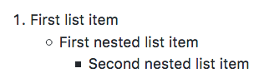
e.g. 1. First list item
- First nested list item
- Second nested list item

