Slide 1
IDA* and Memory-Bounded Search Algorithms
CSCE 580
ANDREW SMITH
JOHNNY FLOWERS

Slide 2
What we’re covering…
Introduction
Korf’s analysis of IDA*
Russell’s criticism of IDA*
Russell’s solution to memory-bounded search

Slide 3
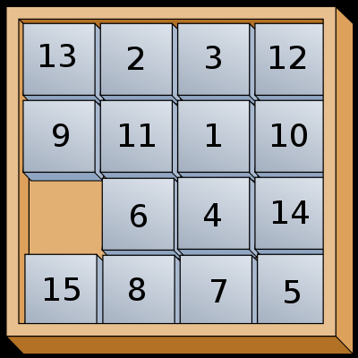
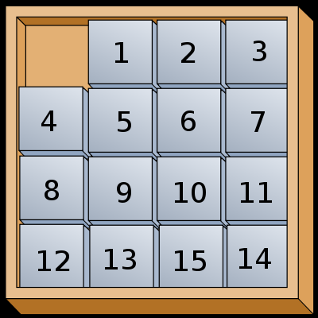
Introduction
Two types of search algorithms:
  Brute force (breadth-first, depth-first, etc.)
  Heuristic (A*, heuristic depth-first, etc.)
Measure of optimality – The Fifteen Puzzle!
INTRODUCTION

Slide 4
Korf’s Analysis
A few definitions…
  Node branching factor (b):
  The number of new states that are generated by the application of a single operator to a given state, averaged over all states in the problem space
  Edge branching factor (e):
  The average number of different operators which are applicable to a given state (i.e. how many edges are coming out of a node)
  Depth (d):
  Length of the shortest sequence of operators that map the initial state to a goal state
KORF’S ANALYSIS

Slide 5
Brute Force Algorithm Analysis
Breadth-first search
  Expands all nodes from the initial state, until a goal state is reached.
  Pros:
    Always finds the shortest path to the goal state.
  Cons:
    Requires time O(b^{d})
    SPACE! – O(b^{d}) nodes must be stored!
  Most problem spaces exhaust memory far before a goal is reached (in 1985 anyway).
KORF’S ANALYSIS

Slide 6
Brute Force Algorithm Analysis
Depth first search
  Expands a path to depth d before expanding any other path, until a goal state is reached.
  Pros:
    Requires little space; only the current path from the initial node must be stored, O(d)
  Cons:
    Does not typically find the shortest path
    Takes time O(e^{d})!
    If a depth cutoff is not set, the algorithm may never terminate
KORF’S ANALYSIS

Slide 7
Brute Force Algorithm Analysis
Depth-first iterative-deepening
  Perform a depth-first search at depth 1, then depth 2,
  ... all the way to depth d
  Pros:
    Optimal time, O(b^{d}) [proof]
    Optimal space, O(d), since it is performing depth-first search , and never searches deeper than d
    Always finds the shortest path
  Cons
    Wasted computation time at depths not containing the goal
      Proven to not affect asymptotic performance (next slide)
    Must explore all possible paths to a given depth
KORF’S ANALYSIS

Slide 8
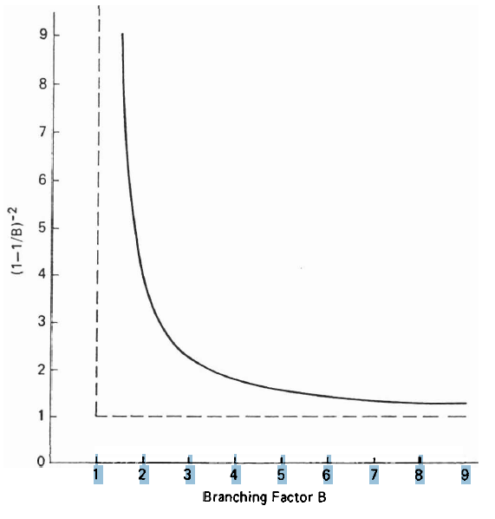
Brute Force Algorithm Analysis
Branching factor vs. constant coefficient as search depth -> infinity
KORF’S ANALYSIS

Slide 9
Increasing Optimality with Bi-Directional Search
DFID with Bi-Directional search
  Depth-first search up to depth k from start node; 2 depth-first searches from goal node up to depth k and k+1
  Performance
    Space, solution of length d, O(b^{d/2})
    Time, O(b^{d/2})
KORF’S ANALYSIS

Slide 10
IDA*
A*, like depth-first search, except based on increasing values of total cost rather than increasing depths
IDA* sets bounds on the heuristic cost of a path, instead of depth
A* always finds a cheapest solution if the heuristic is admissible
  Extends to a monotone admissible function as well
    Korf, Lemma 6.2
  Also applies to IDA*
    Korf, Lemma 6.3
KORF’S ANALYSIS

Slide 11
IDA*
IDA* is optimal in terms of solution cost, time, and space for admissible best-first searches on a tree
  With an admissible monotone heuristic.
  Korf, Theorem 6.4
    IDA* expands the same number of nodes, asymptotically, as A*.
    A* proven to be optimal for nodes expanded.
KORF’S ANALYSIS

Slide 12
IDA* vs. A*
Fifteen Puzzle with Manhattan distance heuristic
IDA* generates more nodes than A*, but runs faster.
Initial State | Estimate | Actual | Total Nodes
7 6 8 1 11 5 14 10 3 4 9 13 15 2 0 12 | 41 | 59 | 1,369,596,778
KORF’S ANALYSIS

Slide 13
Other conclusions…
Also optimal for two-player games
  Can search deeper in the tree at optimal time
  Can be used to order nodes, so alpha-beta cutoff is more efficient – only possible with ID
KORF’S ANALYSIS
Notes:
Alpha value : never greater than the true score
Beta value: never less than the true score

Slide 14
Russell’s Criticism
A* must store all nodes in an open list
  A good implementation of the Fifteen Puzzle will run out of memory (on a 64 MB machine – this is a small issue now)
Memory-bounded variants developed
  Problems:
    Ensuring an optimal solution
    Avoiding re-expansion of nodes (wasted computation)
RUSSELL’S CRITICISM

Slide 15
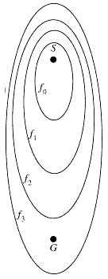
Russell’s Criticism
In worst-case scenarios (and for large problems), IDA* is sub-optimal compared to A*
  Worst case = every node has a different f-cost
    If A* examines k-nodes [O(k)], then IDA* examines
    k²-nodes [O(k²)]
    Unacceptable slowdown for large k
  Evident in real-world problems, such as Traveling
  Salesman
IDA* retains no path information between
iterations
RUSSELL’S CRITICISM

Slide 16
Russell’s Solutions to MB Searches
MA*
  Once a preset limit is reached (in memory), the algorithm prunes the open list by highest f-cost
SMA*
  Improves upon MA* by:
    1. Using a more efficient data structure for the open list (binary tree), sorted by f-cost and depth
    2. Only maintaining two f-cost quantities (instead of four with MA*)
    3. Pruning one node at a time (the worst f-cost)
    4. Retaining backed-up f-costs for pruned paths
RUSSELL’S SOLUTIONS TO MEMORY BOUNDED SEARCH

Slide 17
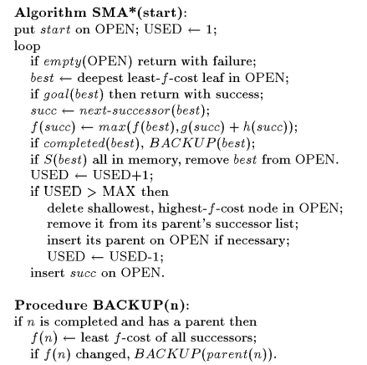
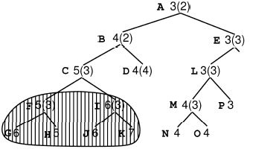
SMA* Algorithm
SMA* - If memory can only hold 10 nodes.
RUSSELL’S SOLUTIONS TO MEMORY BOUNDED SEARCH
Notes:
Pruned in the order GKJIHF, memory holds 10 nodes and becomes full when J is added

Slide 18
Properties of SMA*
Maintain f-costs of the best path (lower bound)
The best lower bound node is always expanded
Guaranteed to return an optimal solution
  MAX must be big enough to hold the shortest path
Behaves identical to A* if
MAX > number of nodes generated
RUSSELL’S SOLUTIONS TO MEMORY BOUNDED SEARCH

Slide 19
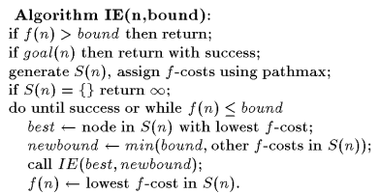
IE Algorithm
IE – All but the current best path and sibling nodes are pruned away. Otherwise, similar to SMA*, until the bound is exceeded. Very similar to best-first search as well.

Slide 20
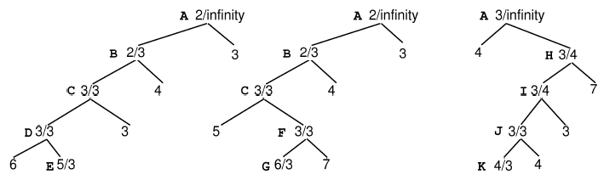
IE Algorithm Example
Labels are f-cost / bound

Slide 21
Russell’s Performance Tests
Used a “perturbed 8-puzzle” as opposed to Korf’s 15-puzzle test
  Small perturbations on Manhattan-distance heuristic
    This is to ensure each node has a different f-cost
  Run on a Macintosh Powerbook 140 w/ 4MB RAM
SMA* vs. A* vs. IE vs. IDA*

Slide 22
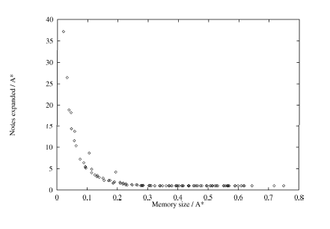
Russell’s Performance Results
Notes:
X-axis: Memory sized used by SMA* as a fraction of the memory needed by A*
Y-axis: Ratio of nodes expanded by SMA* to nodes expanded by A*

Slide 23
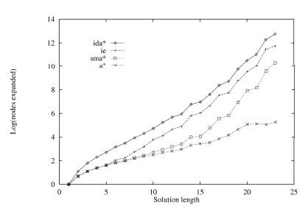
Russell’s Performance Results
Notes:
SMA* dominates IE
IE dominates IDA*

Slide 24
Breadth-First Heuristic Search
Storing all open and closed nodes, as in A*, allows
  Reconstruction of the optimal solution path
  Detection of duplicate node expansions
Sacrificing one of these reduces required memory
Variations of A* such as DFIDA* and RBFS give up duplicate detection
  In doing so, such algorithms convert graph-search into tree-search
  For complex problems in which a given state may be reached through many paths, these algorithms perform poorly

Slide 25
Breadth-First Heuristic Search
Second strategy: maintain duplicate detection, but give up traceback solution reconstruction

Slide 26
Proofs
ID Optimality proof (Korf)
  To see that this is optimal, we present a simple adversary argument. The number of nodes at depth d is bd. Assume that there exists an algorithm that examines less than bd nodes. Then, there must exist at least one node at depth d which is not examined by this algorithm. Since we have no additional information, an adversary could place the only solution at this node and hence the proposed algorithm would fail. Hence, any brute-force algorithm must take at least cbd time, for some constant c.

Slide 27
Proofs
IDA* optimal solution
  Therefore, since IDA* always expands all nodes at a given cost before expanding any nodes at a greater cost, the first solution it finds will be a solution of least cost.

Slide 28
References
Korf, Richard E. Depth-First Iterative-Deepening: An Optimal Admissible Tree Search.
Russell, Stuart. Efficient memory-bounded serach methods.
Zhou, Rong. A Breadth-First Approach to Memory-Efficient Graph Search.

