Slide 1
2008 Summer Road Trip
Welcome!

Slide 2
Overview
Showcase of 2008 Launch Wave offerings
End to end application build with Visual Studio 2008 and .NET 3.5
Targeting SQL 2008 for storage
Deployed on Windows Server 2008

Slide 3
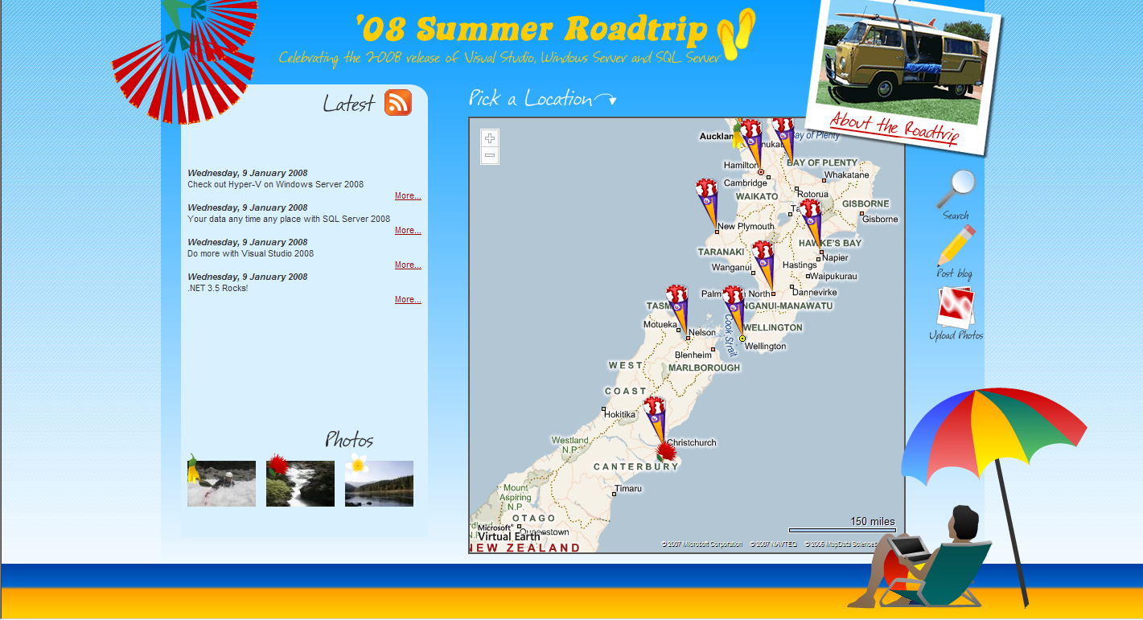
The Vision

Slide 4
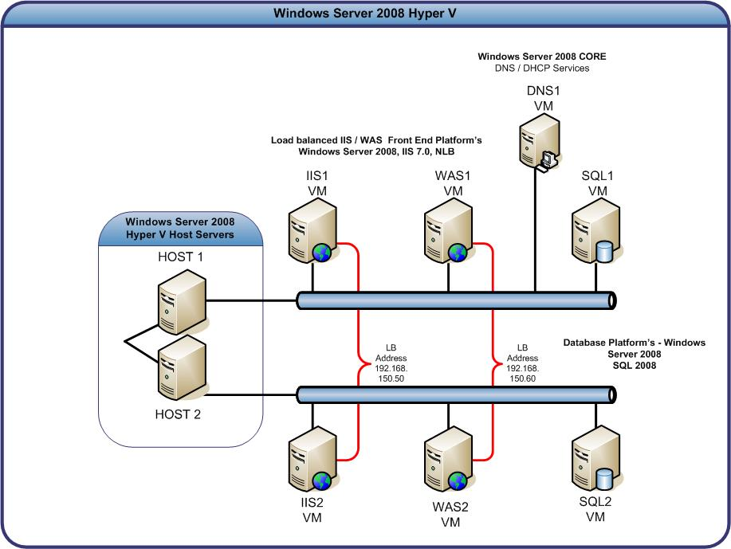
Network Diagram

Slide 5
End to End Plan
Build Data Model (D)
Build Domain Model (D)
Publish Data using Services (D)
Set up infrastructure (I)
Deploy Services (I)
Build Web Site (D)
Deploy and configure Web Site (I)
Go Live!

Slide 6

Logical Architecture
Website
(ASP.NET 3.5)
Web Endpoints (WCF 3.5)
Web Tier
(IIS)
Services (WCF 3.0)
Services Tier
(WAS)
Domain Model
(ADO.NET Entity Framework)
SQL Server 2008
(SQL)

Slide 7














SQL Server 2008
Enterprise Data Platform
Services
Reporting
Integration
Analysis
Synch
Entity Data Model
Beyond Relational
FILE
Query
RDBMS
OLAP
Search
XML
Dynamic Development
Mobile and
Desktop
Cloud
Server
Pervasive Insight

Slide 8
Demo: Setting up our Model

Slide 9
Data Services / Service Layer
Windows Communication Foundation
Flexible, scalable and standard approach
New in .NET 3.5
New support for Web based programming through REST services
JSON message encoding
Tighter integration with Windows Workflow Foundation

Slide 10
Demo: Service Layer

Slide 11
End to End Plan
Build Data Model (D)
Build Domain Model (D)
Publish Data using Services (D)
Set up infrastructure (I)
Deploy Services (I)
Build Web Site (D)
Deploy and configure Web Site (I)
Go Live!

Slide 12
Windows Server 2008
Built for the Web
IIS7
Server Core
Virtualization Built In
Hyper-V
More manageable
Terminal Services
Most Secure Windows Server Yet
Solid Foundation for Business

Slide 13
Virtualization using Hyper-V
Native Hypervisor based solution
Integrated with 2008 Server or Standalone
Key Scenarios
Server Consolidation
Disaster Recovery
Dynamic Environment
Development and Test Environments

Slide 14
Server Core
No Windows explorer shell
Administration via
Command line
Remote Microsoft Management Console
Remote desktop to command line
WS-Management and Windows Remote Shell
WMI
Broad set of simple roles
AD, ADLDS (ADAM), DNS, DHCP, File, Print, Windows Media , IIS 7, Hyper-V

Slide 15
Demo: Hyper-V + Server Core

Slide 16
Hosting Services
HTTP
NET.TCP
NET.PIPE
NET.MSMQ
Self Hosted
Process
WAS
.NET Worker
W3SVC
Service Host

Slide 17

Refresher on Architecture
2. AJAX Calls need to be made against local server
Web Tier
(IIS)
Website
(ASP.NET 3.5)
Web Endpoints (WCF 3.5)
Web site calls services directly
3. Proxy calls against Service Layer
Services Tier
(WAS)
Services (WCF 3.0)

Slide 18
Demo: Hosting under WAS

Slide 19
End to End Plan
Build Data Model (D)
Build Domain Model (D)
Publish Data using Services (D)
Set up infrastructure (I)
Deploy Services (I)
Build Web Site (D)
Deploy and configure Web Site (I)
Go Live!

Slide 20
Visual Studio 2008
Latest and greatest IDE for the Microsoft platform
Allows targeting of 2.0/3.0 and 3.5 Frameworks on a project by project basis
Large number of new designers and productivity tools
JavaScript intellisense/debugging
Web and CSS Designers
WPF / WF designers

Slide 21
Demo: Building our Web Site

Slide 22
ASP.NET AJAX
AJAX WCF Calls
WCF callable by Javascript by configuration
<enableWebScript/> behaviour
Basic JavaScript skills required
Great support in Visual Studio 2008
Integrated designer support

Slide 23
Demo: Hosting in IIS 7

Slide 24
End to End Plan
Build Data Model (D)
Build Domain Model (D)
Publish Data using Services (D)
Set up infrastructure (I)
Deploy Services (I)
Build Web Site (D)
Deploy and configure Web Site (I)
Go Live!

Slide 25
Scope Creep… Spatial Search ☺
Native support in SQL Server 2008
Vector based, industry spatial standards
Two new data types:
GEOMETRY
GEOGRAPHY
Integration into Virtual Earth
Use DHTML + ASP.NET AJAX to select a region and update results

Slide 26
Demo: Adding Spatial Support

Slide 27
SQL Management
Policy-Based Management
New declarative policy system to manage instances
Uses DDL triggers and SQLCLR to enforce policy
Supports “true transactional” events
Fully scriptable
Powershell Support
Native Providers to access SMO data and Policy
Invoke-sqlcmd cmdlet

Slide 28
Demo: SQL Management

Slide 29
Go Live!

Slide 30
Summary: Windows Server
Hyper-V
Server Core
Terminal Services Remote App
IIS7
Call To Action
Run with it today
Available NOW to Partners/MSDN/TechNet

Slide 31
Summary: SQL Server
Your data, any time, any place
Enhancement focused release
Enterprise Data Platform (Mirroring)
Dynamic Development (ADO.NET Entities)
Beyond Relational (FILESTREAM)
Call To Action: Grab the latest CTP today!

Slide 32
Summary: Visual Studio
The IDE for .NET 3.5 Development
New Designers
Allows targeting of 2.0/3.0 and 3.5 Frameworks
Call To Action
Available NOW to Partners/MSDN/TechNet
Move your .NET 2.0 Development to VS2008

Slide 33
Special thanks to
NZ Dot Net User Group – Catering and Organisation
www.dot.net.nz
Vantex Limited – Symbol Infrastructure Access Point
www.vantex.co.nz
Advanced Portable Technology – 3G Wireless Access Point
www.cdma.co.nz

Slide 34
Thanks
Intergen- Chris’s time and Data Centre Hosting
www.intergen.co.nz
Mindscape – Jeremy’s time
www.mindscape.co.nz
Microsoft New Zealand – Sponsorship
www.microsoft.co.nz/msdn/

Slide 35
Links, Resources & Q/A
Heroes Happen Here: http://www.microsoft.com/heroeshappenhere
Windows Server 2008: http://www.microsoft.com/windowsserver2008
Visual Studio 2008: http://msdn2.microsoft.com/en-us/vstudio/default.aspx
SQL Server 2008: http://www.microsoft.com/sql/2008/default.mspx
Our Blogs:
http://www.syringe.net.nz (Chris)
http://turtle.net.nz/blog (Jeremy)
http://blogs.msdn.com/darrylburling (Darryl)

