Slide 1

Model Driven Development
With Enterprise Architect
Presented By Alex Henderson

Slide 2
Introductions
Senior developer and managing director of a Boutique software development company (DevDefined Limited) based in Auckland
Active participant in the New Zealand .Net Development community, presenting at user groups, code camps etc.
Organiser of the Auckland “Architecture Chat” group – which hosts fortnightly forums to discuss architectural and technical topics affecting .Net and the wider development community.
Keen technical blogger and open source contributor.

Slide 3
What am I talking about?
Model Driven Development basics
MDA Transformations in EA
MDG Integration for Visual Studio .Net
Real-world MDD
Conclusions
Questions

Slide 4
Overview
Model driven development in a nut shell is using models (and in this case UML models) to forward engineer into code.
The dream of MDD is to decouple the design, realizing the functional requirements of a system through a platform independent model (PIM), while implementing the system using a set of platform specific models (PSM’s) - allowing the underlying technology of the system to change while the PIM remains the same.
Within Enterprise Architect A PIM is transformed into a PSM via an “MDA Transformation” – which is in effect a simple templating language (the same one used for code generation in EA).

Slide 5
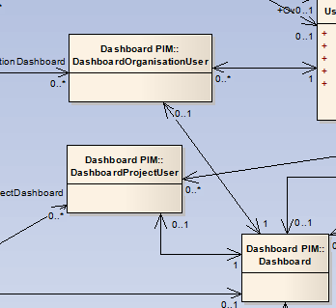
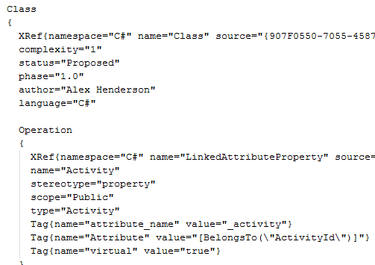
Overview
PIM
Intermediate Language
Transform
Parse
Valid?
Generate
Synchronize
Generated Code / Script
Synchronize
PSM
Generate

Slide 6
MDA Transformations
MDA Transforms are used to read a model (normally Platform independent) and to create one or more resulting models (which are normally Platform specific).
MDA Transformations in EA share the same scripting language as code generation.
The intermediate output of an MDA transformation is a single text file, with all the packages, classes etc. Declared in a simple hierarchical format.
EA reads the intermediate text output, translates it into the corresponding elements and attributes and either creates new elements or attempts to synchronize changes to existing elements (which may have been created as the result of a previous transform run).

Slide 7
MDA Transformations
This is the objectType i.e. Package, Class etc.
Package
{
name="C# Model"
namespaceroot="true"
Class
{
Xref { namespace="C#" name="Class" source="{907F0550...}" }
complexity="1"
status="Proposed"
author="Alex Henderson"
language="C#"
Operation
{
Xref { namespace="C#" name="LinkedAttributeProperty" source="{907F0550-...}" }
name="Activity" notes="An Activity"
stereotype="property"
scope="Public"
type="Activity"
Tag { name="attribute_name" value="_activity" }
Tag { name="Attribute" value="[BelongsTo(\"ActivityId\")]" }
Tag { name="virtual" value="true" }
}
}
}
This is an objectProperty – often these have a direct counterpart in the properties dialog within EA.
XRef provides the mechanism for forward synchronizing changes from your PIM to your PSM.
Tag is an element (basically a property with child properties) – other common elements include Attribute, Parameter or any valid objectType.
Backslash is used to escape characters, such as the double quote within a value string.

Slide 8
MDA Transformations
This will output the contents of the variable “elemType”.
%elemType%
{
%TRANSFORM_REFERENCE("Class")%
%TRANSFORM_CURRENT("language", "name")%
name=%qt%$name%qt%
language="C#"
%list="ClassBase" @separator="\n" @indent=" "%
%list="ClassInterface" @separator="\n" @indent=" "%
%list="InnerClass" @separator="\n" @indent=" "%
%if elementType =="Class" and classStereotype == "picklist"%
%list="Attribute" @separator="\n" attStereotype != "enum"%
%else%
%if elemType == "Class"%
%list="Attribute" @separator="\n" @indent=" "%
%endIf%
%endIf%
%if elemType == "Class" and classStereotype != "enumeration"%
Tag
{
name="partial"
value="true"
}
Outputs all the properties of the current class excluding the list of properties supplied...
List calls another template, passing a list of elements...
Support exists for basic if/else statements.
Anything not inside %quotes% is output “as-is”

Slide 9
MDA Transformations – Object Types
Action
ActionPin
Activity
ActivityParameter
ActivityPartition
ActivityRegion
Actor
Association
Change
Class
Collaboration
CollaborationOccurrence
Component
DeploymentSpecification
DiagramFrame
Decision
EntryPoint
Event
ExitPoint
ExceptionHandler
ExpansionNode
ExpansionRegion
ExposedInterface
GUIElement
InteractionFragment
InteractionOccurrence
InteractionState
Interface
InterruptibleActivityRegion
Issue
Iteration
Object
ObjectNode
MessageEndpoint
Node
Package
Parameter
Part
Port
ProvidedInterface
RequiredInterface
Requirement
Sequence
State
StateNode
Synchronization
Table
TimeLine
UMLDiagram
UseCase
There are a lot of object types, but in most cases you will only need a few to handle the basic scenarios!

Slide 10
MDA Transformations – Object Properties & Elements
Properties
Abstract
Alias
Arguments
Author
Cardinality
Classifier
Complexity
Concurrency
Filename
Header
Import
IsActive
IsLeaf
IsRoot
IsSpecification
Keyword
Language
Multiplicity
Name
Notes
Persistence
Phase
Scope
Status
Stereotype
Version
Visibility
Elements
Attribute
Classifier
Parameter
Operation
Parent
Tag
XRef
This is the list of documented properties – there are more, but they’re undocumented – some can be discovered by reviewing the source for the “out of the box” MDA templates or searching the EA forums.

Slide 11
Real world MDD
MDG Integration with Visual Studio .Net.
A quick look at what it does and does not do...

Slide 12
MDG Integration for Visual Studio 2008
Allows developers to avoid having to leave the confines of the Visual Studio IDE to achieve functions such as:
Basic model changes i.e. Element properties.
Version control
Code Generation & MDA Transformations
Generate HTML & RTF Documentation.
Navigation between code and model and back again.
Makes generating and synchronizing code for a single class very easy.
Information about the model is generally displayed as HTML served under the hood by an inbuilt web server within EA.
Import & Synchronization of Team Foundation Server (TFS) work items.

Slide 13
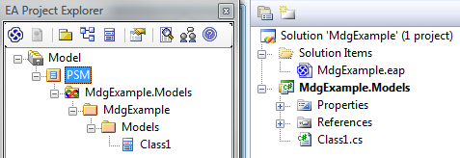
MDG Integration for Visual Studio 2008
Users connect projects in Visual Studio to packages in Enterprise Architect.
These packages would be the target package used when applying your language specific MDA transforms i.e. To VB.Net, C++ or C#.
Packages linked to Visual Studio Projects are designated by the Visual Studio infinite loop icon.

Slide 14
MDG Integration for Visual Studio 2008
MDG integration is just that – integration – it doesn’t provide any functionality that isn’t already part of Enterprise Architect, it just makes it more convenient for a developer to use.
In some ways it’s too crippled for a developer who is responsible for maintaining the model – for example you can’t delete packages or Elements without launching EA, and worse yet you can not view Tagged values for an element – which are often vital for Platform independent models.
Hampered by the same limitations as EA when synchronizing between code and models i.e. Refactoring code will break your model (for example renaming a class in code will result in your model having two classes, one with the old name, one with the new).

Slide 15
Real world MDD
MDA is often discussed in high level terms – but let’s bring it back down to a practical level, by looking at some real examples of transformations.

Slide 16
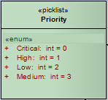
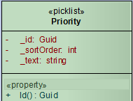
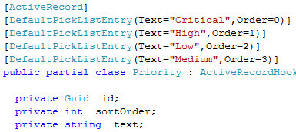
Real world MDD
Scenario 1 – pick lists / lookup tables.
Often enumeration classes are used to model pick lists or lookup tables – problem here is that in some cases an enumeration class should be an enumeration in code as well (if for example the value isn’t persisted, or the set of values / labels can not be changed).
MDA Transform
Code
Generation
Enumeration members become declarative attributes in code (which can be examined to generate data when application starts up for the first time...

Slide 17

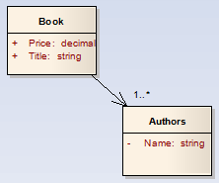


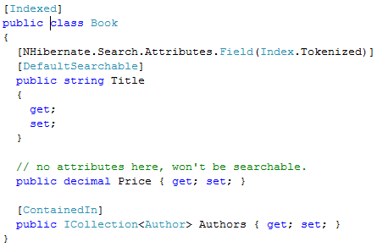
Real world MDD
Scenario 2 – free text searching
Relational databases are not great candidates for free-text searching, but there exists search engines (such as Lucene for Java or Lucene.Net for the .Net Framework) which excel at “google” style document searching. But indexing all your entities is often too granular / risky.
Make this entity searchable.
Make price unsearchable.
Embed the authors entity in the book entity for searching purposes (denormalize)

Slide 18
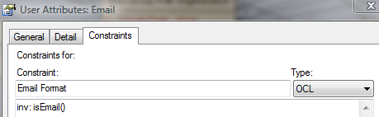
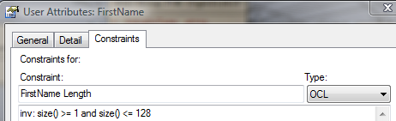

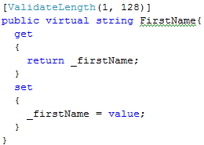
Real world MDD
Scenario 3 – validation framework
Validation frameworks exist for most languages – allowing entities to be validated at point of saving against business rules etc.
Using OCL we define simple constraints, then
Use a custom developed add-in to parse the constraints to create the associated attribute declarations.

Slide 19
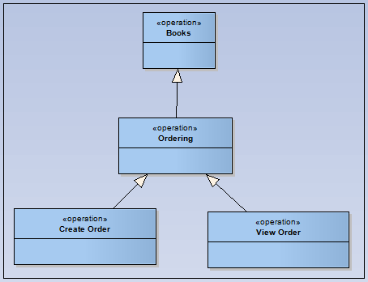
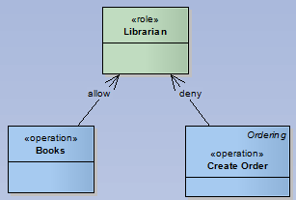
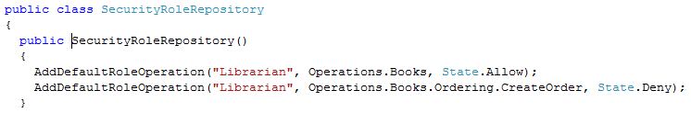
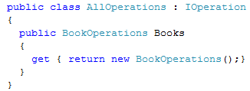
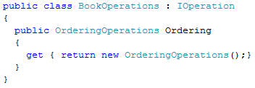
Real world MDD
Scenario 4 – security
Role based security is common but more often then not each role represents a set of operations...
Librarian role can access all book operations,
Except for “Create Order” which is explicitly
Denied to them.
A security role repository is generated with all the default role to operation mappings. Operations are generated as a set of nested classes – avoid operation names being miss-typed etc. In code.

Slide 20
Conclusions
If you’re working on multiple products/projects that are reasonably similar the benefits of MDA will be greater (i.e. If you’re leaning towards becoming a software factory).
Don’t underestimate the time it takes to get your templates right – there is no debugging support and the scripts are not pre-compiled – and be prepared to write add-ins to achieve what you need.
MDG Integration is nice to have but certainly not essential.
There are a number of companies performing MDA/MDG with EA but so far there hasn’t been much effort put towards sharing templates etc. (partly because the template language leans towards you embedding lots of business logic/business knowledge in your templates, because you can say inherit from a more abstract “generic” template and just override features for your specific project requirements.

Slide 21
Any questions?
Website: http://www.devdefined.com/
Blog: http://www.devdefined.com/blogs.aspx
Email: alex@devdefined.com

