Slide 2

Domain Specific Languages
With a side order of Boo

Slide 3

A little about Me...
Passionate Developer
Auckland Architecture Chat Organiser
Sometimes Blogger
Work/Play at DevDefined Limited

Slide 4
Agenda
The context and the usual issues we face.
Some real life examples of domain specific languages.
Boo’s DSL Capabilities.
Integrating a DSL into your Application.
Considerations to remember when designing your own DSL (If we get time)

Slide 5
Domain & Context
Context
Domain
Notes:
Domain & Context example:
Domain – Healthcare
Context – Medication dosages, Heard Condition Diagnosis
Domain – E-Commerce Website
Context – Cart Discounts

Slide 6
Who has the knowledge?
Subject matter experts
Business Analysts
Customers
Clients
Everyone... But the developer.

Slide 7
What are the problems?
Our languages are too general purpose – too many ways to solve the same problem.
We don’t share a common metaphor of understanding between developers and subject matter experts.
Our domain experts can’t help with the design of the business logic of an application.
Business code is full of boilerplate and needless ceremony.
Our business logic is not cleanly separated from our application code.
Business rules tied to the release cycle of the application.
Notes:
So what are the problems.... Well speaking from my experience.
Our languages are too general purpose – this is a blessing for writing applications, but it’s a heavy price to pay when trying to expression business rules and logic – there are many ways to solve the same problem, and that general purpose nature forces restrictions on how we can write our business logic. Business users can’t read and understand the general purpose code your write.
Next off, we don’t share a common metaphor between our developers and subject matter experts – now this is partly solved by disciplines such as domain driven design, but really in most cases when your writing business logic in software, the code you are writing is expressed in terms that your subject matter expert of business analyst is not familiar with, at best you’re both speaking the same language, but with different regional dialects.
Our domain experts can’t help us – now I’m not necessarily saying they might be able to cut code along side you, but they can’t even proof read the logic your writing – and have to resort to interaction based testing, which is really examining effect rather then cause.
Business code is full of boilerplate and ceremony – by boilerplate I mean repeated information – so for example if each of your business rules is defined in it’s own class, you have a namespace and class declarations for every rule, you might have some constructor parameters to inject services, you’re probably overriding some method and maybe even decorating the class with some attributes, to provide human readable descriptions for the rule – and finally, inside that one overridden method is the only piece of code that’s of interest to the business. Same goes for needless ceremony – Think of expressing a lambda in C#, array declarations etc. - this is useful and allows for precision in a general purpose language, but it’s not something I want to expose by domain experts too.

Slide 8
DSL: A Possible Solution
DSL : a Domain-Specific Language.
From Wikipedia: “A Domain-Specific Language is a programming language designed to be useful for a specific set of tasks”
A DSL is a language that models a certain domain of experience, knowledge or expertise – and those concepts are tied to the constructs of the language.

Slide 9
How to Spot A DSL
Quite possibly not Turing complete.
It covers a particular domain of knowledge (not general purpose).
Has a form: textual or graphical.
Produces a result:
Could represent data, configure objects, calculate discounts etc.
Can be internal or external.
Has certain attributes emphasized over others – the ility’s ;o)
Readability, usability, testability.

Slide 10
Examples of DSL’s - Technical
Regular Expressions
\b[A-Z0-9._%+-]+@[A-Z0-9.-]+\.[A-Z]{2,4}\b
SQL Statements
SELECT * FROM CodeCampSpeakers WHERE FirstName Like “Alex%”
Build Engines
<Target Name="BuildAll" DependsOnTargets="Clean;Compile" />
Cascading Style Sheets
#left_col { float: left; }

Slide 11

Examples of DSL’s - Notation
Notations – obviously pre-dating computer programming itself...
Chess Moves:
1.e4 e5 2.Nf3 Nf6
Knitting:
1st Row: K1, * k1, k2together, yfwd, k1, yfwd, ssk, k2; rep from * to end. 2nd and every alt Row: Purl.
Music:

Slide 12
Business
Insurance – Policy structure, Risk Calculation, rating etc.
Telecommunications – Call plans, specials, routing calls.
Local Government – Development Contribution Rules, Asset Management, especially for Water Services.
Customer Relationship Management – Rules for calculating lead/opportunity rankings, event handling and workflow.
Human resources – skill set evaluation / rankings etc.
E-Commerce applications - discount and promotional rules.
Simulations: Anti Malaria drug resistance simulations, Artificial Intelligence Simulations such as Noble Ape.
Products Customisation – any time you plan to sell the same piece of software to many companies.
Notes:
Business DSL’s are actually quite hard to track down “in the wild”– this is often because they tend to be quite simple, and business specific – so you don’t see people publishing information about them, or in fact they are protective of them because they represent hard won Intellectual Property and analysis of the their domain.
Telecommunication – DSL’s describing call plans – just pick up your bill and you’ll see things like
300 Free Minutes
1000 free texts
Date your bill must be paid by
Discount applied when paying on time
Traffic usage
When to send email / messages to customers if their volume of calls/data/txts exceed a certain threshold.
When to recommend a different (cheaper) plan to a customer.
Local government
I Have worked as a developer at a Local Council for a while
Lots of domain specific terms and languages, unfortunately not all of them codified – but still, tailored to expressing particular details and information.
Examples, water services – materials, when they were installed, at what point they need to be reviewed, lifespans, policies regarding things like joining – i.e. You have a long piece of pipe, that’s damaged in the middle – based on age, materials it’s made from etc. Will determine if the entire length of pipe should be replaced vs. Replacing a section and joining it to either end of the original length of pipe. There’s also workflow around asset identification etc. i.e. Does the piece of pipe at either end get assigned a new identifier (because we now have 3 pipes and 2 joiners in our network).
Customer Relationship Management
Developing a DSL for describing how opportunities and leads are ranked and evaluated. This can be based of ranking information collected, as well as incorperating data from other systems.
Human resources
Skill set evaluation and ranking – providing ways to weight candidates against each other based on skills and experience – by externalising this information into a DSL you can slow evolve and improve these weightings, without having to make full releases of the software product.
E-Commerce applications
If anyone’s written support for discounting products and coupons in an E-Commerce solution, this is a common problem where during the development phase the customer is really only guessing at how they wish there online discounting structure would work... Any approach that uses language, rather then a data based approach allows you to be more flexible.
Simulations – noble ape is interesting - It features a number of autonomous simulation components including:
landscape simulation
biological simulation
weather simulation
sentient creature (Noble Ape) simulation
and comes with a scripting language called ape script – which can be used code additional behaviour into the “noble apes” as well orchestrate sandbox-wide simulations.
Product customisation – When building a selling products, it’s not uncommon to end up with customisations per client – DSL’s can provide a better customisation experience, so users don’t need to be exposed to a full development environment, and so you can limit the scope of customisations they can make or have tighter control.

Slide 13
Categories of DSL - External
External DSL
External to your application language.
Normally defined by a Grammar i.e. BNF, and converted to AST using a tool like ANTLR.
Checkout Oslo’s M-Grammar and Quadrant, or Eclipses XText for the java space. Funnily enough both of these are DSL’s for defining DSL’s ☺
Generally more complex to implement and integrate.
More syntax freedom.
Requires more specialised skills.
Notes:
Backus–Naur Form

Slide 14
Categories of DSL - Internal
Internal DSL (also known as Embedded)
Embedded into an existing general purpose language.
Not all languages are really suitable for creating internal DSL’s.
Generally less complex / requires less specialised skills to write.
Less Syntax freedom
You get things like warning and error support , and existing rich AST and compilation for free.

Slide 15
Categories of DSL - Fluent
I’m loathed to call them DSL’s (at best it’s an Internal DSL Technique).
Uses method chaining, operator overloading and abuse of properties and lambdas to achieve code that reads like a sentence.
Can improve readability, unfortunately shortly past that point you fall off a cliff....
Pattern findGamesPattern = Pattern.With
.Literal(@"<div")
.WhiteSpace.Repeat.ZeroOrMore
.Literal(@"class=""game""")
.WhiteSpace.Repeat.ZeroOrMore
.Literal(@"id=""")
.NamedGroup("id", Pattern.With.Digit.Repeat.OneOrMore)
.Literal(@"-game""")
.NamedGroup("txt", Pattern.With.Anything.Repeat.Lazy.ZeroOrMore)
.Literal(@"<!--gameStatus")
.WhiteSpace.Repeat.ZeroOrMore
.Literal("=")
.WhiteSpace.Repeat.ZeroOrMore
.NamedGroup("state", Pattern.With.Digit.Repeat.OneOrMore)
.Literal("-->");

Slide 16
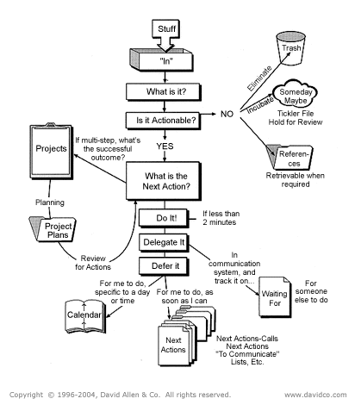
Categories of DSL - Graphical
Examples
SSIS
Workflows
Process Management, BPMN
UML
BizTalk
Good for high level views, difficult to convey details or cross-cutting concerns.
Source control and merging changes can be an issue.
Testing can be a problem.
Easier to get business buy in (wow factor).

Slide 17
Getting More Technical
Enough Theory.... let’s take a look at the language.

Slide 18

What Is Boo?
Boo is a .Net Language
First Appeared Around 2003
Entirely Open Source
Python Inspired Syntax
Very extensible

Slide 19
Why Boo Is Good For DSL’s?
Extensible Compiler and Language
Syntax (optionally) lacks ceremony
Syntax Reads well to humans
Statically Typed
Compiles Down to Assemblies
... Let’s look at some examples...
Notes:
Boo let’s you define macros which generates code “on the fly” at compile time, without loosing track of line numbers etc. Syntax lacks ceremony – I can leave out parentheses if I want to - Boo known as “wrist friendly”.
Syntax reads well – Boo has a richer conditional syntax then languages like C# and uses words rather then symbols for boolean operators i.e. And, or, unless etc.
Compiles down to Assemblies – it’s still a .Net compiler, so all our existing skill sets apply, and in the end we are consuming compiled classes etc. – rather the just some raw AST from an external DSL.
Open Source & Ended – The entire language implementation is open ended... You can extend or remove some aspects of it, and everything can be altered – this is important when choosing a language which is in effect going to be a part of products you build.

Slide 20
Basics – Implicit Typing
Implicit Typing
Boo doesn’t need a “var” keyword, by default all variables are implicitly typed, as well as return values from methods etc.
Semi-colons are optional
C#
var a = 10; var b = 20; var c = a + b;
Boo
a = 10 b = 20 c = a + b
Notes:
Implicit typing...

Slide 21
Basics – Boolean Operators
Boolean operators
Boo has English words for Boolean operators and more options when it comes to if etc. Statements.
C#
if (!(user.IsAdmin || user.InRole("Editor"))) { throw new Exception(“Error"); }
Boo
raise “Error!" unless user.IsAdmin or user.InRole("Editor")
Notes:
Key point of this example is that non-programmers need less training to read and understand conditional expressions in Boo than say C#.

Slide 22
Basics – Optional Parentheses
Calling methods
When calling methods, you can drop the parentheses...
Also, Boo has some handy literals, i.e. Timespan literals etc. Which makes this even more concise.
C#
AddReminder(new TimeSpan(5, 0, 0), ”About time you posted to your blog”);
Boo
AddReminder 5d, ”About time you posted to your blog"
Notes:
We can drop the parentheses from method calls...
Also notice the 5d, that’s a timespan literal – boo has support for a number of different literals, and support for custom literals – so you can concisely specify things like 5kg’s or 120psi as part of your DSL, using the same written terminology as your subject matter experts.

Slide 23
Basics – Anonymous Blocks
Given a method that takes a last parameter as a delegate i.e.
Public void OnState(string state, Action action)
Boo will let you supply that parameter implicitly as a block...
C#
OnState("paid", ()=> { ship_goods(); mail_receipt(); });
Boo
OnState "paid”: mail_receipt ship_goods
Notes:
So, hopefully now it’s starting to get a little more intriguing... When I talk about the ceremony of C#, this is what comes to my mind.
In the C# version we have a mass of what to most business users would read as crazy punctuation...
We have 8!! parentheses 1 set of braces.
3 semicolons
One comma
And a lambda operator (the arrow =>) And in the boo equivalent we have, one colon and two significant tabs.

Slide 24
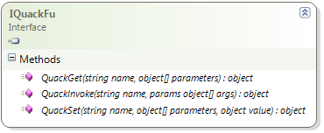
Basics – Duck Typing
Boo is a static language, like C#, but it does support duck typing – similar to dynamic in c# 4.0.
To support duck typing, your class needs to implement the IQuackFu interface.
Notes:
Duck typing – the old saying if that walks like and duck and it quacks like it duck... It must be duck.
Duck typing is the equivalent to missing method in other languages, it allows you to intercept calls to methods where the property or method may not exist.

Slide 25
Basics – Duck Typing
Duck typing lets us work against data etc. As if it were methods or properties... Such that if customer implements IQuackFu, and does not have a property called “Gold” then:
At this point our code can handle the QuackGet request in our customer class, perhaps returning true after a database lookup.
if customer.Gold: apply_discount 15.percent Becomes... if customer.QuackGet("Gold", null): apply_discount 15.percent
Notes:
Meta methods are one way of altering compiler behaviour
So during compilation the compiler identifies any calls to methods which are marked with the meta attribute, it then passes the Expression (which is the AST, or abstract syntax tree) for the macro call to the meta method, at which point it can then rearrange or replace the expression completely.
Boo also supports syntactic macros and attributes – these allow you to use similar techniques, but working on blocks of statements or at the properties/methods/classes level – this gives you the ability to write small amounts of code, which at compile time are translated into different shapes – for example you could

Slide 26
Trickier Stuff
You should hopefully now have a good taste for the language.
However – Boo offers a lot more than just that to the DSL Author – one of it’s claims to fame is extensibility – There are 4 key ways to extend Boo:
Meta Methods
AST Macros
AST Attributes
Adding a new step to the compiler pipeline
However they really are all means to the same end, so we won’t dive to deep on them (and we don’t have the time) – but let us instead look at the concepts behind them and how Boo works.
Notes:
You should hopefully now have a good taste for the language – and we still haven’t touched on some other cool things like extension properties, first class functions etc.

Slide 27
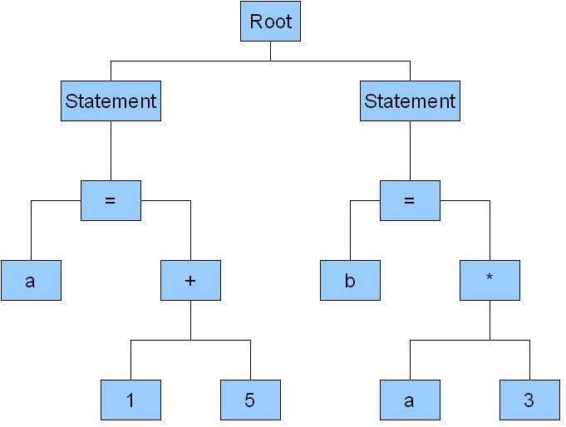
What is an AST?
AST: Abstract Syntax Tree
Notes:
An AST or abstract syntax tree, is a representation (in tree form) of the code that the compiler will then subsequently process and compile.
If you have ever interacted with the Code DOM or Linq Expression Tree’s you should be familiar with the concepts.
Unlike Linq Expressions boo’s AST is not immutable, and can be easily changed and tweaked.
Boo as a language gives you many different entry points at which you can write code that Takes the AST at compile time and transforms, or even replaces it completely.
You can also do other things with the AST – for example detect code that you don’t want to execute and throw an error.. Or even use it in your own language editors to provide basic refactoring support.

Slide 28
Compiler Pipeline (Partial)
Parse
Initialize Type System
Merge Partial Classes
Expand Macros
Bind Methods
Process Method Bodies
Emit Assembly
Save To File
Notes:
So – for the boo language, the compiler parses the input files, and generates the matching AST – at which point that AST is passed through a pipeline of transforms, until eventually it’s emitted as intermediate language in an assembly and saved to disk.

Slide 29
The Full Pipeline
And here are all the classes in the pipeline...
Boo.Lang.Parser.BooParsingStep InitializeTypeSystemServices PreErrorChecking MergePartialClasses InitializeNameResolutionService IntroduceGlobalNamespaces TransformCallableDefinitions BindTypeDefinitions BindGenericParameters BindNamespaces BindBaseTypes MacroAndAttributeExpansion ExpandAstLiterals IntroduceModuleClasses NormalizeStatementModifiers NormalizeTypeAndMemberDefinitions NormalizeOmittedExpressions BindTypeDefinitions BindGenericParameters BindEnumMembers | BindBaseTypes CheckMemberTypes BindMethods ResolveTypeReferences BindTypeMembers CheckGenericConstraints ProcessInheritedAbstractMembers CheckMemberNames ProcessMethodBodiesWithDuckTyping PreProcessExtensionMethods ConstantFolding NormalizeLiterals OptimizeIterationStatements BranchChecking CheckIdentifiers StricterErrorChecking CheckAttributesUsage ExpandDuckTypedExpression ProcessAssignmentsToValueTypeMembers ExpandProperties | RemoveDeadCode CheckMembersProtectionLevel NormalizeIterationStatements ProcessSharedLocals ProcessClosures ProcessGenerators ExpandVarArgsMethodInvocations InjectCallableConversions ImplementICallableOnCallableDefinitions CheckNeverUsedMembers EmitAssembly SaveAssembly
Notes:
The key things to take away is that we can alter almost any of the compilers behaviour with relative ease, by adding new compiler steps or replacing existing ones, and because it’s open source we have full access to those compiler steps to learn form etc.
Now let’s take a look at an example compiler step...

Slide 30
Example – Meta Method
import Boo.Lang.Compiler.MetaProgramming
import Boo.Lang.Compiler.Ast
[meta]
def assert(condition as Expression):
return [|
if not $condition:
raise AssertException($(condition.ToCodeString()))
|]
x = null
assert x is null
if not x is null:
raise AssertException("x is null")
Notes:
Meta method
Quasi notation
The equivalent in C# is a little bit more long-winded.

Slide 31
Example – Compiler Step
Perhaps in our DSL we want to make it clear what is a string and what is say an application role... so
Instead of this: belongs_to “Administrator”, “Editor”
We’d like this: belongs_to @administrator, @editor
public class ResolveSymbolsStep : AbstractTransformerCompilerStep
{
public override void Run()
{
Visit(CompileUnit);
}
public override void OnReferenceExpression(ReferenceExpression node)
{
if (node.Name.StartsWith("@") == false) return;
var replacement = new StringLiteralExpression(node.Name.Substring(1));
ReplaceCurrentNode(replacement);
}
}
Notes:
A compiler step provides you with the highest level of power – allowing you to gain access to entire context of the compiler, including source files, referenced types, the AST etc.
In this case our compiler step is Visiting the current Compile Unit (in this case, the file being compiled) and we’re then overriding the OnReferenceExpression method – this will Visit

Slide 32
Bringing it all together
Now let’s bring it all together – by examining a simple DSL and how it integrates into an application.
Rather then re-invent the wheel, we’re going to take a look at an example from Ayende’s great book “Writing Domain Specific Languages With Boo”.

Slide 33
Quote Generator - Demo
This code show a hypothetical quote generator.
Takes in a list of module names for a large App (think of something like SAP) and a total number of users.
Can return a list of the modules and associated details that will be required (and handles dependencies between modules).
App can then print a report based on the returned list of modules...
Let’s start with a very brief demo then review...

Slide 34
The DSL Syntax
specification @vacations: requires @scheduling_work requires @external_connections
specification @scheduling_work: users_per_machine 100 min_memory 4096 min_cpu_count 2
specification @salary: users_per_machine 150
specification @taxes: users_per_machine 50
specification @pension:
if total_users < 1000:
same_machine_as @health_insurance
Notes:
So here’s the DSL Syntax.
Business Scenario – generating quotes regarding how many machines and of what specifications are required

Slide 35
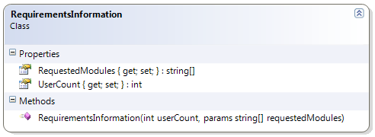
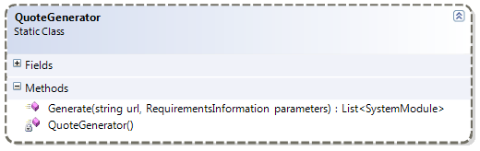
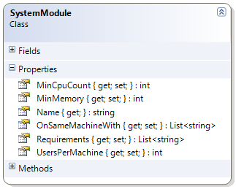
Overview
Notes:
We have a request for requirements information, that’s supplied to the quote generator, and returns a set of system modules, containing the information required.

Slide 36
The Quote Generator
public static class QuoteGenerator
{
private static readonly DslFactory dslFactory;
public static List<SystemModule> Generate(
string url, RequirementsInformation parameters)
{
QuoteGeneratorRule rule =
dslFactory.Create<QuoteGeneratorRule>(url, parameters);
rule.Evaluate();
return rule.Modules;
}
}
HMmmm.... What’s this?

Slide 37
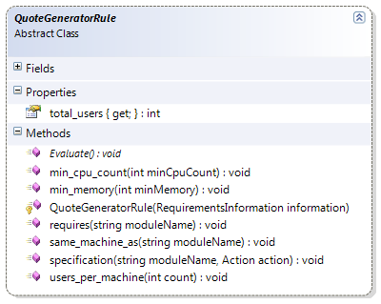
Implicit Base Class
specification @pension:
if total_users < 1000:
same_machine_as @health_insurance
Because of a compiler step – our Boo script is compiled as a sub class of “QuoteGeneratorRule” with the contents of the script becoming the body of the “Evaluate” method of the class. Notice how the method names match up with those we’ve used in our DSL – this is still just the CLR, No magic here.
Notes:
So we have seen that the quote generator creates an instance of a QuoteGeneratorRule, evaluates it and then returns the list of modules it collected during execution. Now taking a close look, we can see that QuoteGeneratorRule is in fact abstract – this is because we actually have compiler still which creates the surrounding class for our boo script – inheriting from QuoteGeneratorRule and inserting the statements from our script into the body of the evaluate method.
This approach is also great for a testing perspective – i.e. When testing, replace QuoteGeneratorRule with a TestableQuoteGeneratorRule – which might expose all the information it’s collecting in a way that’s easier test against.

Slide 38
Customising the Compiler
public class QuoteGenerationDslEngine : DslEngine
{
protected override void CustomizeCompiler(
BooCompiler compiler,
CompilerPipeline pipeline,
string[] urls)
{
pipeline.Insert(1,
new ImplicitBaseClassCompilerStep(
typeof(QuoteGeneratorRule),
"Evaluate",
"BooDslExampleApp.QuoteGeneration"));
pipeline.Insert(2, new UseSymbolsStep());
}
}
Notes:
Here we’re making use of the RhinoDSL library which handles compiling the scripts – notice that we override the customize compiler method... We’re doing two things here: Adding a compiler step, which handles wrapping our scripts up inside an implicit base class, and two, adding a step to expand symbols (names starting with a @ - ampersand) into strings. Notice that the first parameter of insert takes an offset, so in this case these two pipelines will follow immediately after the first compiler step – which parses the input scripts into AST.

Slide 39
Using the DSL Factory
public static class QuoteGenerator
{
private static readonly DslFactory dslFactory;
static QuoteGenerator()
{
dslFactory = new DslFactory();
dslFactory.Register<QuoteGeneratorRule>(
new QuoteGenerationDslEngine());
}
Notes:
And the last piece of the puzzle – we register the QuoteGenerationDslEngine with the DSL Factory, which will take care of constructing instances of the classes, when supplied with the path of the script.
For these examples we’re using files – but you can store your scripts in other locations, such as a source control repository, database, embedded resources etc.

Slide 40
Review - Typical DSL Stack
Syntax
API
Model
Engine
Notes:
Syntax is the textual representation of your DSL.
The Syntax is transformed into calls against an API.
The Model is what your API acts upon. Generally speaking your API and Syntax should interact with a Model Facade, so that the model can undergo changes without thought needing to be given as to the effects on existing scripts etc.
And finally the Engine is what handles invoking your DSL scripts, and orchestrates all moving parts – because it’s a compiled language and compilation can be resource intensive your engine normally also handles things like batch compilation (when you have lots of scripts in the same folder) – recompiling on the fly when scripts change – caching compilation results, so they don’t need to be compiled when the system next starts up etc.

Slide 41
Wrapping Up
We’re almost done...
let’s quickly wrap up with some tips & thoughts.

Slide 42
Stay Iterative
Never start with a DSL in mind, Iterate towards it, if it feels right.
See how far you can go with tools like “Fluent” DSL’s.
Ensure you have tests which test all aspects of your language, not just the expected path (i.e. Expect your users to create invalid/broken scripts).
Make sure anything which can be achieved via DSL code can also be achieved by directly interacting with your API.

Slide 43
Tooling
I haven’t talked about tooling yet...
Tooling is paramount to adoption.
Doesn’t have to be an Editor With Intellisense...
Graphical Views (Flow charts etc.)
Reporting
Getting simple tooling in place can be relatively easy, but complexity significantly grows with capability.
Quick Example – if we have time.
Notes:
Tooling is not just an Editor with Intellisense, but it can be.
Graphical views of scripts can be helpful.
Management.
Reporting is also useful – think about how you would manage a set of 100 or a 1000 scripts.

Slide 44
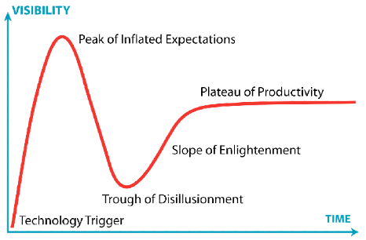
Advocacy verses Pessimism
Notes:
Now, I wouldn’t be doing a talk on DSL’s If I wasn’t an Advocate for them – but I think at this point I would be reckless to suggest you all go off and start incorporating them in all your own projects.
I love what DSL’s are – and it’s fun code to write – but you need to avoid overselling it, in some ways the onset of tools like Oslo and
Hype curve. If you only have a hammer everything looks like a nail.
Same could be said for your favourite tool, if you only want to use a hammer, you’ll spend your time looking for nails.

Slide 45
There’s lots of think about...
You need to think about your script lifecycle
If people other then developers are editing the DSL, it often wont match the development lifecycle.
Versioning of your DSL syntax needs to be well thought out – have a strategy.
If you want live updates, think about the impacts of:
Non-atomic changes.
Keeping a farm of servers in sync.
Auditing and security needs to be considered.
Notes:
Versioning of your DSL syntax needs to be well thought out – breaking hundreds of scripts could be time consuming.
If you want live updates, think about the impacts of:
Not rolling out changes atomically for a set of scripts.
Keeping a farm of servers in sync when rolling out script changes.
Auditing and security is important – changes made to the system by scripts may need to record the name & version of the script itself that made them.

Slide 46
Boo for Every Day Use?
Visual Studio Support in 2008 is Poor.
Hopefully this might change with VS2010.
Reasonably good support in Sharp Develop.
MonoDevelop 2.2 looks promising.
Lack of mainstream tooling support a big problem (this applies to all languages other then C# and VB.Net)

Slide 47
Boo DSL’s in the Wild
Brails – MVC View Engine
RhinoETL – ETL Tool
Boo Build System – Nant like DSL
Spectre – BDD Framework
Binsor - Windsor Configuration
Horn – .Net Package Manager
Notes:
ETL Tool – Extract, Transform, Load

Slide 48

Resources
“Building domain specific languages in Boo”
Written By Ayende Rahien (Oren Eini).
Very Thorough, 355 pages!
Boo Website
Boo Google group
Lots of Tutorials On Line
Source Code & Tests

Slide 49
Questions?
Email: alex@devdefined.com
Blog: http://blog.bittercoder.com/
Twitter: @bittercoder

Slide 50





