Slide 1
BOSTIn – User-Friendly Phylogenetic Problem Assessment
James F. Fleming
@jamesfvfleming

Slide 2
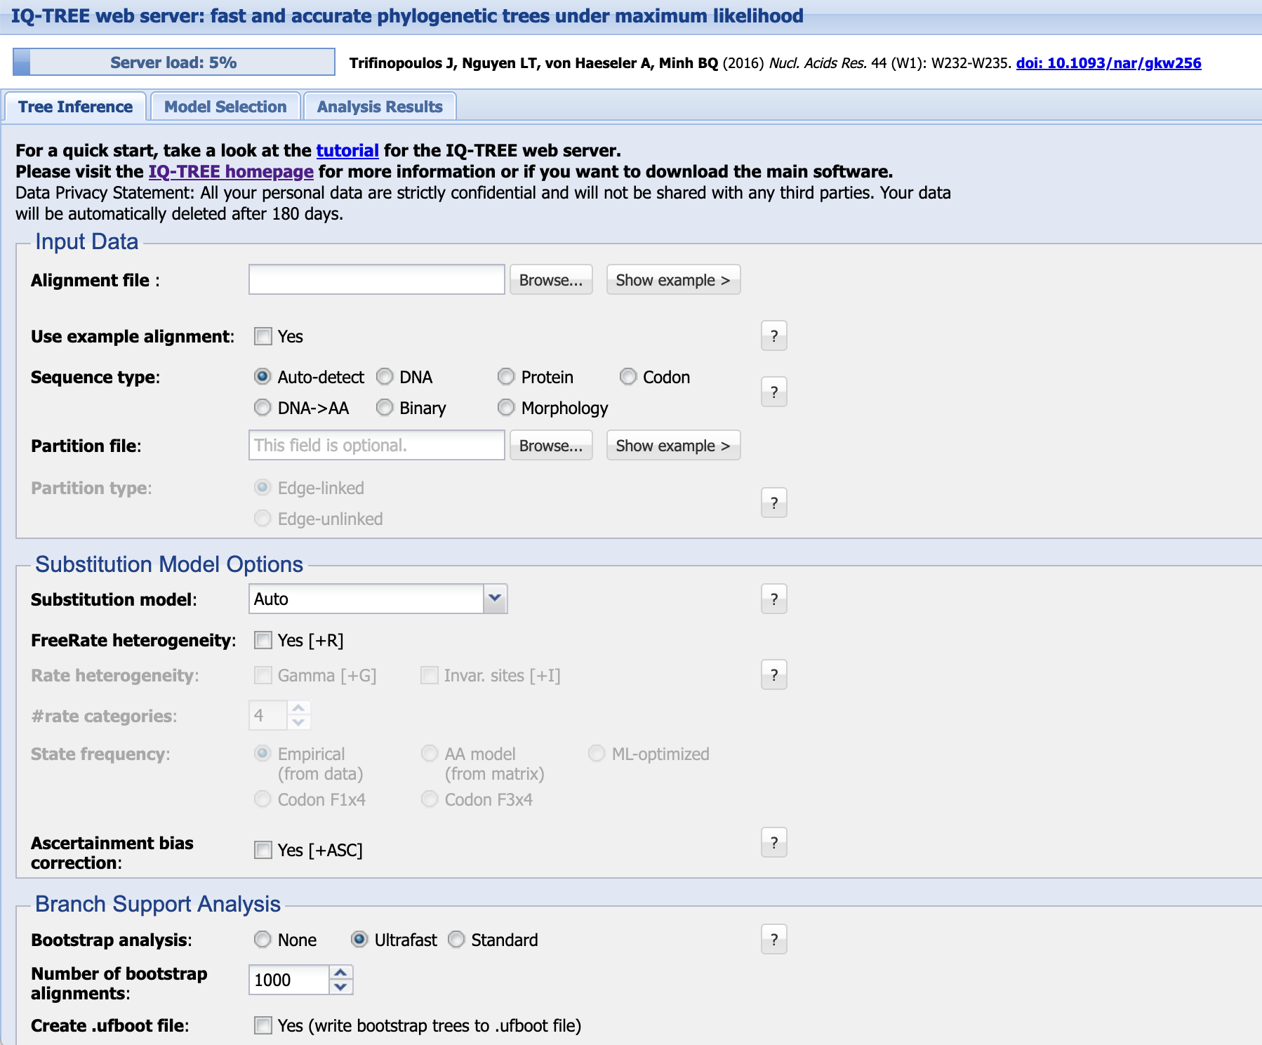
Progress in User-Friendly Phylogenetics
Phylogenetics is a fundamental part of how biological research is undertaken in the modern day.
Great strides have been made in automated model selection and easy, accessible phylogenetic analysis.
IQ-Tree (as an example) is an incredible starter program for non-specialists to easily get sensible results on default settings

Slide 3
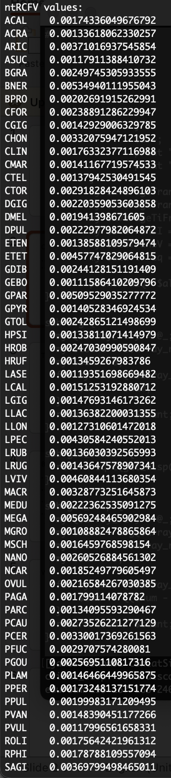
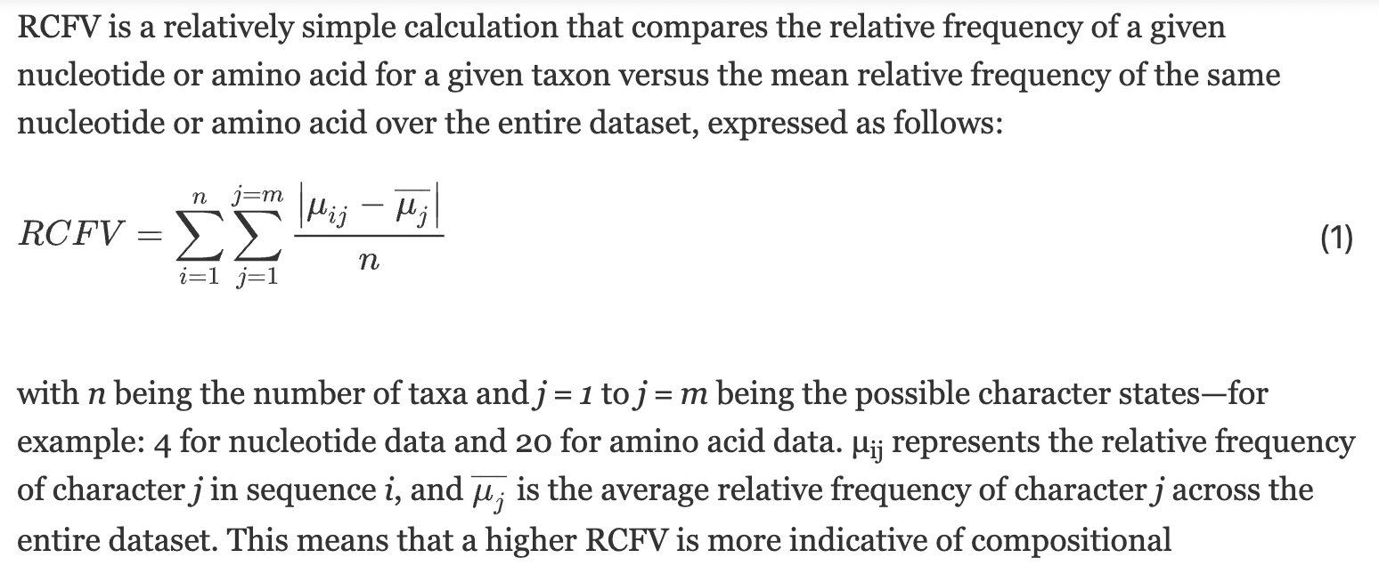
Core Problems in Phylogenetics
Phylogenetic artifact analysis is increasingly important in the modern day
As datasets become larger and more complex, far more necessary.
Large amounts of technical jargon, lots of maths, often impenetrable to non-specialists
Numbers without context

Slide 4
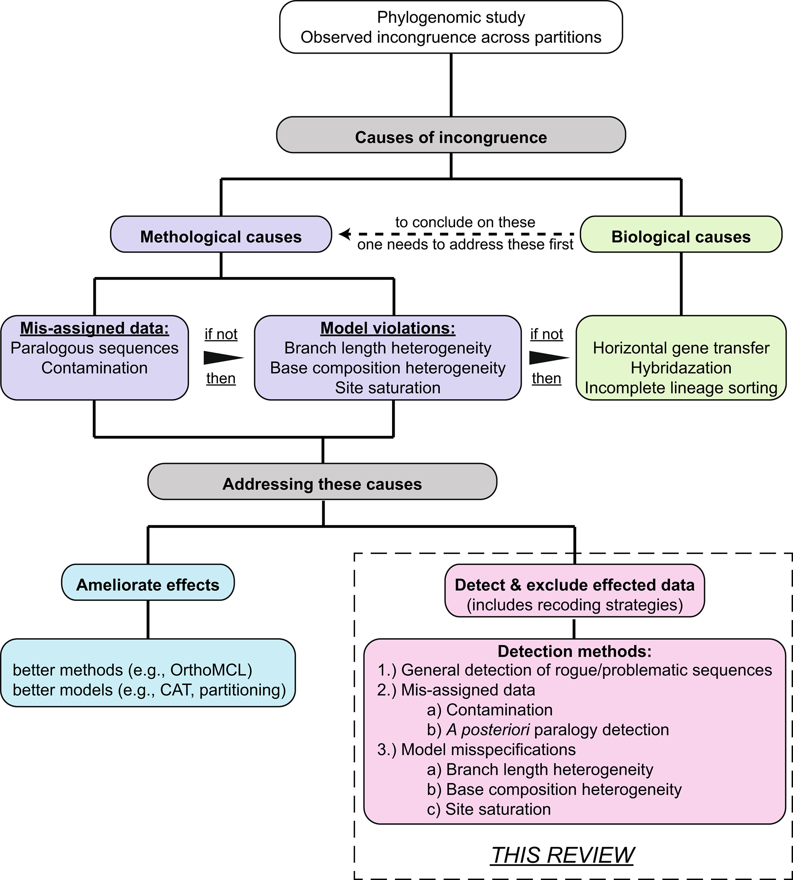
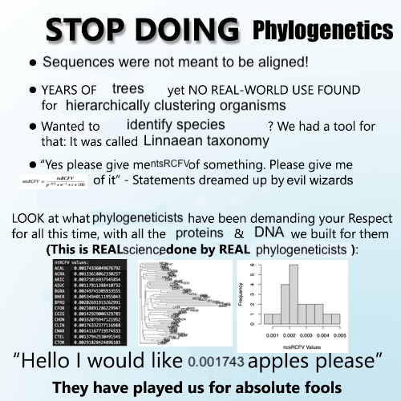

Slide 5
S, R and H
Stationarity: The rate of Evolution is similar across the tree
Violated when taxa of the dataset have substantially longer branches relative to the others
BRANCH LENGTH HETEROGENEITY (Long Branch Attraction)
Reversibility: The process of nucleotide and amino acid change is undirected –
Violated when the probability of one nucleotide or amino acid exchanging with another is NOT the same in both directions
COMPOSITIONAL HETEROGENEITY

Slide 6
S, R and H
Homogeneity: The composition of sequences within the source dataset is broadly homogeneous
Violated when taxa or sites are significantly distinct from the overall averages of the dataset
ALSO COMPOSITIONAL HETEOGENEITY
Finally, Saturation: When particular sites within a dataset are prone to change more frequently than assumed by the model

Slide 7
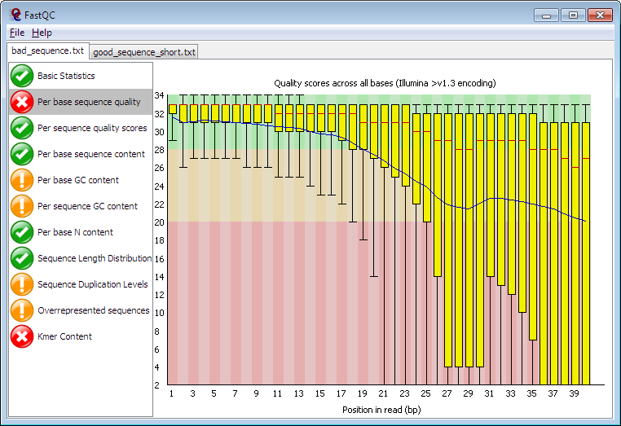
The Inspiration

Slide 8

BOSTIn – Broad Overview of Sequence & Topology Incongruence
Compositional Heterogeneity? nRCFV!
Branch Length Heterogeneity? LB-Score!
Site Saturation?
DE-Score and C-Value!

Slide 9
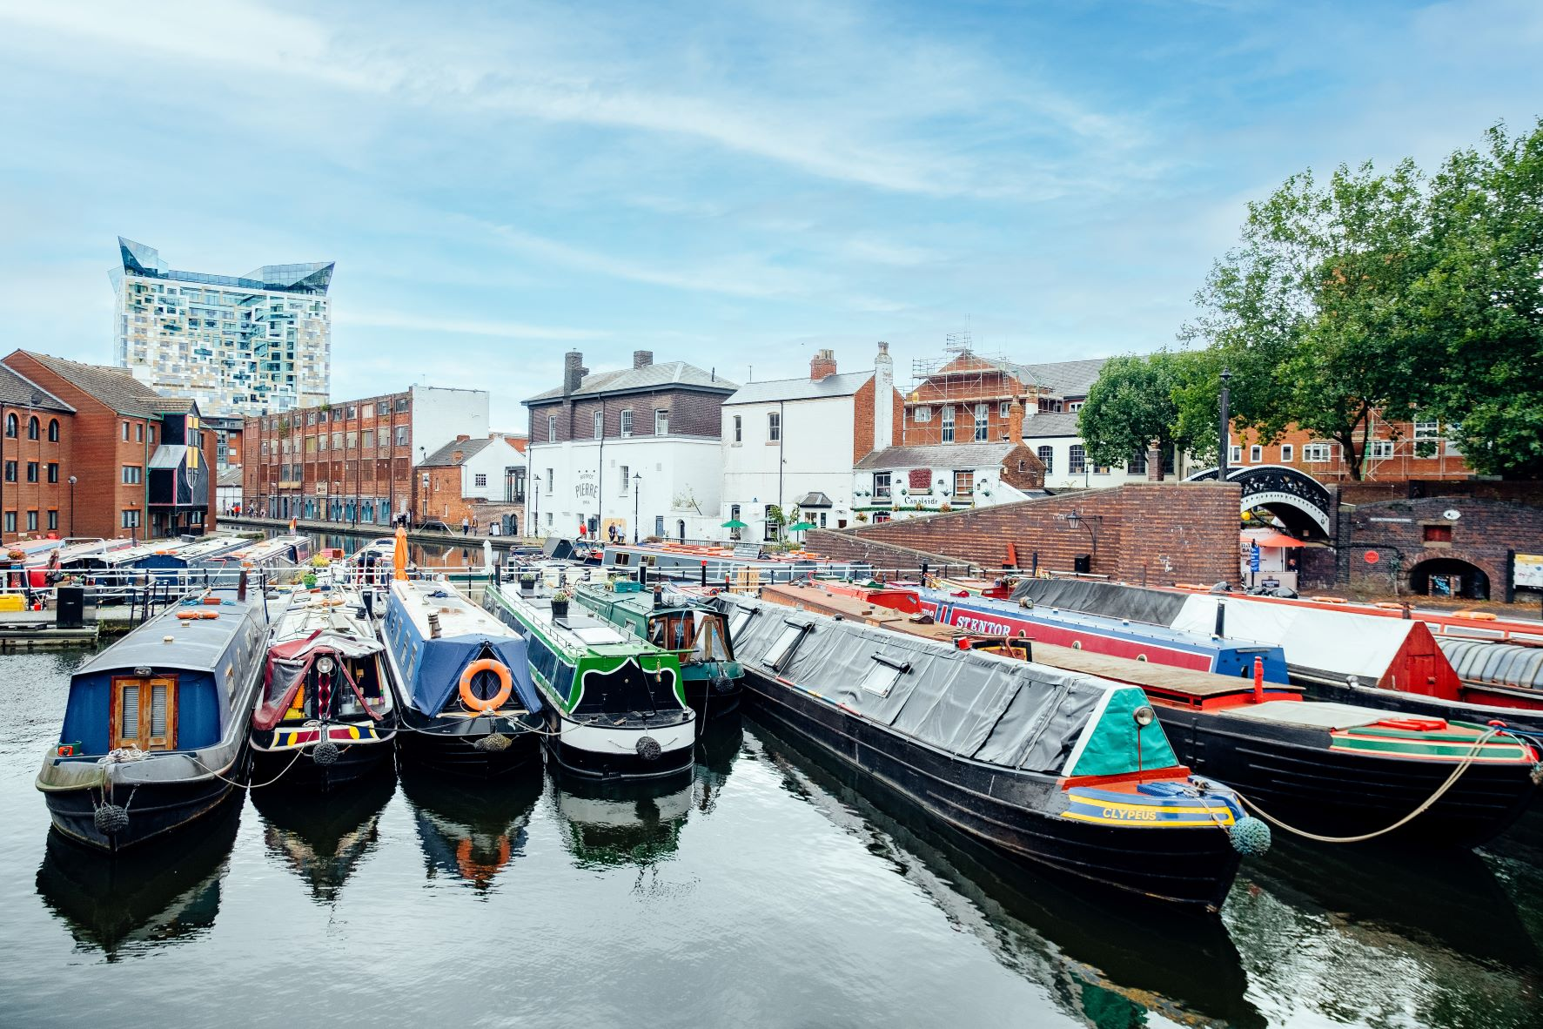
Bostin’
Birmingham, a canal city in the UK and my hometown
Bostin’ is a local dialect word, meaning “Great”
In the same city, meanwhile, Bost means “Broken”
Tells you whether your data is Bost – or Bostin’!

Slide 10
What does BOSTIn do?
BOSTIn is a package comprising three metrics. It works on both DNA and Amino Acid Multiple Sequence Alignments.
Normalised Relative Compositional Frequency Variability (nRCFV) – Compositional Heterogeneity
Long Branch Score (LB-Score) – Branch Length Heterogeneity
Convergence Value & Dayhoff Exchange Score (C-Value and DE-Score) – Site Saturation
SPECIAL NOTE: DE-Score is New – Preprint is coming “soon”
Designed with speed and efficiency in mind – all quick, pre-analysis metrics that don’t require more than a Neighbour Joining Tree (which BOSTIn will also make for you!)

Slide 11
Using BostIn
Ease of installation – only one Perl module and one R Package to install, both with instructions in the GitHub.
Fast - assesses all three artifacts on 638 single gene alignments, each containing 74 taxa (121980 sites total, average 190 amino acids per gene) in 28 minutes and 50 seconds!
Average 2.7 seconds per gene
Ease of Use
Perl Bostin.pl --blh --ch --s <protein or dna> <name of your alignment> <prefix for your outputs>

Slide 12
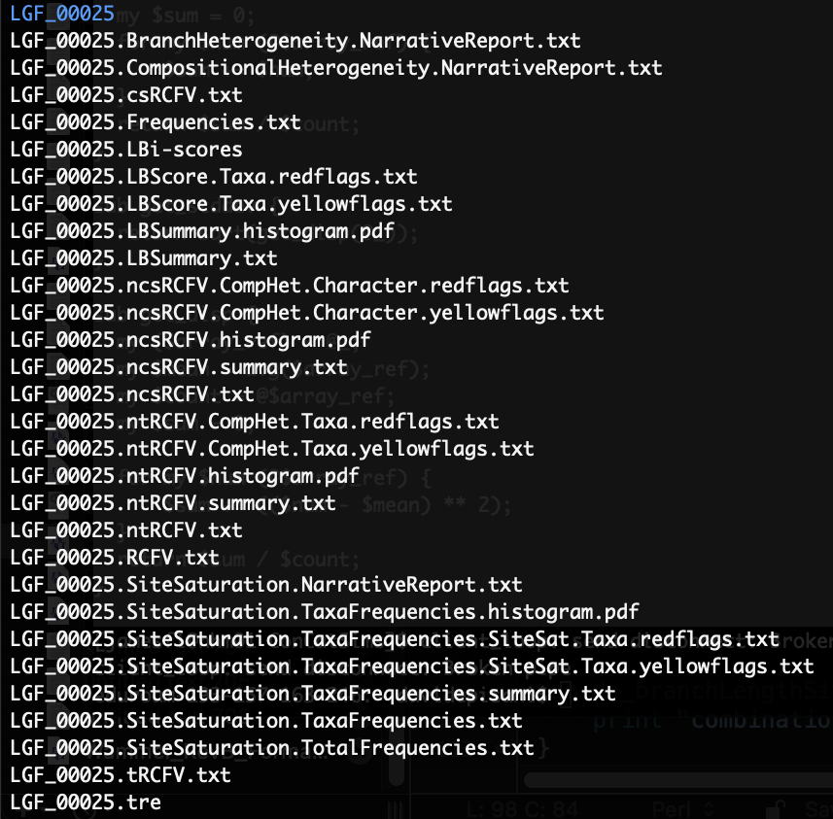
Bostin Output

Slide 13
The Narrative Report Function
The really unique feature of BOSTIn.
Not just telling you what is wrong, but why
No more searching through the literature or hunting through documentation!
Specialised answers for your data.

Slide 14
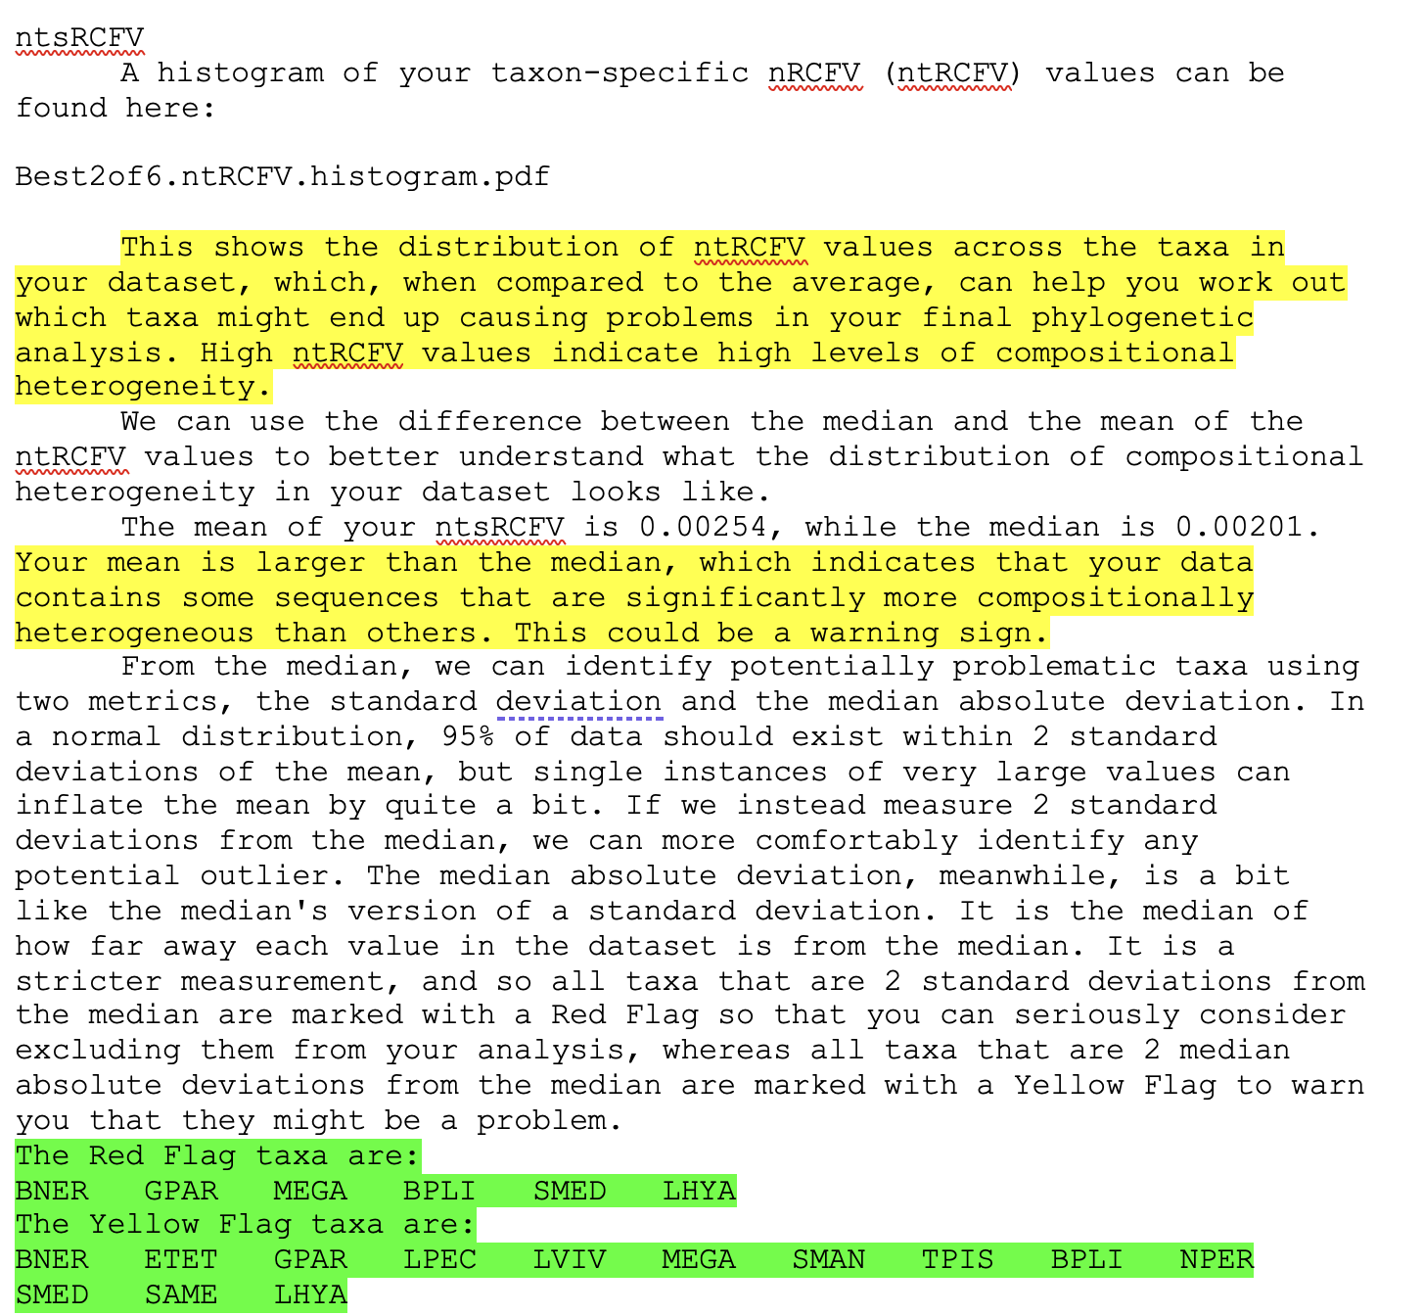

Slide 15
Summary
BOSTIn is made to be fast, accessible and user-friendly.
Built with teaching in mind
It can be found at GitHub here:
https://github.com/JFFleming/BOSTIn
We are still adding new features – more graphs, more breaking down of statistical tests or the methods used?
C-Value coming in the next few weeks.
We’d really appreciate feedback on the Narrative Report – is it useful? What can we add to make everything clearer?

Slide 16



Thanks

