Slide 1
Conf_Call_Analysisv2
File created on: 4/19/2020 10:51:41 PM

Slide 2
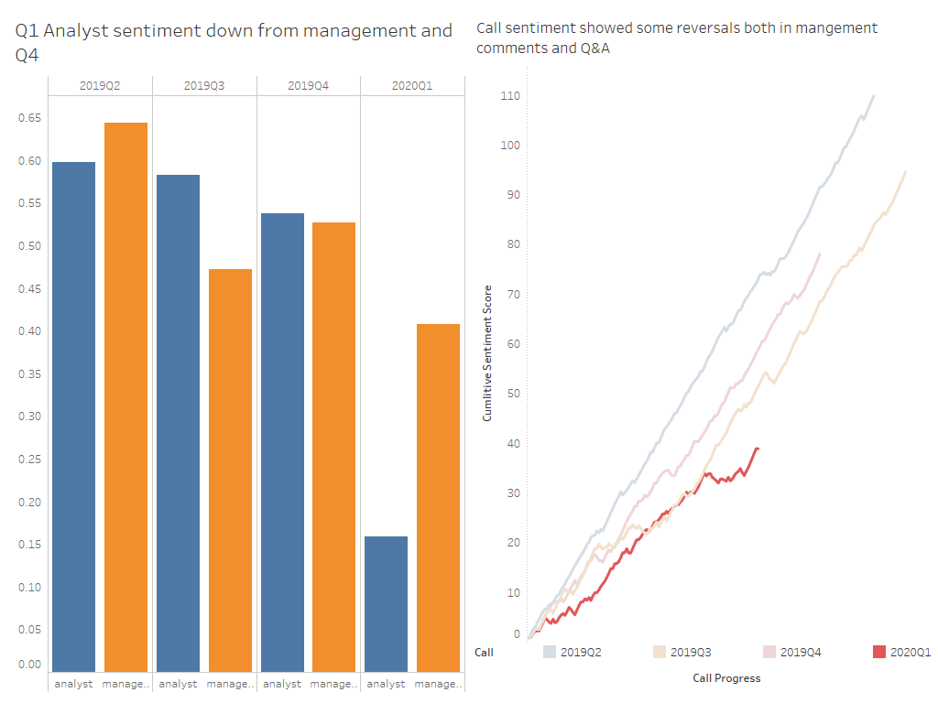

Slide 3
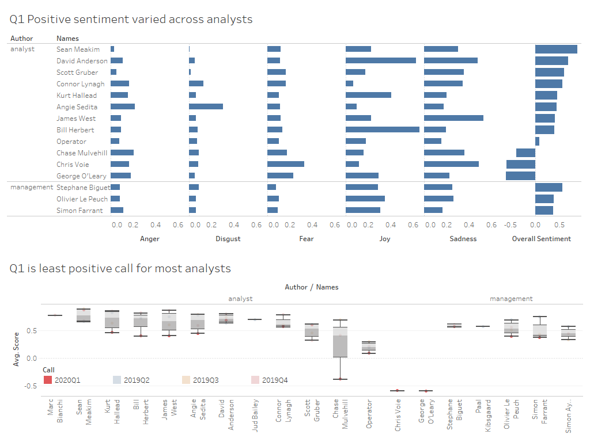

Slide 4
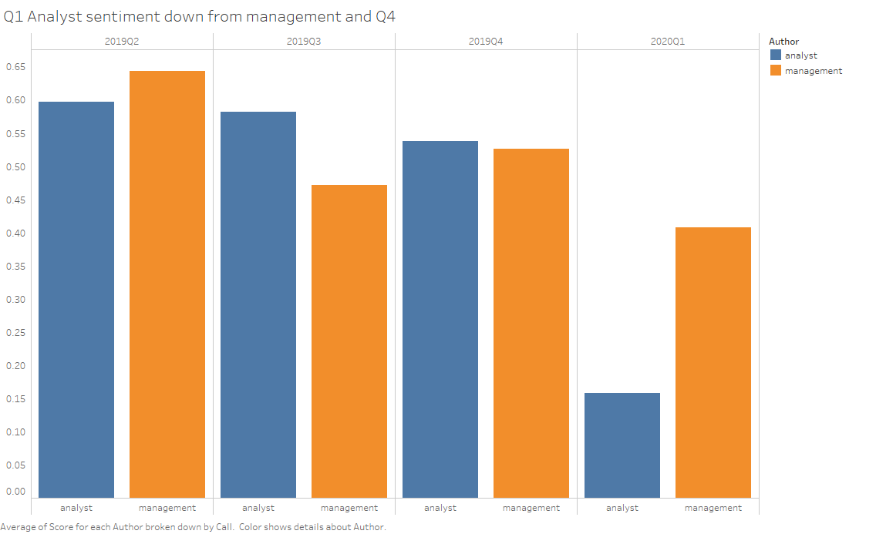

Slide 5
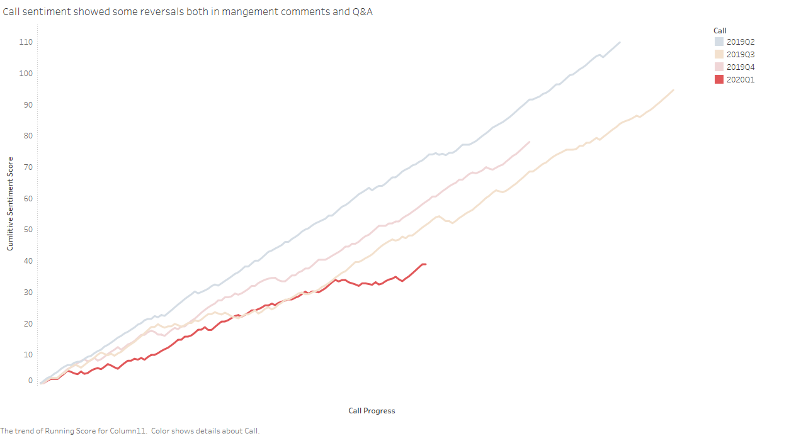

Slide 6
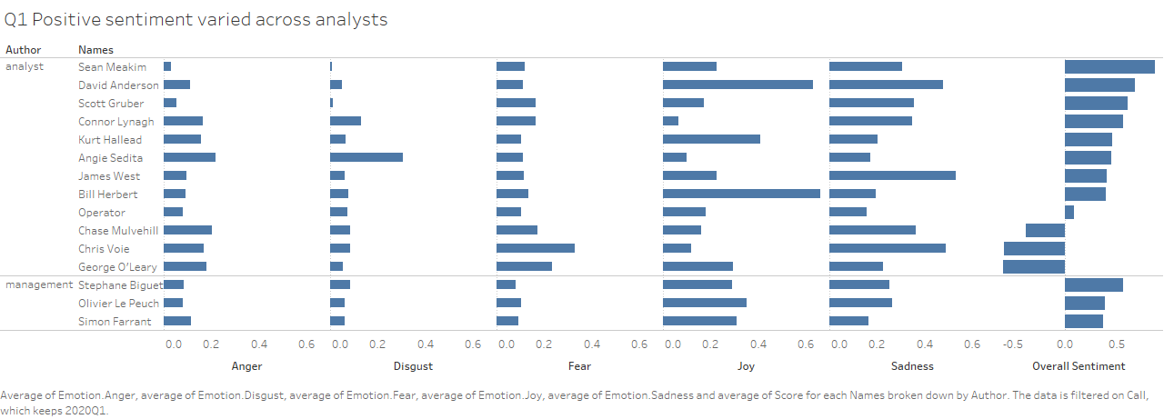

Slide 7
