Slide 1
Reconstructing RFI-corrupted MeerKAT visibilities
with generative in-painting
A diffusion model that fills RFI gaps instead of discarding them —
improving delay-spectrum fidelity for spectral-line science.
Jacques Malan · MeerKAT L-band · July 2026
Notes:
Frame: RFI is a data-loss problem; we treat it as a reconstruction problem. 'Improving', not 'restoring' — we never claim to recover truth inside RFI.

Slide 2

INTRODUCTION
About me
Jacques Malan — part-time BSc Honours (Computer Science), University of Pretoria; this project is the research component.
Software engineer at EPI-USE Labs, Pretoria.
RFI in-painting · MeerKAT L-band
2
Notes:
30 seconds max, then move on.

Slide 3
MOTIVATION
Why it matters: flagging discards data and leaves gaps
RFI is unavoidable in L-band — satellites, aviation and GNSS occupy fixed parts of the observing band.
Standard practice is flagging: corrupted samples are discarded, losing good signal flagged alongside the RFI.
The remaining frequency gaps corrupt the delay / power spectrum used for HI and 21-cm science — missing channels ring across all delays.
MeerKAT L-band, one baseline
900 MHz
1650 MHz
dark = flagged RFI: signal discarded, frequency coverage broken
Our approach: fill the gaps, don't discard them.
RFI in-painting · MeerKAT L-band
3
Notes:
Persistent offenders: GNSS 1170–1300 MHz, satcom 1530–1630 MHz. Gaps act as a multiplicative mask in frequency → convolution in delay space.

Slide 4
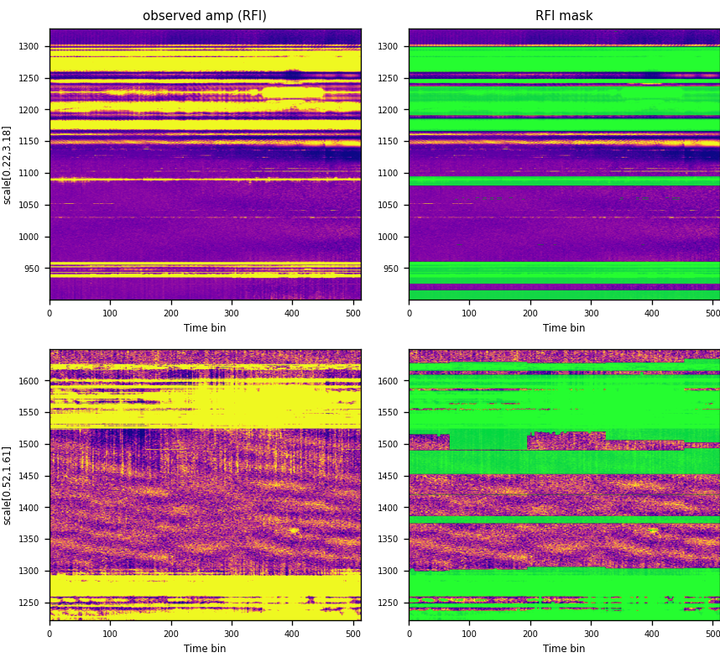
THE PROBLEM
What RFI actually looks like in MeerKAT data
Real baseline tiles from observation 1570802018: observed amplitude spectrograms (left) and what tricolour flags (right).
Persistent bands (GNSS 1170–1300 MHz, satcom 1530–1630 MHz) plus intermittent bursts — typically 10–25% of the band is lost.
Every flagged pixel is a hole in frequency coverage. This is the data the model has to fill — no in-painting shown here.
Observed amplitude (left) · tricolour flag mask (right; green = flagged).
RFI in-painting · MeerKAT L-band
4
Notes:
Point at the horizontal stripes: those are the persistent satellite bands — same channels ruined in every observation. The bursts vary; the bands don't.

Slide 5
CONTEXT
Where in-painting sits in the processing chain
Correlator
(L0 MS)
→
RFI flagging
(tricolour)
→
In-painting
(this work)
→
Calibration
(1GC / 2GC)
→
Imaging /
delay analysis
Operates pre-calibration, on uncalibrated L0 visibilities — everything downstream sees a gap-free band.
Drop-in step: it uses the observatory's standard tricolour flags and fills exactly what the flagger flags.
RFI in-painting · MeerKAT L-band
5
Notes:
If asked why pre-calibration: that is where flags are applied and where the archive product sits. Interaction with calibration is untested — stated on the scope slide.

Slide 6
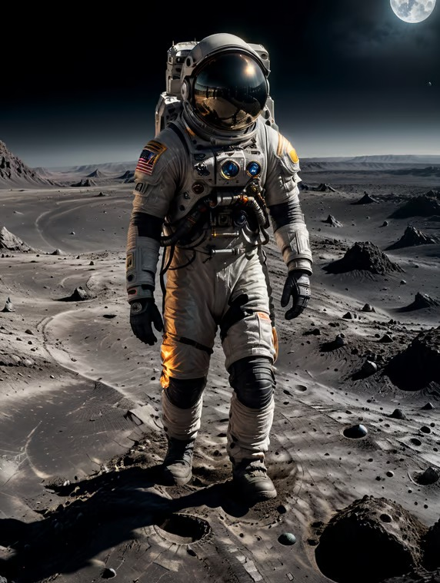
BACKGROUND — DIFFUSION MODELS
You already know diffusion models
Prompt: “an astronaut walking on the Moon”
→
Stable Diffusion, DALL·E, Midjourney — all diffusion models: they turn random noise into an image, step by step.
Those are text-to-image: the text prompt steers the denoising.
We use the image-to-image form: the surviving data around each gap is the “prompt” that steers what gets generated.
Actual diffusion-model output (prompt paraphrased).
RFI in-painting · MeerKAT L-band
6
Notes:
Disarming opener for the ML section: everyone in the room has seen these tools. The one-line pivot: same machinery, but our conditioning is the surrounding data instead of a text prompt.

Slide 7
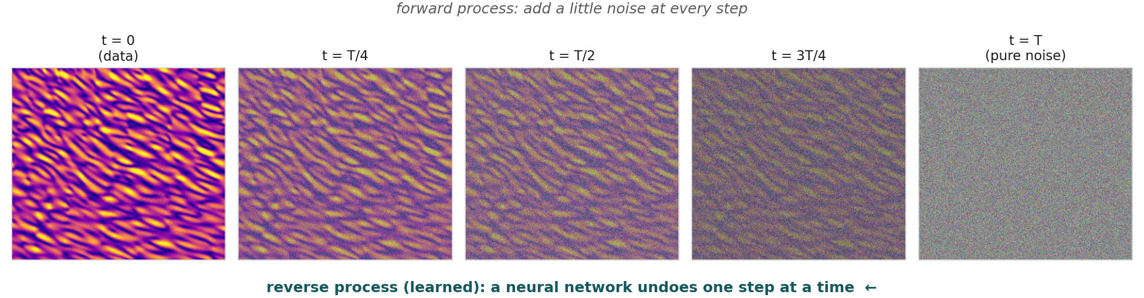
BACKGROUND — DIFFUSION MODELS
A one-minute primer on diffusion models
Training: add noise to data step by step, and teach a network to undo one step at a time.
Generation: start from pure noise and apply the learned denoising repeatedly — a sample of realistic data emerges.
Same model class as modern image generators — here it generates radio spectrograms instead of pictures.
RFI in-painting · MeerKAT L-band
7
Notes:
Keep it to a minute. The key intuition: the network never learns to produce an image in one shot — it only ever learns 'make this slightly less noisy', which is an easier, well-posed task.

Slide 8
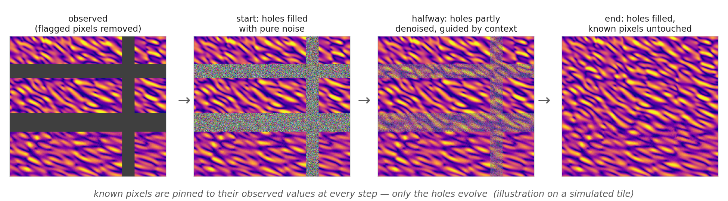
BACKGROUND — DIFFUSION MODELS
In-painting = diffusion with the known pixels pinned
The flagged holes start as pure noise and are denoised step by step, guided by the surrounding data.
Known pixels are pinned to their observed values at every step — the model cannot alter data it was given.
We use deterministic sampling (DDIM): the best single estimate of the missing data, not one random plausible fill.
RFI in-painting · MeerKAT L-band
8
Notes:
Pinning is the honesty guarantee: outputs agree exactly with the observation wherever data exists. Only flagged pixels are model output.

Slide 9
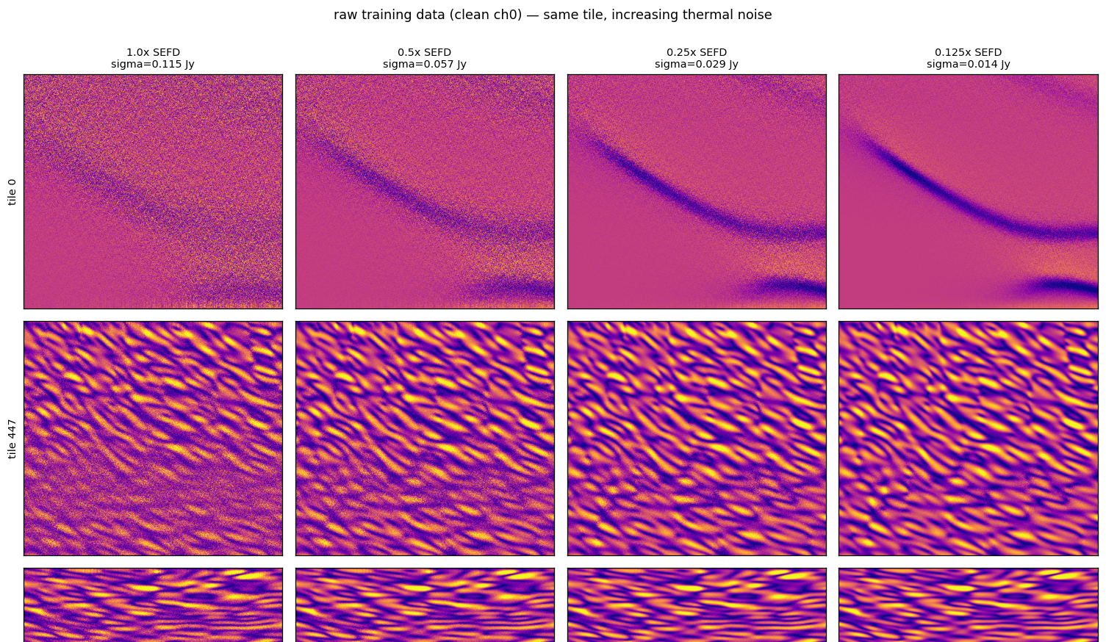
METHOD
How it's trained: supervised on simulation, then real data
Simulate RFI-free visibilities
→
Add thermal noise
→
Inject synthetic RFI
→
Amplitude + phase spectrograms
→
Train to reconstruct hidden pixels
Training pairs: the model sees the corrupted spectrogram and the flag mask,
and learns to reconstruct only the hidden (flagged) pixels.
The diffusion model from the previous slides, conditioned on the surviving pixels.
Works per baseline; the model only fills flagged pixels, so it inherits the flagger's recall.
RFI in-painting · MeerKAT L-band
9
Notes:
Palette-style conditional DDPM. Conditioning hides RFI pixels — true inpainting; the model never sees the corrupted values.

Slide 10
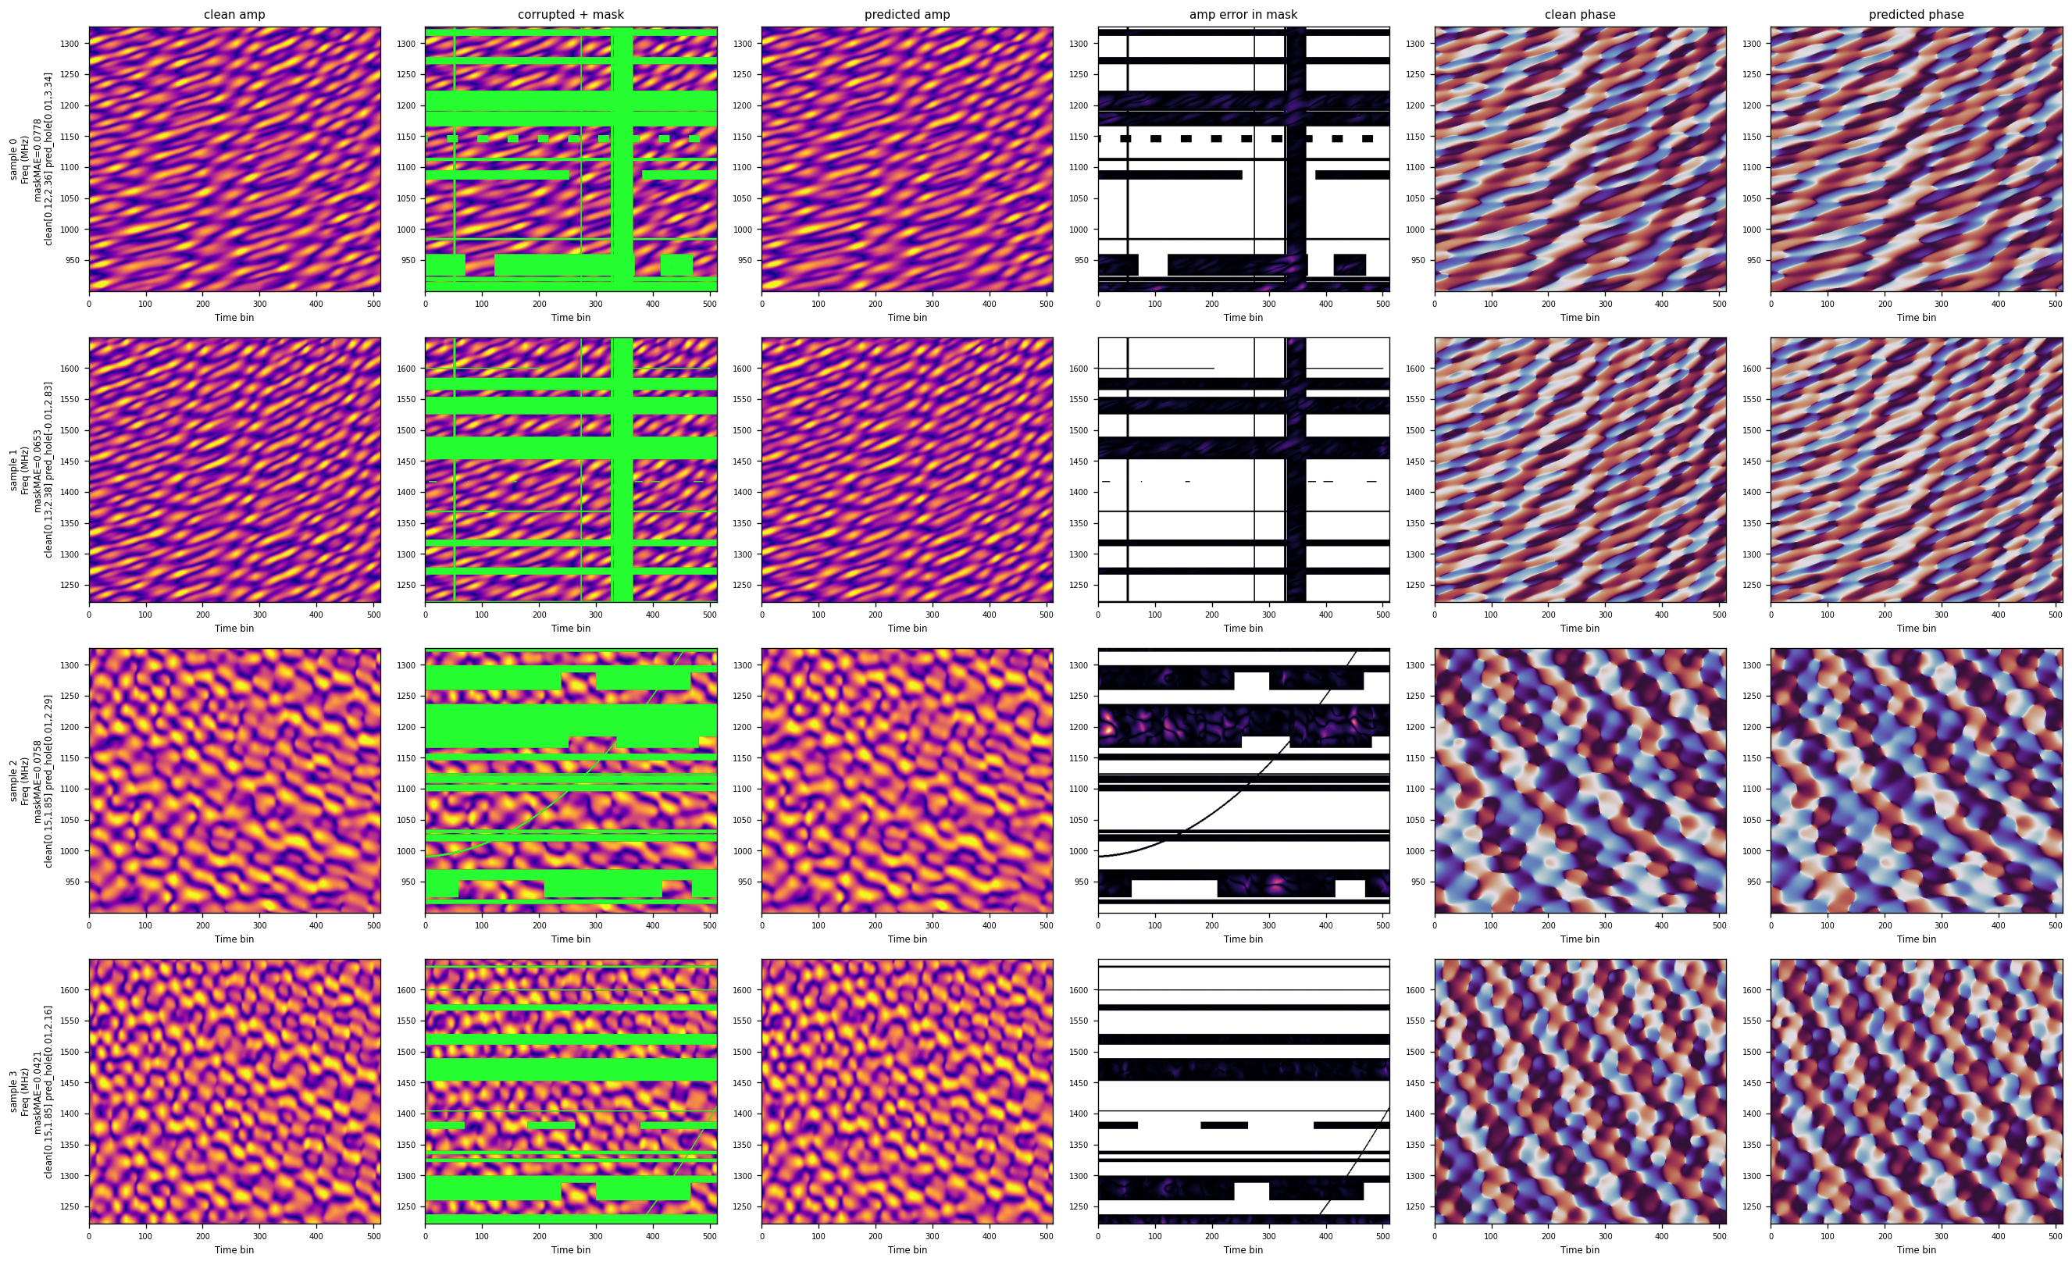
SIMULATION — KNOWN TRUTH
It works in simulation, where the truth is known
Left to right: RFI-free truth, corrupted input + mask, model prediction, error map, true vs predicted phase.
Reconstructs amplitude and phase — cos/sin phase channels are renormalised to a valid phasor.
RFI in-painting · MeerKAT L-band
10
Notes:
Simulation gives pixel-level ground truth: this is where quantitative claims are anchored. Figure panel labels say 'clean' — that means the RFI-free reference, not the CLEAN algorithm.

Slide 11
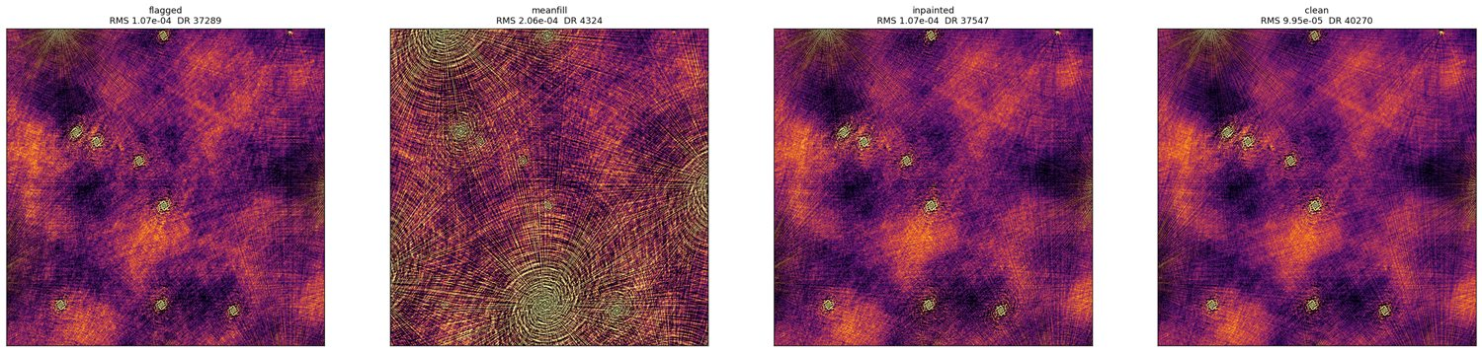
SIMULATION — KNOWN TRUTH
Simulated continuum image: on par with flagging
In-painting recovers the uncorrupted image: dynamic range ~37.5k vs ~40k for the RFI-free reference — on par with flagging.
A naive mean-fill collapses the image to ~4.3k dynamic range: what you fill with matters.
Continuum imaging is robust to gaps, so parity is the expected — and achieved — result here.
RFI in-painting · MeerKAT L-band
11
Notes:
Parity framing, not 'beats': continuum imaging averages over frequency, so flagging already does well. The point is in-paint does no harm here.

Slide 12
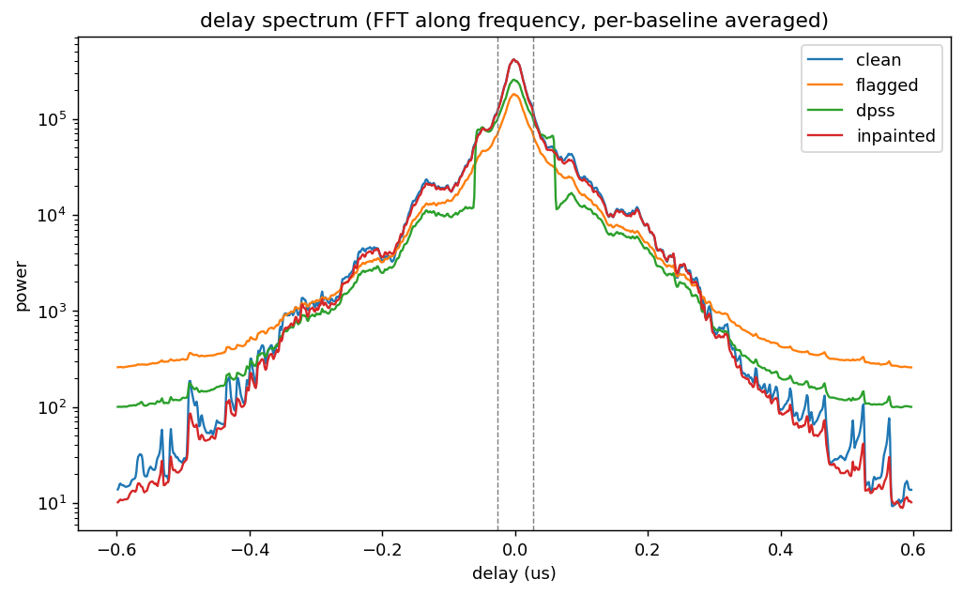
SIMULATION — KNOWN TRUTH
Simulated delay spectrum: this is where flagging hurts
In-painting tracks the true RFI-free spectrum; flagging raises a spurious noise floor across delays.
DPSS — band-limited by construction — clips real spectral structure.
Across all ablations, in-paint ≥ flagging at every SNR (90→3) and RFI fraction (15–60%); delay-space error 27–33× below flagging at full brightness (median over tiles, 95% CI shown).
RFI in-painting · MeerKAT L-band
12
Notes:
Headline result on sim. The 27–33× number is the median over tiles at full source brightness; separation narrows to ~6× at SNR≈3.

Slide 13
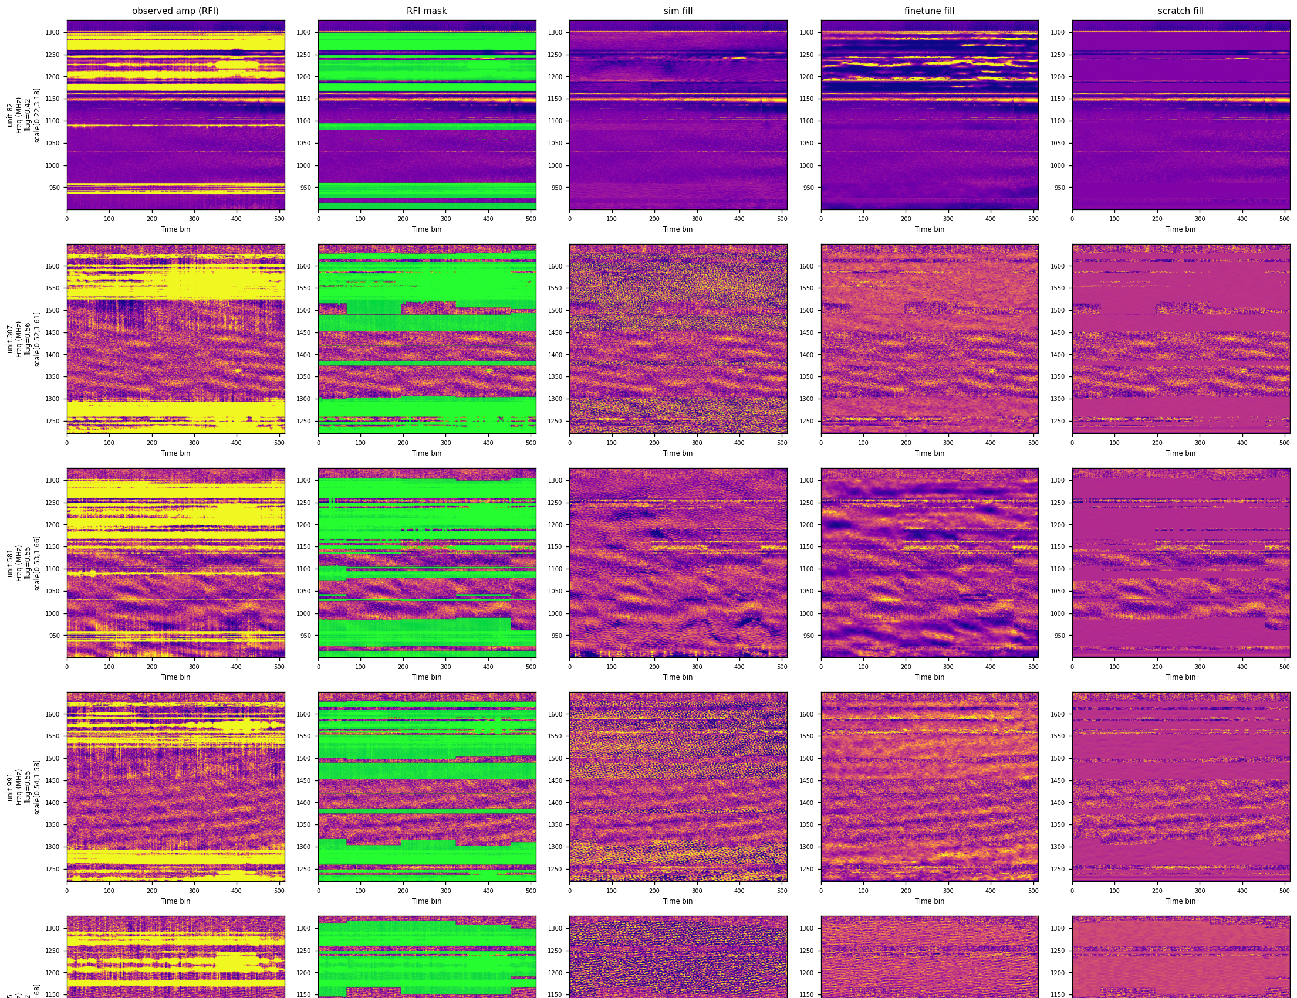
PART II · REAL MEERKAT DATA
Does it transfer to real MeerKAT data?
MeerKAT L-band observation 1570802018 (J2018-5539), operational tricolour flags.
Real RFI has no uncorrupted truth, so we do two things: show the effect directly (next slides) and validate on hidden known-good pixels (the fake-hole test).
The model is fine-tuned on real data with fake holes, then applied frozen.
Figure: the model filling flagged regions of a real baseline — amplitude and phase.
RFI in-painting · MeerKAT L-band
13
Notes:
Divider into the real-data half. Be explicit about the epistemics: no ground truth inside real RFI.

Slide 14
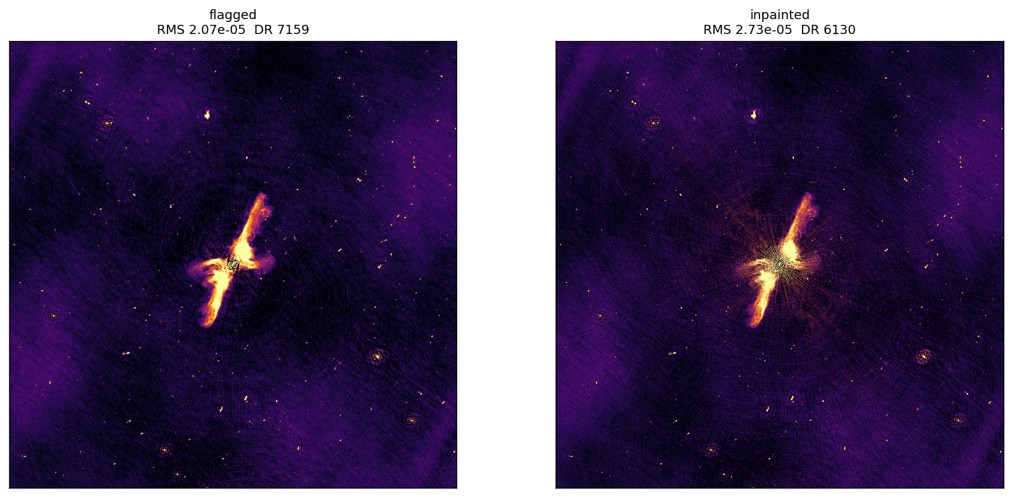
REAL MEERKAT DATA
Real continuum image: on par with flagging
Same source structure, comparable noise, no artefacts introduced — flagging baseline is the observatory's operational tricolour flags.
Classical fills (DPSS, GPR) visibly corrupt the image.
Off-source RMS is a noise diagnostic, not a correctness score — there is no truth on real data.
RFI in-painting · MeerKAT L-band
14
Notes:
DPSS/GPR write-back corrupts the image because their fills are inconsistent across time; the diffusion fill is coherent per tile. Full comparison lives in backup.

Slide 15
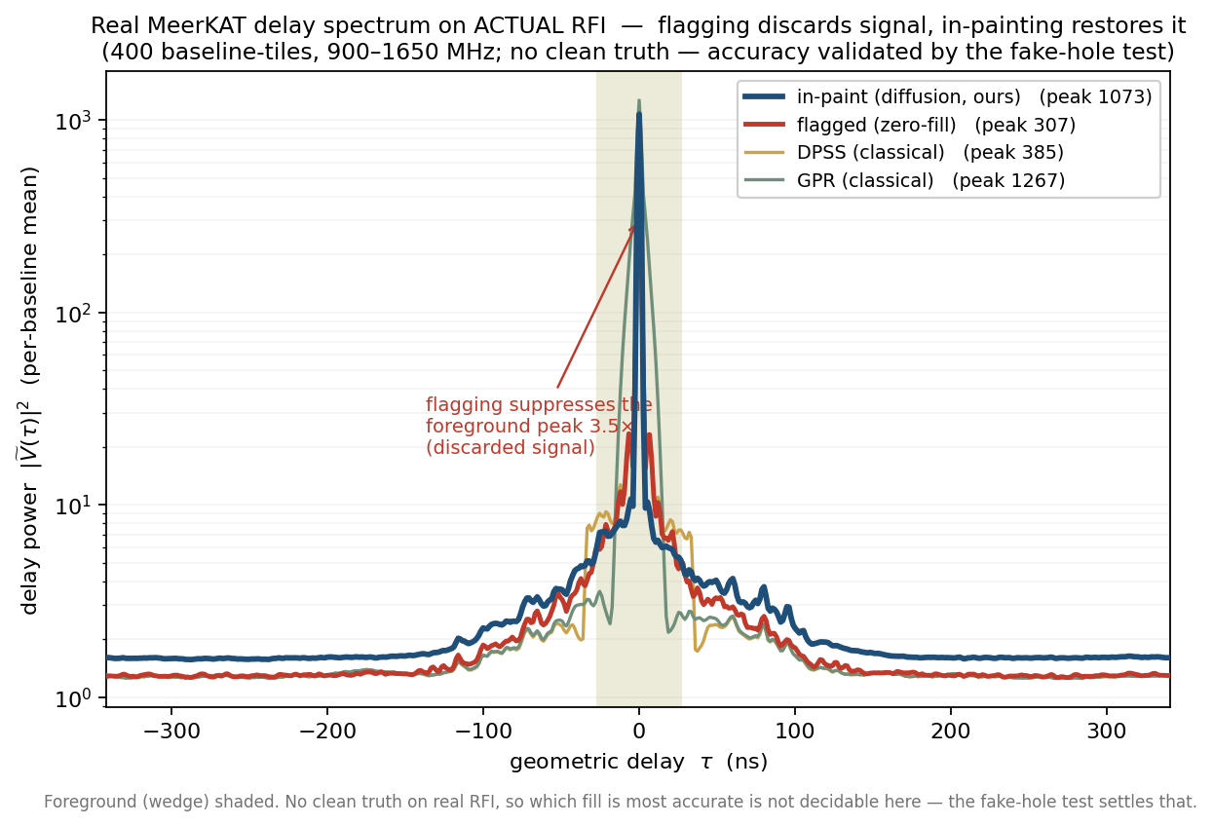
REAL MEERKAT DATA
Real delay spectrum, actual RFI: gaps removed
Flagging zeroes the RFI channels and discards signal — the delay peak drops ~3.5×; in-painting restores it.
No invented signal: in-paint adds essentially no power in empty high-delay bins — high-delay power ratio ≈ 1.00.
No uncorrupted truth on real RFI — accuracy is validated on the next slides.
RFI in-painting · MeerKAT L-band
15
Notes:
The high-delay ratio kills the 'does it hallucinate HI signal' question: the model neither fabricates nor removes power where the data are empty.

Slide 16
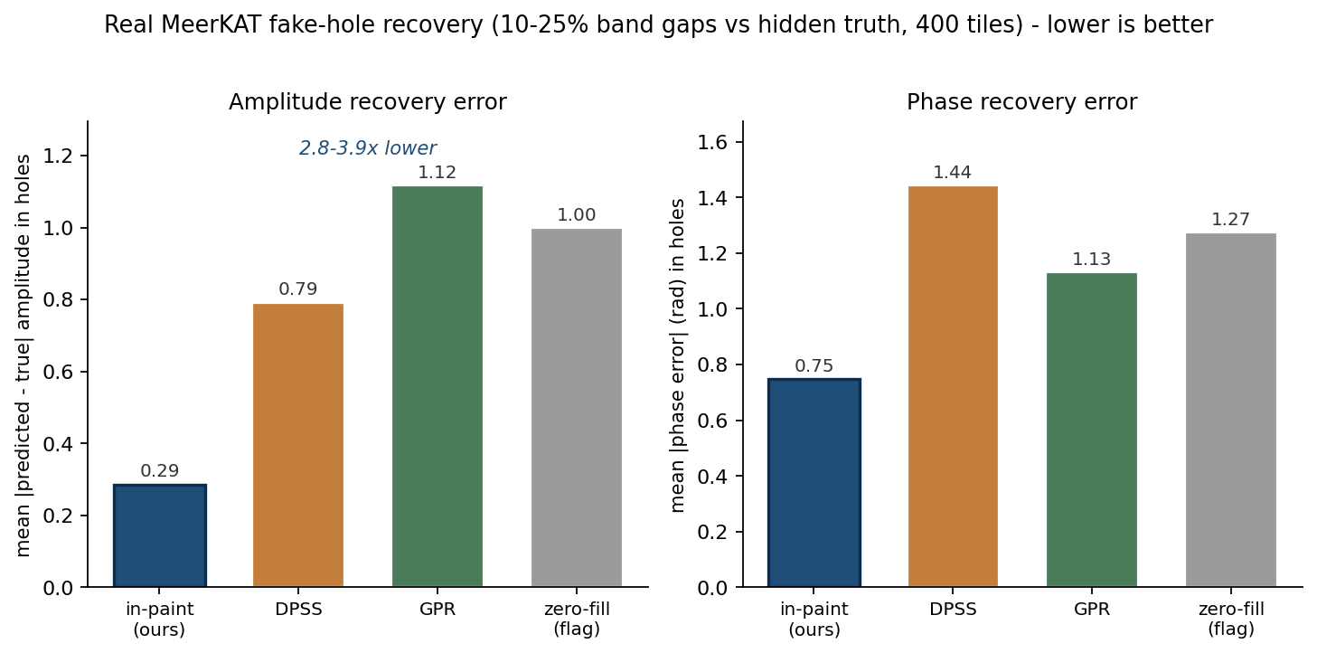
VALIDATION — GROUND TRUTH ON REAL DATA
Does it actually recover the data? (fake-hole test, with ground truth)
We hide known-good real pixels (band-shaped, like real RFI), reconstruct, and compare to the hidden truth — the one real-data test with an answer key.
In-painting recovers amplitude 2.8–3.9× more accurately than any classical method: mean error 0.29 vs 0.79 (DPSS), 1.12 (GPR), 1.00 (zero-fill / flagging).
Phase error ~2× lower: 0.75 rad vs 1.13–1.44.
Flagging = zero-fill is the floor; every faithful fill beats it, and the diffusion model beats the classical fills too.
Moderate flagging (10–25%), 400 baseline-tiles, real MeerKAT observation. Masked-region metric (hole pixels only) — standard inpainting evaluation.
RFI in-painting · MeerKAT L-band
16
Notes:
Fine-tuning from simulation transfers: real validation error 0.0031 fine-tuned vs 0.0068 trained from scratch. Baselines tuned per hole fraction: DPSS half-width 0.1, ridge 0.1; GPR SE kernel, length-scale 30 channels, noise 0.05.

Slide 17
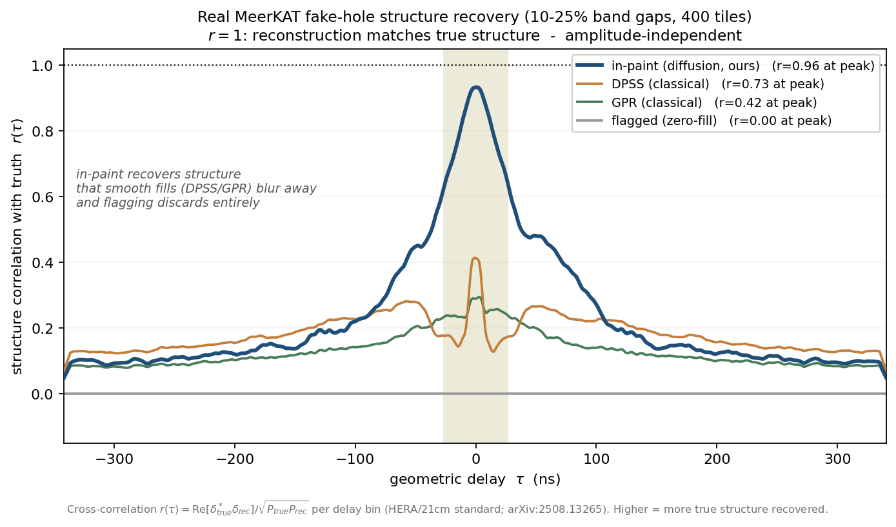
VALIDATION — STRUCTURE RECOVERY
Recovering real structure, not just smooth filler
Cross-correlation r(τ) measures how much of the true structure each method recovers, independent of amplitude — the standard 21-cm/EoR reconstruction metric.
In-paint recovers r = 0.96 of the true structure at the foreground peak, vs 0.73 (DPSS), 0.42 (GPR), 0.00 (flagging).
Classical fills are smooth by construction — they blur out fine spectral structure and decorrelate; flagging recovers nothing (zeros).
This is where a generative model earns its keep: reproducing detail that band-limited / smooth methods cannot.
The model's advantage is reconstruction fidelity at typical flagging levels. At extreme flagging (>~40% of the band) classical smooth fills become competitive — a genuine information limit, not a shortcoming of the metric.
r(τ) = Re[δ*_true·δ_rec] / √(P_true·P_rec) per delay bin. Refs: HERA arXiv:2411.10529; cross-correlation arXiv:2508.13265; Pagano MNRAS 520, 5552.
RFI in-painting · MeerKAT L-band
17
Notes:
If pressed on the r=0.00 for flagging: zeroed channels contribute nothing, so the correlation is zero by construction — that IS the point: flagging recovers none of the structure.

Slide 18
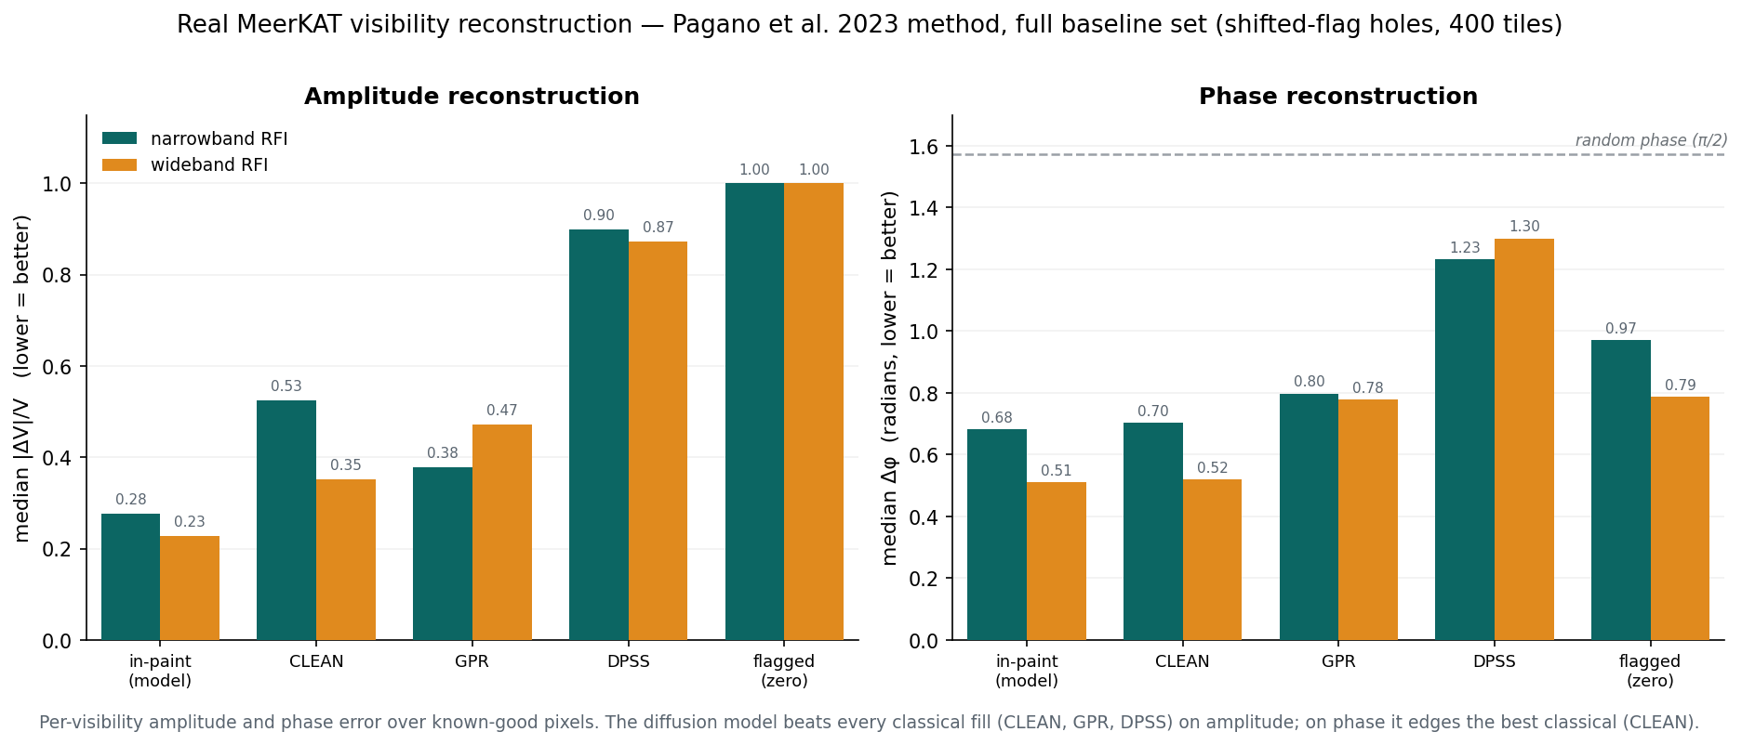
VALIDATION — PUBLISHED BENCHMARK
Benchmarked with a published method (Pagano et al. 2023)
Per-visibility amplitude and phase error over known-good pixels — full baseline set, 400 tiles, narrowband and wideband RFI shapes. In-paint halves the amplitude error of the best classical fill (0.28 / 0.23 vs 0.53 / 0.35) and edges it on phase (0.68 / 0.51 vs 0.70 / 0.52).
‘CLEAN’ here is the deconvolution-style gap-fill method from the benchmark — not the wsclean imaging algorithm. Flagged = zero-fill baseline; dashed line = random-phase level.
RFI in-painting · MeerKAT L-band
18
Notes:
This is the same fake-hole protocol scored with the comparison method used in published RFI-recovery work (Pagano et al. 2023, MNRAS 520, 5552) — so the numbers are directly comparable to the literature. Amplitude: decisive. Phase: parity with the best classical method, both well below the random-phase line.

Slide 19
Takeaways and next steps
Takeaways
Next steps
A diffusion model reconstructs RFI-corrupted MeerKAT visibilities — amplitude and phase.
On real data: on par with flagging in the continuum image, and removes the spectral gaps that corrupt the delay spectrum — beating classical fills (DPSS, GPR).
Biggest gains where gaps matter most: the delay / power spectrum, i.e. the spectral-line and 21-cm regime.
Multi-observation generalisation — does one model serve many fields and epochs?
Deployment cost at survey scale.
Benchmark against other machine-learning in-painters.
RFI in-painting · MeerKAT L-band
19
Notes:
Close on the honest scope: validated on one observation, decisive in delay space, parity in the image.

