Slide 1

Hotel Booking System

Slide 2
Problem : Concurrency Issues
When multiple people book the last room, there may be an issue, resulting a negative number of available rooms.
Concurrent booking or modification requests might lead to data inconsistencies or race conditions

Slide 3
Proposed Solution
Locking mechanism on DB :
Optimistic Locking
Maximizes concurrency
Allows concurrent access, checks for conflicts before committing changes
Ideal for low contention and read-heavy operations
Pessimistic Locking
Guarantees data integrity
Locks resources preemptively
Suitable for high contention and critical data scenarios
May lead to performance bottlenecks and deadlock situations
Notes:
Implement a locking mechanism or optimistic concurrency control to handle concurrent booking or modification requests. Additionally, introduce a feature where users can hold their booking for 15 minutes to make the payment, after which it will be automatically canceled if payment is not completed.

Slide 4

Methodology : JMeter
Testing:
Simulate concurrent booking and modification requests.
Monitoring:
Monitor system logs and metrics.
Notes:
Testing: Simulate concurrent booking and modification requests under load testing scenarios to evaluate the correctness and effectiveness of the implemented locking mechanism.
Monitoring: Monitor system logs and metrics to identify any instances of race conditions or data inconsistencies during high traffic periods.

Slide 5
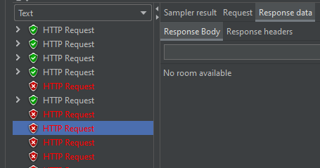
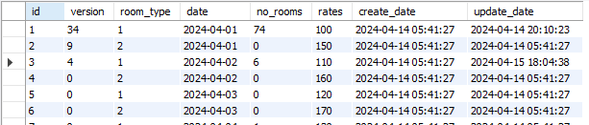
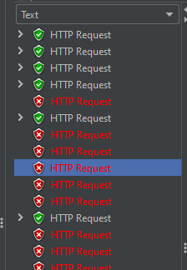
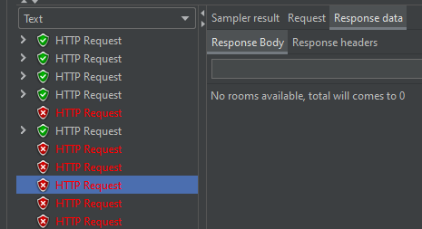
Preliminary Results

Slide 6
Future Work
Performance issues.
First come, First served?
Message Queue

