Slide 1
ENGI 301 Colorful Melodies - Proposal
10/19/2019
Jorge F. Tito-Arce

Slide 2
Background Information
Using color sensors, buzzers with musical ranges, and an embedded computing system, the curious tinkerer can convert a string of colors to sounds.
Previous project by Yuri Suzuki: Music from Art
Color Chaser 2010: Follows a black line and reads the colors painted on that line
People can add whatever color they want, thus contribute directly to the music being produced.
https://vimeo.com/72853276
Improvements with my design:
Stationary
Use circle properties to create a melodic sound: like a CD, but can be interacted with by coloring specific parts

Slide 3
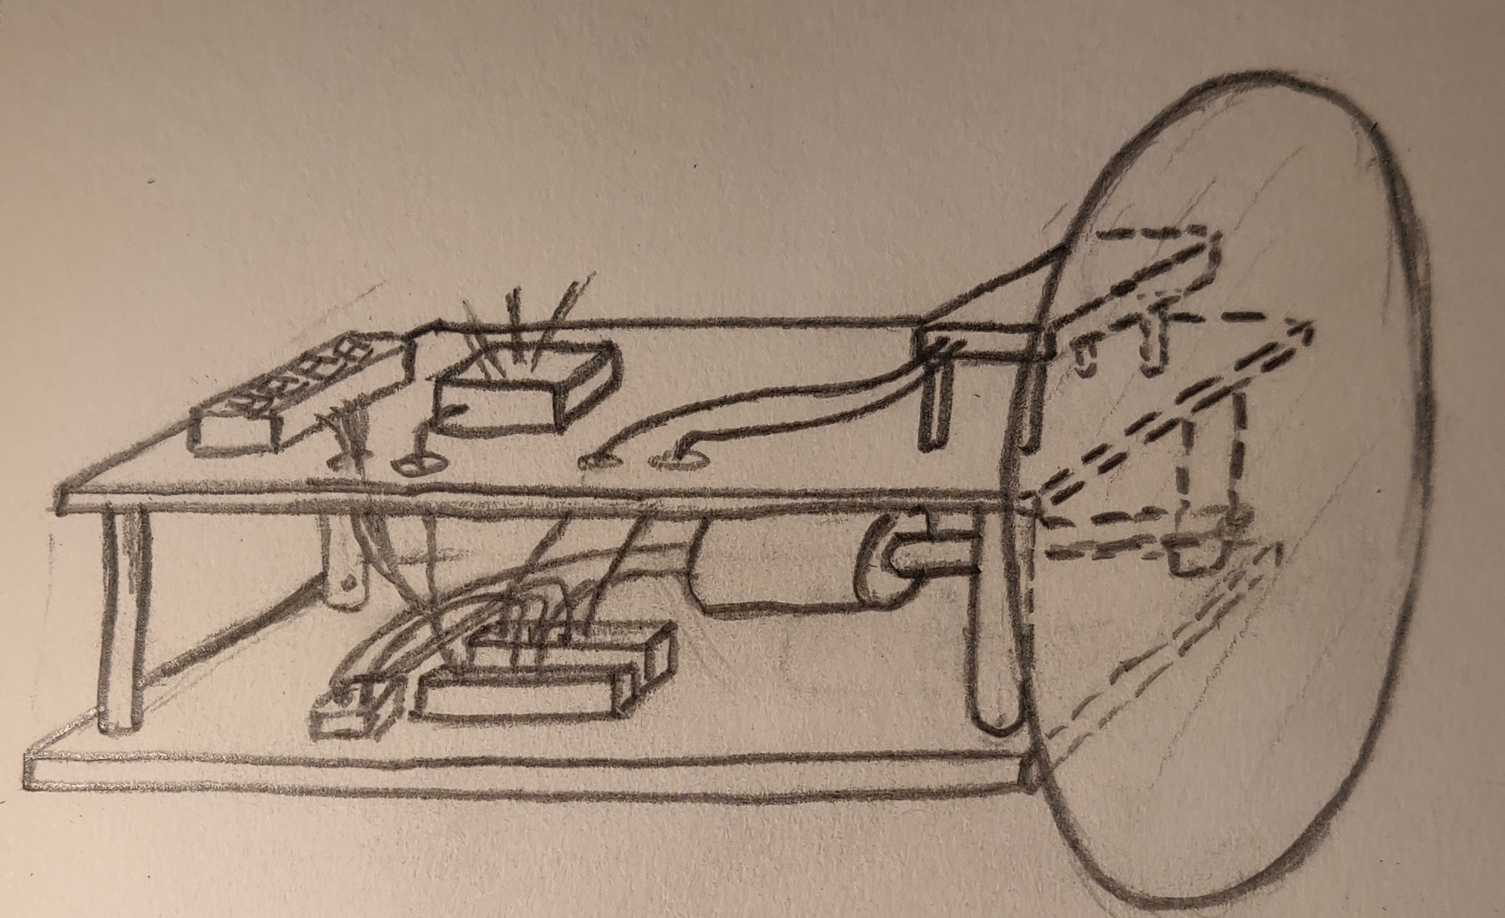
Design
7
3
8
2
4
6
9
1
5

Slide 4
Bill of Materials
Number on Drawing | Name
1 | Color Wheel
2 | Top and Bottom Plates
3 | Color Sensor
4 | D.C. Motor
5 | Beagle Bone
6 | Pillars
7 | USB Audio Adapter, Speaker
8 | Hex Display for tempo
9 | Variable Resistor

Slide 5
Design Intent
To allow users to interact with the music they want to hear
Can color in pre-made disks or even make their own disks
Can slow down the tempo by having a variable resistance to the motor driving the color wheel
To show the connection between visual and audio stimuli
Robot with synesthesia
Appreciation of the arts in a technical world

Slide 6
System Block Diagram
Pocket
Beagle
Color Sensor
I2C1
Variable Resistor
Hex Display for Tempo
I2C2
SYS
DC Motor
AIN
USB1
Resistor Divider
USB Audio Adapter

Slide 7
Power Block Diagram
Power In
Pocket
Beagle
USB0
3.3V
330 µA max
Color Sensor
I2C1
3.3 V
2 mA max
3.3 V
Variable Resistor
Hex Display for Tempo
I2C2
110 mA
DC Motor
3.3V
Out
PWM1
USB1
USB Audio Adapter

Slide 8
Components / Budget
Component | Need to Buy | Cost
AdaFruit Color Sensor | Yes | $7.95
DC Motor | Yes | $1.95
Plugable USB Audio Adapter | Yes | $14.99
PocketBeagle | No
Hex Display | No
Variable Resistor | Yes | $4.59
Wood | Yes/No | ~$20.00
Speaker | No
Total: 49.48

