Slide 1
ENGI 301 Colorful Tunes PCB Design Proposal
11/26/2019
Jorge F. Tito Arce

Slide 2
Description of Board Functionality
Electrical components on two sides
Top layer → Components the user interacts with
Hex Display
Potentiometer: User turns this knob
Switch: User turns on device
RBG LED
Bottom Layer → Components the user does not interact with
Pocket Beagle
3-prong connector for Servo
4-prong connector for Color Sensor
USB

Slide 3
Functional Block Diagram
Pot.
Servo
Power
PWM
REF-
AIN0
Pocket Beagle
REF+
RGB LED
PWM
GND
PWM
5V
PWM
PWM
Breakout USB
GND
Color Sensor
GND
ID
D+
D-
SV
SV
5V
GND
SCL
SDA
D-
5V
D+
GND
ID
I2C1
GND
SCL
I2C2
SDA
5V
GND
SCL
SDA
Hex Display
5V
GND
SCL
SDA

Slide 4
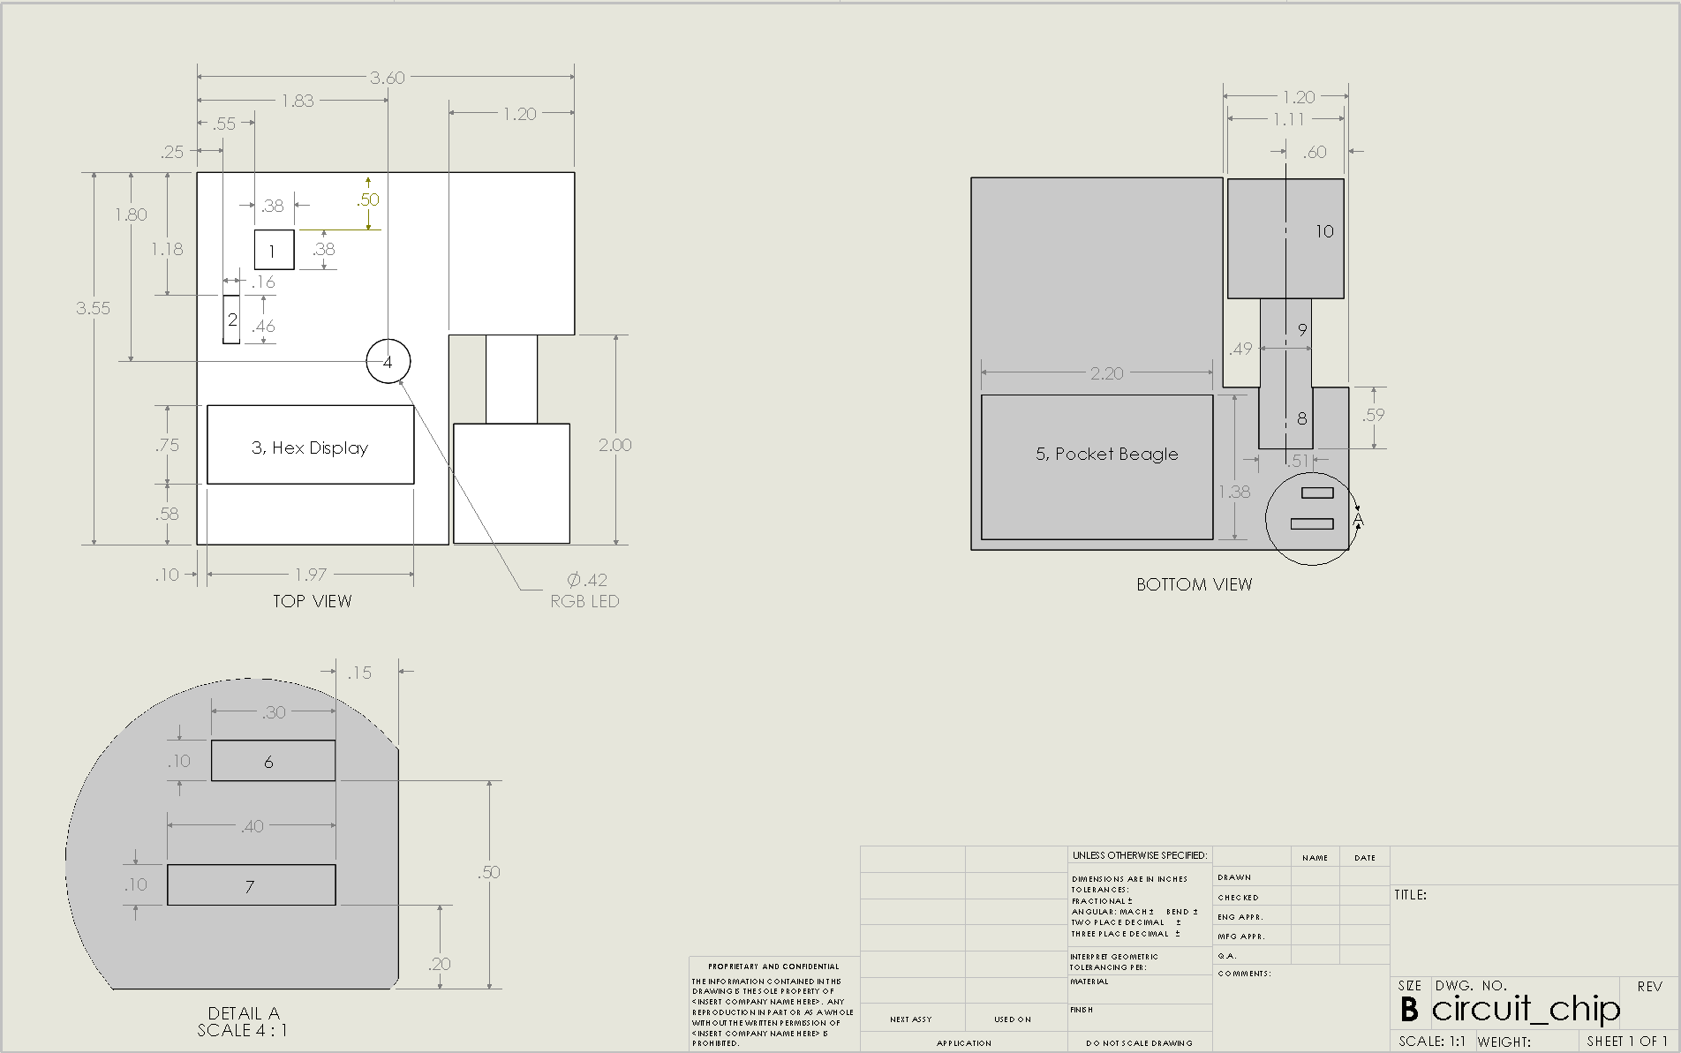
Mechanical Diagram With Dimensions

Slide 5
Mechanical Diagram Disclaimer
Add another 0.1 in. to each corner, then make a 0.111 in hole in the place where the corner used to be. That should be enough space for a machine screw hole.

Slide 6
Components / Budget
Component | Name
1 | Potentiometer
2 | On/Off Switch
3 | Hex Display
4 | RGB LED
5 | Pocket Beagle
6 | Pins for Servo Motor
7 | Pins for Color Sensor
8 | USB Breakout
9 | Mini-USB to USB
10 | Plugable Audio Output

