Slide 1
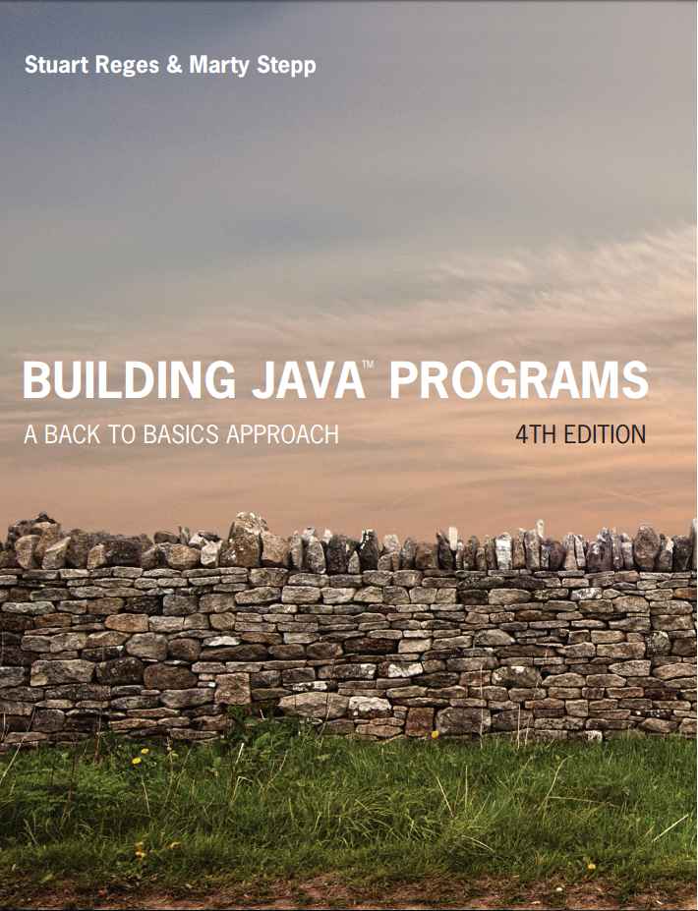
Building Java Programs
Fourth Edition
Supplement 3G
Graphics
Copyright © 2017, 2014, 2011 Pearson Education, Inc. All Rights Reserved
Notes:
If this PowerPoint presentation contains mathematical equations, you may need to check that your computer has the following installed:
1) MathType Plugin
2) Math Player (free versions available)
3) NVDA Reader (free versions available)

Slide 2
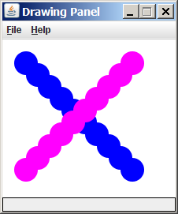
Graphical Objects
We will draw graphics in Java using 3 kinds of objects:
DrawingPanel: A window on the screen.
Not part of Java; provided by the authors. See class web site.
Graphics: A “pen” to draw shapes and lines on a window.
Color: Colors in which to draw shapes.

Slide 3
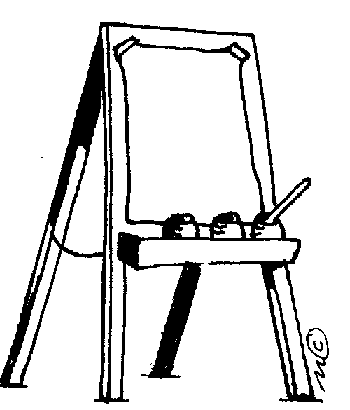
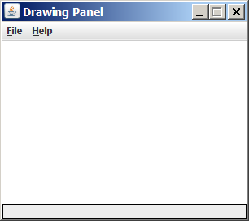
DrawingPanel
“Canvas” objects that represents windows/drawing surfaces
To create a window:
DrawingPanel name = new DrawingPanel(width, height);
Example:
DrawingPanel panel = new DrawingPanel(300, 200);
The window has nothing on it.
We draw shapes / lines on it with another object of type Graphics.

Slide 4
Coordinate System
Each (x, y) position is a pixel (“picture element”).
Position (0, 0) is at the window's top-left corner.
x increases rightward and the y increases downward.
The rectangle from (0, 0) to (200, 100) looks like this:
(0,0)
X+
(200,100)
y+

Slide 5

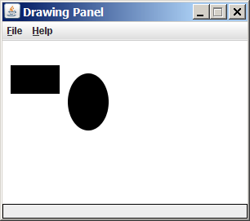
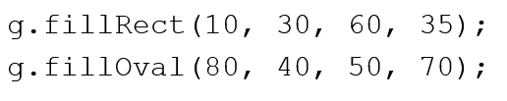
Graphics
“Pen” or “paint brush” objects to draw lines and shapes
Access it by calling getGraphics on your DrawingPanel.
Graphics g = panel.getGraphics();
Draw shapes by calling methods on the Graphics object.

Slide 6

Java Class Libraries, Import
Java class libraries: Classes included with Java’s J D K.
organized into groups named packages
To use a package, put an import declaration in your program:
Graphics belongs to a package named java.awt
To use Graphics, you must place the above line at the very top of your program, before the public class header.

Slide 7
Graphics Methods
Method name | Description
g.drawLine(x1, y1, x2, y2); | line between points (x1, y1), (x2, y2)
g.drawOval(x, y, width, height); | outline largest oval that fits in a box of size width * height with top-left at (x, y)
g.drawRect(x, y, width, height); | outline of rectangle of size width * height with top-left at (x, y)
g.drawString(text, x, y); | text with bottom-left at (x, y)
g.fillOval(x, y, width, height); | fill largest oval that fits in a box of size width * height with top-left at (x, y)
g.fillRect(x, y, width, height); | fill rectangle of size width * height with top-left at (x, y)
g.setColor(Color); | set Graphics to paint any following shapes in the given color

Slide 8
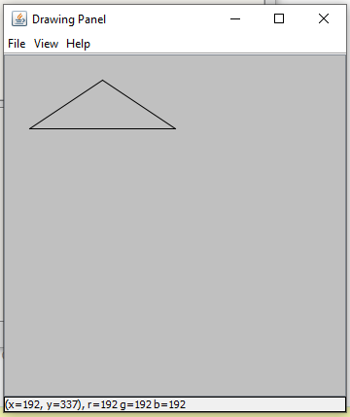
In-Class Assignment 2, Part 1
Create a project and class named JGraphics in BlueJ.
Add import java.awt.*; at the beginning of the program.
Copy the DrawingPanel.java file to your project folder.
Within main(), do the following:
Create a DrawingPanel object named panel with width and height of 500.
Create a Graphics object named g.
Set the background color to LIGHT_GRAY
Draw a triangle by drawing three lines with the following coordinates:
(25, 75) and (100, 25)
(100, 25) and (175, 75)
(25,75) and (175, 75)
You should get this:

Slide 9

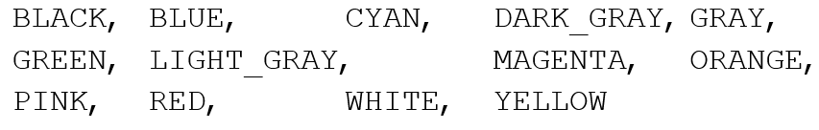
Color
Specified as predefined Color class constants:
Color.Constant_name
where Constant_name is one of:
Or create one using Red-Green-Blue (R G B) values of 0-255
Color name = new Color(red, green, blue);
Example:
Color brown = new Color(192, 128, 64);

Slide 10
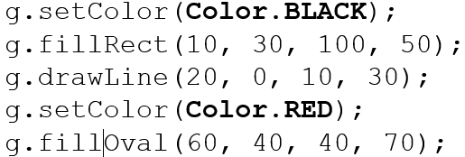
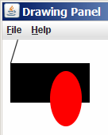
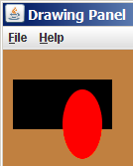

Using Colors
Pass a Color to Graphics object’s setColor method
Subsequent shapes will be drawn in the new color.
Pass a color to DrawingPanel’s setBackground method
The overall window background color will change.

Slide 11
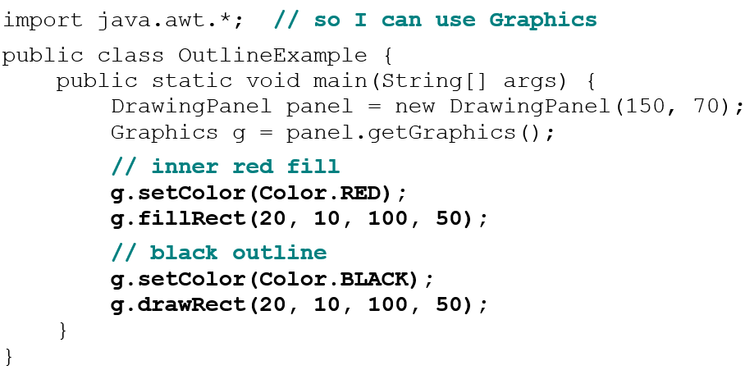
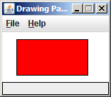
Outlined Shapes
To draw a colored shape with an outline, first fill it, then draw the same shape in the outline color.

Slide 12
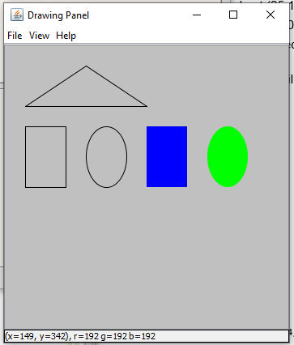
In-Class Assignment 2, Part 2
Add code to the Jgraphics class as follows:
Draw the outline of a rectangle at (25,100), width=50, height=75.
Draw the outline of an oval at (100,100), width=50, height=75
Change color to BLUE and draw a filled rectangle at (175, 100), width=50, height=75
Change color to GREEN and draw a filled oval at (250, 100), width=50, height=75
You should get this:

Slide 13
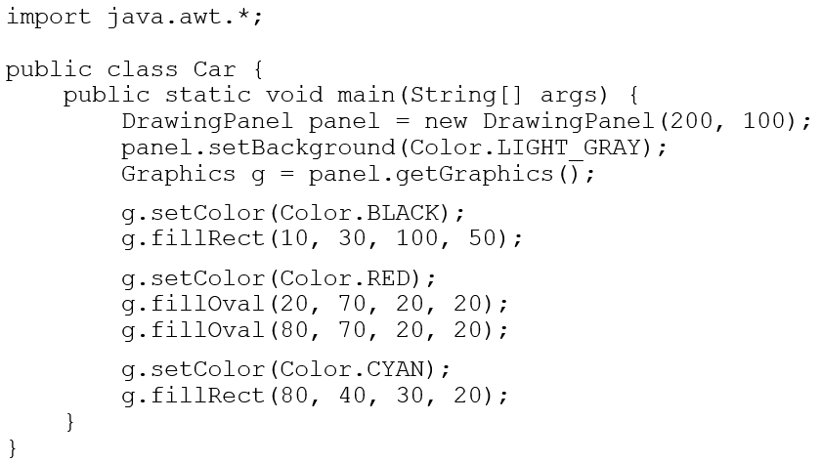
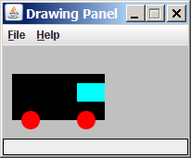
Superimposing Shapes
When ≥ 2 shapes occupy the same pixels, the last drawn “wins.”

Slide 14
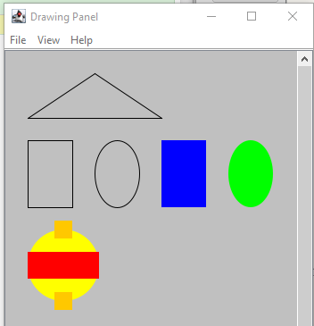
In-Class Assignment 2, Part 3
Add code to the JGraphics class as follows:.
Draw a yellow filled circle at (25,200) with width and height 80
Draw an orange filled rectangle at (55, 190) with width and height 20
Draw a red filled rectangle at (22, 225) with width 80 and height 30
Draw another orange filled rectangle at (55, 270) with width and height 20
You should get this:

Slide 15
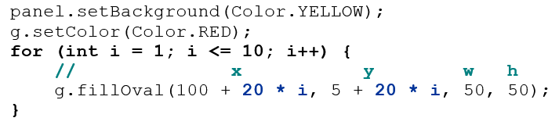
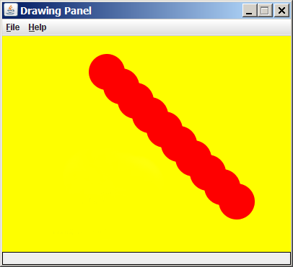
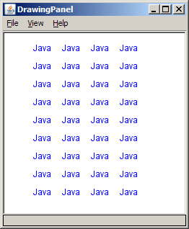
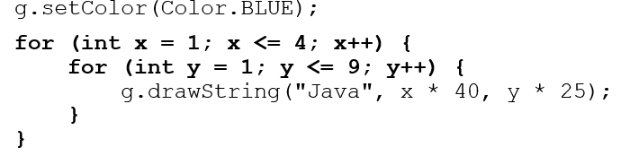
Drawing with Loops
The x,y,w,h expressions can use the loop counter variable:
Nested loops can be used with graphics:

Slide 16
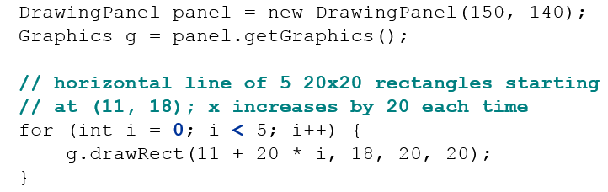
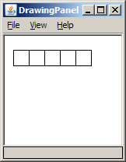
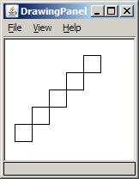
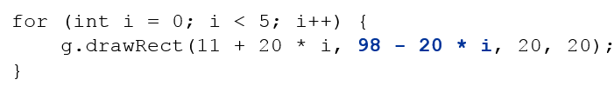
Zero-based Loops
Beginning at 0 and using < can make coordinates easier.
Exercise: Write a variation of the above program that draws the output at right.
The bottom-left rectangle is at (11, 98).

Slide 17
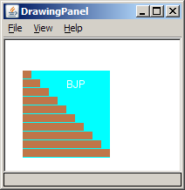
Java Book Figure
Write a program that draws the following figure:
drawing panel is size 200x150
book is at (20, 35), size 100x100
cyan background
white “B J P” text at position (70, 55)
stairs are in color (red=191, green=118, blue=73)
each stair is 9px tall
1st stair is 10px wide
2nd stair is 20px wide ...
stairs are 10px apart (1 blank pixel between)

Slide 18
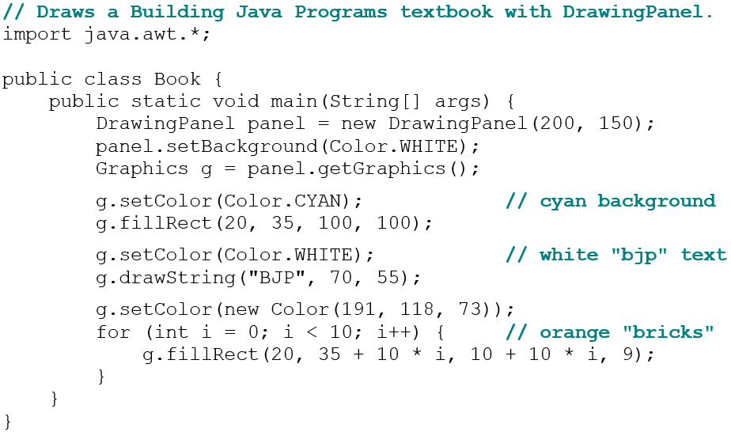
Java Book Solution

Slide 19
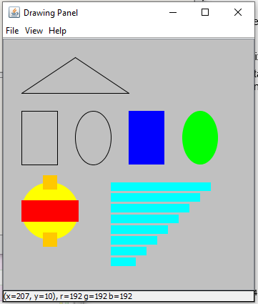
In-Class Assignment 2, Part 4
Add code to the JGraphics class as follows:.
Change the color to WHITE
Using a loop, draw a stack of 6 filled rectangles as follows:
All rectangles should be 7 px tall.
The first rectangle should be 85 pixels wide and start at (55, 300).
The width of each successive rectangle should be 15 pixels less than the previous one and have a y coordinate 7 pixels larger than the previous one.
You should get this:

Slide 20
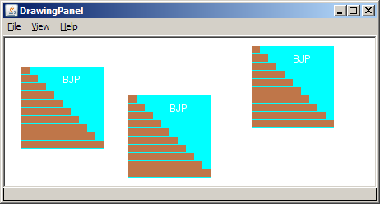
Multiple Java Books
Modify the Java book program so that it can draw books at different positions as shown below.
book top/left positions: (20, 35), (150, 70), (300, 10)
drawing panel’s new size: 450x180

Slide 21
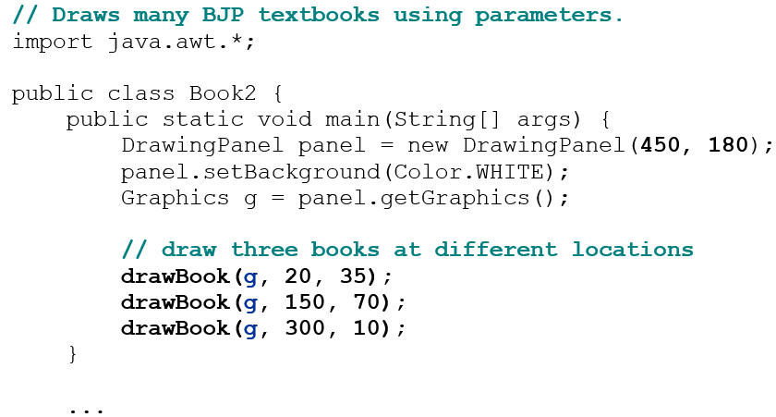
Multiple Books Solution (1 of 2)
To draw in a method, you must pass Graphics g to it.

Slide 22
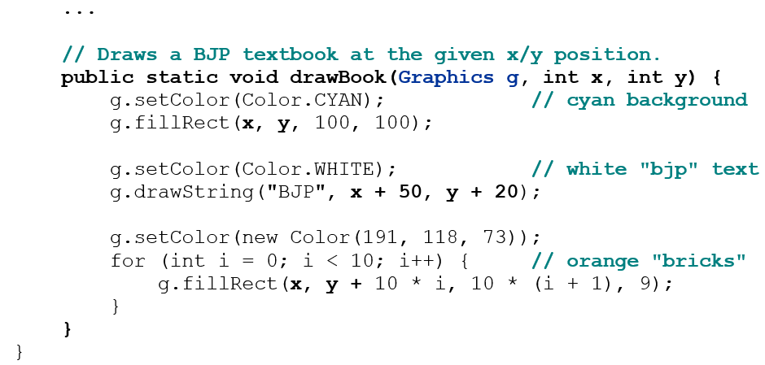
Multiple Books Solution (2 of 2)

Slide 23
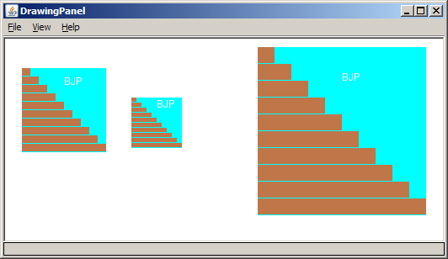
Resizable Java Books
Modify the Java book program so that it can draw books at different sizes as shown below.
book sizes: 100x100, 60x60, 200x200
drawing panel’s new size: 520x240

Slide 24
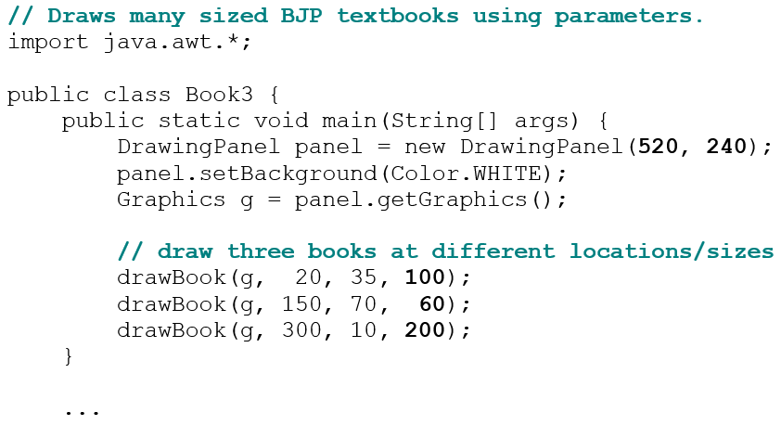
Resizable Books Solution (1 of 2)

Slide 25
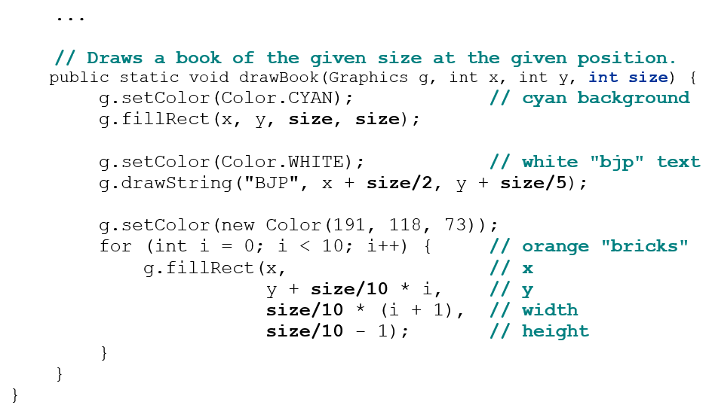
Resizable Books Solution (2 of 2)

Slide 26
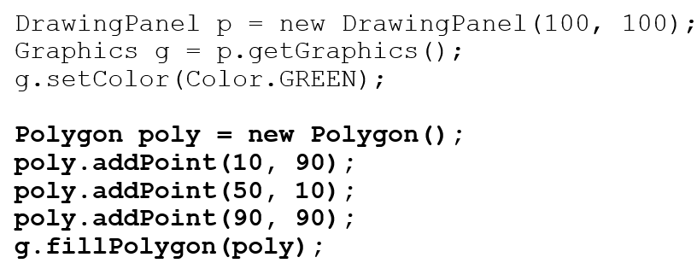
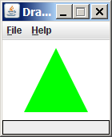
Polygon
Objects that represent arbitrary shapes
Add points to a Polygon using its addPoint(x, y) method.
Example:

Slide 27
DrawingPanel Methods
panel.clear(); Erases any shapes that are drawn on the drawing panel.
panel.setWidth(width); panel.setHeight(height); panel.setSize(width, height); Changes the drawing panel's size to the given value(s).
panel.save(filename); Saves the image on the panel to the given file (String).
panel.sleep(ms); Pauses the drawing for the given number of milliseconds.

Slide 28
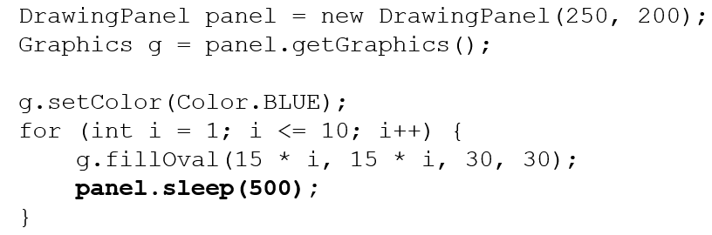
Animation with Sleep
DrawingPanel’s sleep method pauses your program for a given number of milliseconds.
You can use sleep to create simple animations.
Try adding sleep commands to loops in past exercises in this chapter and watch the panel draw itself piece by piece.

Slide 29

Copyright

