Slide 1
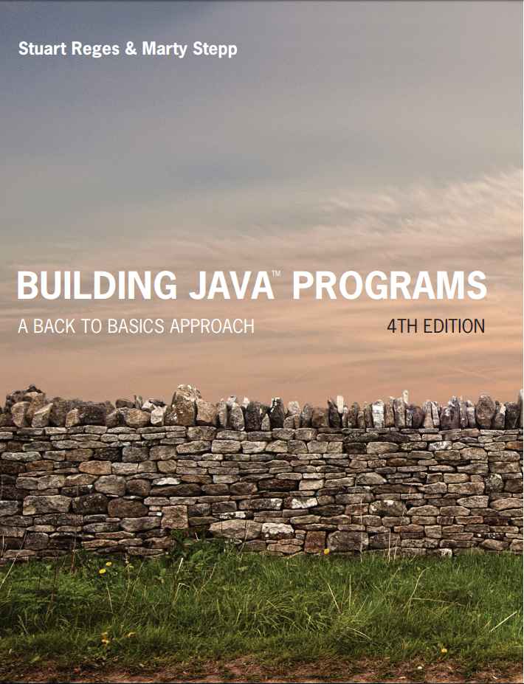
Building Java Programs
Fourth Edition
Chapter 3
Parameters and Objects
Copyright © 2017, 2014, 2011 Pearson Education, Inc. All Rights Reserved
Notes:
If this PowerPoint presentation contains mathematical equations, you may need to check that your computer has the following installed:
1) MathType Plugin
2) Math Player (free versions available)
3) NVDA Reader (free versions available)

Slide 2

Redundant Figures

Slide 3
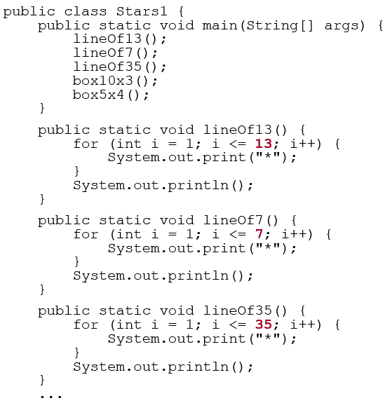
A Redundant Solution
This code is redundant.
Would variables help? Would constants help?
What is a better solution?
line - A method to draw a line of any number of stars.
box - A method to draw a box of any size.

Slide 4
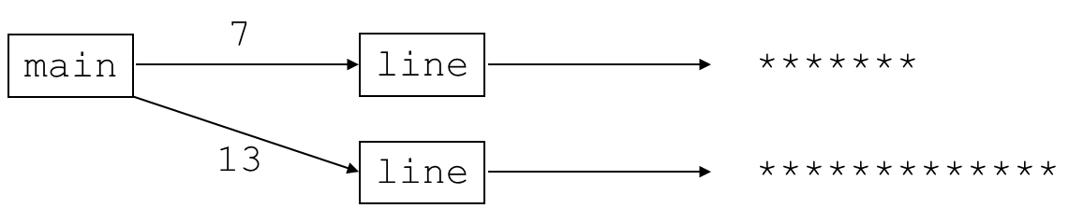
Parameterization
parameter: A value passed to a method by its caller.
Instead of lineOf7, lineOf13, write line to draw any length.
When declaring the method, we will state that it requires a parameter for the number of stars.
When calling the method, we will specify how many stars to draw.

Slide 5
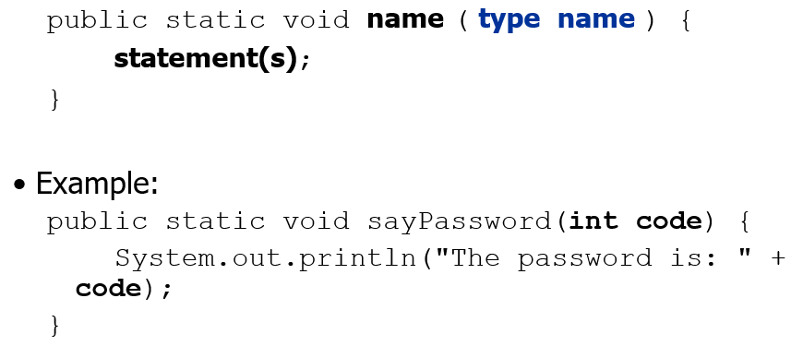
Declaring a Parameter
Stating that a method requires a parameter in order to run
When sayPassword is called, the caller must specify the integer code to print.

Slide 6
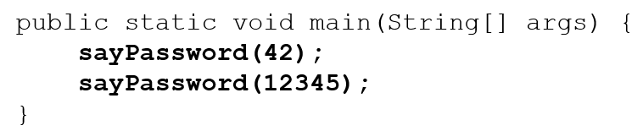
Passing a Parameter
Calling a method and specifying values for its parameters
name (expression);
Example:
Output:
The password is 42
The password is 12345
Notes:
You have already called System.out.println and passed parameters to it.

Slide 7
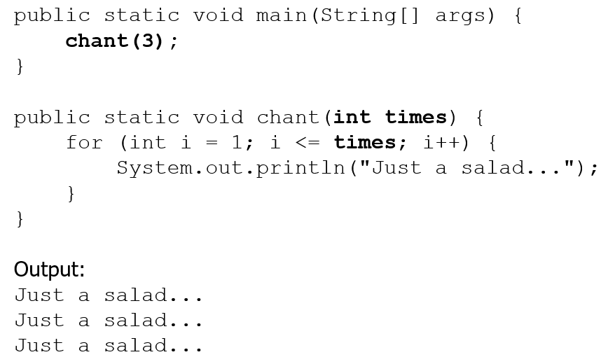
Parameters and Loops
A parameter can guide the number of repetitions of a loop.

Slide 8
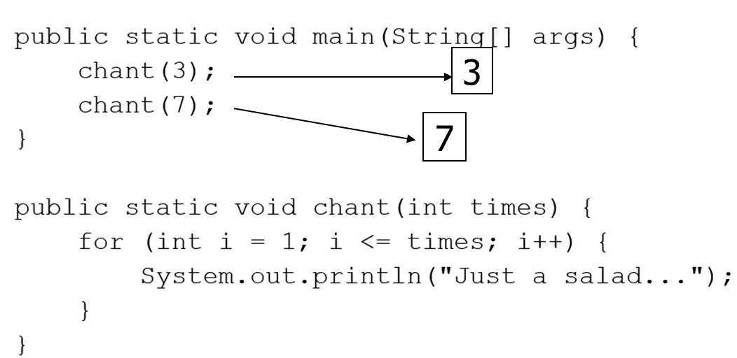
How Parameters are Passed
When the method is called:
The value is stored into the parameter variable.
The method’s code executes using that value.

Slide 9
Common Errors
If a method accepts a parameter, it is illegal to call it without passing any value for that parameter.
chant(); // Error: parameter value required
The value passed to a method must be of the correct type.
chant(3.7); // Error: must be of type int
Exercise: Change the Stars program to use a parameterized method for drawing lines of stars.

Slide 10
In-Class Assignment 1, Part 1
Create the class Stars in BluJ
Have the main program call a method called line, with a single parameter, like this:
line(6);
line(10);
Create the method called line that has a single integer parameter. Use a for loop to draw a line of stars. This for loop should use the parameter in its condition.

Slide 11
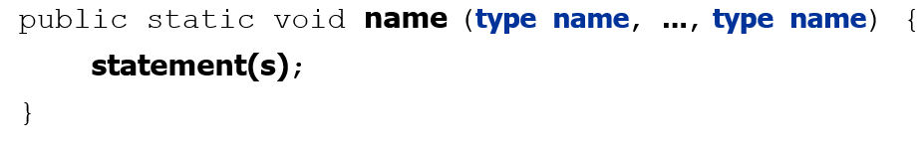
Multiple Parameters
A method can accept multiple parameters. (separate by , )
When calling it, you must pass values for each parameter.
Declaration:
Call:
methodName (value, value, ..., value);

Slide 12
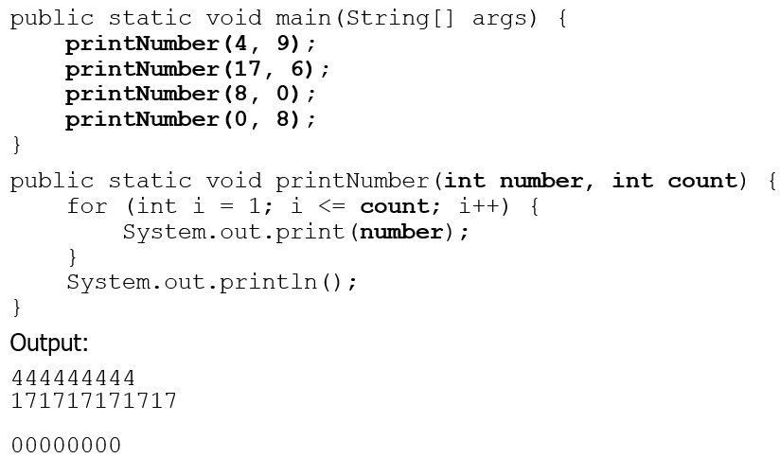
Multiple Params Example
Modify the Stars program to draw boxes with parameters.

Slide 13
In-Class Assignment 1, Part 2
In the Stars class, define another method named box, which has two integer parameters, one for the length of the box and the other for the width of the box.
Use nested for loops to draw the box, following these directions:
The top and bottom rows of the box should be solid lines (so call the line() method).
The rows in between should have one star on each end and blanks in between them.
Think about how you would express the number of rows in between in terms of one of the parameters
Think about how you would express the number of blanks in terms of one of the parameters.
Call the box method from the main program, like this: box(10,3);

Slide 14
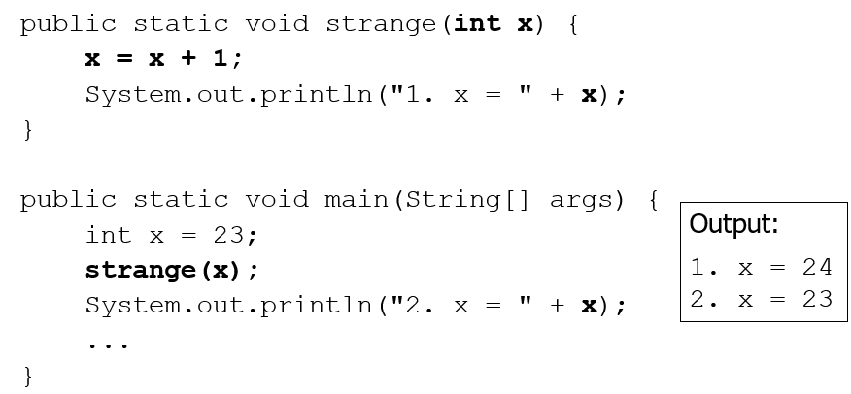
Value Semantics
value semantics: When primitive variables (int, double) are passed as parameters, their values are copied.
Modifying the parameter will not affect the variable passed in.

Slide 15
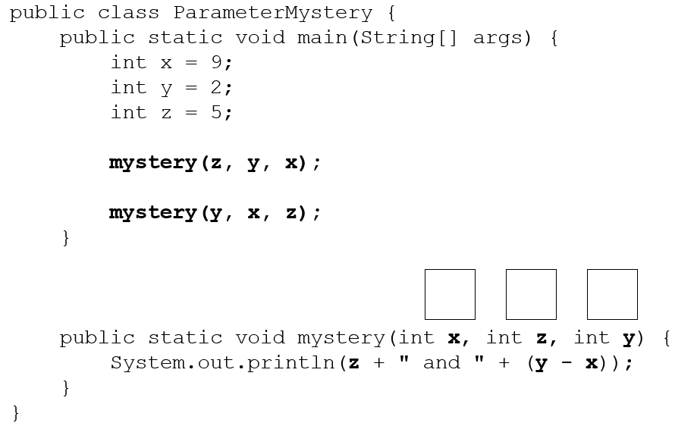
“Parameter Mystery” Problem
Notes:
Output:
2 and 4
9 and 3

Slide 16
Overloading
value semantics: When primitive variables (int, double) are passed as parameters, their values are copied.
Modifying the parameter will not affect the variable passed in.

Slide 17
In-Class Assignment 1, Part 3
In the Stars class, add two integer variables to main: len and wid.
Give these variables any values you want, although make sure the value for len is greater than the value for wid.
Call the line and box methods from main using these variables.
Define another method called box() that has no parameters and draws a box of length 11 and width 5.
Call the box() method from main.

Slide 18
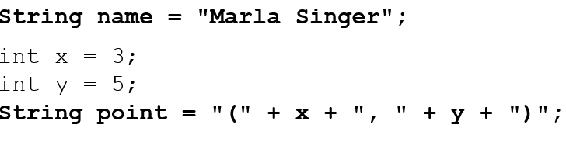
Strings 1
string: A sequence of text characters.
String name = “text”;
String name = expression;
Examples:

Slide 19
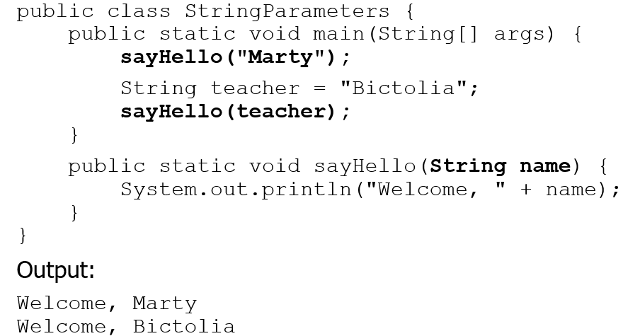
Strings as Parameters
Modify the Stars program to use string parameters. Use a method named repeat that prints a string many times.

Slide 20
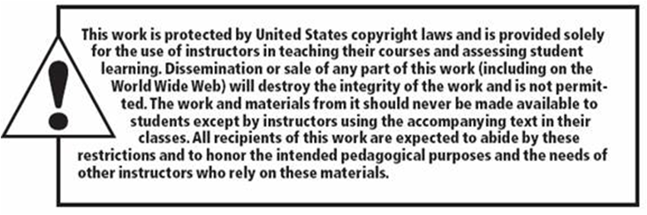
Copyright

