Slide 1
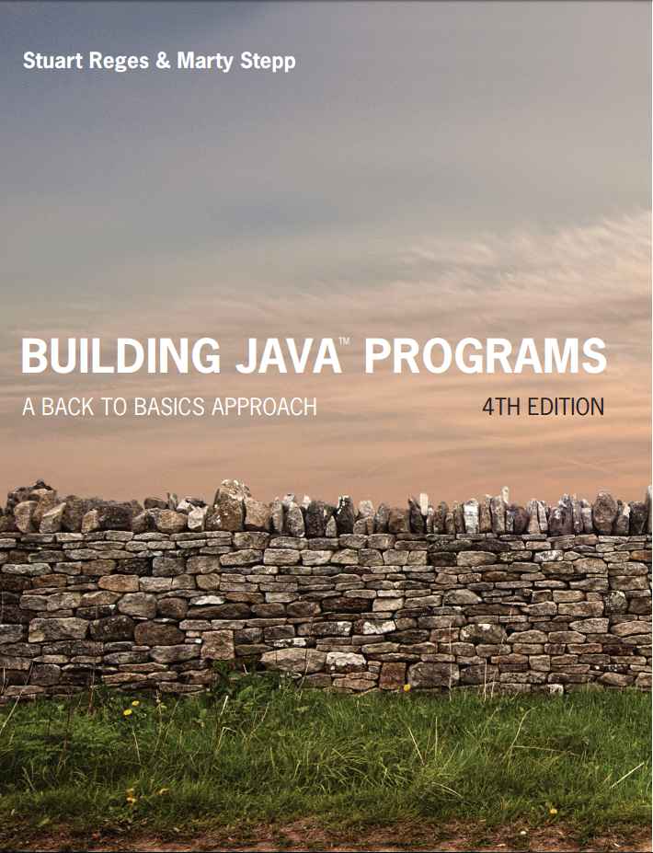
Building Java Programs
Fourth Edition
Chapter 3, Section 3.2
Parameters and Objects
Copyright © 2017, 2014, 2011 Pearson Education, Inc. All Rights Reserved
Notes:
If this PowerPoint presentation contains mathematical equations, you may need to check that your computer has the following installed:
1) MathType Plugin
2) Math Player (free versions available)
3) NVDA Reader (free versions available)

Slide 2
Return Values

Slide 3
Java’s Math Class
Method name | Description
Math.abs(value) | absolute value
Math.ceil(value) | rounds up
Math.floor(value) | rounds down
Math.log10(value) | logarithm, base 10
Math.max(value1, value2) | larger of two values
Math.min(value1, value2) | smaller of two values
Math.pow(base, exp) | base to the exp power
Math.random() | random double between 0 and 1
Math.round(value) | nearest whole number
Math.sqrt(value) | square root
Math.sin(value) Math.cos(value) Math.tan(value) | sine/cosine/tangent of an angle in radians
Math.toDegrees(value) Math.toRadians(value) | convert degrees to radians and back
Constant | Description
Math.E | 2.7182818...
Math.P I | 3.1415926...

Slide 4
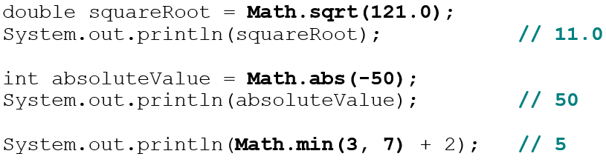
Calling Math Methods
Math.methodName(parameters)
Examples:
The Math methods do not print to the console.
Each method produces (“returns”) a numeric result.
The results are used as expressions (printed, stored, etc.).

Slide 5
Return (1 of 2)
return: To send out a value as the result of a method.
The opposite of a parameter:
Parameters send information in from the caller to the method.
Return values send information out from a method to its caller.
A call to the method can be used as part of an expression.

Slide 6
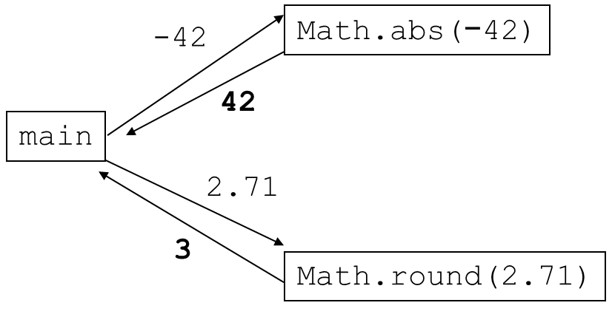
Return (2 of 2)

Slide 7
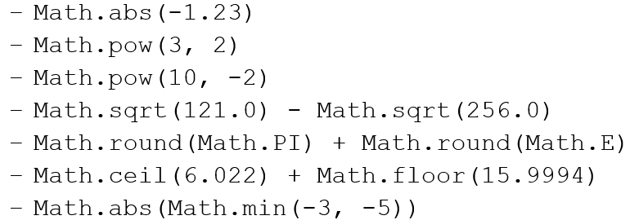
Math Questions
Evaluate the following expressions:
Math.max and Math.min can be used to bound numbers.
Consider an int variable named age.
What statement would replace negative ages with 0?
What statement would cap the maximum age to 40?

Slide 8
Quirks of Real Numbers
Some Math methods return double or other non-int types.
int x = Math.pow(10, 3); // Error: incompat. types
Some double values print poorly (too many digits).
The computer represents doubles in an imprecise way.
System.out.println(0.1 + 0.2);
Instead of 0.3, the output is 0.30000000000000004

Slide 9
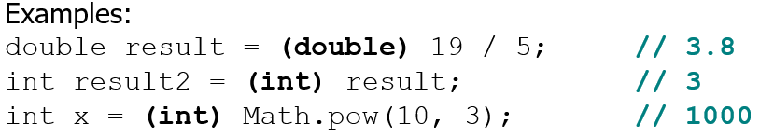
Type Casting
type cast: A conversion from one type to another.
To promote an int into a double to get exact division from /
To truncate a double from a real number to an integer
Syntax:
(type) expression

Slide 10
More About Type Casting
Type casting has high precedence and only casts the item immediately next to it.
You can use parentheses to force evaluation order.
A conversion to double can be achieved in other ways.

Slide 11
In-Class Assignment 1, Part 1
Create the class MathStuff in BluJ
Create a main program and then display each of the following (declaring variables is optional):
Math.pow(8,3);
Math.ceil(4.22);
Math.round(4.22);
Math.floor(4.75);
Math.round(4.75);

Slide 12
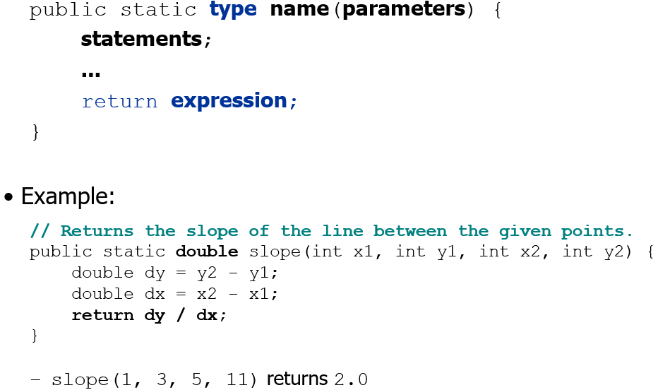
Returning a Value

Slide 13
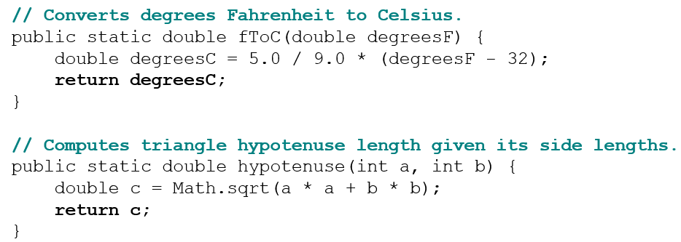
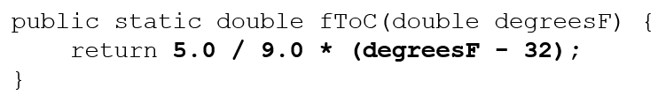
Return Examples
You can shorten the examples by returning an expression:

Slide 14
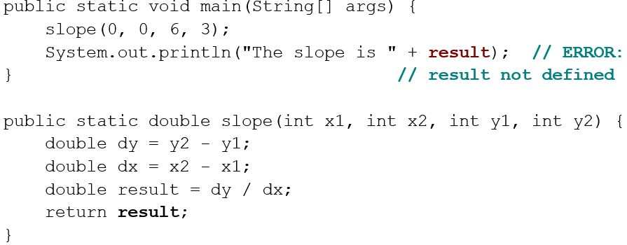
Common Error: Not Storing
Many students incorrectly think that a return statement sends a variable’s name back to the calling method.

Slide 15
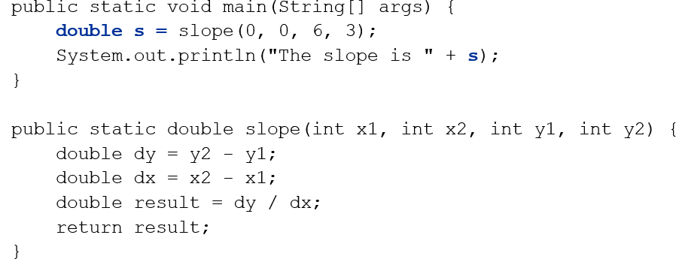
Fixing the Common Error
Instead, returning sends the variable’s value back.
The returned value must be stored into a variable or used in an expression to be useful to the caller.

Slide 16
In-Class Assignment 1, Part 2
In the MathStuff class, define the following two methods:
area – calculates the area of a circle; requires one double parameter for the radius; returns an integer value
volume - calculates the volume of a sphere; requires one double parameter for the radius; returns an integer value
Use a local variable in one of your defined methods to return the value.
You will need to use the Math.pow() method and type casting in both of the defined methods.

Slide 17

Copyright

