Slide 1
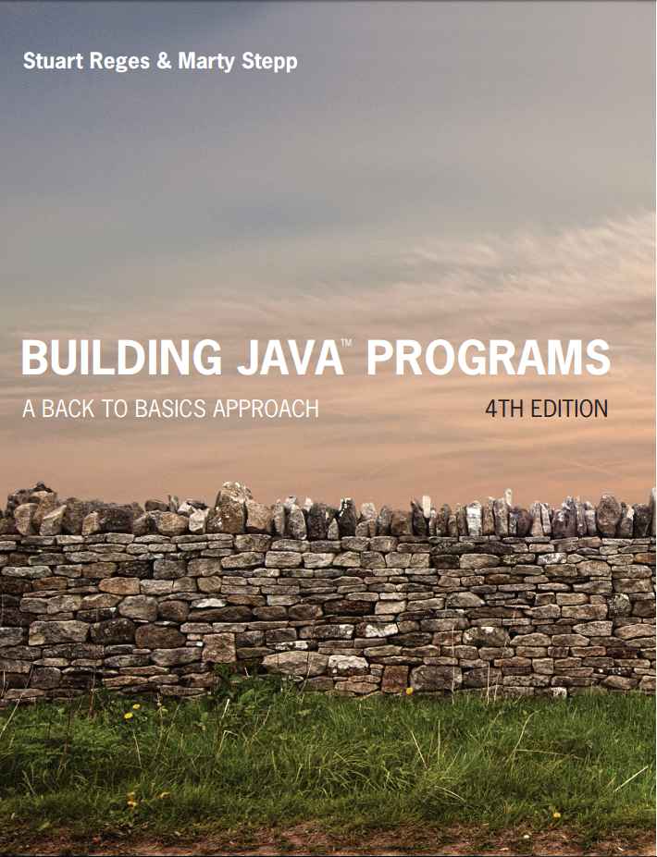
Building Java Programs
Fourth Edition
Chapter 3, Section 3.3
Parameters and Objects
Copyright © 2017, 2014, 2011 Pearson Education, Inc. All Rights Reserved
Notes:
If this PowerPoint presentation contains mathematical equations, you may need to check that your computer has the following installed:
1) MathType Plugin
2) Math Player (free versions available)
3) NVDA Reader (free versions available)

Slide 2
Objects and Classes; Strings

Slide 3
Classes and Objects
class: A program entity that represents either:
1. A program / module, or
2. A type of objects.
A class is a blueprint or template for constructing objects.
Example: The DrawingPanel class (type) is a template for creating many DrawingPanel objects (windows).
Java has 1000s of classes. Later (Ch.8) we will write our own.
object: An entity that combines data and behavior.
object-oriented programming (OOP): Programs that perform their behavior as interactions between objects.

Slide 4
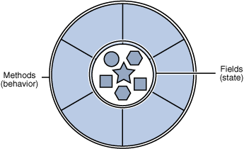
Objects
object: An entity that contains data and behavior.
data: variables inside the object
behavior: methods inside the object
You interact with the methods; the data is hidden in the object.
Constructing (creating) an object:
Type objectName = new Type(parameters;
Calling an object’s method:
objectName.methodName(parameters);

Slide 5
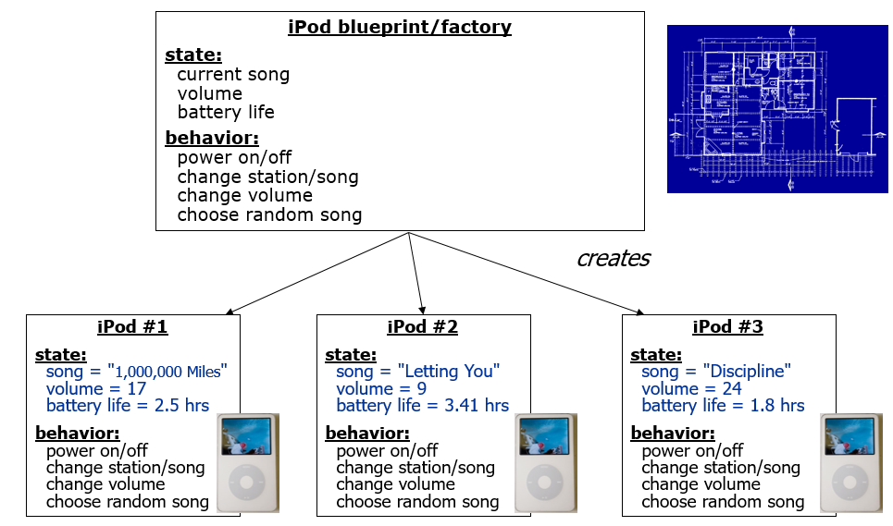
Blueprint Analogy

Slide 6
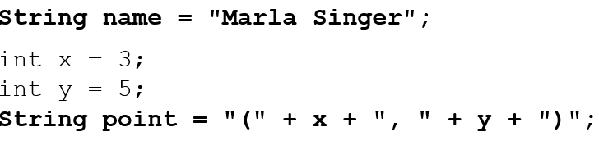
Strings 1
string: A sequence of text characters.
String name = “text”;
String name = expression;
Examples:

Slide 7
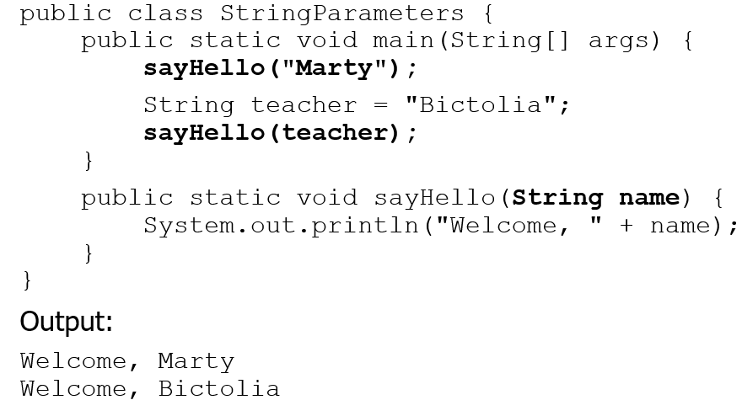
Strings as Parameters
Modify the Stars program to use string parameters. Use a method named repeat that prints a string many times.

Slide 8
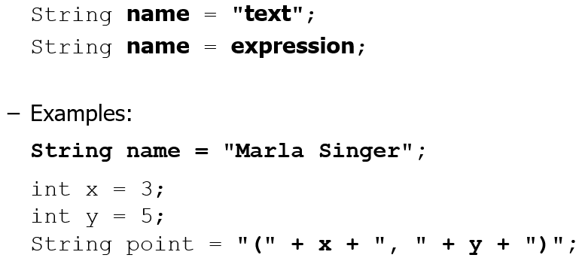
Strings 2
string: An object storing a sequence of text characters.
Unlike most other objects, a String is not created with new.

Slide 9
Indexes
Characters of a string are numbered with 0-based indexes: String name = “R. Kelly”;
index | 0 | 1 | 2 | 3 | 4 | 5 | 6 | 7
character | R | . | blank | K | e | l | l | y
First character’s index : 0
Last character’s index : 1 less than the string's length
The individual characters are values of type char (seen later)

Slide 10
String Methods
Method name | Description
indexOf(str) | index where the start of the given string appears in this string (−1 if not found)
length() | number of characters in this string
substring(index1, index2) or substring(index1) | the characters in this string from index1 (inclusive) to index2 (exclusive); if index2 is omitted, grabs till end of string
toLowerCase() | a new string with all lowercase letters
toUpperCase() | a new string with all uppercase letters
These methods are called using the dot notation:

Slide 11
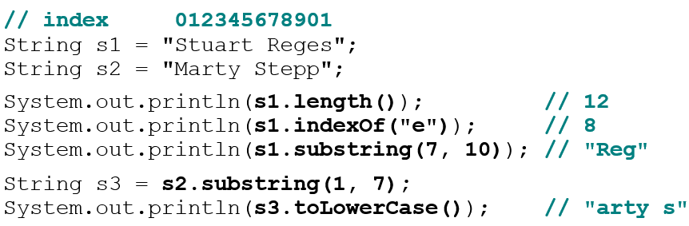

String Method Examples
Given the following string:
How would you extract the word “Java” ?

Slide 12
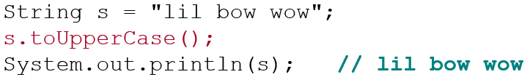
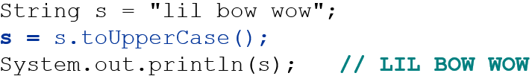
Modifying Strings
Methods like substring and toLowerCase build and return a new string, rather than modifying the current string.
To modify a variable’s value, you must reassign it:

Slide 13
In-Class Assignment 2, Part 1
Create the class StringStuff in BluJ
Declare a string variable named beatles and give it the value “johnpaulgeorgeringo”.
Display the results of the following methods (using variables is optional):
beatles.length();
beatles.indexOf(“l”); // letter l, not number 1
beatles.substring(4,9);
beatles.indexOf(“o”);
beatles.substring(8);
beatles.toUpperCase();

Slide 14
Interactive Programs with Scanner

Slide 15
Input and System.in
interactive program: Reads input from the console.
While the program runs, it asks the user to type input.
The input typed by the user is stored in variables in the code.
Can be tricky; users are unpredictable and misbehave.
But interactive programs have more interesting behavior.
Scanner: An object that can read input from many sources.
Communicates with System.in (the opposite of System.out)
Can also read from files (Ch. 6), web sites, databases, ...

Slide 16
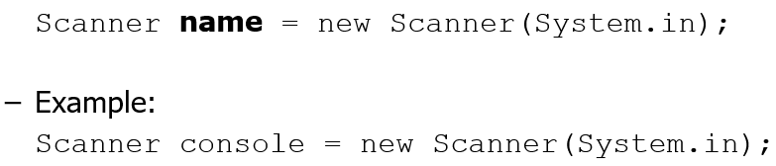
Scanner Syntax
The Scanner class is found in the java.util package.
Constructing a Scanner object to read console input:

Slide 17

Scanner Methods
Method | Description
nextInt() | reads an int from the user and returns it
nextDouble() | reads a double from the user
next() | reads a one-word String from the user
nextLine() | reads a one-line String from the user
Each method waits until the user presses Enter.
The value typed by the user is returned.
prompt: A message telling the user what input to type.

Slide 18
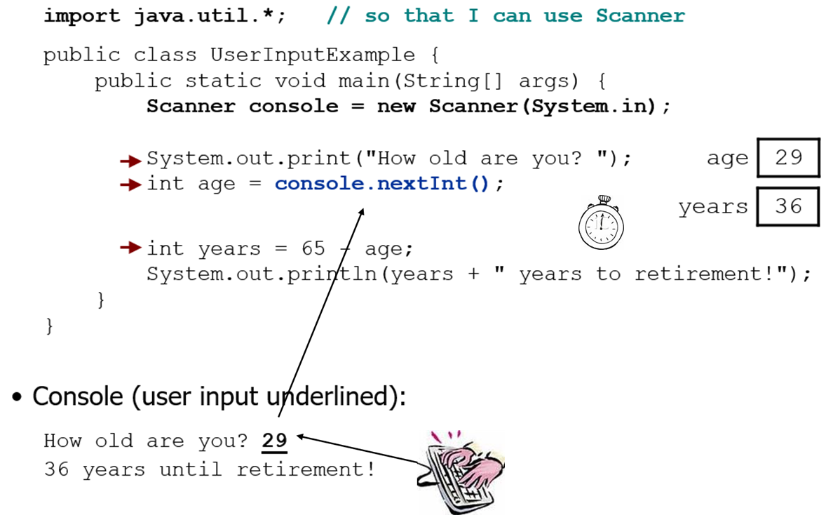
Scanner Example
Notes:
It's also useful to write a program that prompts for multiple values, both on the same line or each on its own line.

Slide 19
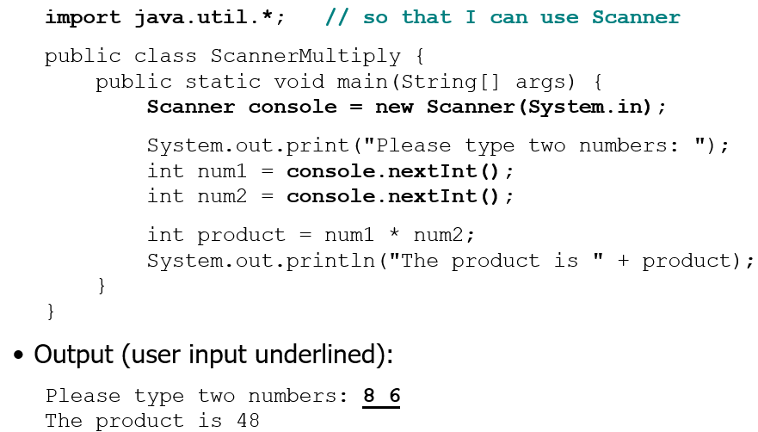
Scanner Example 2
The Scanner can read multiple values from one line.
Notes:
It's also useful to write a program that prompts for multiple values, both on the same line or each on its own line.

Slide 20
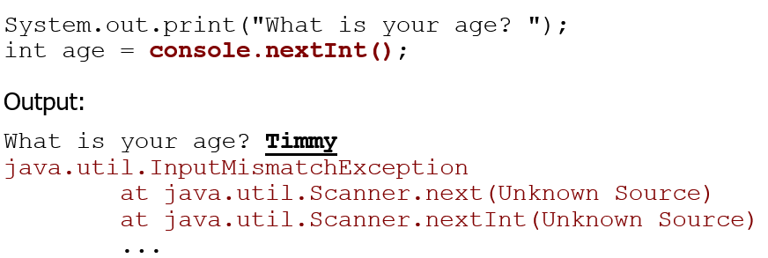
Input Tokens
token: A unit of user input, as read by the Scanner.
Tokens are separated by whitespace (spaces, tabs, new lines).
How many tokens appear on the following line of input?
23 John Smith 42.0 “Hello world” $2.50 “19”
When a token is not the type you ask for, it crashes.

Slide 21
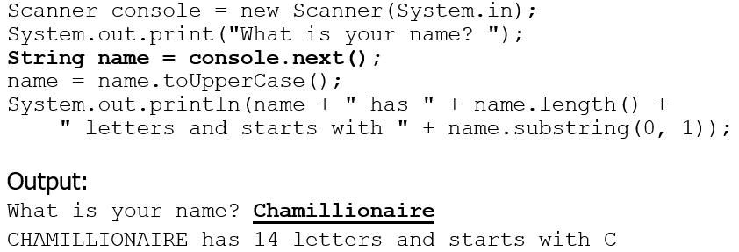

Strings as User Input
Scanner’s next method reads a word of input as a String.
The nextLine method reads a line of input as a String.

Slide 22
In-Class Assignment 2, Part 2
In the StringStuff class, add the following line to the top of your code:
import java.util.*;
Create a Scanner object named keyboard for system input.
Add the following code to your program:
Prompt the user to enter their first name.
Prompt the user to enter how many siblings they have (it’s OK to enter 0 if the user is an only child).
Prompt the user to enter the name of their favorite soccer team (be sure the team name has more than one word).
Display the three input data times in a single sentence.

Slide 23

Copyright

