Slide 1
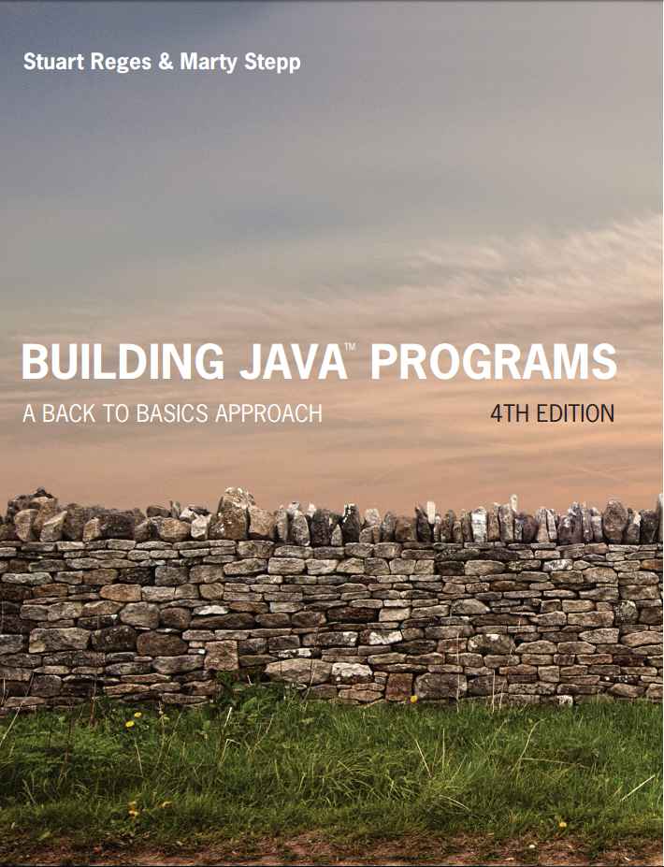
Building Java Programs
Fourth Edition
Chapter 8
Classes
Copyright © 2017, 2014, 2011 Pearson Education, Inc. All Rights Reserved
Notes:
If this PowerPoint presentation contains mathematical equations, you may need to check that your computer has the following installed:
1) MathType Plugin
2) Math Player (free versions available)
3) NVDA Reader (free versions available)

Slide 2
A Programming Problem
Given a group of rectangles which have the following lengths and widths:
3.4 ft, 6.8 ft
12.6 ft, 5.2 ft
7.5 ft, 11.7 ft
Write a program that displays the dimensions of each rectangle, along with the perimeter and area of each rectangle.
Perimeter = sum of all sides = 2*Length + 2*Width
Area = Length * Width

Slide 3
Observations
The data in this problem is a set of dimensions.
It would be better stored as Rectangle objects.
Each object would store a specific rectangle’s length and width
We could then calculate the perimeter and area of each rectangle within its own object.
All values could either be displayed by its object or by another program that has access to the object.
Such a program is known as a client program.

Slide 4
Classes and Objects
class: A program entity that represents either:
A program / module, or
A template for a new type of objects.
The Rectangle class is a template for creating Rectangle objects.
object: An entity that combines state and behavior.
Object-oriented programming (O O P): Programs that perform their behavior as interactions between objects.

Slide 5
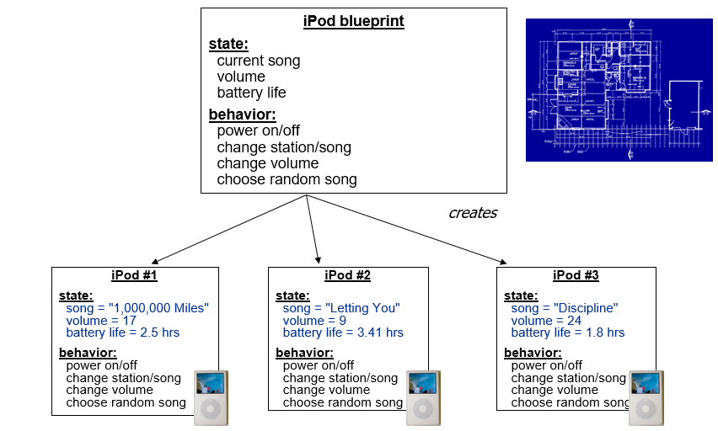
Blueprint Analogy - iPods

Slide 6
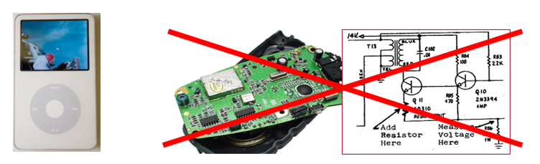
Abstraction
abstraction: A distancing between ideas and details.
We can use objects without knowing how they work.
abstraction in an i Pod:
You understand its external behavior (buttons, screen).
You don’t understand its inner details, and you don’t need to.

Slide 7
Our Task
In the following slides, we will implement a Rectangle class as a way of learning about defining classes.
We will define a type of objects named Rectangle.
Each Rectangle object will contain length and width
Each Rectangle object will contain behaviors called methods.
Client programs will use the Rectangle objects.
main() is considered a client program

Slide 8
Rectangle class (design)
Data in each Rectangle object:
Field name | Description
length | the rectangle’s length
width | the rectangle’s width
Methods in each Rectangle object:
Method name | Description
setLength(l) | sets the rectangle’s length to the given value
setWidth(w) | Sets the rectangle’s width to the given value
getPerimeter() | Calculates the perimeter of the rectangle
getArea() | Calculates the area of the rectangle

Slide 9
Object State: Fields
Notes:
If this PowerPoint presentation contains mathematical equations, you may need to check that your computer has the following installed:
1) MathType Plugin
2) Math Player (free versions available)
3) NVDA Reader (free versions available)

Slide 10
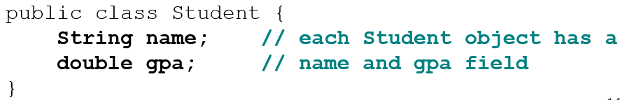
Fields
field: A variable inside an object that is part of its state.
Each object has its own copy of each field.
Declaration syntax:
type name;
Example: suppose we have a class Student

Slide 11
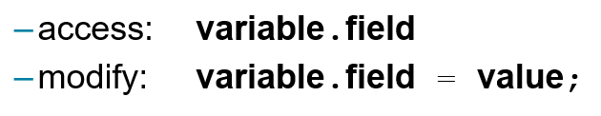
Accessing Fields
Other classes can access/modify an object’s fields.
Example (in main(), which is client program):
Student s1 = new Student();
Student s2 = new Student();
System.out.println(“Student name: “ + s1.name);
s2.gpa = 3.5;

Slide 12
Object Behavior: Methods

Slide 13
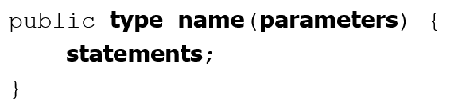
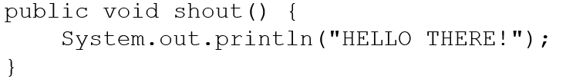
Instance Methods
instance method (or object method): Exists inside each object of a class and gives behavior to each object.
same syntax as static methods, but without static keyword
Example:

Slide 14
Instance Method Example
public class Student {
String name;
double gpa;
public displayData() {
System.out.println(“Name: “ + name);
system.out.printf(“GPA = %.2f”, gpa);
} // end displayData
} // end class Student
In most cases, class methods should not be static
If static, cannot be reused without copying and pasting method code into each client’s program.

Slide 15
In-Class Assignment 1, Part 1
Create the project Rectangle in BlueJ.
In this project, create a class named Rectangle. Do not create a main program for this class.
Within this class, do the following:
Declare two variables of type double named length and width.
Create the following public methods:
getPerimeter() – calculates and returns perimeter
getArea() – calculates and returns the area
Create a second class in the project named RecClient that has a main program. In the main program do the following:
Create an object of the Rectangle class named r1.
Set the length of r1 to 5.5 and the width of r1 to 6.3
Display the length and width of r1.
Display the perimeter of r1 by calling getPerimeter() within System.out.printf so the perimeter is rounded to two decimal places.
Display the area of r1 in the same way by calling getArea().

Slide 16
Kinds of Methods
accessor: A method that lets clients examine object state.
Examples: getName(), getGPA()
often has a non-void return type
mutator: A method that modifies an object’s state.
Examples: setName(), setGPA()
often has void type

Slide 17
The Implicit Parameter
implicit parameter: The object on which an instance method is called.
During the call p1.draw(g); the object referred to by p1 is the implicit parameter.
During the call p2.draw(g); the object referred to by p2 is the implicit parameter.
The instance method can refer to that object’s fields.
We say that it executes in the context of a particular object.
draw can refer to the x and y of the object it was called on.

Slide 18
Object initialization: constructors

Slide 19
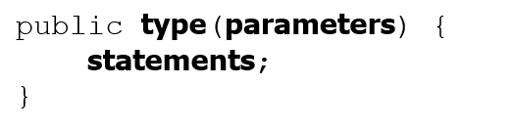
Constructors
constructor: Initializes the state of new objects.
runs when the client uses the new keyword
The type is always the class name.
no return type is specified; it implicitly “returns” the new object being created
If a class has no constructor, Java gives it a default constructor with no parameters that sets all fields to 0.

Slide 20
Constructor Example
public class Student {
String name;
double gpa;
public Student(String n, double g) {
name = n;
gpa = g;
} // end constructor
public displayData() {
System.out.println(“Name: “ + name);
System.out.printf(“GPA = %.2f”, gpa);
} // end displayData
} // end Student class
In main: Student s2 = new Student(“John Smith”, 3.2);

Slide 21
In-Class Assignment 1, Part 2
Update the Rectangle class by doing the following:
Add a constructor with two double parameters, one for length, one for width.
Within the constructor, set each class variable to its respective parameter.
In the main program do the following:
Use the constructor in the declaration of the r1 object to set the length to 5.5 and the width to 6.3 (this is one line of code that uses the constructor).
Create a second object of the rectangle class named r2 with length 11.5 and width 7.9
Display the length and width of r1 as done previously.
Display the perimeter and area of r1 by calling getPerimeter() and getArea() within System.out.printf so the perimeter is rounded to two decimal places.
Display the length, width, perimeter, and area of r2 in the same way as r1.

Slide 22
Encapsulation

Slide 23
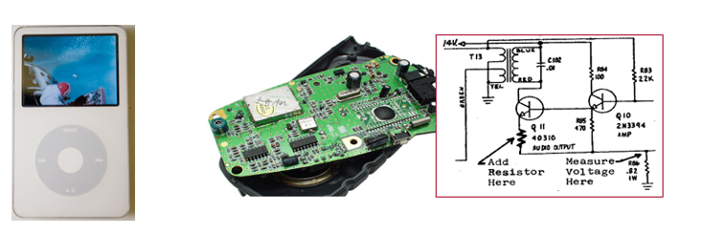
Encapsulation
encapsulation: Hiding implementation details from clients.
Encapsulation forces abstraction.
separates external view (behavior) from internal view (state)
protects the integrity of an object’s data

Slide 24


Private Fields
A field that cannot be accessed from outside the class
Examples:
Client code won’t compile if it accesses private fields:

Slide 25
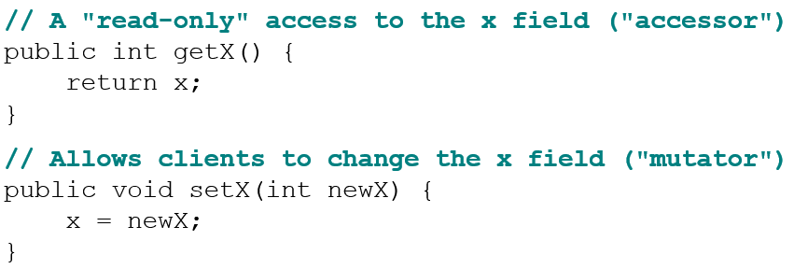
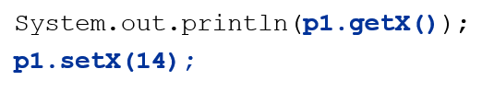
Accessing Private Fields
Client code will look more like this:

Slide 26
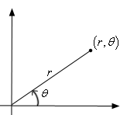
Benefits of Encapsulation
Abstraction between object and clients
Protects object from unwanted access
Example: Can’t fraudulently increase an Account’s balance.
Can change the class implementation later
Example: Point could be rewritten in polar
with the same methods.
Can constrain objects’ state (invariants)
Example: Only allow Accounts with non-negative balance.
Example: Only allow Dates with a month from 1-12.

Slide 27
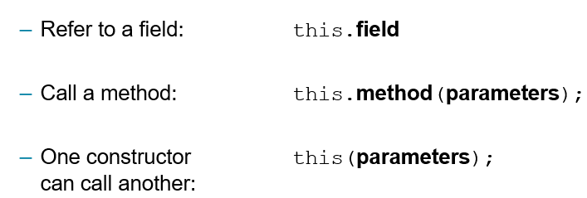
The this Keyword
this : Refers to the implicit parameter inside your class.
(a variable that stores the object on which a method is called)

Slide 28
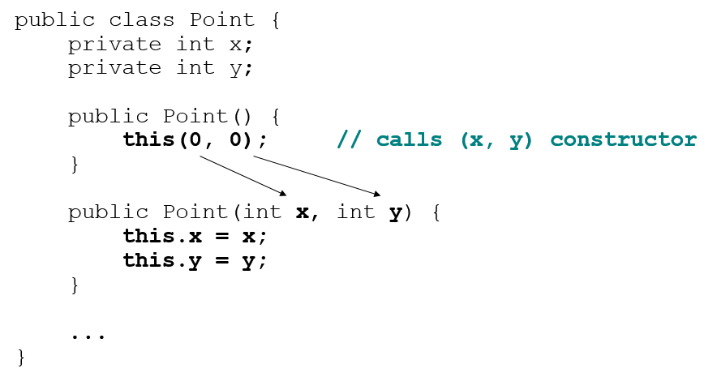
Calling Another Constructor
Avoids redundancy between constructors
Only a constructor (not a method) can call another constructor

Slide 29
In-Class Assignment 1, Part 3
Update the Rectangle class by doing the following:
Make the length and width private fields.
Add public methods getLength() and getWidth() of type double that return the length and width, respectively.
In the main program do the following:
Display the length and width of r1 using the getLength() and getWidth() methods.
Display the perimeter of r1 by calling getPerimeter() within System.out.printf so the perimeter is rounded to two decimal places.
Display the length, width, perimeter, and area of r2 in the same way as r1.

Slide 30
Summary of Java Classes
A class is used for any of the following in a large program:
a program : Has a main and perhaps other static methods.
example: GuessingGame, Birthday, MadLibs, CritterMain
does not usually declare any static fields (except final)
an object class : Defines a new type of objects.
example: Point, BankAccount, Date, Critter, FratGuy
declares object fields, constructor(s), and methods
might declare static fields or methods, but these are less of a focus
should be encapsulated (all fields and static fields private)
a module : Utility code implemented as static methods.
example: Math

Slide 31
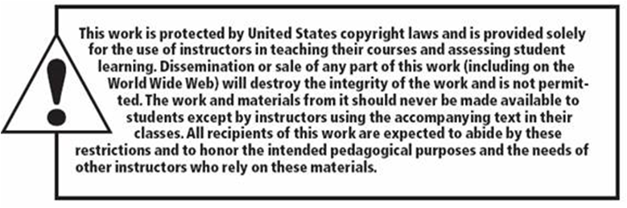
Copyright

