Slide 1
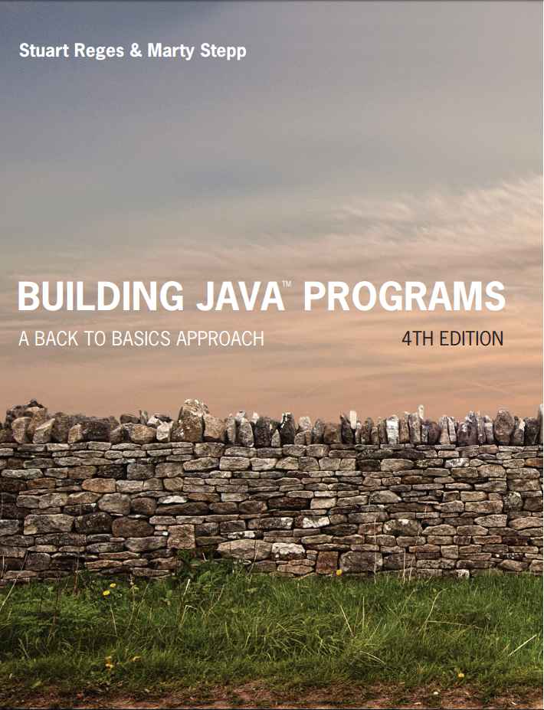
Building Java Programs
Fourth Edition
Chapter 4, Section 4.2
Conditional Execution
Copyright © 2017, 2014, 2011 Pearson Education, Inc. All Rights Reserved
Notes:
If this PowerPoint presentation contains mathematical equations, you may need to check that your computer has the following installed:
1) MathType Plugin
2) Math Player (free versions available)
3) NVDA Reader (free versions available)

Slide 2
Cumulative Algorithms

Slide 3
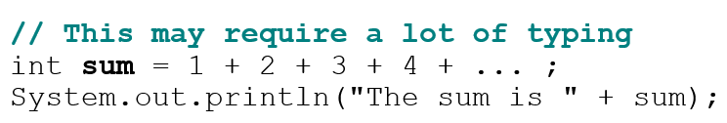
Adding Many Numbers
How would you find the sum of all integers from 1-1000?
What if we want the sum from 1 - 1,000,000? Or the sum up to any maximum?
How can we generalize the above code?

Slide 4
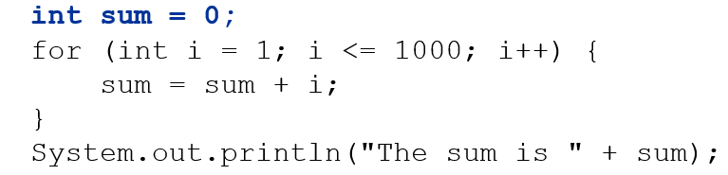
Cumulative Sum Loop
cumulative sum: A variable that keeps a sum in progress and is updated repeatedly until summing is finished.
The sum in the above code is an attempt at a cumulative sum.
Cumulative sum variables must be declared outside the loops that update them, so that they will still exist after the loop.

Slide 5
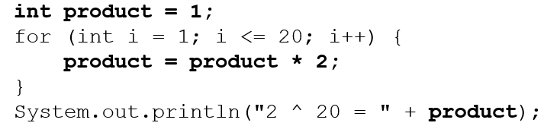
Cumulative Product
This cumulative idea can be used with other operators:
How would we make the base and exponent adjustable?

Slide 6
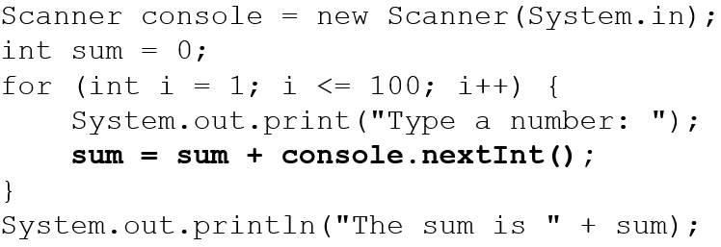
Scanner and Cumul. sum
We can do a cumulative sum of user input:

Slide 7
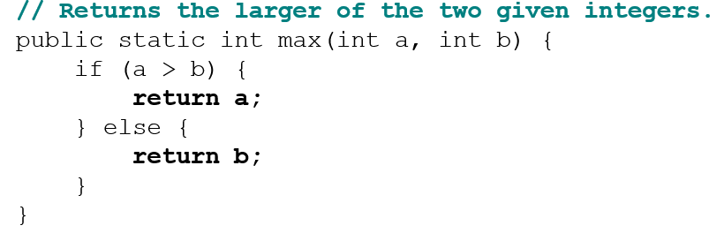
if/else with Return
Methods can return different values using if/else
Whichever path the code enters, it will return that value.
Returning a value causes a method to immediately exit.
All paths through the code must reach a return statement.

Slide 8
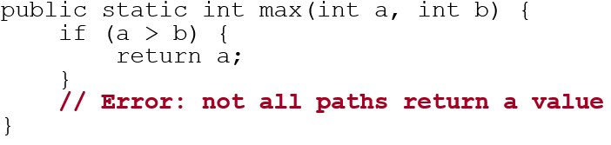
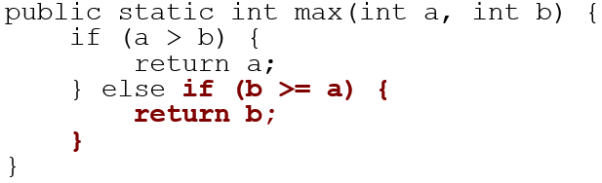
All Paths must Return
The following also does not compile:
The compiler thinks if/else/if code might skip all paths, even though mathematically it must choose one or the other.

Slide 9
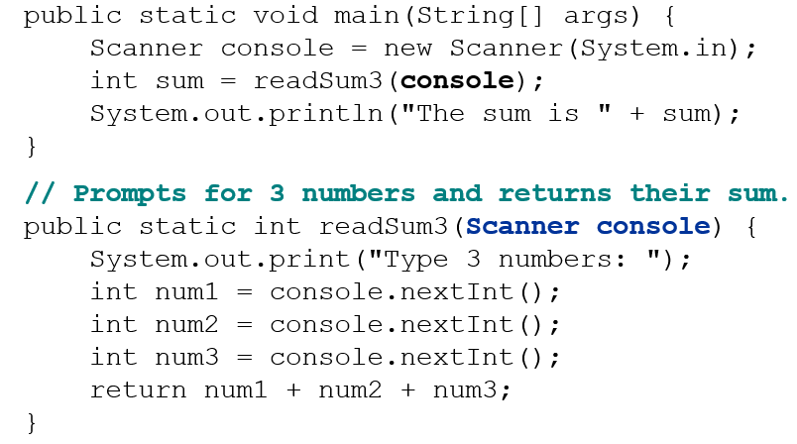
Scanners as Parameters
If many methods need to read input, declare a Scanner in main and pass it to the other methods as a parameter.

Slide 10
In-Class Assignment 2, Part 1
Create the class Numbers in BluJ
In the main program, do the following:
Prompt the user to an integer value for how many numbers will be entered.
Call a method named average that has an integer parameter and a Scanner parameter and returns a String. The number entered and the Scanner object in main() will be passed to it.
This method will do the following:
If the number is greater than 0:
Use a for loop to prompt the user to input numbers and add them to a total variable.
Divide this total by the parameter passed to it to get the average and use it in a sentence: “The average is 12.0”.
If the number is less than or equal to 0:
Return a message saying “There is no average.”

Slide 11
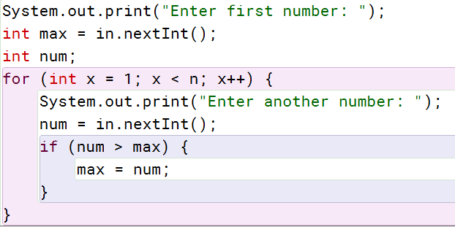
Maximum Value
We can find the maximum largest value of a group of numbers
Assume the variable n represents how many numbers will be entered and in is a Scanner object:

Slide 12
In-Class Assignment 2, Part 2
Add the following to the main() in the Number class program:.
Call a method named getMax() that has an integer parameter and a Scanner parameter and returns a String. The number entered and the Scanner object in main() will be passed to it.
This method will do the following:
If the number is greater than 0:
Prompt the user to enter the first number in a variable named max.
Use a for loop to prompt the user to input numbers and compare each one to the max variable.
If the current number is greater than max, set max equal to this number.
If the number is less than or equal to 0:
Return a message saying “There is no maximum.”

Slide 13
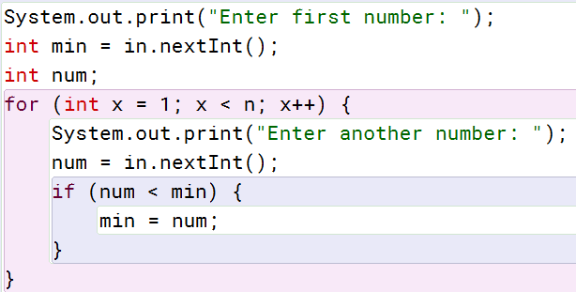
Minimum Value
We can find the minimum largest value of a group of numbers
Assume the variable n represents how many numbers will be entered and in is a Scanner object:

Slide 14
In-Class Assignment 2, Part 3
Add the following to the main() in the Number class program:.
Call a method named getMin() that has an integer parameter and a Scanner parameter and returns a String. The number entered and the Scanner object in main() will be passed to it.
This method will do the following:
If the number is greater than 0:
Prompt the user to enter the first number in a variable named min.
Use a for loop to prompt the user to input numbers and compare each one to the max variable.
If the current number is less than min, set min equal to this number.
If the number is less than or equal to 0:
Return a message saying “There is no minimum.”

Slide 15
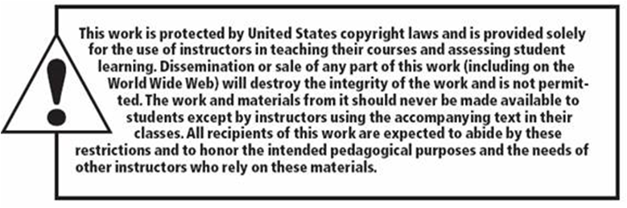
Copyright

