Slide 1
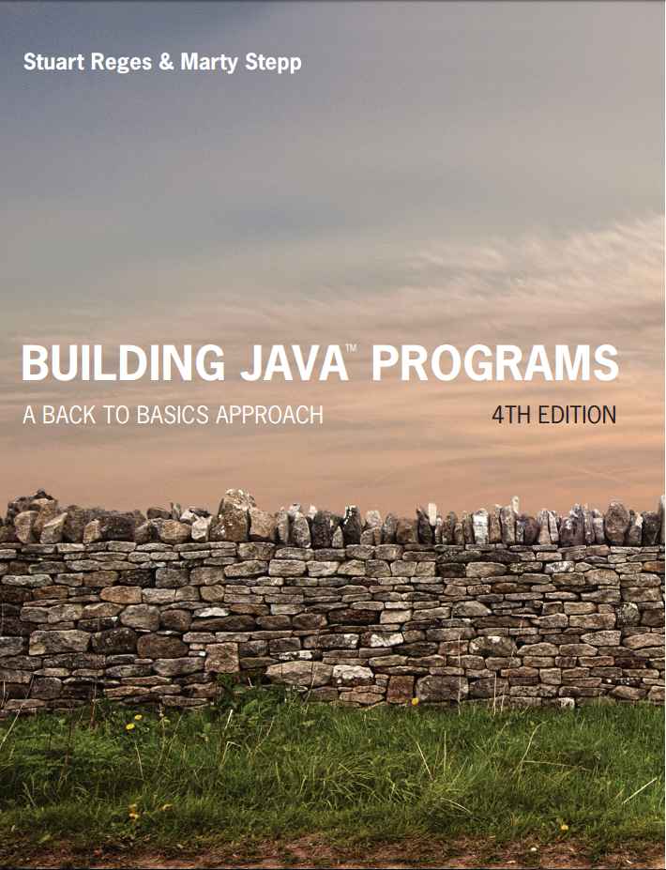
Building Java Programs
Fourth Edition
Chapter 4, Section 4.3
Conditional Execution
Copyright © 2017, 2014, 2011 Pearson Education, Inc. All Rights Reserved
Notes:
If this PowerPoint presentation contains mathematical equations, you may need to check that your computer has the following installed:
1) MathType Plugin
2) Math Player (free versions available)
3) NVDA Reader (free versions available)

Slide 2
Text Processing

Slide 3

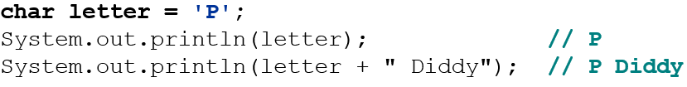
Type Char
char : A primitive type representing single characters.
A String is stored internally as an array of char
index | 0 | 1 | 2 | 3 | 4 | 5
value | ‘A’ | ‘l’ | ‘I’ | ‘ ’ | ‘G’ | ‘.’
It is legal to have variables, parameters, returns of type char
surrounded with apostrophes: ‘a’ or ‘4’ or ‘\n’ or ‘\’

Slide 4
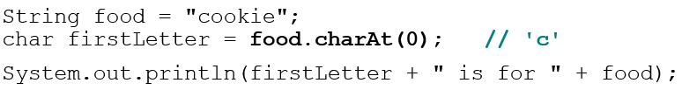
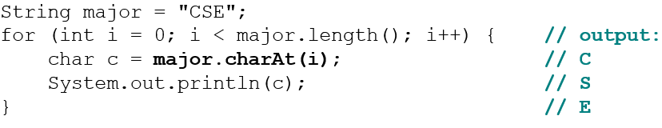
The charAt Method
The chars in a String can be accessed using the charAt method.
accepts an int index parameter and returns the char at that index
You can use a for loop to print or examine each character.

Slide 5
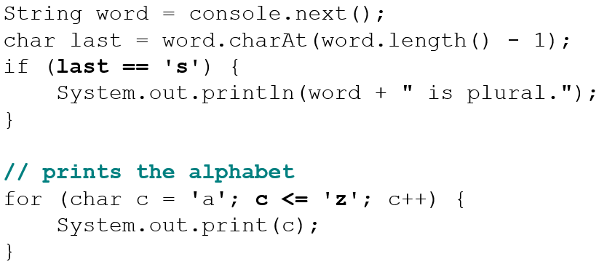
Comparing Char Values
You can compare chars with ==, !=, and other operators:

Slide 6

Char Versus Int
Each char is mapped to an integer value internally
Called an A S C I value
Mixing char and int causes automatic conversion to int.
To convert an int into the equivalent char, type-cast it.

Slide 7
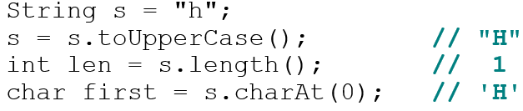
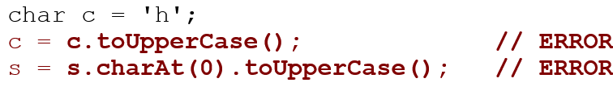
Char vs. String
“h” is a String, but ‘h’ is a char (they are different)
A String is an object; it contains methods.
A char is primitive; you can’t call methods on it.
So what do you do if want to see if a char is a letter, a number, or upper case?? (next slide, please…)

Slide 8
Character Class
Contains static methods that can be used with char parameters
Method | Description
getNumericValue(ch) | Converts a character that looks like a number into that number.
isDigit(ch) | Returns true if character is one of the digits ‘0’ through ‘9’
isLetter(ch) | Returns true if character is one of the letters ‘a’ through ‘z’
isLowerCase(ch) | Returns true if character is a lower-case letter
isUpperCase(ch) | Returns true if character is an upper-case letter
toLowerCase(ch) | Returns the lower-case version of the letter
toUpperCase(ch) | Returns the upper-case version of the letter
Examples:
Character.getNumericValue(‘3’) // returns 3
Character.isLetter(‘5’); // returns false
Character.isDigit(‘x’); // returns false
Character.isUpperCase(‘B’); // returns true

Slide 9
In-Class Assignment 1, Part 1
Create the class scanText in BluJ
In the main program, do the following:
Declare a String variable named statement.
Declare the integer variables vowel, consonant, and number and set them to zero.
Prompt the user to type a sentence, store the input in the statement variable, and convert to all upper case.
Set up a for loop that will go from 0 to one less than the length of the string and do the following.
Get each individual character using the charAt() method and store it in a char variable named ch.
If ch is a letter, determine if it is a vowel or a consonant and add 1 to the corresponding variable.
If ch is a number, add 1 to the number variable.
Display values of all integer variables

Slide 10
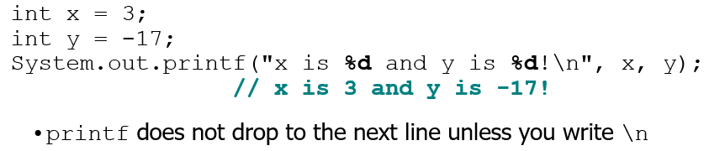
Formatting Text with Printf
A format string can contain placeholders to insert parameters:
%d integer
%f real number
%s string
these placeholders are used instead of + concatenation
Example:

Slide 11
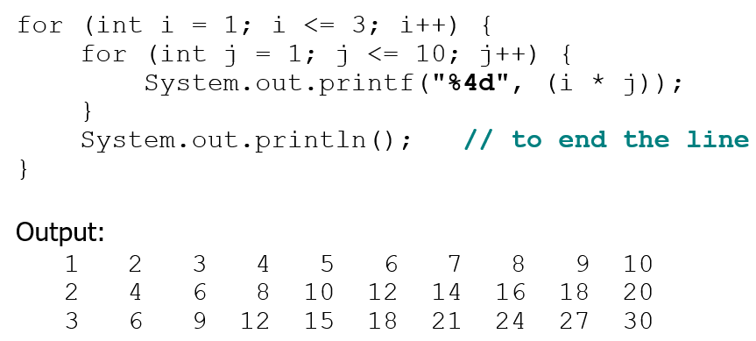
Printf Width
%Wd integer, W characters wide, right-aligned
%-Wd integer, W characters wide, left-aligned
%Wf real number, W characters wide, right-aligned
...

Slide 12
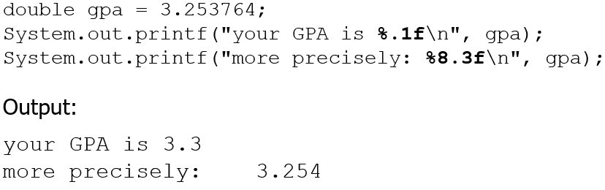
Printf Precision
%.Df real number, rounded to D digits after decimal
%W.Df real number, W chars wide, D digits after decimal
%-W.Df real number, W wide (left-align), D after decimal
3
8

Slide 13
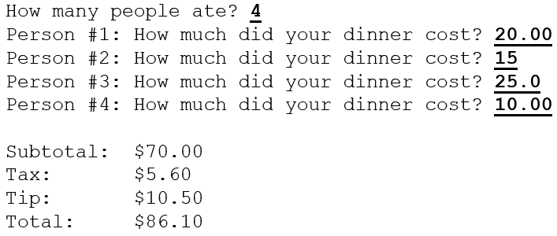
Printf Question
Modify our Receipt program to better format its output.
Display results in the format below, with $ and 2 digits after.
Example log of execution:

Slide 14
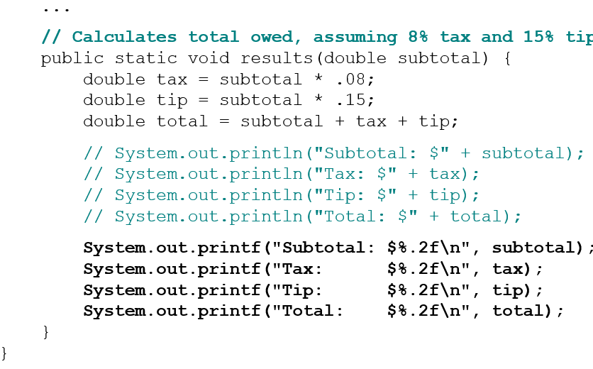
Printf Answer (Partial)

Slide 15
In-Class Assignment 1, Part 2
Create the class Geo in BluJ
In the main program, do the following:
Declare three double variable named radius, area, and volume.
Prompt the user to enter a value for the radius and store this value in the radius variable.
Calculate the area of a circle using the radius variable, the Math.PI constant, and the Math.pow() method. Store this value in the area variable.
Calculate the volume of a sphere using the radius variable, the Math.PI constant, and the Math.pow() method. Store this value in the volume variable.
Display both values in a sentence, using the System.out.printf method to display the values in a field of 10 total spaces, right-aligned, and rounded to 3 digits after the decimal point.

Slide 16
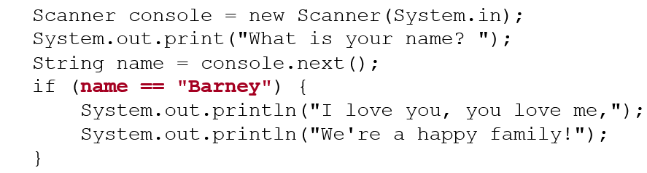
Comparing Strings
Relational operators such as < and == fail on objects.
This code will compile, but it will not print the song.
== compares objects by references (seen later), so it often gives false even when two Strings have the same letters.

Slide 17
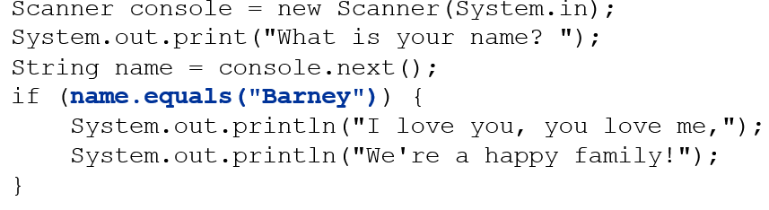
The Equals Method
Objects are compared using a method named equals.
Technically this is a method that returns a value of type boolean, the type used in logical tests.

Slide 18
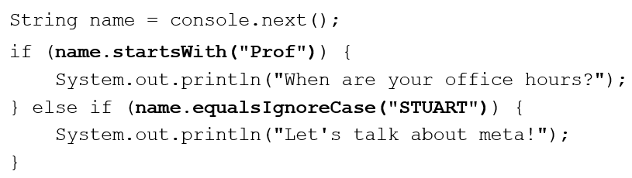
String Test Methods
Method | Description
equals(str) | whether two strings contain the same characters
equalsIgnoreCase(str) | whether two strings contain the same characters, ignoring upper vs. lower case
startsWith(str) | whether one contains other’s characters at start
endsWith(str) | whether one contains other’s characters at end
contains(str) | whether the given string is found within this one

Slide 19

Copyright

