Slide 1
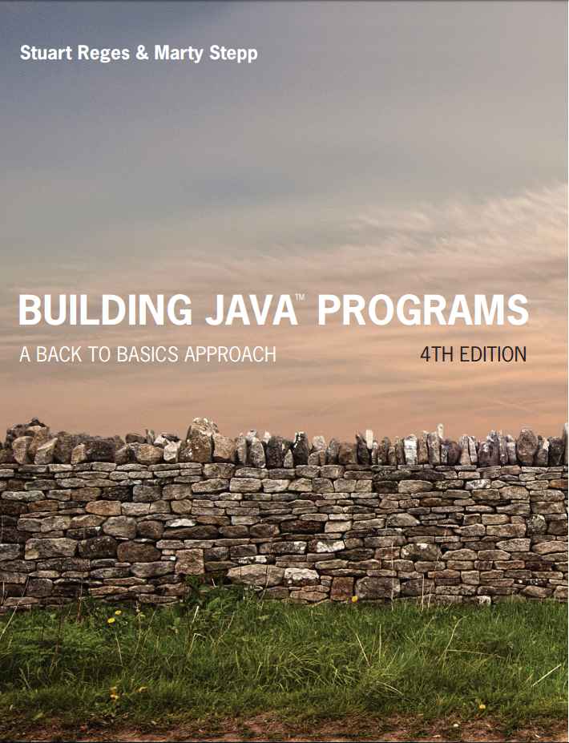
Building Java Programs
Fourth Edition
Chapter 4, Section 4.4
Conditional Execution
Copyright © 2017, 2014, 2011 Pearson Education, Inc. All Rights Reserved
Notes:
If this PowerPoint presentation contains mathematical equations, you may need to check that your computer has the following installed:
1) MathType Plugin
2) Math Player (free versions available)
3) NVDA Reader (free versions available)

Slide 2
Methods with Conditional Execution

Slide 3
Preconditions and Postconditions
Precondition
A condition that must be true before a method executes in order to guarantee that the method can perform its task
Postcondition
A condition that the method guarantees will be true after it finishes executing, as long as the preconditions were true before the method was called.

Slide 4
Factorial Example
The factorial of an integer n, (symbol: n!) is:
n! = n * (n – 1) * (n – 2) * … * 2 * 1, where
0! = 1 and 1! = 1
Code Example:
public static int factorial(int n) {
int product = 1;
for (int i = 2; i <= n; i++) {
product = product * i;
}
return product;
}

Slide 5
Preconditions and Postconditions
Precondition on factorial method
The parameter n must be greater than or equal to 0. It absolutely cannot be a negative number.
Postcondition on factorial method
The method will correctly calculate and return the factorial of the parameter n, as long as the parameter n is greater than or equal to 0.
The method works when n=0 or when n is a positive number.
But…when n is a negative number, the method returns 1…which isn’t right.
So what should we do?

Slide 6
Execptions
Built-in classes in Java that end a program automatically
Use keyword new to create an object
Example:
public static int factorial(int n) {
if (n < 0) {
throw new IllegalArgumentException(“negative n: “+n);
} // no else needed for exceptions
int product = 1;
for (int i = 2; i <= n; i++) {
product = product * I;
}
return product; }
Notes:
Note that == tests equality, not = . The = is used for the assignment operator!

Slide 7
Keep an eye on return values
What problems could happen in the following code?
If x >y or x < y, we’re fine.
But what if x = y? What gets returned?
Nothing!!! But we have to return something, so….
public static int max(int x, int y) {
if (x > y) {
return x;
}
else {
return y;
}
}

Slide 8
Fix for max method
This can be fixed without using an exception by doing this:
If x > y, x gets returned.
If x < y or x = y, y gets returned.
If x and y are equal, it doesn’t matter which one gets returned.
These are examples of “defensive programming”.
public static int max(int x, int y) {
if (x > y) {
return x;
}
return y;
}

Slide 9
In-Class Assignment 1
Create the class ACT in BluJ
In the main program, do the following:
Declare a int variable named score.
Create a Scanner object to be used for user input.
Prompt the user to enter an ACT score and store it in the score variable.
Use System.out.println that will display the score and rating returned from a method called rating.
In the rating method, which is of type String and has an integer parameter, do the following:
Throw an IllegalArgumentException if the score is less than 1 or larger than 36
Returns “not competitive” if the score is less than 15.
Returns “competitive” if the score is between 15 and 27.
Returns “highly competitive” if the score is more than 27.

Slide 10

Copyright

