Slide 1
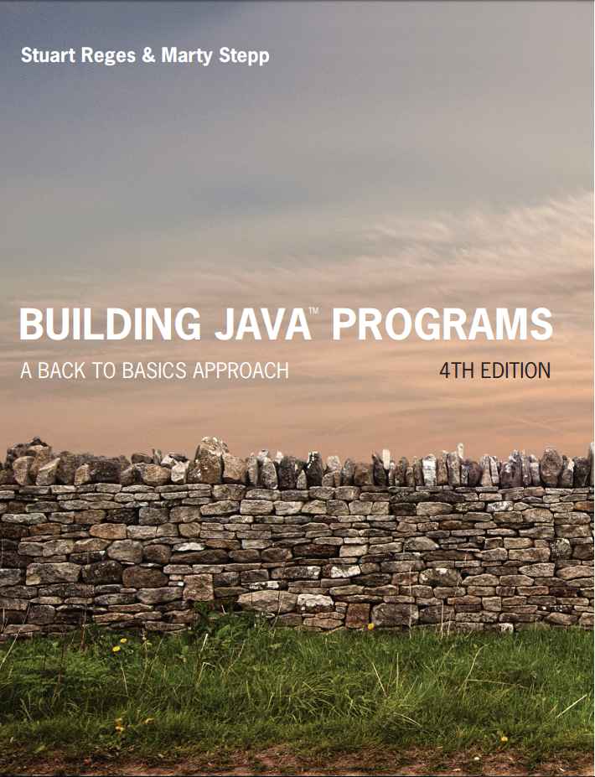
Building Java Programs
Fourth Edition
Chapter 5
Program Logic and Indefinite Loops
Copyright © 2017, 2014, 2011 Pearson Education, Inc. All Rights Reserved
Notes:
If this PowerPoint presentation contains mathematical equations, you may need to check that your computer has the following installed:
1) MathType Plugin
2) Math Player (free versions available)
3) NVDA Reader (free versions available)

Slide 2
While Loops

Slide 3
Categories of Loops
definite loop: Executes a known number of times.
The for loops we have seen are definite loops.
Print “hello” 10 times.
Find all the prime numbers up to an integer n.
Print each odd number between 5 and 127.
indefinite loop: One where the number of times its body repeats is not known in advance.
Prompt the user until they type a non-negative number.
Print random numbers until a prime number is printed.
Repeat until the user has types “q” to quit.

Slide 4
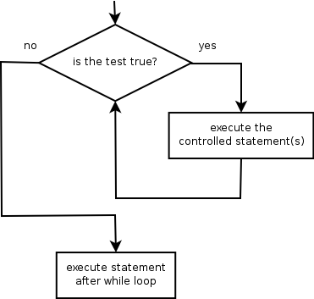
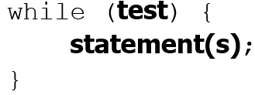
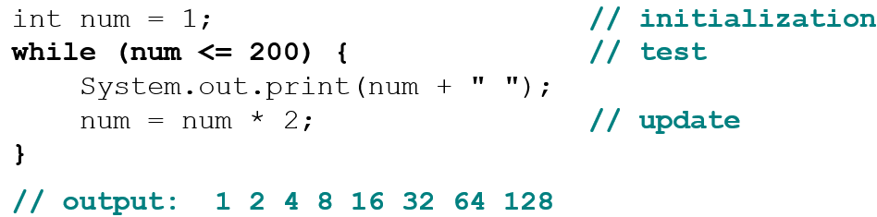
The While Loop
while loop: Repeatedly executes its body as long as a logical test is true.
Example:

Slide 5
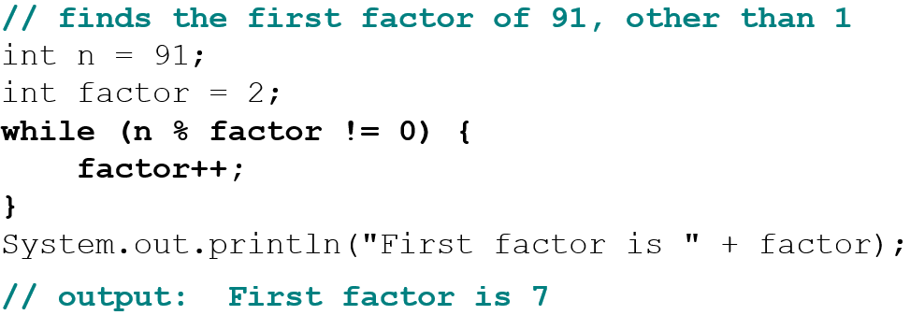
Example while Loop
while is better than for because we don’t know how many times we will need to increment to find the factor.

Slide 6
In-Class Assignment 1, Part 1
Create the class Average in BluJ
In the main program, do the following:
Define a double variable called sum and set it equal to 0.0
Define an int variable called count and set it equal to 0
Create a Scanner object named kb for input
Prompt the user to enter how many numbers they want and store this value in an integer variable named howmany
Set up a while loop to do the following, as long as count is less than or equal to howmany:
Prompt the user to enter a number and store it in a double variable named val.
Add val to the sum variable and add 1 to the count variable.
After the loop is finished, use an if statement to either display the average if count is not 0 or a message saying “No Data” if count is 0.

Slide 7
Random Numbers

Slide 8

The Random Class
A Random object generates pseudo-random numbers.
Class Random is found in the java.util package.
Method name | Description
nextInt() | returns a random integer
nextInt(max) | returns a random integer in the range [0,max) in other words, 0 to max−1 inclusive
nextDouble() | returns a random real number in the range
Example:

Slide 9
Generating Random Numbers
Common usage: to get a random number from 1 to N
To get a number in arbitrary range [min, max] inclusive:
where (size of range) is (max − min + 1)
Example: A random integer between 4 and 10 inclusive:

Slide 10
Random Questions
Given the following declaration, how would you get:
A random number between 1 and 47 inclusive?
A random number between 23 and 30 inclusive?
A random even number between 4 and 12 inclusive?

Slide 11
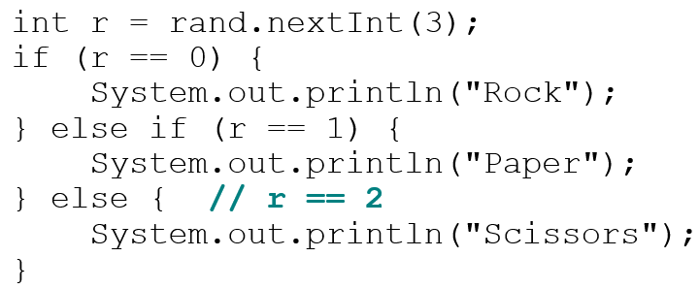
Random and Other Types
nextDouble method returns a double between 0.0 - 1.0
Example: Get a random G P A value between 1.5 and 4.0:
Any set of possible values can be mapped to integers
code to randomly play Rock-Paper-Scissors:

Slide 12
Random Question 1
Write a program that simulates rolling of two 6-sided dice until their combined result comes up as 7.
2 + 4 = 6
3 + 5 = 8
5 + 6 = 11
1 + 1 = 2
4 + 3 = 7
You won after 5 tries!

Slide 13
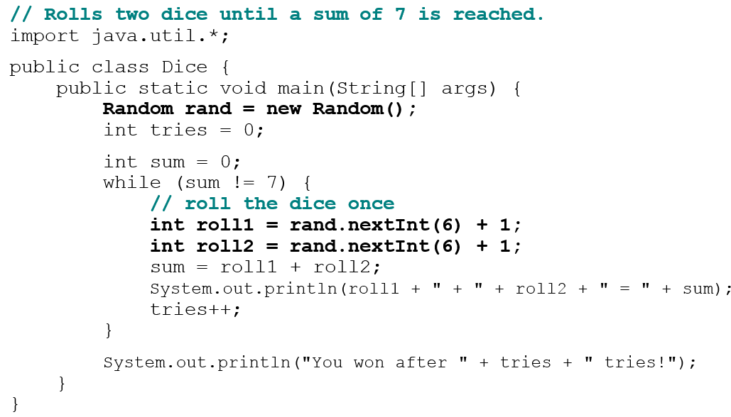
Random Answer 1

Slide 14
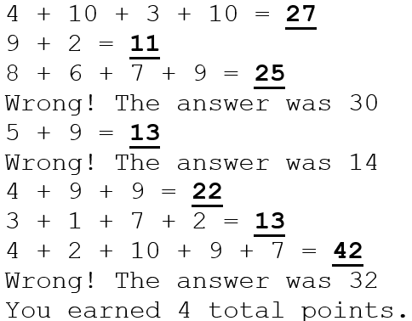
Random Question 2
Write a program that plays an adding game.
Ask user to solve random adding problems with 2-5 numbers.
The user gets 1 point for a correct answer, 0 for incorrect.
The program stops after 3 incorrect answers.

Slide 15
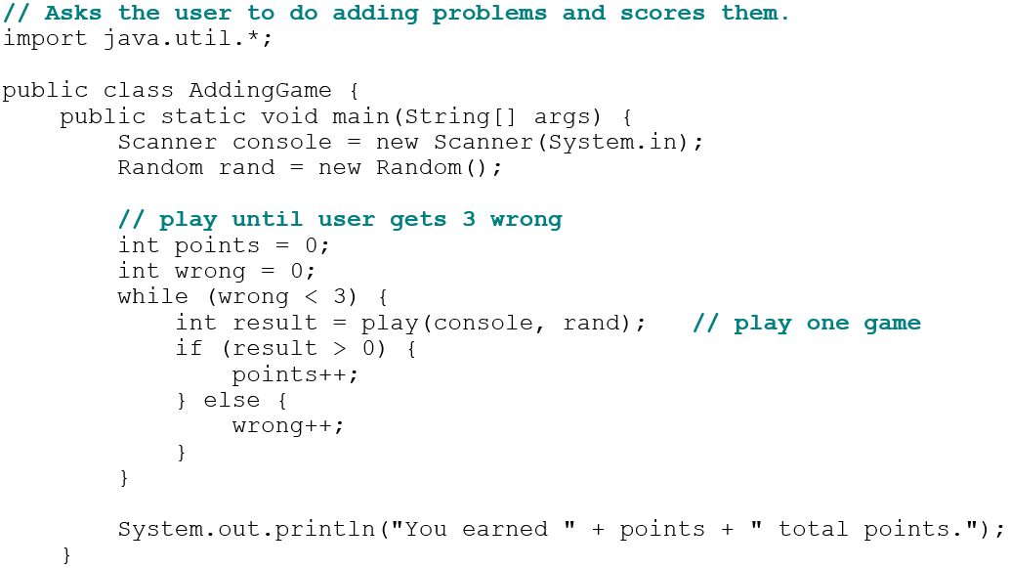
Random Answer

Slide 16
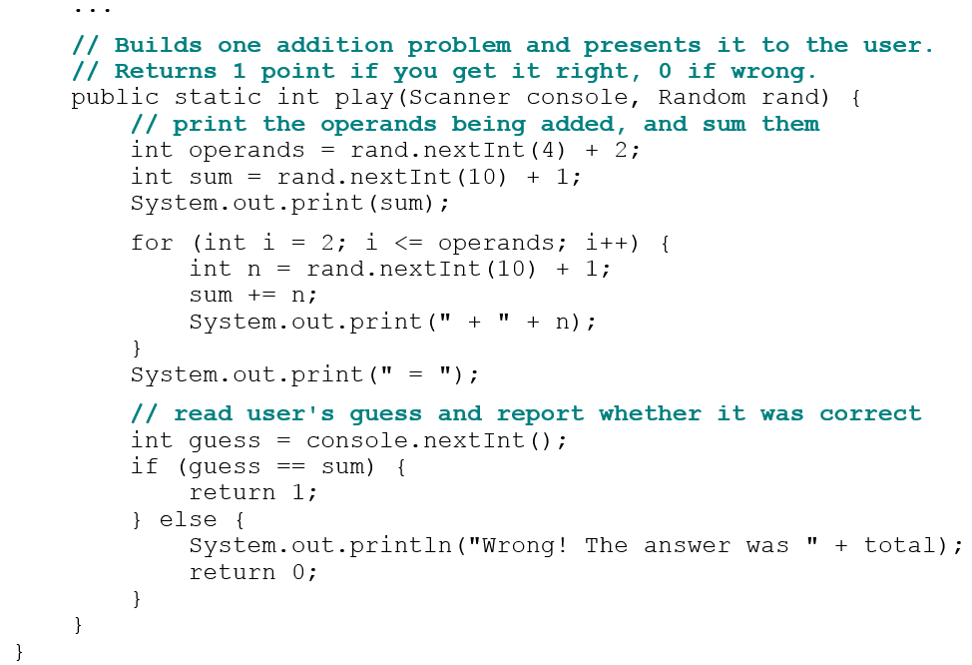
Random Answer 2

Slide 17
In-Class Assignment 1, Part 2
Add code to the main program in the class Average to do the following:
Set sum to 0.0 and count to 0
Declare a integer variable named num that will use random() to be initialized to a random number between 1 and 25
Set up a while loop to do the following, as long as num is less than or equal to 22:
Add num to the sum variable
Add 1 to the count variable
Use random() to give num a new value between 1 and 25
After the loop is finished, use an if statement to either display the average if count is not 0 or a message saying “No Data” if count is 0.

Slide 18
Do-While Loops

Slide 19
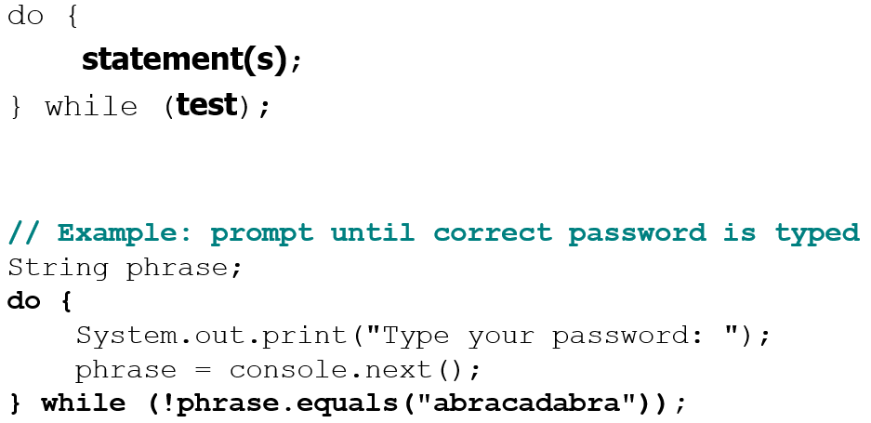
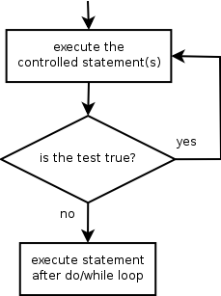
The do/while Loop
do/while loop: Performs its test at the end of each repetition.
Guarantees that the loop’s {} body will run at least once.

Slide 20
do/while Question
Modify the previous Dice program to use do/while.
2 + 4 = 6
3 + 5 = 8
5 + 6 = 11
1 + 1 = 2
4 + 3 = 7
You won after 5 tries!
Is do/while a good fit for our past Sentinel program?

Slide 21
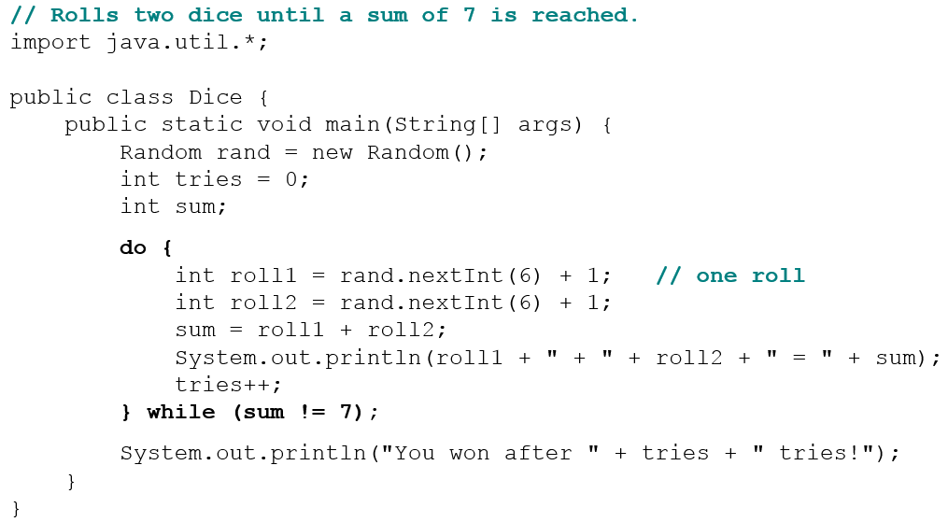
do/while Answer

Slide 22
In-Class Assignment 1, Part 3
Add code the main program in the class Average to do the following:
Declare two integer variables named total and card and initialize both to 0.
Declare a char variable named hitme and initialize it to ‘y’.
Set up a do-while loop to do the following, as long as the value of total is less than 21 and hitme is equal to ‘y’:
Use random() to assign a new value to card that is between 2 and 11. You will have to decide what number to send to the nextInt() method and what needs to be added.
If total is 11 or more and card = 11, set card = 1.
Add card to total
If total is less than 21, display the total and ask the user if they want another card. Store the response in hitme.
After the loop is finished, use an if statement to display “Nice job!” if total is less than or equal to 21 or “Bust!” if total is greater than 21.

Slide 23

Copyright

