Slide 1
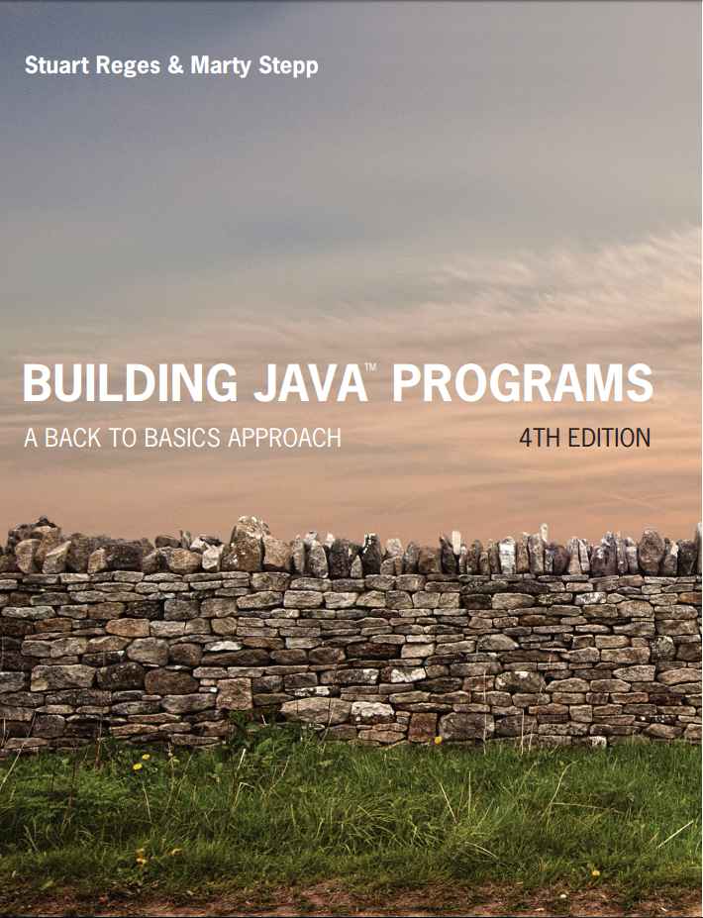
Building Java Programs
Fourth Edition
Chapter 5, Section 5.2
Program Logic and Indefinite Loops
Copyright © 2017, 2014, 2011 Pearson Education, Inc. All Rights Reserved
Notes:
If this PowerPoint presentation contains mathematical equations, you may need to check that your computer has the following installed:
1) MathType Plugin
2) Math Player (free versions available)
3) NVDA Reader (free versions available)

Slide 2
Fencepost Algorithms

Slide 3

A Deceptive Problem...
Write a method printNumbers that prints each number from 1 to a given maximum, separated by commas. For example, the call:
should print:1, 2, 3, 4, 5

Slide 4
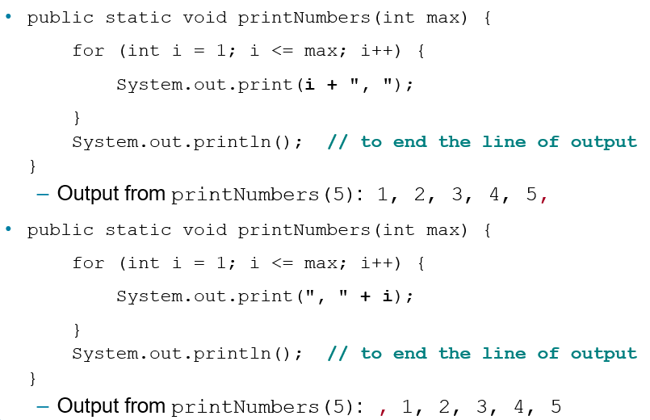
Flawed Solutions

Slide 5
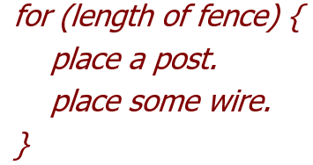

Fence Post Analogy
We print n numbers but need only n−1 commas.
Similar to building a fence with wires separated by posts:
If we use a flawed algorithm that repeatedly places a post + wire, the last post will have an extra dangling wire.

Slide 6
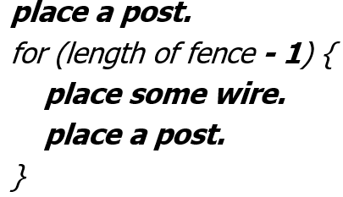

Fencepost Loop
Add a statement outside the loop to place the initial “post.”
Also called a fencepost loop or a “loop-and-a-half” solution.

Slide 7
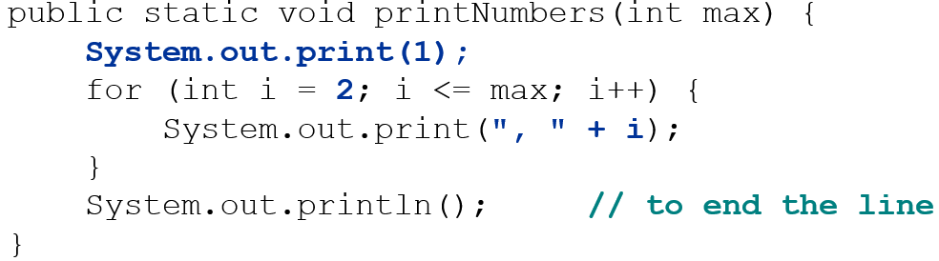
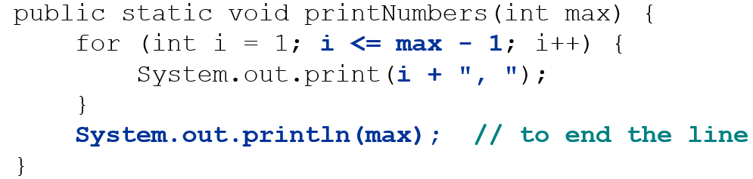
Fencepost Method Solution
Alternate solution: Either first or last “post” can be taken out:

Slide 8

Fencepost Question
Modify your method printNumbers into a new method printPrimes that prints all prime numbers up to a max.
2, 3, 5, 7, 11, 13, 17, 19, 23, 29, 31, 37, 41, 43, 47
If the maximum is less than 2, print no output.
To help you, write a method countFactors which returns the number of factors of a given integer.

Slide 9
In-Class Assignment 2, Part 1
Create a class named Fencepost in BlueJ and do the following:
Write code for the printPrimes method, which is void and takes a single integer parameter. It display all prime numbers between 2 and the parameter.
NOTE: A number is prime if it has exactly 2 factors (itself and 1).
Write code for the countFactors method, which has an integer parameter and returns in integer. It will use a for loop to determine how many factors the parameter has and returns the number of factors. It will be called by the printPrimes method.
NOTE: You determine how many factors a number has by dividing by it by all values between 1 and that number. If you get 0 as a remainder, that value is a factor.

Slide 10
Sentinel-Controlled Loops

Slide 11
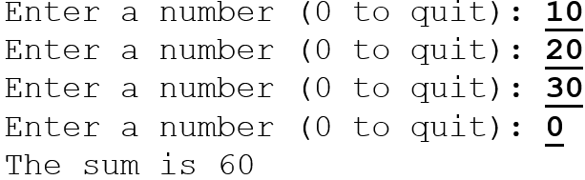
Sentinel Values
sentinel: A value that signals the end of user input.
sentinel loop: Repeats until a sentinel value is seen.
Example: Write a program that prompts the user for numbers until the user types 0, then outputs their sum.
(In this case, 0 is the sentinel value.)

Slide 12
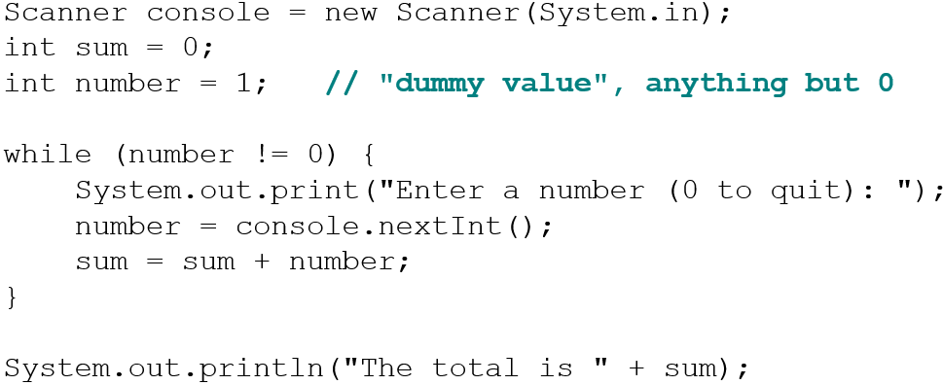
Flawed Sentinel Solution
What’s wrong with this solution?

Slide 13
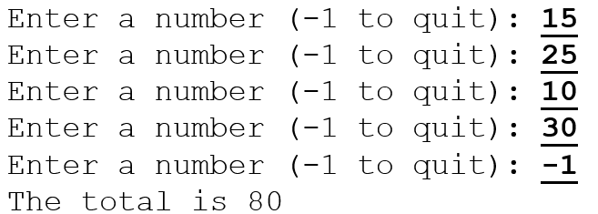
Changing the Sentinel Value (1 of 2)
Modify your program to use a sentinel value of −1.
Example log of execution:

Slide 14
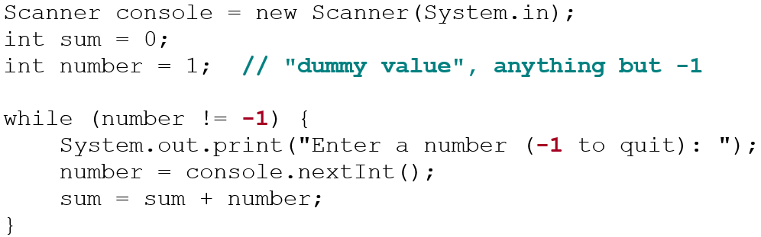
Changing the Sentinel Value (2 of 2)
To see the problem, change the sentinel’s value to −1:
Now the solution produces the wrong output. Why? The total was 79

Slide 15
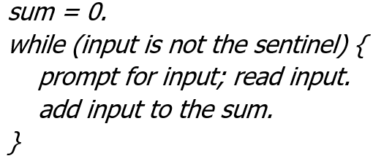

The Problem with our Code
Our code uses a pattern like this:
On the last pass, the sentinel −1 is added to the sum:
This is a fencepost problem.
Must read N numbers, but only sum the first N−1 of them.

Slide 16
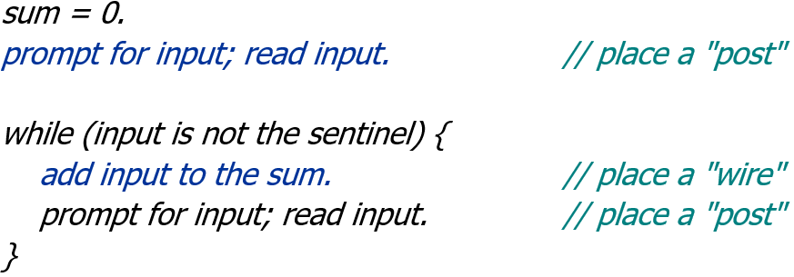
A Fencepost Solution
Sentinel loops often utilize a fencepost “loop-and-a-half” style solution by pulling some code out of the loop.

Slide 17
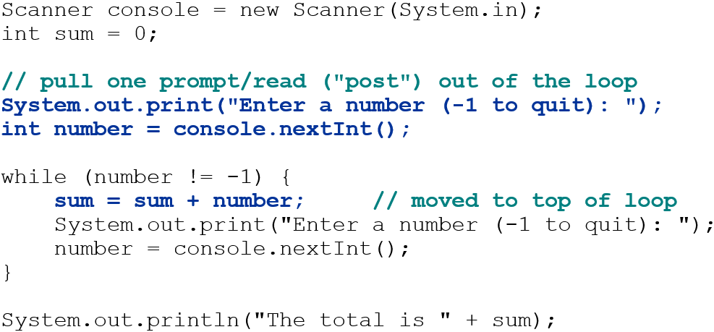
Correct Sentinel Code

Slide 18
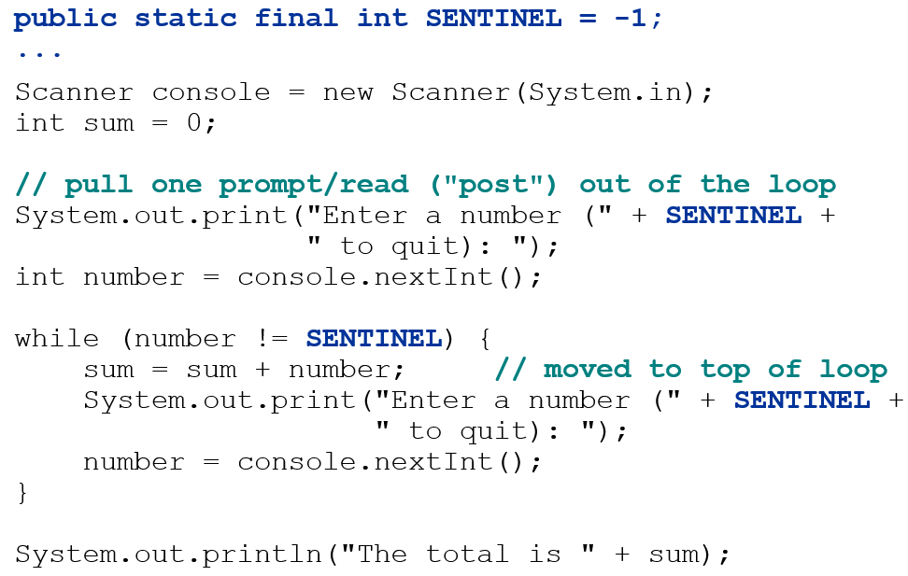
Sentinel as a Constant

Slide 19
In-Class Assignment 2, Part 2
Add the following code to the main program in the Fencepost class:
Define a double variable called sum and initialize it to 0.0
Define a double value called val and initialize it to 0.0
Define an int variable called count and set it equal to 0
Create a Scanner object named kb for input
Prompt the user to enter a number and store this number in the val variable.
Set up a while loop to do the following, as long as val is not equal to -1:
Add val to the sum variable and add 1 to the count variable
Prompt the user to enter a number and store it in a double variable named val.
After the loop is finished, use an if statement to either display the average if count is not 0 or a message saying “No Data” if count is 0.

Slide 20

Copyright

