Slide 1
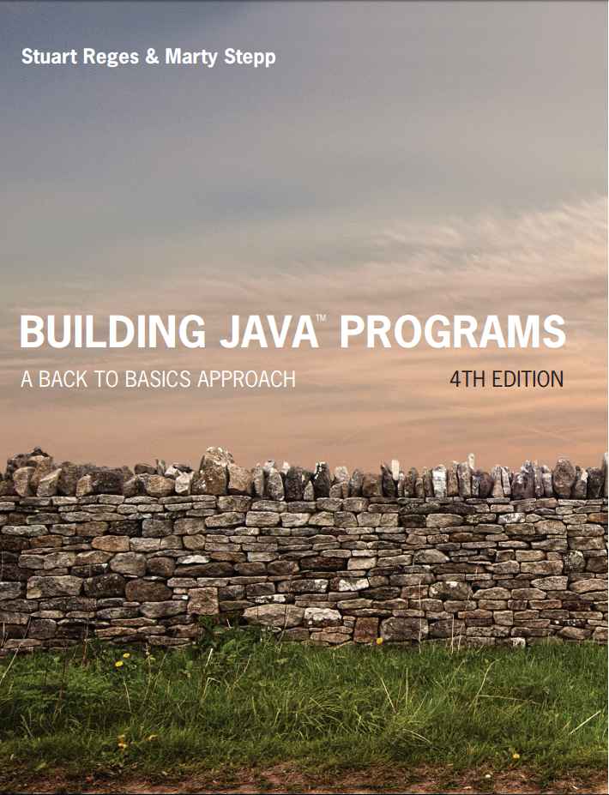
Building Java Programs
Fourth Edition
Chapter 5, Sections 5.3 and 5.4
Program Logic and Indefinite Loops
Copyright © 2017, 2014, 2011 Pearson Education, Inc. All Rights Reserved
Notes:
If this PowerPoint presentation contains mathematical equations, you may need to check that your computer has the following installed:
1) MathType Plugin
2) Math Player (free versions available)
3) NVDA Reader (free versions available)

Slide 2
Type Boolean

Slide 3
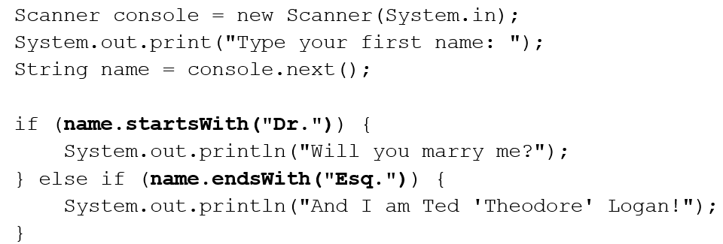
Methods that are Tests
Some methods return logical values.
A call to such a method is used as a test in a loop or if.

Slide 4
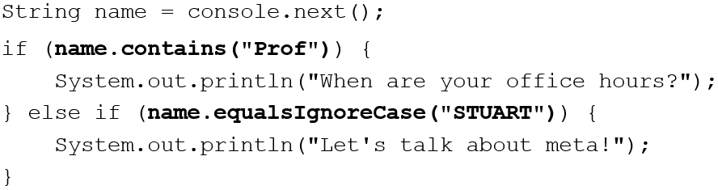
String Test Methods
Method | Description
equals(str) | whether two strings contain the same characters
equalsIgnoreCase(str) | whether two strings contain the same characters, ignoring upper vs. lower case
startsWith(str) | whether one contains other’s characters at start
endsWith(str) | whether one contains other’s characters at end
contains(str) | whether the given string is found within this one

Slide 5
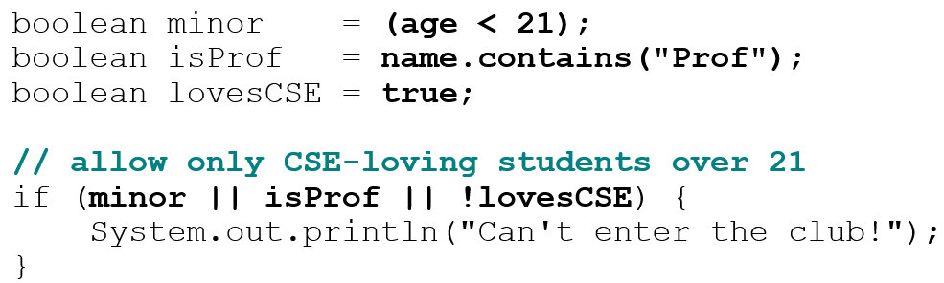
Type Boolean
boolean: A logical type whose values are true and false.
A logical test is actually a boolean expression.
It is legal to:
create a boolean variable
pass a boolean value as a parameter
return a boolean value from methods
call a method that returns a boolean and use it as a test

Slide 6
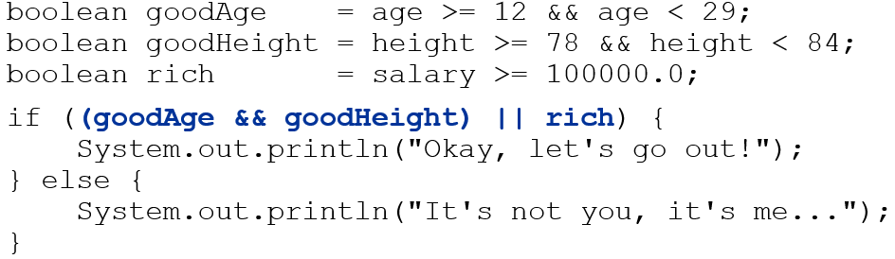
Using Boolean
Why is type boolean useful?
Can capture a complex logical test result and use it later
Can write a method that does a complex test and returns it
Makes code more readable
Can pass around the result of a logical test (as param/return)

Slide 7
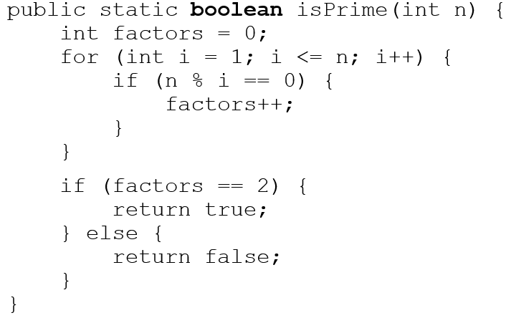
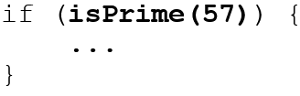
Returning Boolean
Calls to methods returning boolean can be used as tests:

Slide 8
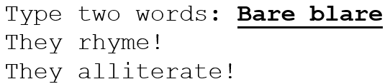
Boolean Question
Improve our “rhyme” / “alliterate” program to use boolean methods to test for rhyming and alliteration.

Slide 9
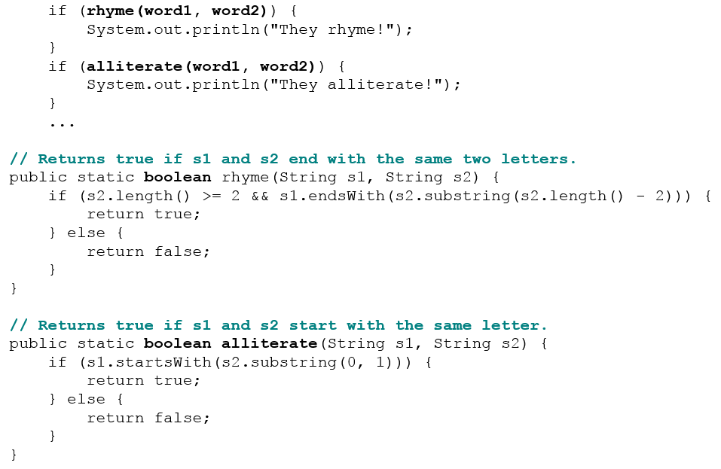
Boolean Answer

Slide 10
In-Class Assignment 1, Part 1
Create the class Boxing in BlueJ
In the main program, do the following:
Define a double variable called weight and set it equal to 0.0
Define an String variable called name.
Create a Scanner object named kb for input
Prompt the user to enter the name of the boxer and store it in the name variable.
Prompt the user to enter the weight of the boxer and store it in the weight variable.
Create a method called isFeatherweight() that has a double parameter and returns a Boolean value. The method will return true if the weight is between 105.0 pounds and 114.5 pounds (inclusive) and false otherwise.
Use this method to print a string with the boxer’s name saying whether or not the boxer is a flyweight.

Slide 11
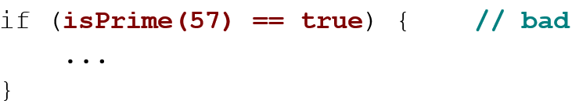
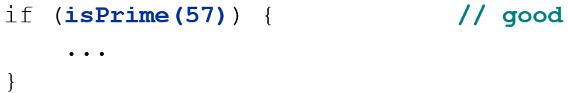

“Boolean Zen”, part 1
Students new to boolean often test if a result is true:
But this is unnecessary and redundant. Preferred:
A similar pattern can be used for a false test:

Slide 12
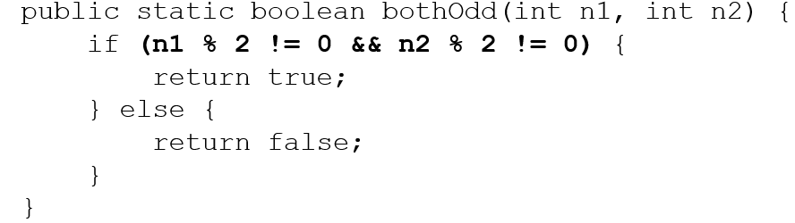
“Boolean Zen”, part 2
Methods that return boolean often have an if/else that returns true or false:
But the code above is unnecessarily verbose.

Slide 13
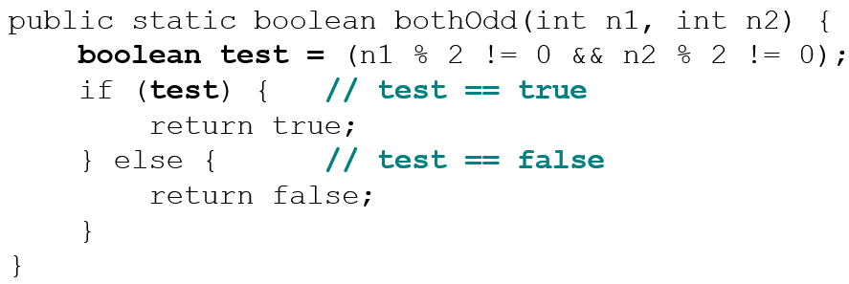
Solution w/ Boolean var
We could store the result of the logical test.
Notice: Whatever test is, we want to return that.
If test is true, we want to return true.
If test is false, we want to return false.

Slide 14
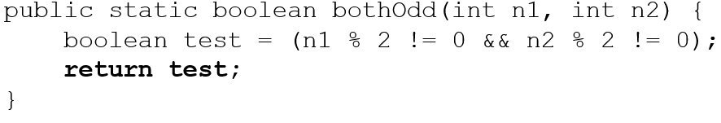
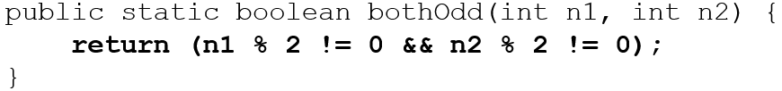
Solution w/ “Boolean Zen”
Observation: The if/else is unnecessary.
The variable test stores a boolean value; its value is exactly what you want to return. So return that!
An even shorter version:
We don’t even need the variable test. We can just perform the test and return its result in one step.

Slide 15
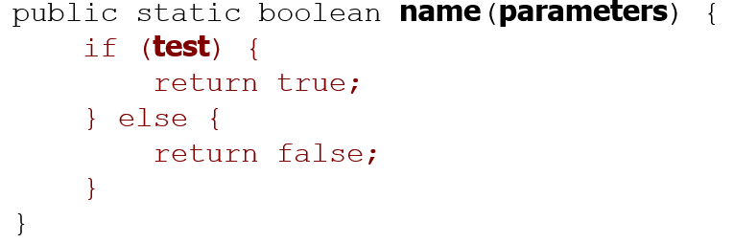
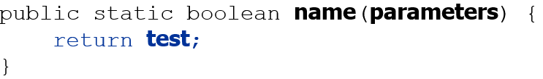
“Boolean Zen” Template
Replace
With

Slide 16
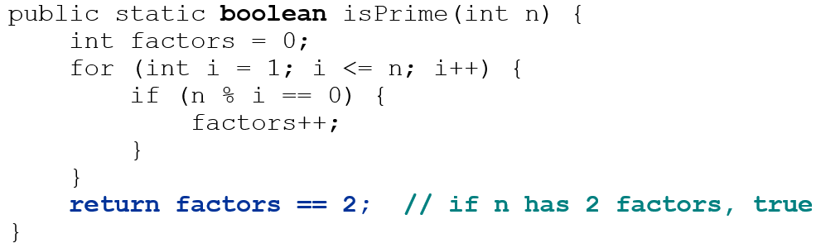
Improved isPrime Method
The following version utilizes Boolean Zen:
Modify our Rhyme program to use Boolean Zen.

Slide 17
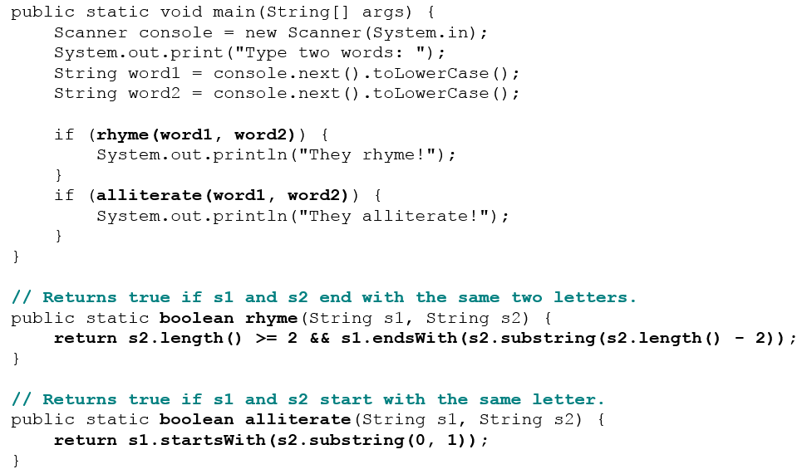
Boolean Zen Answer

Slide 18
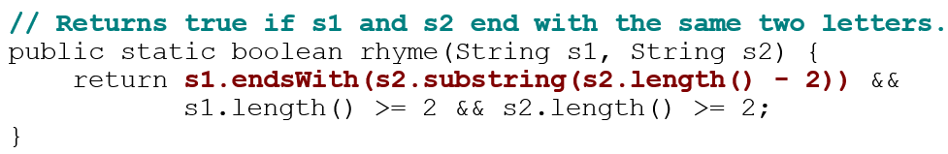
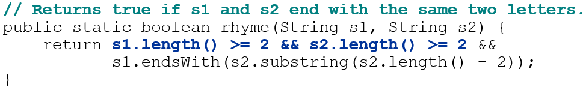
“Short-circuit” Evaluation
Java stops evaluating a test if it knows the answer.
The following test will crash if s2’s length is less than 2:
The following test will not crash; it stops if length < 2:

Slide 19
De Morgan’s Law
De Morgan’s Law: Rules used to negate boolean tests.
Useful when you want the opposite of an existing test.
Not operator (!) means “do the opposite”
Original Expression | Negated Expression | Alternative
a && b | !a || !b | !(a && b)
 | !a && !b | !(a || b)
Example:
Original Code | Negated Code
if (x == 7 && y > 3) { ... } | if (x != 7 || y <= 3) { ... }

Slide 20
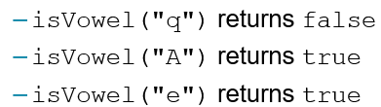
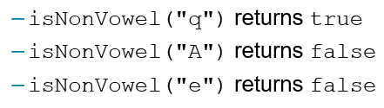
Boolean Practice Questions
Write a method named isVowel that returns whether a String is a vowel (a, e, i, o, or u), case-insensitively.
Change the above method into an isNonVowel that returns whether a String is any character except a vowel.

Slide 21
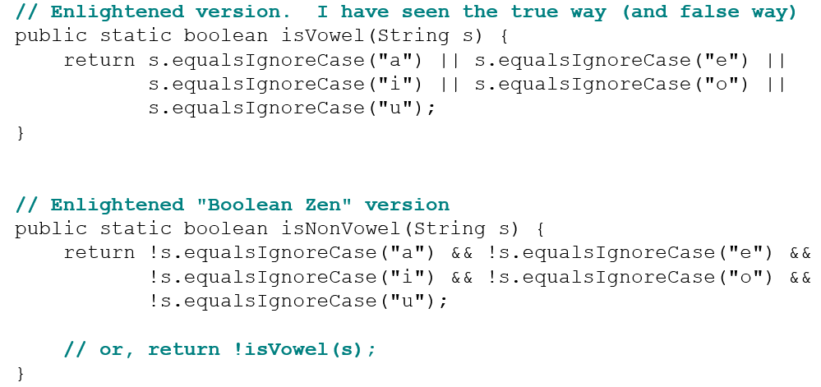
Boolean Practice Answers

Slide 22
In-Class Assignment 1, Part 2
Make the following changes to the Boxing class:
Use “Boolean Zen” to make the isFeatherweight() method use only a return statement with the test.
Using the following table, create the following Boolean methods to see if a boxer is in the respective weight class.
In main, use a nested if/else if/else statement to display the correct weight class. If no methods return true, the boxer is a Heavyweight
Method name | Weight limits
isFlyweight() | 114.6 to 123.4
isBantamweight() | 123.5 to 132.2
IsLightweight() | 132.3 to 141.0
isLightwelterweight() | 141.1 to 152.0
IsWelterweight() | 152.1 to 165.2
isMiddleweight() | 165.3 to 178.5
isLightheavyweight | 178.6 to 200.5

Slide 23
User Errors

Slide 24
Guard Against Users Who Don’t Get It
Suppose you want the user to give you a number that represents the number of data values to enter.
It is assumed the number of values will be a positive number.
But what if the user tries to enter a double value…or a letter?
Most likely, the program will crash! See example on next slide…

Slide 25
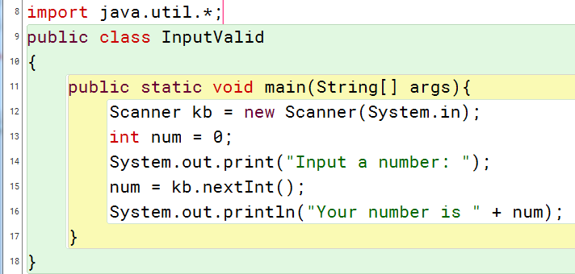
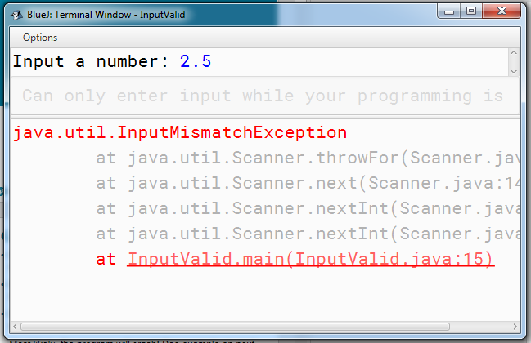
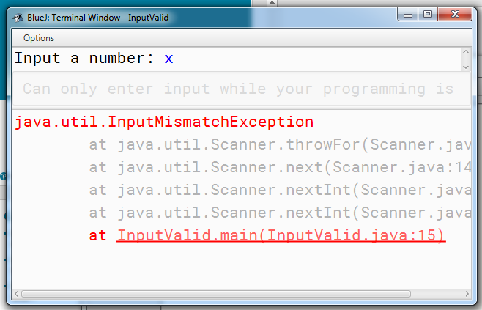
Sample program with input failures

Slide 26
hasNextInt() method
Best to use hasNextInt() method with Scanner object.
Checks if the value user typed is actually an integer
Gives programmer a chance to allow the user to input the right type of data.
Algorithm would be this:
Use hasNextInt() in a loop
If data is invalid, use next() to discard it
Display an error message
Prompt user for input again.
When loop finished, use nextInt() to return value.
There are also hasNextDouble() for doubles, hasNext() for single characters or strings with no spaces, hasNextLine() for lines of text.

Slide 27
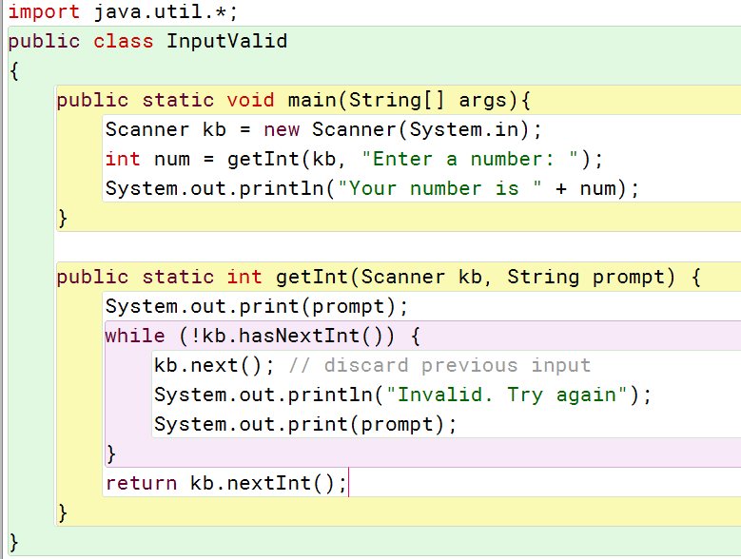
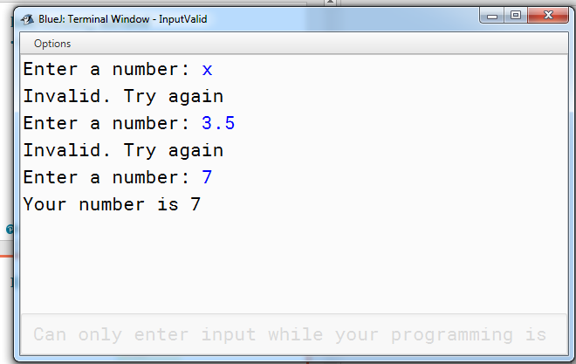
Example of hasNextInt() method

Slide 28
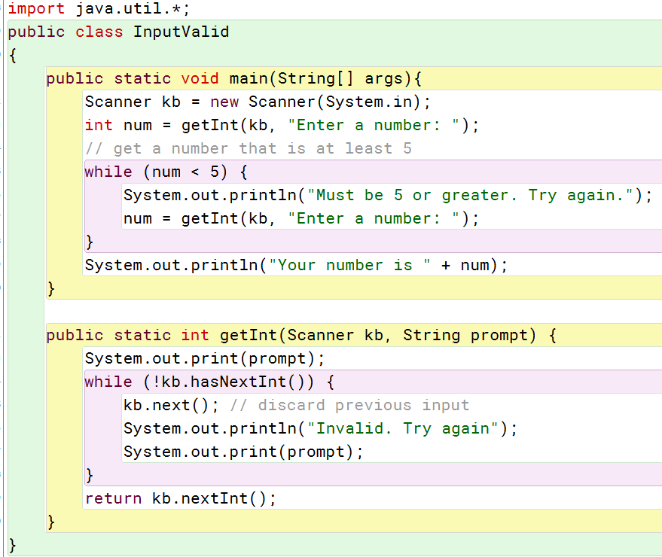
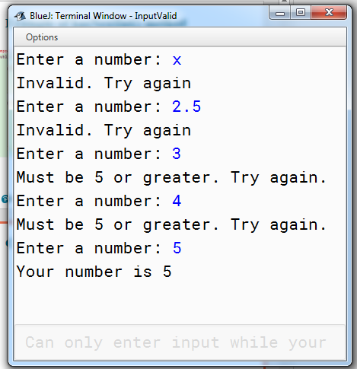
Can also add check for minimum value

Slide 29
In-Class Assignment 1, Part 3
Change the code in the Boxing class to do the following:
Set the value of weight equal to the returned value of a method named getDouble, which should work as follows:
The method should have a Scanner parameter and a string parameter.
Display the String parameter as a prompt to enter the weight.
Use a while loop that executes as long as the user did not enter a double value (use hasNextDouble() to do this). In the loop do the following:
Discard the current input using next().
Display an error message
Prompt the user to enter the weight.
When the loop is finished, use nextDouble() to return the weight.
Add another while loop to be sure the weight is at least 105.

Slide 30
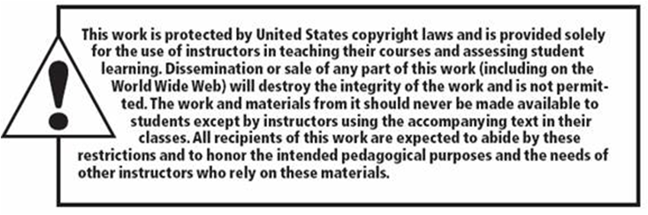
Copyright

