Slide 1
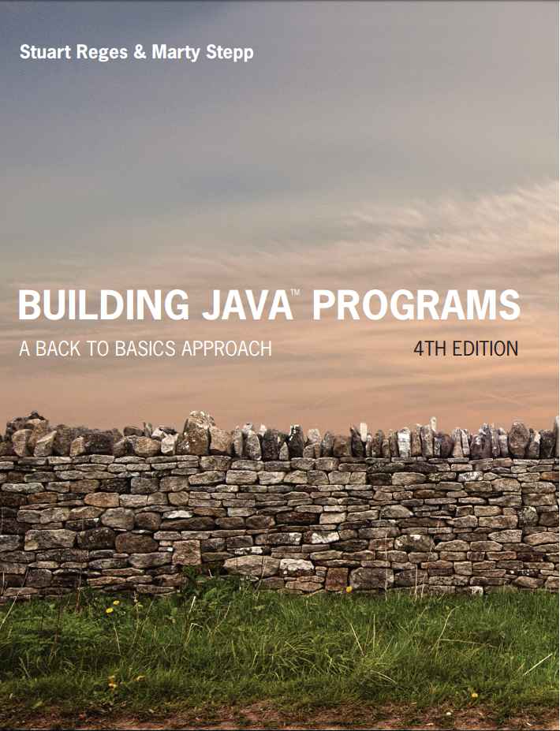
Building Java Programs
Fourth Edition
Chapter 5, Sections 5.4 and 5.5
Program Logic and Indefinite Loops
Copyright © 2017, 2014, 2011 Pearson Education, Inc. All Rights Reserved
Notes:
If this PowerPoint presentation contains mathematical equations, you may need to check that your computer has the following installed:
1) MathType Plugin
2) Math Player (free versions available)
3) NVDA Reader (free versions available)

Slide 2
Logical Assertions

Slide 3
Logical Assertions
assertion: A statement that is either true or false.
Examples:
Java was created in 1995.
The sky is purple.
23 is a prime number.
10 is greater than 20.
x divided by 2 equals 7. (depends on the value of x)
An assertion might be false (“The sky is purple” above), but it is still an assertion because it is a true/false statement.

Slide 4
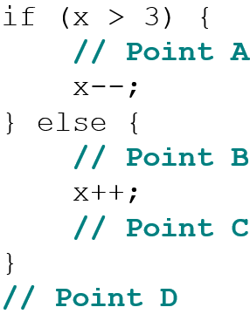
Reasoning About Assertions (1 of 2)
Suppose you have the following code:
What do you know about x’s value at the three points?
Is x > 3? Always? Sometimes? Never?

Slide 5
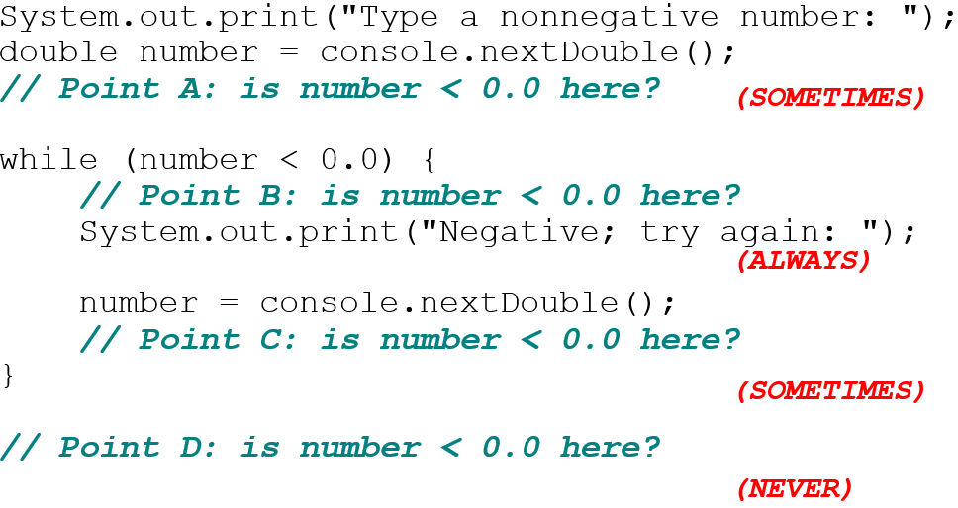
Assertions in Code
We can make assertions about our code and ask whether they are true at various points in the code.
Valid answers are ALWAYS, NEVER, or SOMETIMES.

Slide 6

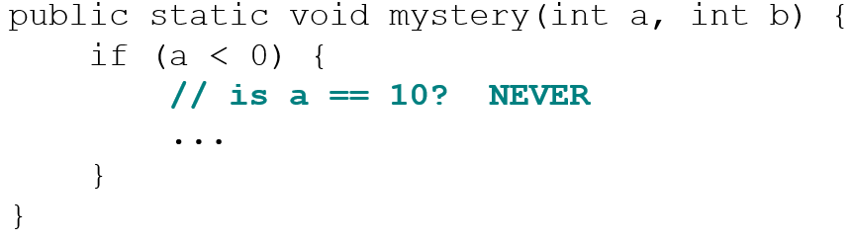
Reasoning About Assertions (2 of 2)
Right after a variable is initialized, its value is known:
In general you know nothing about parameters’ values:
But inside an if, while, etc., you may know something:

Slide 7
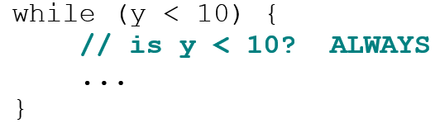
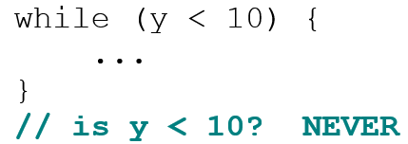
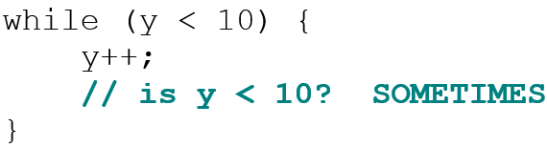
Assertions and Loops
At the start of a loop’s body, the loop’s test must be true:
After a loop, the loop’s test must be false:
Inside a loop’s body, the loop’s test may become false:

Slide 8
“Sometimes”
Things that cause a variable’s value to be unknown (often leads to “sometimes” answers):
reading from a Scanner
reading a number from a Random object
a parameter’s initial value to a method
If you can reach a part of the program both with the answer being “yes” and the answer being "no", then the correct answer is “sometimes”.
If you’re unsure, “Sometimes” is a good guess.

Slide 9
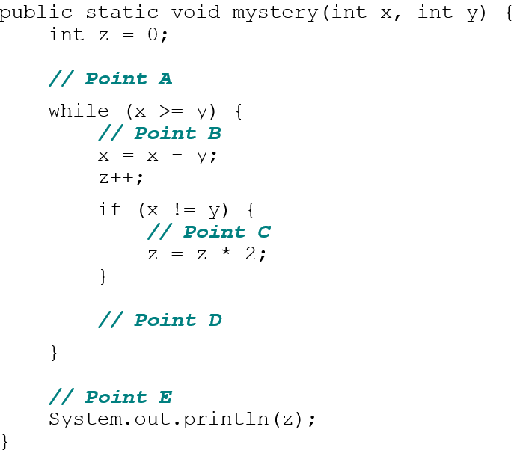
Assertion Example 1
Which of the following assertions are true at which point(s) in the code? Choose ALWAYS, NEVER, or SOMETIMES.
blank | x<y | x==y | z==0
Point A | SOMETIMES | SOMETIMES | ALWAYS
Point B | NEVER | SOMETIMES | SOMETIMES
Point C | SOMETIMES | NEVER | NEVER
Point D | SOMETIMES | SOMETIMES | NEVER
Point E | ALWAYS | NEVER | SOMETIMES

Slide 10
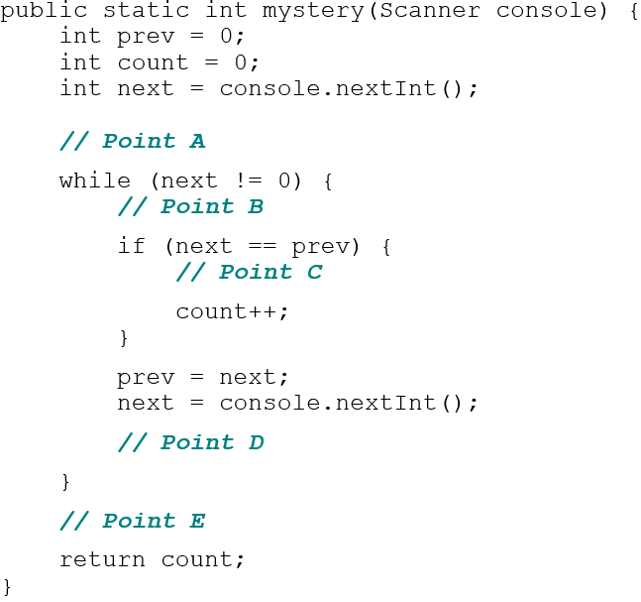
Assertion Example 2
Which of the following assertions are true at which point(s) in the code? Choose ALWAYS, NEVER, or SOMETIMES.
blank | next==0 | prev==0 | next==prev
Point A | SOMETIMES | ALWAYS | SOMETIMES
Point B | NEVER | SOMETIMES | SOMETIMES
Point C | NEVER | NEVER | ALWAYS
Point D | SOMETIMES | NEVER | SOMETIMES
Point E | ALWAYS | SOMETIMES | SOMETIMES

Slide 11
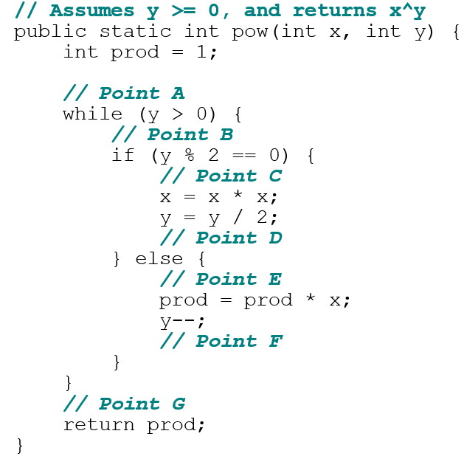
Assertion Example 3
Which of the following assertions are true at which point(s) in the code? Choose ALWAYS, NEVER, or SOMETIMES.
blank | y>0 | y % 2 == 0
Point A | SOMETIMES | SOMETIMES
Point B | ALWAYS | SOMETIMES
Point C | ALWAYS | ALWAYS
Point D | ALWAYS | SOMETIMES
Point E | ALWAYS | NEVER
Point F | SOMETIMES | ALWAYS
Point G | NEVER | ALWAYS

Slide 12
In-Class Assignment 2
In the class Average2, prompt the user to enter an integer and store it in a variable named num.
Define a method named digitSum that has an integer parameter and returns an integer.
When this method is called, it should do the following:
Define a local integer variable named sum and initialize it to 0.
Make sure the number passed to it is a positive number. This can be done either through a while loop or by using the Math.abs() method.
Within a while loop, do the following as long as the number passed in is greater than 0:
Use the remainder operator to get a digit and add it to sum.
Divide the number passed in by 10 so it has one less digit.
Return sum when the loop is finished.

Slide 13
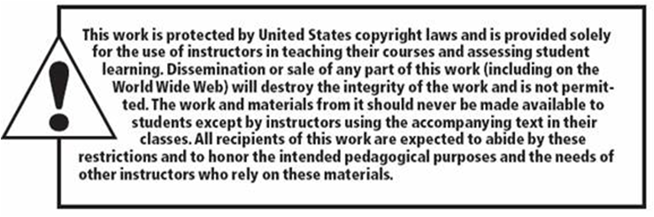
Copyright

