Slide 1
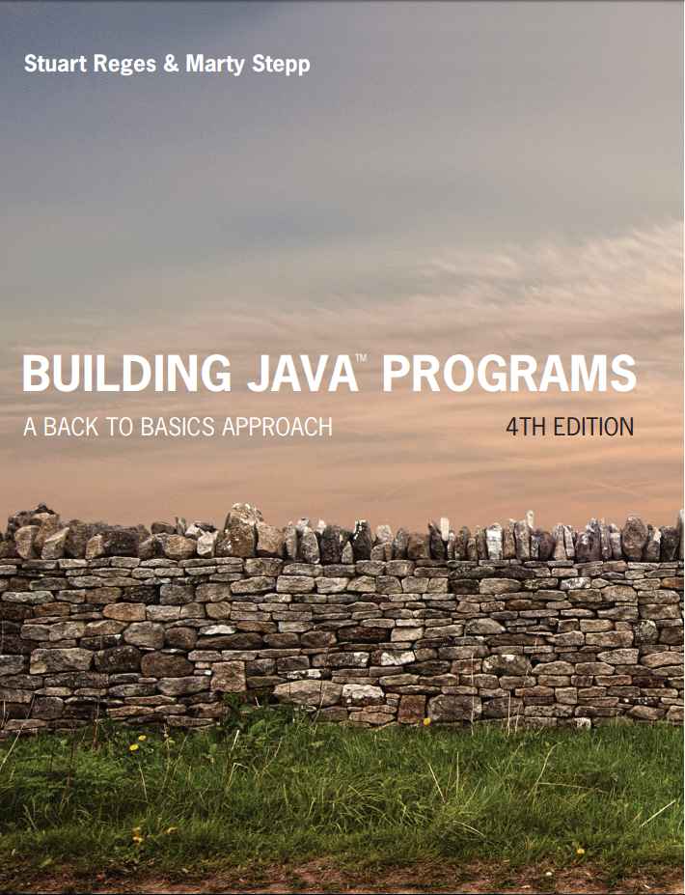
Building Java Programs
Fourth Edition
Chapter 6
File Processing
Copyright © 2017, 2014, 2011 Pearson Education, Inc. All Rights Reserved
Notes:
If this PowerPoint presentation contains mathematical equations, you may need to check that your computer has the following installed:
1) MathType Plugin
2) Math Player (free versions available)
3) NVDA Reader (free versions available)

Slide 2

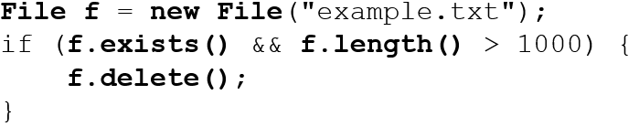
Input/output (I/O) (1 of 2)
Create a File object to get info about a file on your drive.
Must have before doing this.
Doesn’t actually create a new file on the hard disk.

Slide 3
Input/output (I/O) (2 of 2)
Method name | Description
canRead() | returns whether file is able to be read
delete() | removes file from disk
exists() | whether this file exists on disk
getName() | returns file’s name
length() | returns number of bytes in file
renameTo(file) | changes name of file
getAbsolutePath() | Returns the full path where file is located

Slide 4

Reading Files
To read a file, pass a File when constructing a Scanner.
Example:
or (shorter…and better and preferred way):
Notes:
It is nice that Java uses the same object to read files as it does to read the keyboard. It's simpler and easier to learn. Some languages (C, Python, etc.) don't do this.

Slide 5

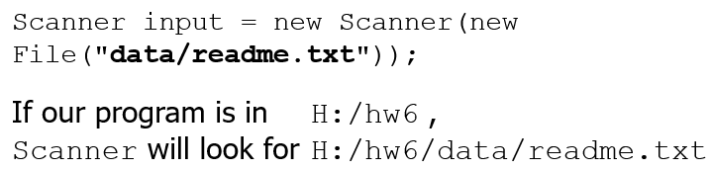
File Paths
absolute path: specifies a drive or a top “/” folder
Windows can also use backslashes to separate folders.
Java accepts forward slashes, regardless of operating system.
relative path: does not specify any top-level folder
Assumed to be relative to the current directory:

Slide 6
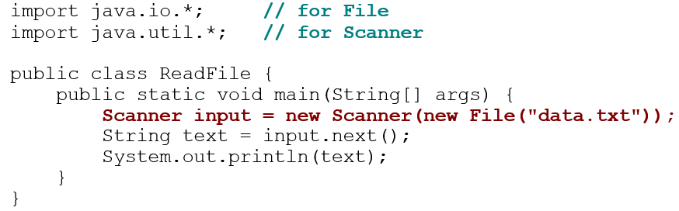
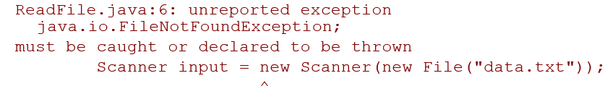
Compiler error w/ files
The program fails to compile with the following error:

Slide 7
Exceptions
exception: An object representing a runtime error.
dividing an integer by 0
calling substring on a String and passing too large an index
trying to read the wrong type of value from a Scanner
trying to read a file that does not exist
We say that a program with an error “throws” an exception.
It is also possible to “catch” (handle or fix) an exception.
checked exception: An error that must be handled by our program (otherwise it will not compile).
We must specify how our program will handle file I/O failures.

Slide 8
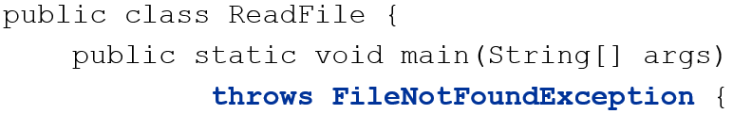
The throws Clause
throws clause: Keywords on a method’s header that state that it may generate an exception (and will not handle it).
Syntax:
Example:
Like saying, “I hereby announce that this method might throw an exception, and I accept the consequences if this happens.”
Notes:
analogy: A throws clause is like the legal waiver you sign before you go bungee jumping. "I understand that I am taking a risk, and I promise not to sue!"

Slide 9

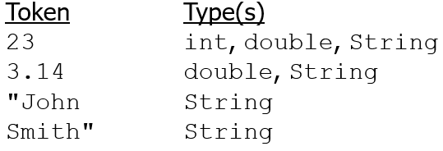
Input Tokens
token: A unit of user input, separated by whitespace.
A Scanner splits a file’s contents into tokens.
If an input file contains the following:
The Scanner can interpret the tokens as the following types:
Notes:
Even though we think of 23 as being an int, it can be any of the three types: 23, 23.0, or "23".

Slide 10
Scanner Tests for Valid Input
Method | Description
hasNext() | returns true if there is a next token
hasNextInt() | returns true if there is a next token and it can be read as an int
hasNextDouble() | returns true if there is a next token and it can be read as a double
These methods of the Scanner do not consume input; they just give information about what the next token will be.
Useful to see what input is coming, and to avoid crashes.
These methods can be used with a console Scanner, as well.
When called on the console, they sometimes pause waiting for input.
Notes:
Don't spend much time talking about using these methods on a console Scanner. We don't need that right now and it may confuse students.

Slide 11
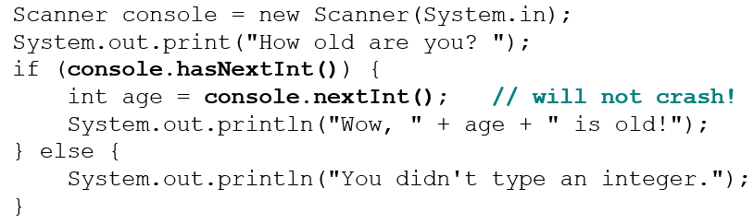
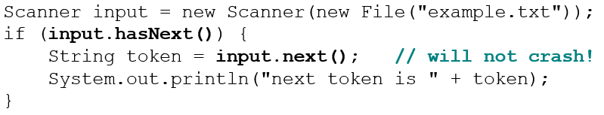
Using hasNext Methods
Avoiding type mismatches:
Avoiding reading past the end of a file:

Slide 12
In-Class Assignment 1, Part 1
Create the project and class Files in BluJ
Download the baseball.txt file from Canvas and store it in the same directory as the .java file in your project.
In the main program, do the following:
Create a Scanner object named input that is associated with the baseball.txt file.
Declare an integer variable named count and set it equal to 0.
Using a while loop, input each word from the file and add one to count.
Continue to do this until no more words can be read from the file.
When the loop is finished, output the number of words in the file as a sentence.

Slide 13
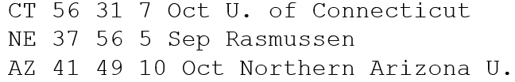

Election Question
Write a program that reads a file poll.txt of poll data.
Format: State Obama% McCain% ElectoralVotes Pollster
The program should print how many electoral votes each candidate leads in, and who is leading overall in the polls.
Notes:
I don't usually have time to do this program in lecture. It's just here in case I have extra time, or for students to look at later.

Slide 14
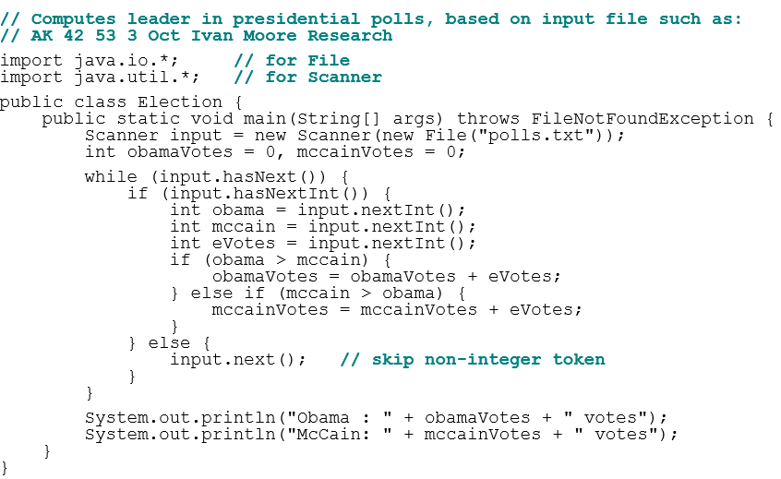
Election Answer

Slide 15
In-Class Assignment 1, Part 2
Download the file hockey1.txt from Canvas and store it in the same directory as the .java file in your Files project.
Add code to the main program in the Files class to do the following:
Redefine the Scanner object named input so that is associated with the hockey1.txt file.
Using a while loop, do the following for each line in the file:
Store the first name in a String variable named first.
Store the last name in a String variable named last.
Using another while loop, add the goals scored for each of the five seasons to an integer variable named total.
Use these three variables to display the first name, last name, and the total goals scored over the last 5 seasons for each player in a sentence.

Slide 16
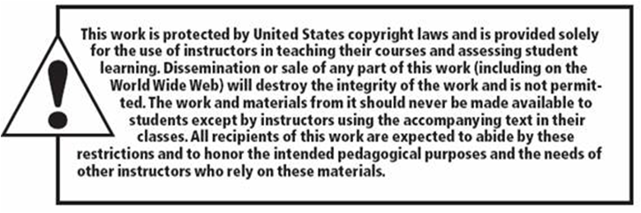
Copyright

