Slide 1
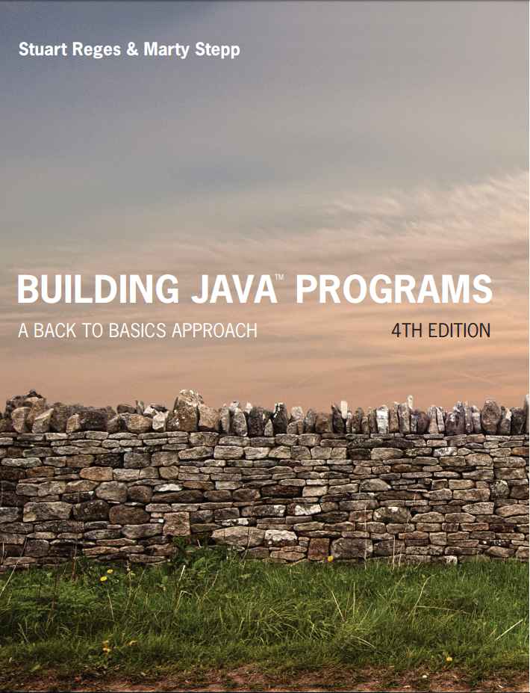
Building Java Programs
Fourth Edition
Chapter 6, Sections 6.3 and 6.4
File Processing
Copyright © 2017, 2014, 2011 Pearson Education, Inc. All Rights Reserved
Notes:
If this PowerPoint presentation contains mathematical equations, you may need to check that your computer has the following installed:
1) MathType Plugin
2) Math Player (free versions available)
3) NVDA Reader (free versions available)

Slide 2
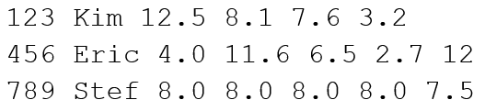
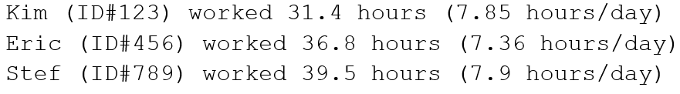
Hours Question (1 of 2)
Given a file hours.txt with the following contents:
Consider the task of computing hours worked by each person:
Let’s try to solve this problem token-by-token ...

Slide 3
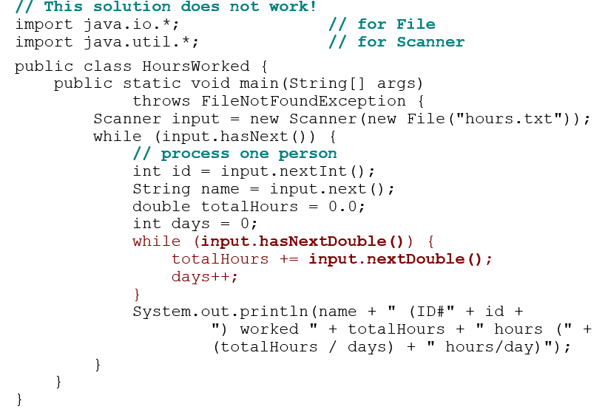
Hours Answer (Flawed)

Slide 4
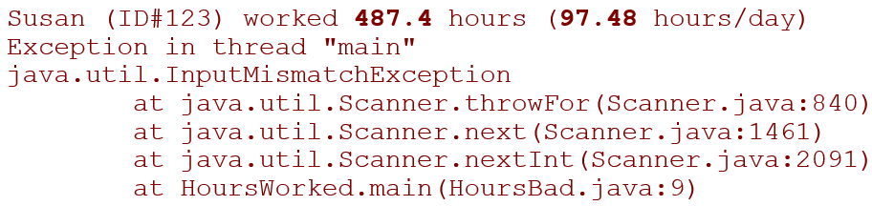
Flawed Output
The inner while loop is grabbing the next person’s I D.
We want to process the tokens, but we also care about the line breaks (they mark the end of a person’s data).
A better solution is a hybrid approach:
First, break the overall input into lines.
Then break each line into tokens.

Slide 5
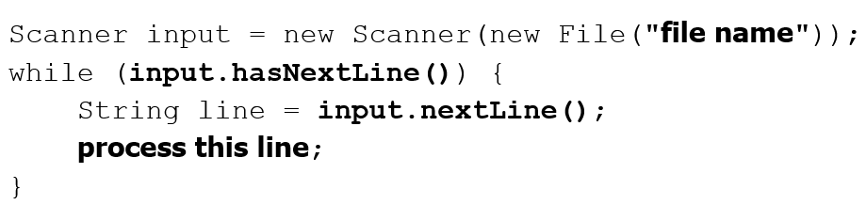
Line-based Scanners
Method | Description
nextLine() | returns next entire line of input (from cursor to \n)
hasNextLine() | returns true if there are any more lines of input to read (always true for console input)

Slide 6

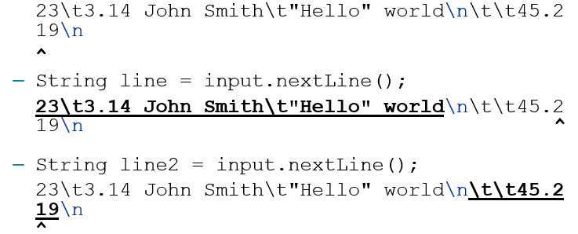
Consuming Lines of Input
The Scanner reads the lines as follows:
Each \n character is consumed but not returned.

Slide 7
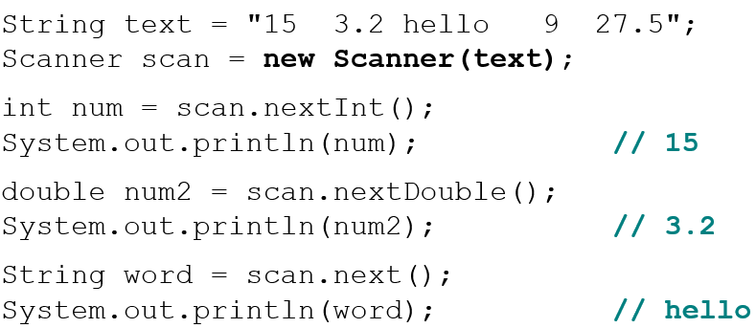
Scanners on Strings
A Scanner can tokenize the contents of a String:
Example:

Slide 8
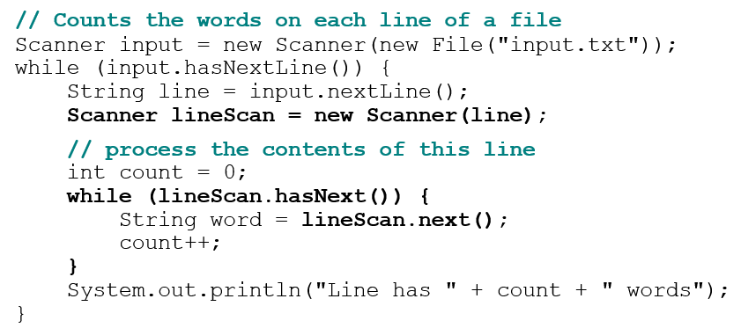
Mixing Lines and Tokens 1
Input file input.txt: | Output to console:
The quick brown fox jumps over the lazy dog. | Line has 6 words Line has 3 words

Slide 9
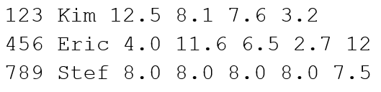
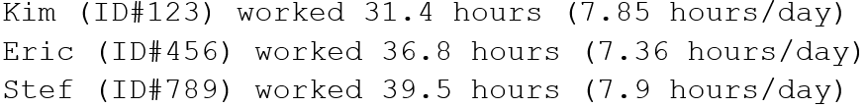
Hours Question (2 of 2)
Fix the Hours program to read the input file properly:
Recall, it should produce the following output:
Notes:
Draw a picture (or write it in the file as comments) of the two Scanners (input and lineScanner) as each one advances.

Slide 10
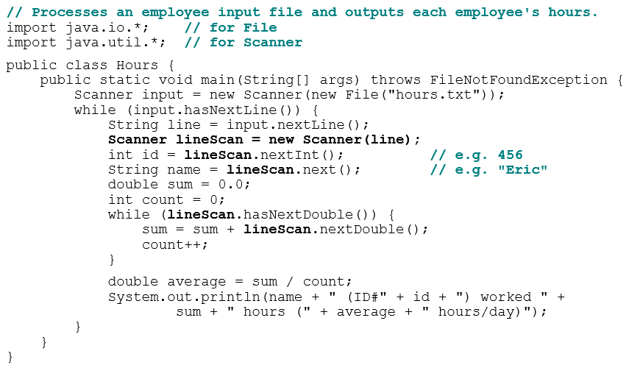
Hours Answer, Corrected
Notes:
common bugs here:
- not understanding the difference between a String and a Scanner. They try to call line.nextInt() or similar.
- calling a method on the wrong Scanner. e.g. They forget to change input to lineScan.

Slide 11
In-Class Assignment 2, Part 1
Create the project and class MoreFiles in BluJ
Download the hockey2.txt file from Canvas and store it in the same directory as the .java file in your project.
In the main program, do the following:
Create a Scanner object named input that is associated with the hockey2.txt file.
Within a while loop, do the following for each line of text:
Read each line into a String variable named text.
Call a void method named hockeyData that has a String parameter. Within this method, do the following:
Create a Scanner object named info and associate it with the parameter.
Read the first and last name into String variables named first and last, respectively. Read the team name into a String variable named team and the jersey number into an int variable named num.
Using a while loop, add the goals for each of the last 5 seasons in an integer variable named total.
Use System.out.println along with the variables to display the first name, last name, team, jersey number, and the total in a sentence.

Slide 12
File Output

Slide 13

Output to Files
PrintStream: An object in the java.io package that lets you print output to a destination such as a file.
Any methods you have used on System.out (such as print, println) will work on a PrintStream.
Syntax:
Example:

Slide 14
Details About PrintStream
If the given file does not exist, it is created.
If the given file already exists, it is overwritten.
The output you print appears in a file, not on the console. You will have to open the file with an editor to see it.
Do not open the same file for both reading (Scanner) and writing (PrintStream) at the same time.
You will overwrite your input file with an empty file (0 bytes).
Notes:
common PrintStream bug:
- declaring it in a method that gets called many times. This causes the file to be re-opened and wipes the past contents. So only the last line shows up in the file.

Slide 15
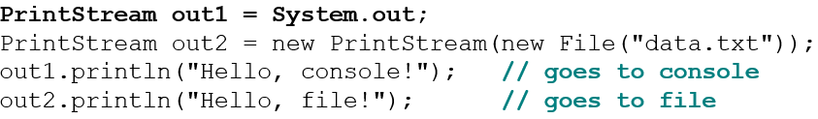
System.out and PrintStream
The console output object, System.out, is a PrintStream.
A reference to it can be stored in a PrintStream variable.
Printing to that variable causes console output to appear.
You can pass System.out to a method as a PrintStream.
Allows a method to send output to the console or a file.

Slide 16
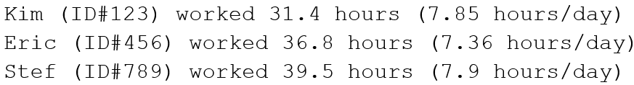
PrintStream Question
Modify our previous Hours program to use a PrintStream to send its output to the file hours_out.txt.
The program will produce no console output.
But the file hours_out.txt will be created with the text:

Slide 17
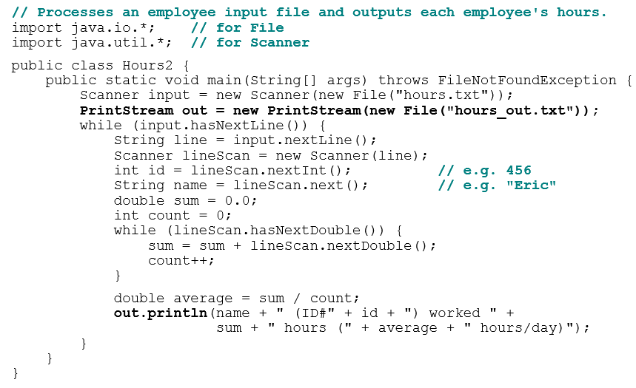
PrintStream Answer
Notes:
You should also probably show them the version that has a static method for processing one person's data. It takes a String line and a PrintStream as parameters.

Slide 18
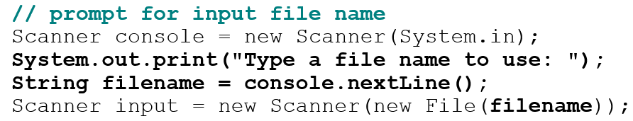
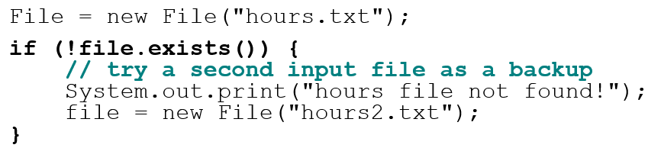
Prompting for a File Name
We can ask the user to tell us the file to read.
The filename might have spaces; use nextLine(), not next()
Files have an exists method to test for file-not-found:

Slide 19
In-Class Assignment 2, Part 2
Update the code in the class MoreFiles as follows:
In the main program, create a PrintStream object named output that will be associated with a file named results.txt.
Update the hockeyData method so that is now has two parameters: first parameter is a String and the second is a PrintStream. Update the method’s code to do the following:
Create a String variable named team that will store the name of the team from each line before storing the first and last name.
After the total has been calculated, declare two String variables named line1 and line2.
The line1 variable will be set equal to a sentence using the variables for the first name, last name, team, and jersey number.
The line2 variable will be set equal to a sentence saying how many goals the player has scored over the past 5 years. The total variable should be used.
Output line1 and line2 to the output file using the PrintStream parameter.
Back in main, update the input Scanner to be associated with the file results.txt.
Use a while loop to display all lines of text in the results.txt file.

Slide 20

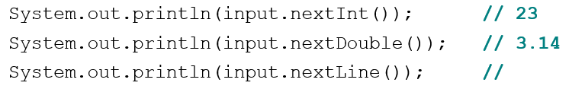
Mixing Tokens and Lines
Using nextLine in conjunction with the token-based methods on the same Scanner can cause bad results.
You’d think you could read 23 and 3.14 with nextInt and nextDouble, then read Joe "Hello" world with nextLine.
But the nextLine call produces no output! Why?
Notes:
I don't intend to reach this in lecture; it's just extra information.

Slide 21
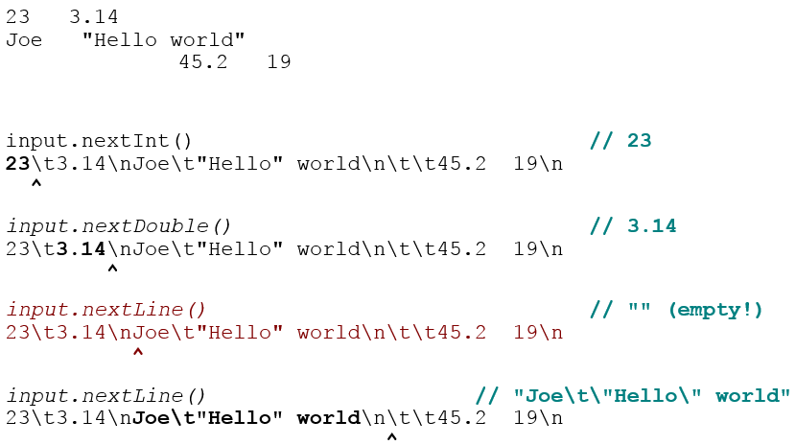
Mixing Lines and Tokens 2
Don’t read both tokens and lines from the same Scanner:

Slide 22
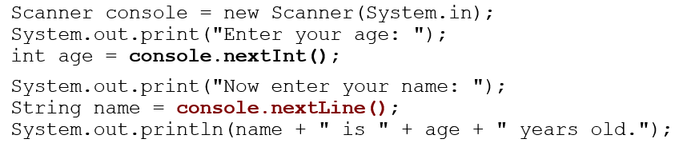

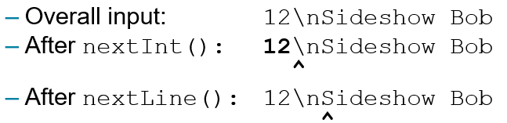
Line-and-token Example
Log of execution (user input underlined):
Why?

Slide 23
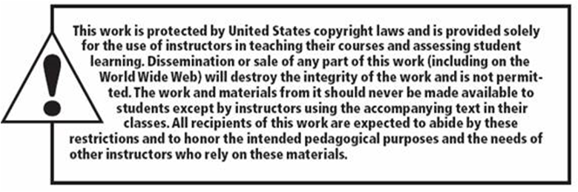
Copyright

