Slide 1
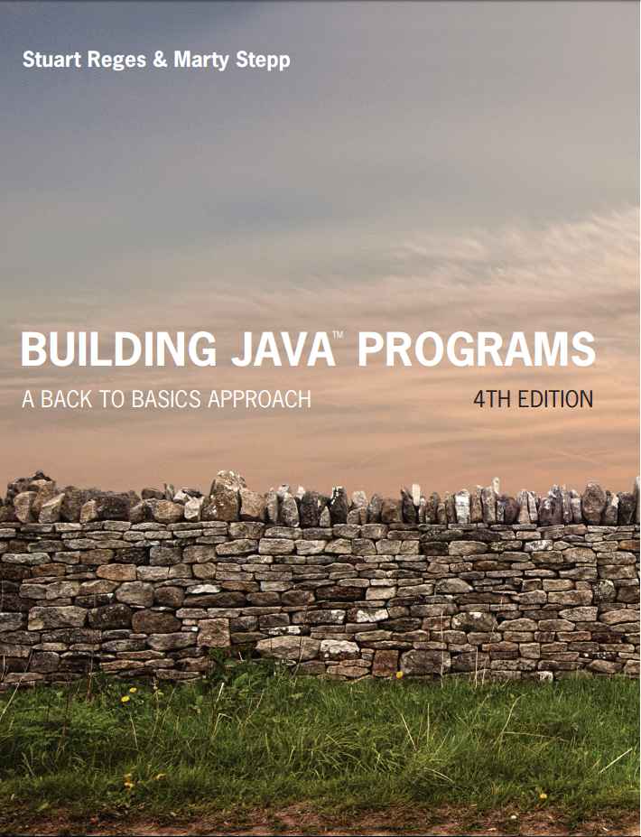
Building Java Programs
Fourth Edition
Chapter 7, Sec 7.1
Arrays
Copyright © 2017, 2014, 2011 Pearson Education, Inc. All Rights Reserved
Notes:
If this PowerPoint presentation contains mathematical equations, you may need to check that your computer has the following installed:
1) MathType Plugin
2) Math Player (free versions available)
3) NVDA Reader (free versions available)

Slide 2
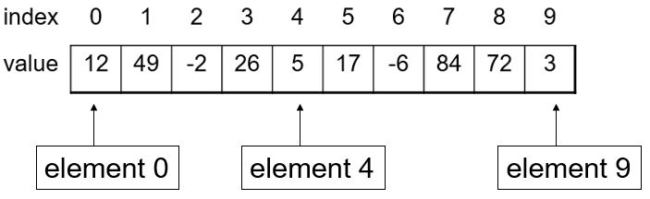
Arrays
array: object that stores many values of the same type.
element: One value in an array.
index: A 0-based integer to access an element from an array.

Slide 3
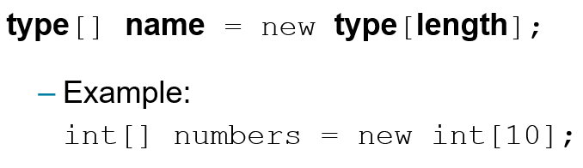
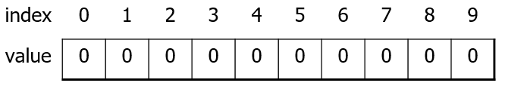
Array Declaration (1 of 2)

Slide 4

Array Declaration (2 of 2)
The length can be any integer expression.
Each element initially gets a “zero-equivalent” value.
Type | Default value
int | 0
double | 0.0
boolean | false
String or other object | Null (means, “no object”

Slide 5
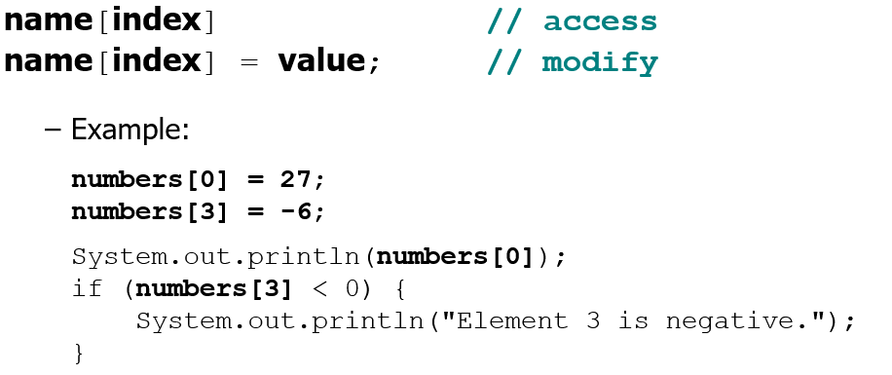
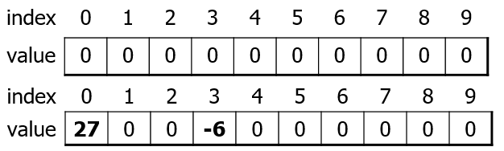
Accessing Elements

Slide 6
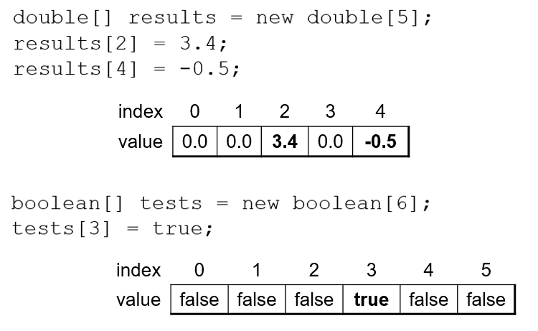
Arrays of Other Types

Slide 7
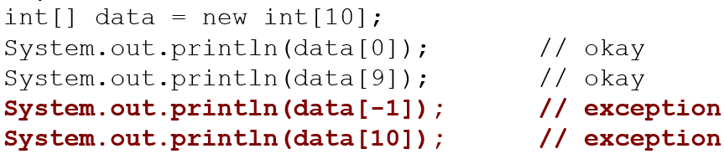

Out-Of-Bounds
Legal indexes: between 0 and the array's length −1.
Reading or writing any index outside this range will throw an
Example:

Slide 8
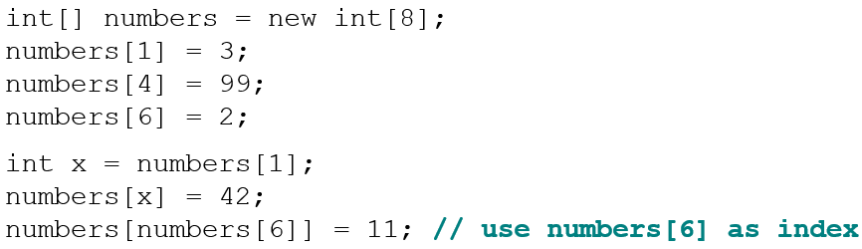
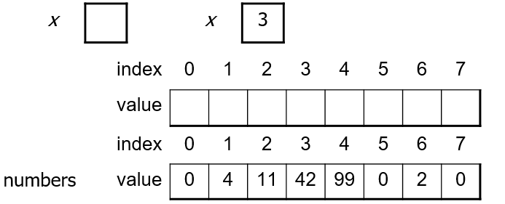
Accessing Array Elements

Slide 9
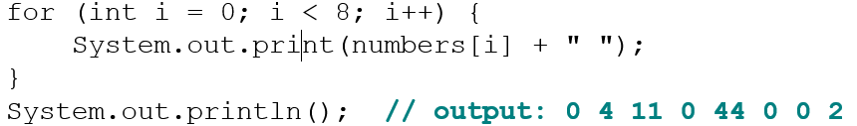
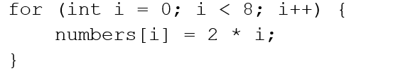
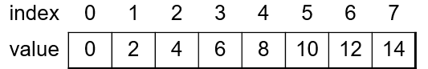
Arrays and for Loops
It is common to use for loops to access array elements.
Sometimes we assign each element a value in a loop.

Slide 10
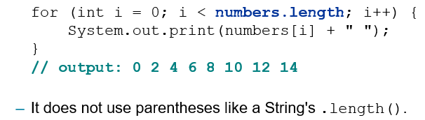
The Length Field
An array’s length field stores its number of elements.
Name.length
What expressions refer to:
The last element of any array?
The middle element?

Slide 11
In-Class Assignment 1, Part 1
Create the project and class BoxOffice in BlueJ
In the main program, do the following:
Create a Scanner object for keyboard input.
Prompt the user to enter the number of weeks of box office figures for the movie Black Panther. Store this value in an integer variable named weeks.
Declare a double array named panther, using the weeks variable for the number of elements.
Using a for loop going from 0 to one less than the length of the array, do the following:
Prompt the user to input the box office figures for each week of the movie’s run and store each figure in its correct position in the array.
Add this figure to a double variable named total.
Using another for loop, display the box office figures for each week. After this loop is finished, display the total.
For the first 6 weeks, enter the following figures: 291.9, 143.4, 85.5, 57.5, 35.9, 25.2. The total for 6 weeks should be 639.4 million dollars.

Slide 12

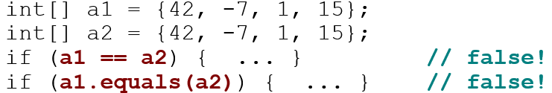
Limitations of Arrays
You cannot resize an existing array:
You cannot compare arrays with == or equals:
An array does not know how to print itself:

Slide 13
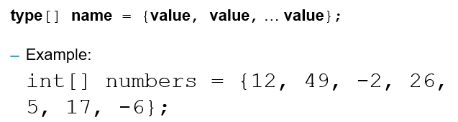
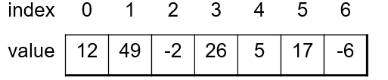
Quick Array Initialization
Useful when you know what the array’s elements will be
The compiler figures out the size by counting the values

Slide 14
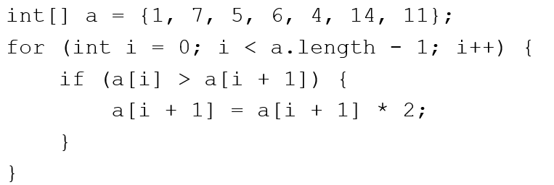
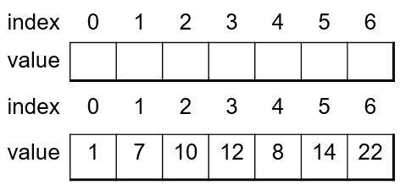
“Array Mystery” Problem
traversal: An examination of each element of an array.
What element values are stored in the following array?

Slide 15
Arrays as Parameters
Notes:
If this PowerPoint presentation contains mathematical equations, you may need to check that your computer has the following installed:
1) MathType Plugin
2) Math Player (free versions available)
3) NVDA Reader (free versions available)

Slide 16
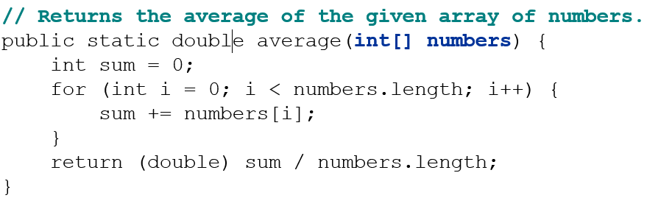
Array Parameter (Declare)
Example:
You don’t specify the array’s length (but you can examine it).

Slide 17
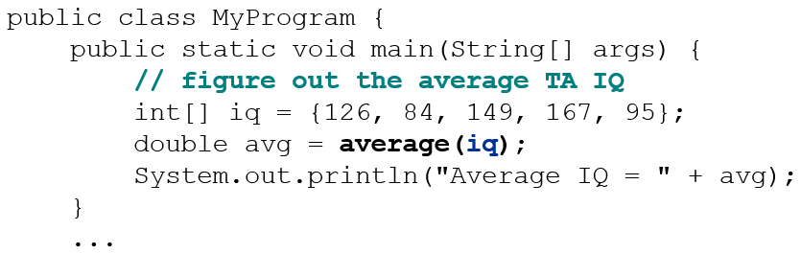
Array Parameter (Call)
Example:
Notice that you don’t write the

Slide 18
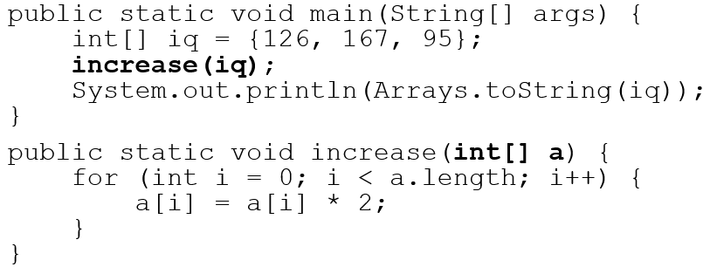
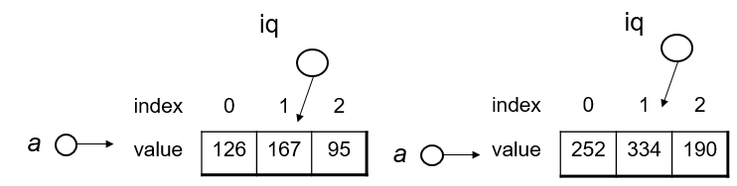
Arrays Pass by Reference
Arrays are passed as parameters by reference.
Changes made in the method are also seen by the caller
Output:
[252, 334, 190]

Slide 19
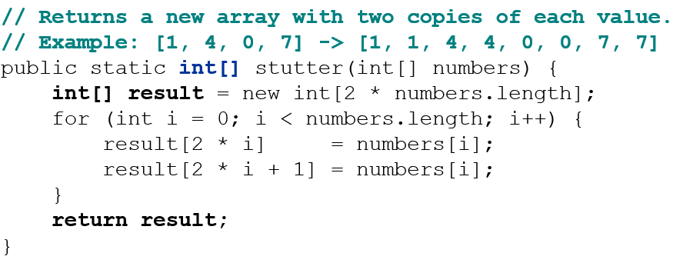
Array Return (Declare)
Example:

Slide 20
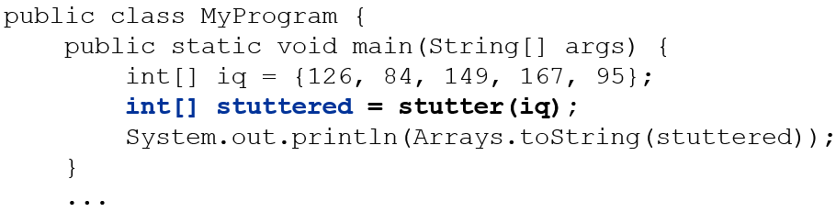
Array Return (Call)
Example:
Output:

Slide 21
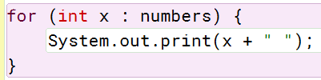

The for-each loop
Alternate loop structure
Used to examine each element of an array
Looks like this:
for (<type> <name> : <array>) { …}
Example:
Output:

Slide 22
In-Class Assignment 1, Part 2
Modify the BoxOffice program by doing the following:
Declare an array named incred of type double and give it the following values in the declaration: 269.4, 124.7, 81.2, 44.2, 26.2, 19.8. This represents box office figures for the first 6 weeks of the movie Incredibles 2.
Create a method named compare that will accept two double arrays as parameters, which contain weekly box office figures for the two movies, and two String parameters, which are the titles of the two movies. The method will return a String array.
Declare a String array named titles whose length is the same as either of the two arrays passed in as parameters.
Use a for loop to do the following:
Compare the two box office figures for each week to determine which is bigger and store the title of the movie that had the bigger box office during each week in each respective element of the titles array.
When the method is finished, return the titles array.
In main, declare an array of Strings named titles that will accept the array returned by the compare method.
Using a for-each loop, print each element of the titles array in a sentence, like this:
Black Panther had the bigger box office figures in Week 1.

Slide 23
The Arrays Class
Class Arrays in package java.util has useful static methods for manipulating arrays:
Method name | Description
binarySearch(array, value) | returns the index of the given value in a sorted array (or < 0 if not found)
copyOf(array, length) | returns a new copy of an array
equals(array1, array2) | returns true if the two arrays contain same elements in the same order
fill(array, value) | sets every element to the given value
sort(array) | arranges the elements into sorted order
toString(array) | returns a string representing the array, such as “[10, 30, -25, 17]”
Syntax:Arrays.methodName(parameters)

Slide 24
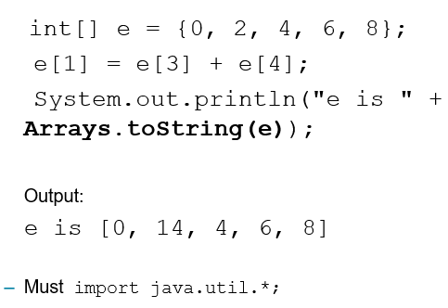
Arrays.toString
Arrays.toString accepts an array as a parameter and returns a String representation of its elements.

Slide 25
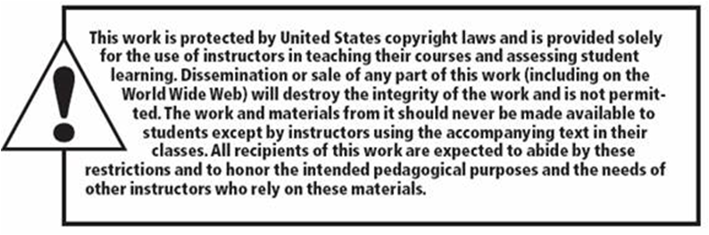
Copyright

