Slide 1
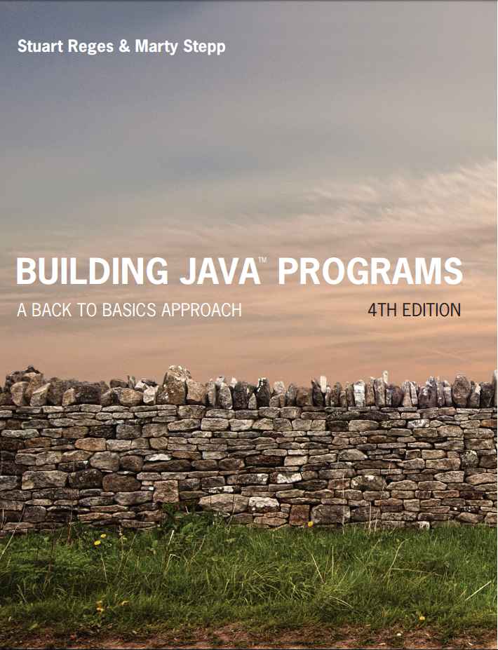
Building Java Programs
Fourth Edition
Chapter 7, Sections 7.2 and 7.3
Arrays
Copyright © 2017, 2014, 2011 Pearson Education, Inc. All Rights Reserved
Notes:
If this PowerPoint presentation contains mathematical equations, you may need to check that your computer has the following installed:
1) MathType Plugin
2) Math Player (free versions available)
3) NVDA Reader (free versions available)

Slide 2
Array-Traversal Algorithms
Notes:
If this PowerPoint presentation contains mathematical equations, you may need to check that your computer has the following installed:
1) MathType Plugin
2) Math Player (free versions available)
3) NVDA Reader (free versions available)

Slide 3
Searching for a value in an array
Suppose you want to find out how many times a certain value appears in an integer array.
Call the array list and call the value target.
How do we do this?
Check each value in the array to see if it matches the target value.
If it does, increase the count by 1.
Do this for each element of the array.
This means we’re going to need to have a counter variable and use a loop (for or for-each) to traverse the array.

Slide 4
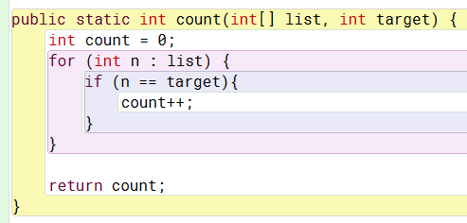
Code for searching for appearances of a value

Slide 5
Searching for location of a value in an array
Suppose you want to find the location (index) of the first appearance of a certain value that appears in an integer array.
Call the array list and call the value target.
How do we do this?
Check each element in the array to see if it matches the target value.
If it does, save the index of that element.
Do this until we find the target value.
If we don’t find the target value, use -1 for the index value.
This means we’re going to use a for loop to traverse the array.

Slide 6
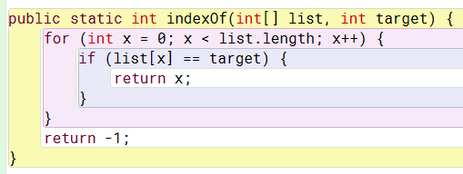
Code for searching for location of a value

Slide 7
Replacing values in an array
Suppose you want to replace all ocurrences of a certain (target) value in an array with a new value.
Call the array list, call the current value target and call the new value newVal.
How do we do this?
Check each element in the array to see if it matches the target value.
If it does, replace it with newVal.
Do this for all elements of the array
This means we’re going to use a for loop to traverse the array.

Slide 8
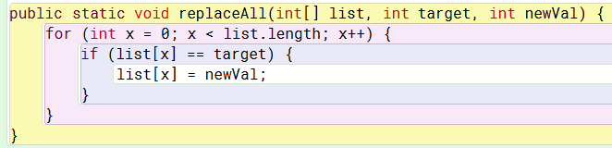
Code for replacing values

Slide 9
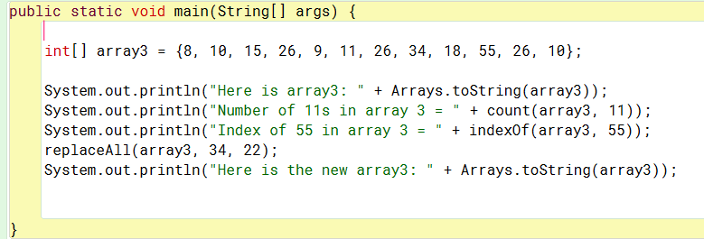
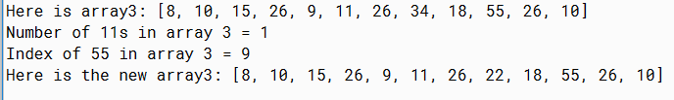
Example of using these three methods

Slide 10
In-Class Assignment 2, Part 1
Create a project and class named MoreArrays in BlueJ.
In main(), declare an array of type String named array4, which should look like this:
Create methods named count, indexOf and replaceAll just like the ones in the examples, except the ones you make need to handle arrays of type String.
This means you will have to use the equals() method for Strings.
In the main program, do the following:
Use the Array.toString method to display array4.
Use the count method to display the number of times the word “hockey” appears in the array
Use the indexOf method to display the index of the first occurrence of the word “rubgy”.
Use the replaceAll method to replace all occurrences of the word “football” with the word “tennis”.
Use the Array.toString method to display array4 again.

Slide 11
Reversing an Array
Notes:
If this PowerPoint presentation contains mathematical equations, you may need to check that your computer has the following installed:
1) MathType Plugin
2) Math Player (free versions available)
3) NVDA Reader (free versions available)

Slide 12
Array Reversal Question
Write code that reverses the elements of an array.
For example, if the array initially stores:
[11, 42, -5, 27, 0, 89]
Then after your reversal code, it should store:
[89, 0, 27, -5, 42, 11]
The code should work for an array of any size.
Hint: think about swapping various elements...

Slide 13
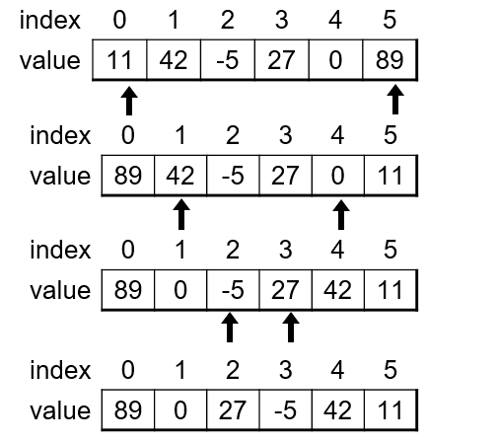
Algorithm Idea
Swap pairs of elements from the edges; work inwards:

Slide 14
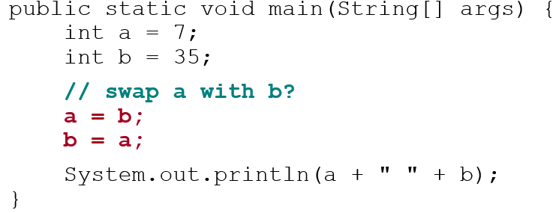
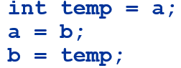
Swapping Values
What is wrong with this code? What is its output?
The red code should be replaced with:

Slide 15
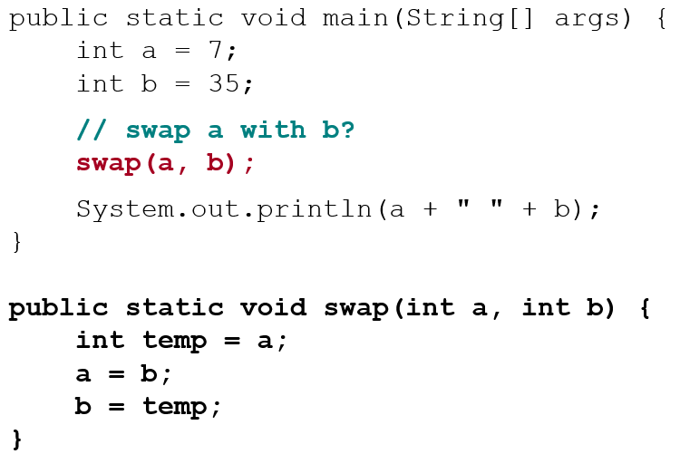
A Swap Method?
Does the following swap method work? Why or why not?

Slide 16
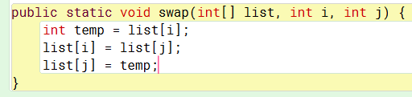
A Swap Method – for real this time…
The previous method doesn’t work because we are using the primitive type of int for the parameters.
Those parameters will not keep the changed values once the method ends.
But…array parameters keep changed values when the method ends, so…

Slide 17
Calling the swap method
We need to figure out what integer parameters (indexes) to send to the swap method each time we call it.
First time
We send index 0(=i) and index list.length – 1(=j)
1=0+1,so list.length-1=list.length-(0+1)=list.length-0-1
Second time
We send index 1(=i) and index list.length – 2(=j)
2=1+1,so list.length-2=list.length-(1+1)=list.length-1-1
Third time
We send index 2(=i) and index list.length – 3(=j)
3=2+1,so list.length-3=list.length-(2+1)=list.length-2-1
This means j = list.length – i - 1

Slide 18
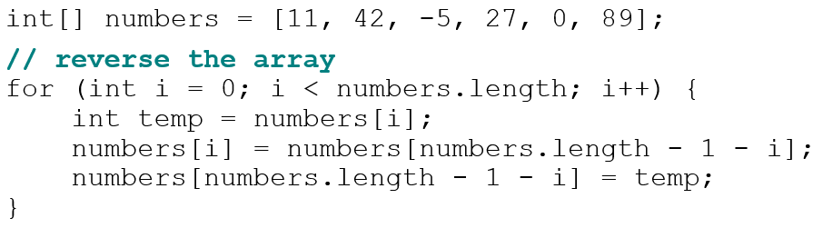
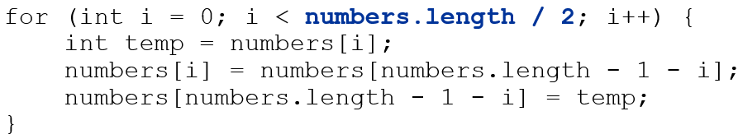
Flawed Algorithm
What’s wrong with this code?
The loop goes too far and un-reverses the array! Fixed version:

Slide 19
In-Class Assignment 2, Part 2
Modify the ArrayStuff class in BluJ as follows:
Create a swap method like the one shown earlier in this presentation.
In the main program, do the following:
Use a for loop to reverse array3. Call the swap method within the for loop.
Use the Array.toString method to display array3 after it has been reversed.

Slide 20
Reference Semantics

Slide 21
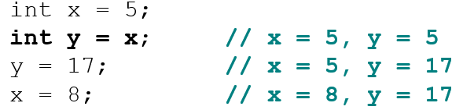
Value Semantics
value semantics: Behavior where values are copied when assigned, passed as parameters, or returned.
All primitive types in Java use value semantics.
When one variable is assigned to another, its value is copied.
Modifying the value of one variable does not affect others.

Slide 22
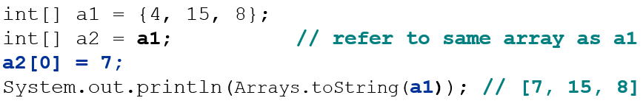
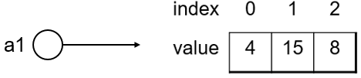
Reference Semantics (Objects) (1 of 2)
reference semantics: Behavior where variables actually store the address of an object in memory.
When one variable is assigned to another, the object is not copied; both variables refer to the same object.
Modifying the value of one variable will affect others.

Slide 23
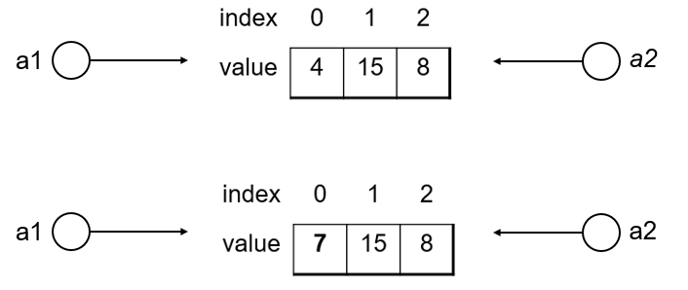
Reference Semantics (Objects) (2 of 2)

Slide 24
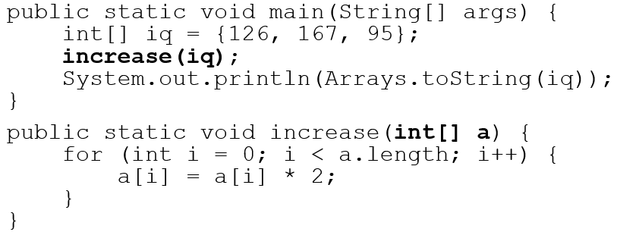
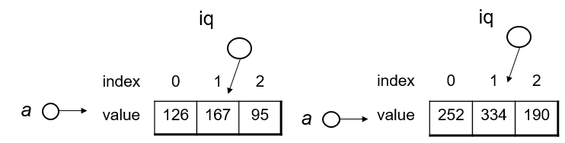
Arrays Pass by Reference
Arrays are passed as parameters by reference.
Changes made in the method are also seen by the caller
Output:
[252, 334, 190]

Slide 25
In-Class Assignment 2, Part 3
Add code to the MoreArrays project as :
Create two integer arrays named a1 and a2. Initialize them as follows:
int[] a1 = {10, 22, 15, 33, 25, 41, 38};
int[] a2 = {51, 98, 47, 29, 62, 76, 81};
Declare another integer array named a3 and set it equal to a1.
Declare another integer array named a4 and set it equal to a2.
Use Arrays.toString to print all 4 arrays, one at a time.
Create a void method called decrease that accepts an integer array as a parameter and uses a for loop to decrease each element of the array by 15.
Call the decrease method and pass a1 as a parameter.
Create a void method called increase that accepts an integer array as a parameter and uses a for loop to increase each element of the array by 15.
Call the decrease method and pass a2 as a parameter.
Use Arrays.toString to print all 4 arrays, one at a time.

Slide 26

Copyright

