Slide 1
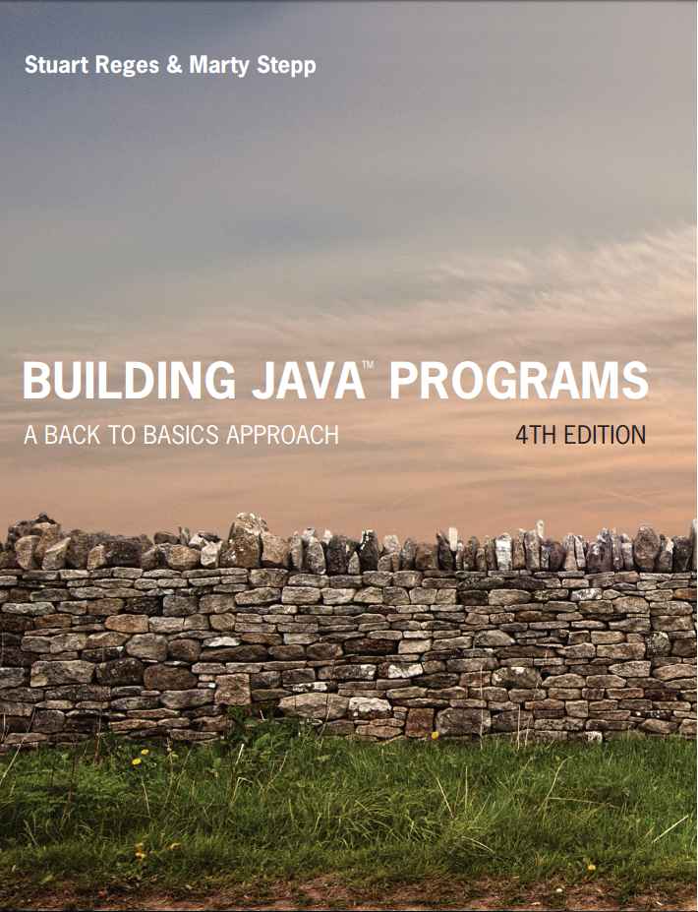
Building Java Programs
Fourth Edition
Chapter 7, Section 7.4
Arrays
Copyright © 2017, 2014, 2011 Pearson Education, Inc. All Rights Reserved
Notes:
If this PowerPoint presentation contains mathematical equations, you may need to check that your computer has the following installed:
1) MathType Plugin
2) Math Player (free versions available)
3) NVDA Reader (free versions available)

Slide 2
Shifting Values in an Array
Notes:
If this PowerPoint presentation contains mathematical equations, you may need to check that your computer has the following installed:
1) MathType Plugin
2) Math Player (free versions available)
3) NVDA Reader (free versions available)

Slide 3
Shifting Left
Suppose we have an array named list, like this:
list
Goal: Move first element to end of array and shift all other elements one spot to the left, so that we get this:
list
We need to save the value of the first element in a variable and then figure out how we’re going to move the others.
3 | 8 | 9 | 7 | 5
8 | 9 | 7 | 5 | 3

Slide 4
Start of Code
Variable to save first element:
int first = list[0];
Moving elements means this happens:
We overwrite array values in this way:
list[0] = list[1];
list[1] = list[2];
list[2] = list[3];
list[3] = list[4];
3 | 8 | 9 | 7 | 5
8 | 9 | 7 | 5 | 5

Slide 5
Time to Use a Loop
This means that, if i represents the index of an element, we do this:
list[i] = list[i+1];
Now we can make a loop
for (int i = 0; ?????; i++) {
list[i] = list[i+1]; }
But….what should the condition be????
Ponder this: How many elements need to be shifted?
It’s 4, rather than 5, since we will just set the last element equal to the first element when done.
So condition should be: i < list.length - 1

Slide 6
In-Class Assignment 1, Part 1
Create the project and class ShiftArrays in BluJ
Add import java.util.*;
In the main program, do the following:
Declare an integer array named list1 and give it the following values (in this order): 6,8,10,5,7,3,1
Use Arrays.toString() to display the elements of list1.
Create a void method named shiftLeft that accepts an integer array as a parameter. Have this method do the following:
Set the first element of the parameter to a local variable named first.
Use a for loop to shift all elements of the parameter (except the last element) one spot to the left.
After the loop is complete, set the last element of the parameter to the variable.
Back in main, call the shiftLeft method, with list1 as the parameter.
Use Arrays.toString() to display the elements of list1 after shifting left.

Slide 7
Shifting Right
Suppose we have an array named list, like this:
list
Goal: Move first element to end of array and shift all other elements one spot to the left, so that we get this:
list
We need to save the value of the last element in a variable and then figure out how we’re going to move the others.
3 | 8 | 9 | 7 | 5
5 | 3 | 8 | 9 | 7

Slide 8
Start of Code
Variable to save last element:
int last = list[list.length-1];
Moving elements means this happens:
We overwrite array values in this way:
list[1] = list[0];
list[2] = list[1];
list[3] = list[2];
list[4] = list[3];
3 | 8 | 9 | 7 | 5
3 | 3 | 8 | 9 | 7

Slide 9
Time to Use a Loop
This means that, if i represents the index of an element, we do this:
list[i] = list[i-1];
But how should we do the loop?
for (int i = 0; i < list.length; i++) {
list[i] = list[i-1]; }
No good; first time through, we get list[0]=list[-1]
for (int i = 1; i < list.length; i++) {
list[i] = list[i-1]; }
Still no good; results in all elements being the same
Need to do this in reverse…

Slide 10
In-Class Assignment 1, Part 2
Update the ShiftArrays class as follows:
In the main program, do the following:
Declare an integer array named list2 and give it the following values (in this order): 8,6,7,5,3,0,9
Use Arrays.toString() to display the elements of list2.
Create a void method named shiftRight that accepts an integer array as a parameter. Have this method do the following:
Set the last element of the parameter to a local variable named last.
Use a for loop to shift all elements of the parameter (except the first element) one spot to the right.
The loop counter should start at the index of the last element and count down, as long as the counter is greater than or equal to 1
After the loop is complete, set the first element of the parameter to the variable.
Back in main, call the shiftRight method, with list2 as the parameter.
Use Arrays.toString() to display the elements of list2 after shifting right.

Slide 11
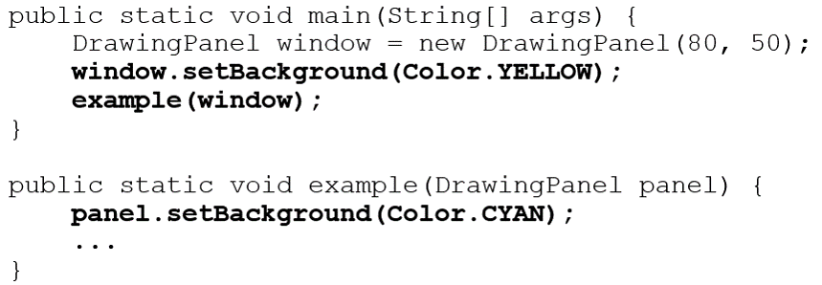
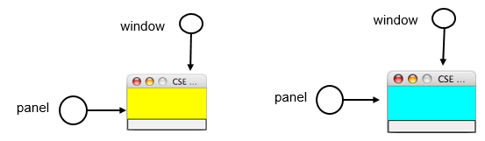
Objects as Parameters
When an object is passed as a parameter, the object is not copied. The parameter refers to the same object.
If the parameter is modified, it will affect the original object.

Slide 12

Copyright

