Slide 1
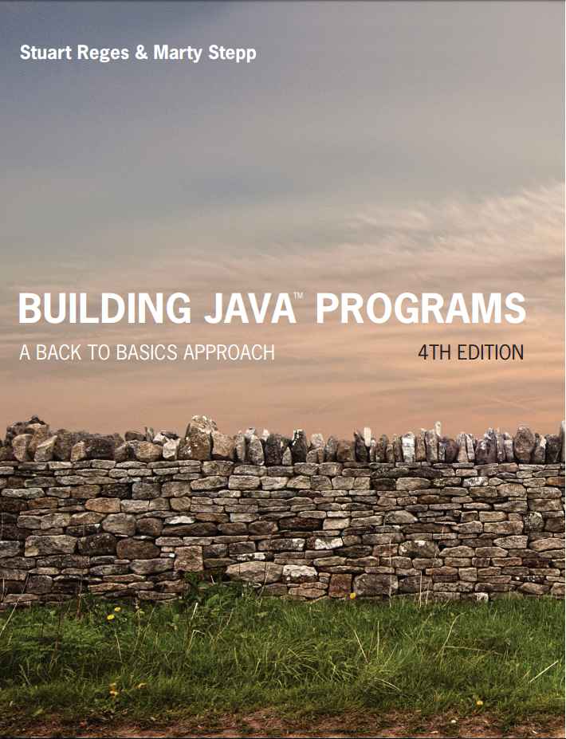
Building Java Programs
Fourth Edition
Chapter 7, Section 7.5
Arrays
Copyright © 2017, 2014, 2011 Pearson Education, Inc. All Rights Reserved
Notes:
If this PowerPoint presentation contains mathematical equations, you may need to check that your computer has the following installed:
1) MathType Plugin
2) Math Player (free versions available)
3) NVDA Reader (free versions available)

Slide 2
Two-Dimensional Arrays
Notes:
If this PowerPoint presentation contains mathematical equations, you may need to check that your computer has the following installed:
1) MathType Plugin
2) Math Player (free versions available)
3) NVDA Reader (free versions available)

Slide 3
Declaration
Can have any number of rows and columns
int[][] grid = new int[3][5]
This array has 3 rows and 5 columns
In memory, it looks like this:
grid col 0 col 1 col 2 col 3 col 4
row 0
row 1
row 2
0 | 0 | 0 | 0 | 0
0 | 0 | 0 | 0 | 0
0 | 0 | 0 | 0 | 0

Slide 4
Setting elements to values
Must use both row and column indexes
grid[0][3] = 8; // first row, fourth col
grid[2][0] = 4; // third row, first col
In memory, it looks like this:
grid col 0 col 1 col 2 col 3 col 4
row 0
row 1
row 2
0 | 0 | 0 | 8 | 0
0 | 0 | 0 | 0 | 0
4 | 0 | 0 | 0 | 0

Slide 5
Passing parameters
Two-dimensional arrays can be passed as parameters just like one-dimensional arrays.
A method can also return a two dimensional array.
public static void print(int[][] grid) {
for (int i=0; i < grid.length; i++) {
for (int j=0; j < grid[i].length; j++) {
System.out.print(grid[i][j]+” “);
}
}
}
grid.length = number of rows; grid[i].length = number of columns

Slide 6
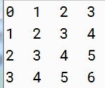
In-Class Assignment 2, Part 1
Create the project and class TwoD in BlueJ.
In the main program, do the following:
Declare a two-dimensional integer array named vals with 4 rows and 4 columns.
Create and call each of the following void methods, which will accept the two-dimensional array as a parameter.
init – initializes each element of the array to its row index plus its column index.
display – displays the array row by row. This method should use System.out.printf to make sure each value is displayed in a field of 3 characters and is left justified. It should look like this:

Slide 7
Jagged Arrays
Arrays where not all rows have the same number of columns.
Declare rows, then declare columns in each individual row
int[][] jagged = new int[3][];
jagged[0] = new int[2];
jagged[1] = new int[3];
jagged[2] = new int[4];
We get this:
col 0 col 1 col 2 col 3
row 0
row 1
row 2
0 | 0
0 | 0 | 0
0 | 0 | 0 | 0

Slide 8
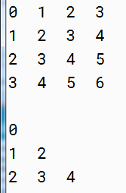
In-Class Assignment 2, Part 2
Update the TwoD class as follows:
Declare a two-dimensional integer array named nums with 3 rows. Do not designate a number of columns for this array.
Construct each row of the nums array in the following manner.
First row has 1 column.
Second row has 2 columns.
Third row has 3 columns.
Call the init and display methods, passing the nums array to both methods as a parameter.
The display should look like this:

Slide 9
Using Nested Loops with Jagged Arrays
Suppose we want to build an array that looks like this:
First declare a jagged array with 3 rows:
int[][] stuff = new int[3][];
int num = 0;
We can use for loops to define how many columns are in each row.
There are three rows, so we know stuff.length = 3
Row 0 will have 1 column and 1 = 0 + 1
Row 1 will have 2 columns and 2 = 1 + 1
Row 2 will have 3 columns and 3 = 2 + 1
col 0 col 1 col 2
row 0
row 1
row 2
0
1 | 1
2 | 2 | 2

Slide 10
Code for nested loops
Need an outer loop for the rows. Counter i is row number
Inside this loop, create i + 1 columns for each row and use another loop to give values to the columns.
int[][] stuff = new int[3][]
int num = 0;
for (int i = 0; i < stuff.length; i++) {
stuff[i] = new int[i+1]; // make column
for (int j = 0; j <= i; j++) {
stuff[i][j] = num;
} // end inner loop
num++;
} // end outer loop

Slide 11
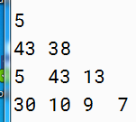
In-Class Assignment 2, Part 3
Update the TwoD class as follows:
Add the line import java.util.*; to the beginning.
Create an object of type Random named r.
Declare a two-dimensional integer array named data with 4 rows.
Use nested for loops to create 1 column for the row 0, 2 columns for row 1, and so on, and give the elements in each column a random integer value that is between 1 and 50.
Call the display method, passing the data array as a parameter.
The display should look similar to this:

Slide 12

Copyright

