Slide 1
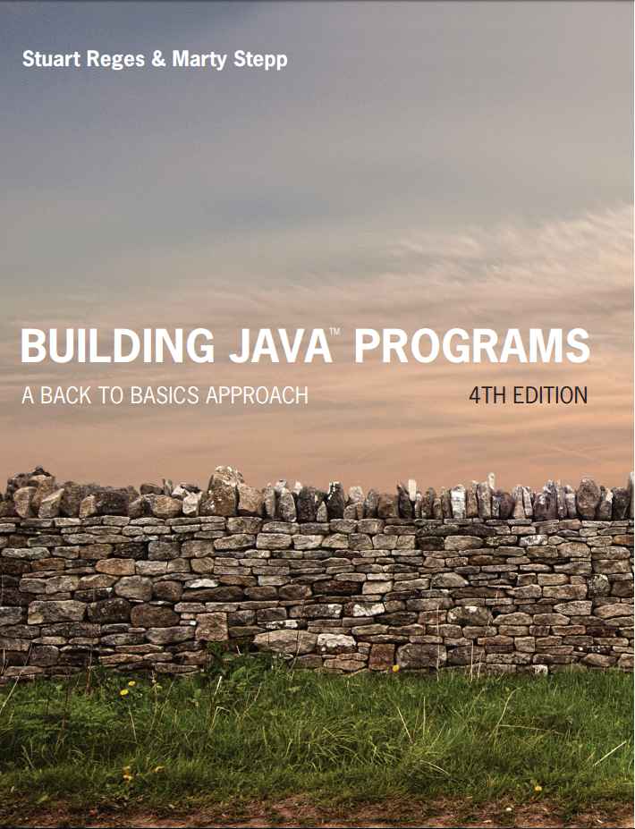
Building Java Programs
Fourth Edition
Chapter 1
Sections 1 and 2
Introduction to Java Programming
Copyright © 2017, 2014, 2011 Pearson Education, Inc. All Rights Reserved
Notes:
If this PowerPoint presentation contains mathematical equations, you may need to check that your computer has the following installed:
1) MathType Plugin
2) Math Player (free versions available)
3) NVDA Reader (free versions available)

Slide 2
What is Computer Science? (1 of 2)
Computer Science
The study of theoretical foundations of information and computation and their implementation and application in computer systems. --Wikipedia
Many subfields
Graphics, Computer Vision
Artificial Intelligence
Scientific Computing
Robotics
Databases, Data Mining
Computational Linguistics, Natural Language

Slide 3
What is Computer Science? (2 of 2)
Computer Engineering
Overlap with C S and E E; emphasizes hardware

Slide 4
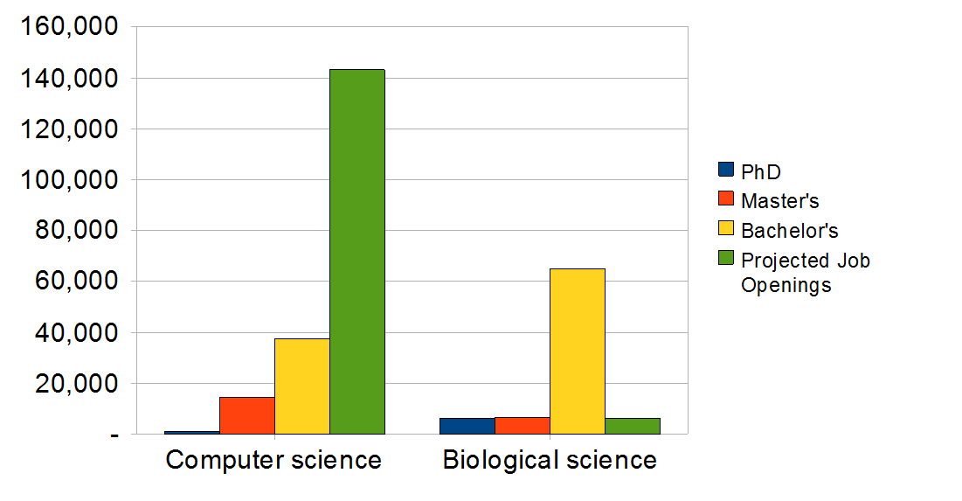
The C S Job Market
SOURCES: Tabulated by National Science Foundation/Division of Science Resources Statistics; data from Department of Education/National Center for Education Statistics: Integrated Postsecondary Education Data System Completions Survey; and N S F/S R S: Sur

Slide 5

What is Programming?
program: A set of instructions to be carried out by a computer.
program execution: The act of carrying out the instructions contained in a program.
programming language: A systematic set of rules used to describe computations in a format that is editable by humans.
This textbook teaches programming in a language named Java.

Slide 6
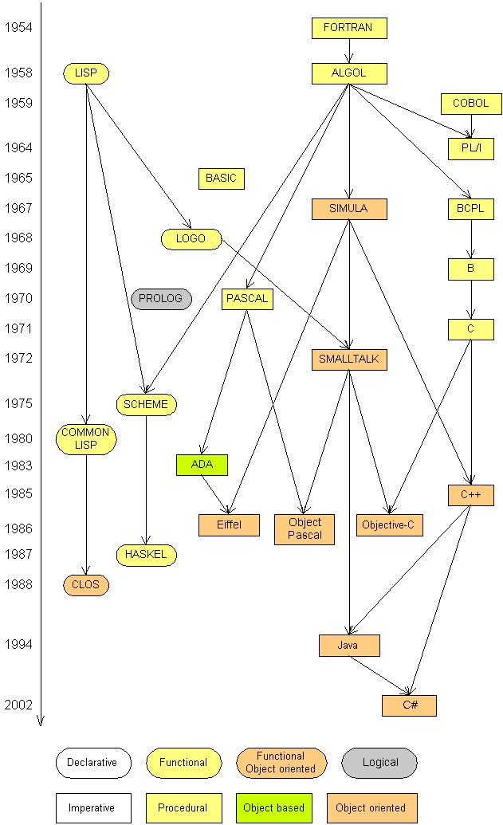
Programming Languages
Some influential ones:
F O R T R A N
science / engineering
C O B O L
business data
L I S P
logic and A I
B A S I C
a simple language

Slide 7
Some Modern Languages (1 of 2)
procedural languages: programs are a series of commands
Pascal (1970):designed for education
C (1972): low-level operating systems and device drivers
functional programming: functions map inputs to outputs
Lisp (1958) / Scheme (1975), M L (1973), Haskell (1990)

Slide 8
Some Modern Languages (2 of 2)
object-oriented languages: programs use interacting “objects”
Smalltalk (1980): first major object-oriented language
C++ (1985): “object-oriented” improvements to C
successful in industry; used to build major O Ses such as Windows
Java (1995): designed for embedded systems, web apps/servers
Runs on many platforms (Windows, Mac, Linux, cell phones...)
The language taught in this textbook

Slide 9
Basic Java Programs with Println Statements

Slide 10
Compile/Run a Program (1 of 2)
Write it.
code or source code: The set of instructions in a program. Contained in a .java file in Java
Compile it.
compile: Translate a program from one language to another. Done by a compiler.
byte code: The Java compiler converts your code into a format named byte code that runs on many computer types. Contained in a .class file in Java.

Slide 11
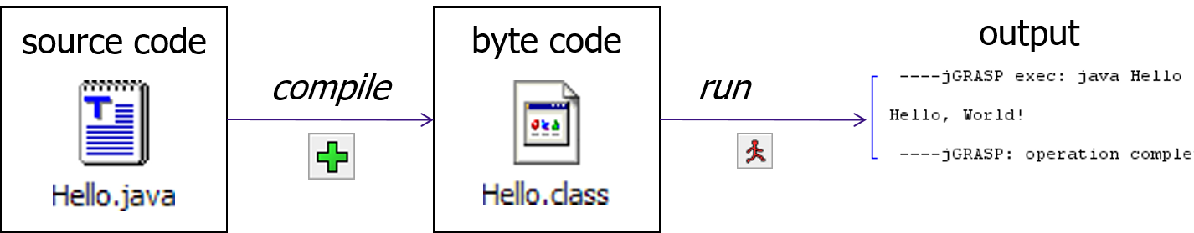
Compile/Run a Program (2 of 2)
Run (execute) it.
output: The messages printed to the user by a program.

Slide 12
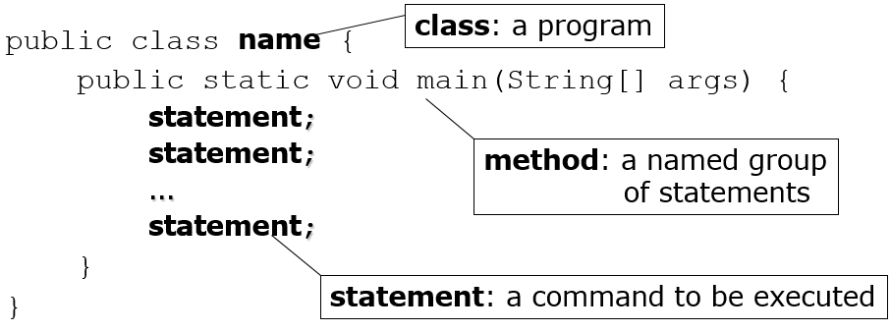
Structure of a Java Program
Every executable Java program consists of a class,
that contains methods (must have one named main),
that contains the statements (commands) to be executed.

Slide 13
Creating a class
You must give your program a name.
public class Hello {
public – indicates the class is available for anyone to use:
Naming convention: capitalize each word of class name (e.g. MyClassName)
Elements of the class are contained in curly brackets {}
Java requires the program’s file name must match class name exactly (Hello.java)
includes capitalization (Java is “case-sensitive”)

Slide 14
Creating a method
Methods start with keywords “public static”
They are followed by a type, which for now is always “void”
There must be at least one method named main.
Example:
public static void main(String[] args)
Code is contained in curly brackets { }

Slide 15
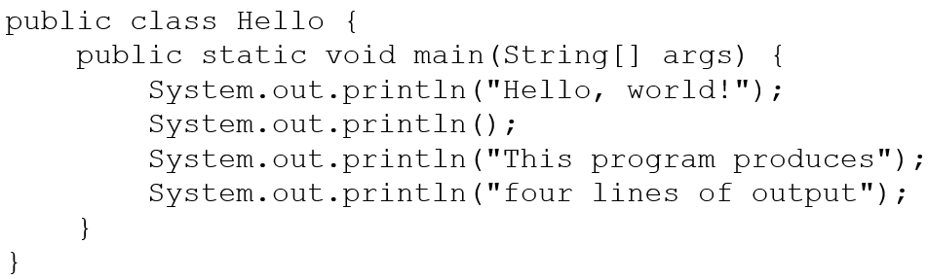
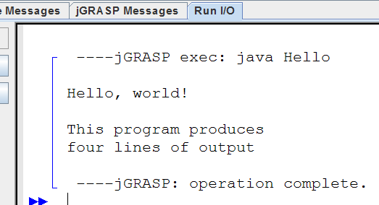
A Java Program
The output:
Hello, world! This program produce four lines of output
console: Text box into which the program’s output is printed.

Slide 16
Practice ICA, Part 1
Create the class Hello in BlueJ.
Type the code from the previous slide.
Change the second line of code to output a sentence with your first and last name.
Example output:
My name is Kyle Muldrow.

Slide 17
System.out.println
A statement that prints a line of output on the console.
pronounced “print-linn”
sometimes called a “println statement” for short
Two ways to use System.out.println :
System.out.println(“text”);
Prints the given message as output.
System.out.println();
Prints a blank line of output.

Slide 18
Syntax
syntax: The set of legal structures and commands that can be used in a particular language.
Every basic Java statement ends with a semicolon ;
The contents of a class or method occur between { and }
syntax error (compiler error): A problem in the structure of a program that causes the compiler to fail.
Missing semicolon
Too many or too few { } braces
Illegal identifier for class name
Class and file names do not match
...

Slide 19
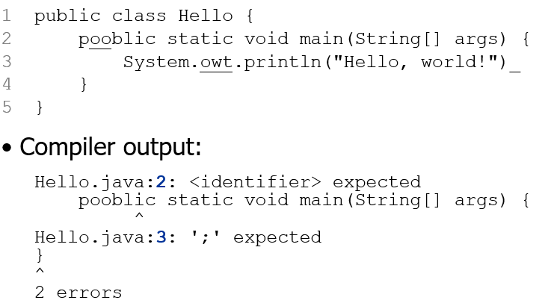
Syntax Error Example
The compiler shows the line number where it found the error.
The error messages can be tough to understand!

Slide 20

Strings (1 of 2)
string: A sequence of characters to be printed.
Also called a string literal
Starts and ends with a “ quote ” character.
The double quotes do not appear in the output.
Examples:

Slide 21

Strings (2 of 2)
Restrictions:
May not span multiple lines.
May not contain a “ character.
But what do you do if you want to output a double quote? You have to use…

Slide 22

Escape Sequences
escape sequence: A special sequence of characters used to represent certain special characters in a string.
\t tab character
\n new line character
\” quotation mark character
\\ backslash character
Example: System.out.println(“\\hello\nhow\tare “you\”?\\\\”);
Output:

Slide 23
Practice ICA, Part 2
Go back to the code for the Hello class in BluJ.
Change the last two lines of code to output the following:
A sentence that contains the last movie you saw with the movie title in quotation marks.
A sentence that contains a TV show you like to watch with the title in quotation marks.
Example output:
The last movie I saw was “Creed”.
I like to watch the TV show “Blue Bloods”.

Slide 24
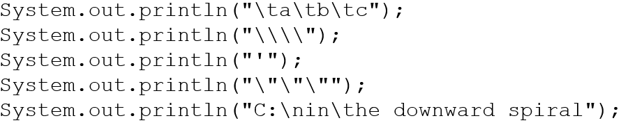
Questions 1
What is the output of the following println statements?
Write a println statement to produce this output:
/ \ // \\ /// \\\

Slide 25
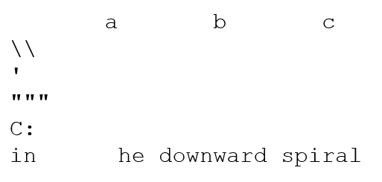
Answers 1
Output of each println statement:
println statement to produce the line of output:
System.out.println(“/ \\ // \\\\ /// \\\\\\”);

Slide 26
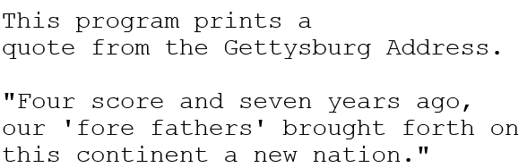
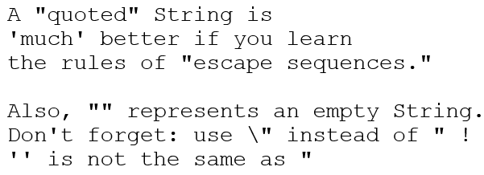
Questions 2
What println statements will generate this output?
What println statements will generate this output?

Slide 27
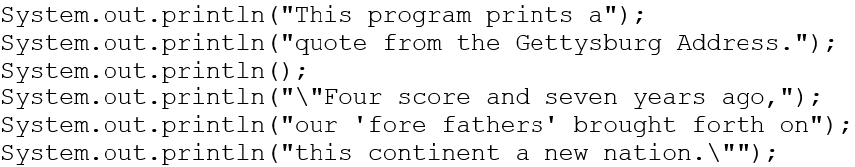
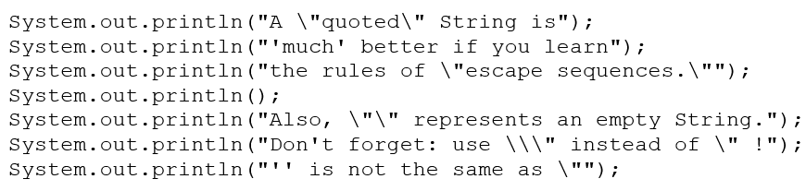
Answers 2
println statements to generate the output:
println statements to generate the output:

Slide 28
Identifiers
identifier: A name given to an item in your program.
must start with one of the following three characters:
A letter
An underscore ( _ )
A dollar sign ($)
subsequent characters can be any of those or a number
legal: _myName TheCure $bling$
illegal: me+u 49ers side-swipe Ph.D’s

Slide 29
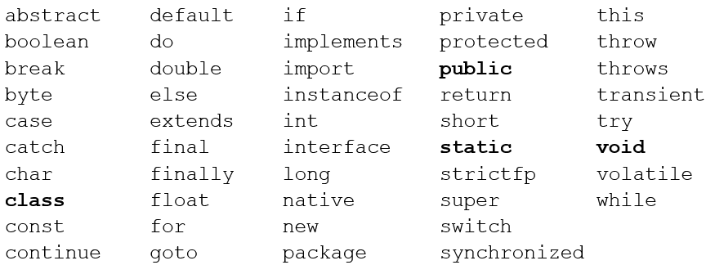
Keywords
keyword: An identifier that you cannot use because it already has a reserved meaning in Java.

Slide 30
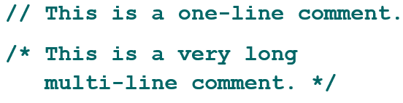
Comments
comment: A note written in source code by the programmer to describe or clarify the code.
Comments are not executed when your program runs.
Syntax:
// comment text, on one line or, /* comment text; may span multiple lines */
Examples:

Slide 31
Using Comments
Where to place comments:
at the top of each file (a “comment header”)
at the start of every method (seen later)
to explain complex pieces of code
Comments are useful for:
Understanding larger, more complex programs.
Multiple programmers working together, who must understand each other’s code.

Slide 32
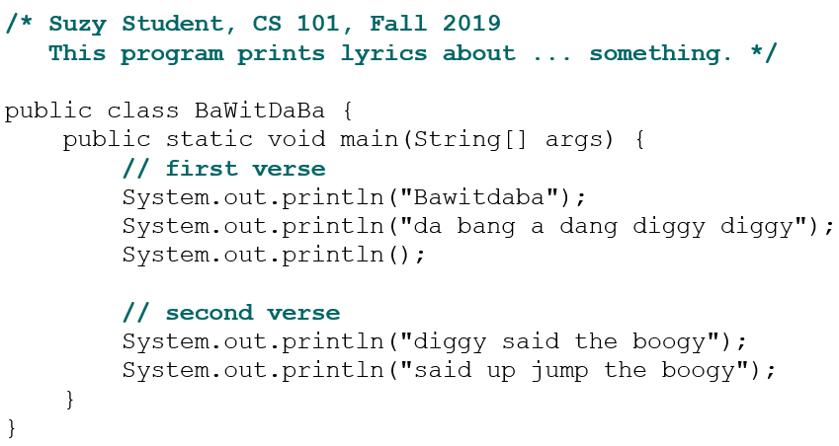
Comments Example

Slide 33
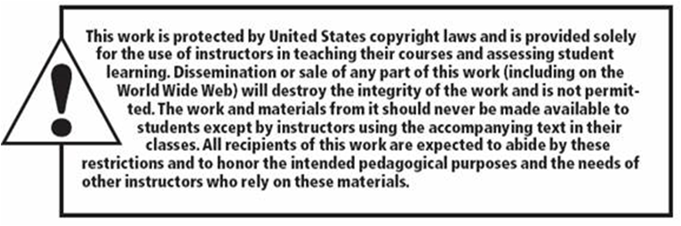
Copyright

