Slide 1
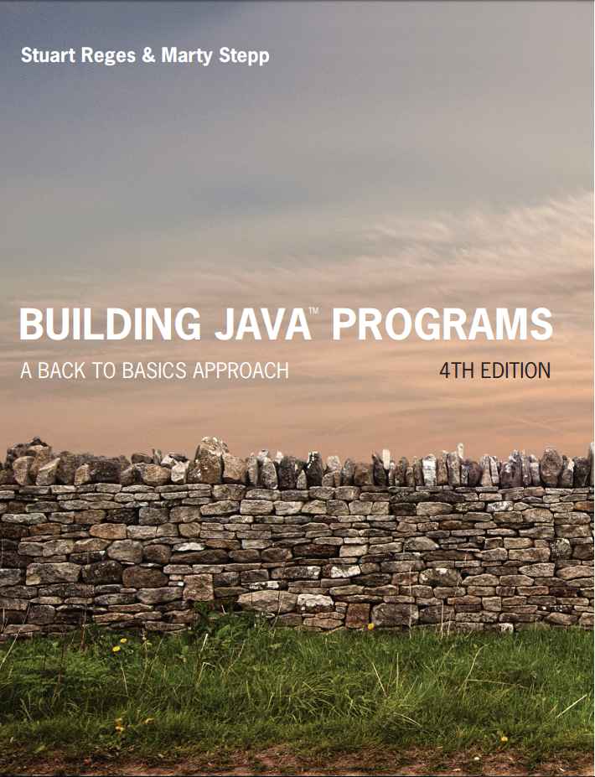
Building Java Programs
Fourth Edition
Chapter 1
Sections 3 and 4
Introduction to Java Programming
Copyright © 2017, 2014, 2011 Pearson Education, Inc. All Rights Reserved
Notes:
If this PowerPoint presentation contains mathematical equations, you may need to check that your computer has the following installed:
1) MathType Plugin
2) Math Player (free versions available)
3) NVDA Reader (free versions available)

Slide 2
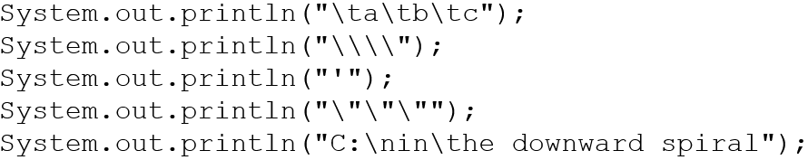
Questions 1
What is the output of the following println statements?
Write a println statement to produce this output:
/ \ // \\ /// \\\

Slide 3
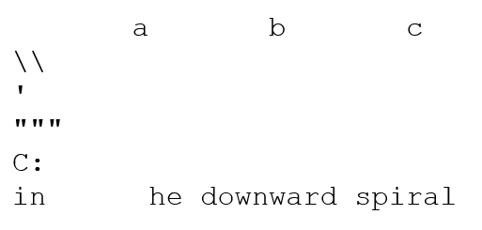
Answers 1
Output of each println statement:
println statement to produce the line of output:
System.out.println(“/ \\ // \\\\ /// \\\\\\”);

Slide 4
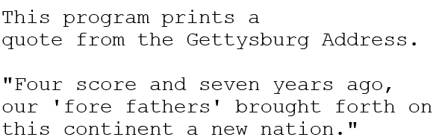
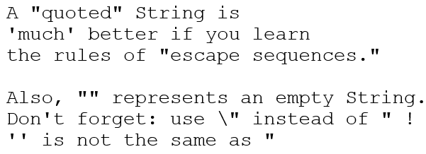
Questions 2
What println statements will generate this output?
What println statements will generate this output?

Slide 5
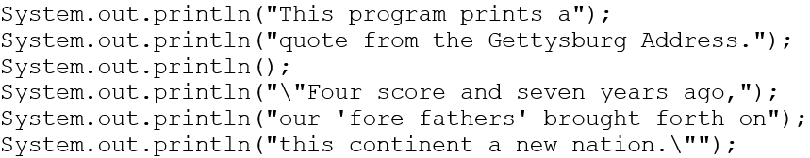
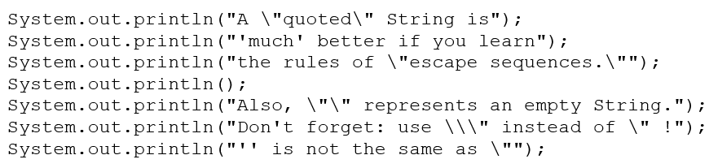
Answers 2
println statements to generate the output:
println statements to generate the output:

Slide 6
Identifiers
identifier: A name given to an item in your program.
must start with one of the following three characters:
A letter
An underscore ( _ )
A dollar sign ($)
subsequent characters can be any of those or a number
legal: _myName TheCure $bling$
illegal: me+u 49ers side-swipe Ph.D’s

Slide 7
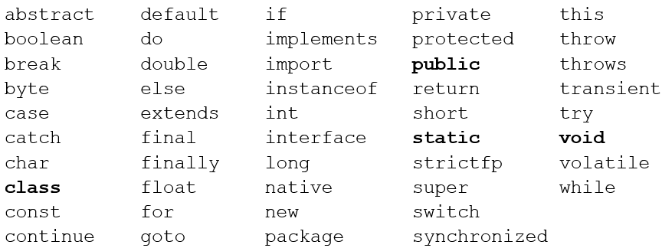
Keywords
keyword: An identifier that you cannot use because it already has a reserved meaning in Java.

Slide 8
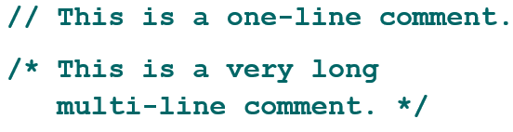
Comments
comment: A note written in source code by the programmer to describe or clarify the code.
Comments are not executed when your program runs.
Syntax:
// comment text, on one line or, /* comment text; may span multiple lines */
Examples:

Slide 9
Using Comments
Where to place comments:
at the top of each file (a “comment header”)
at the start of every method (seen later)
to explain complex pieces of code
Comments are useful for:
Understanding larger, more complex programs.
Multiple programmers working together, who must understand each other’s code.

Slide 10
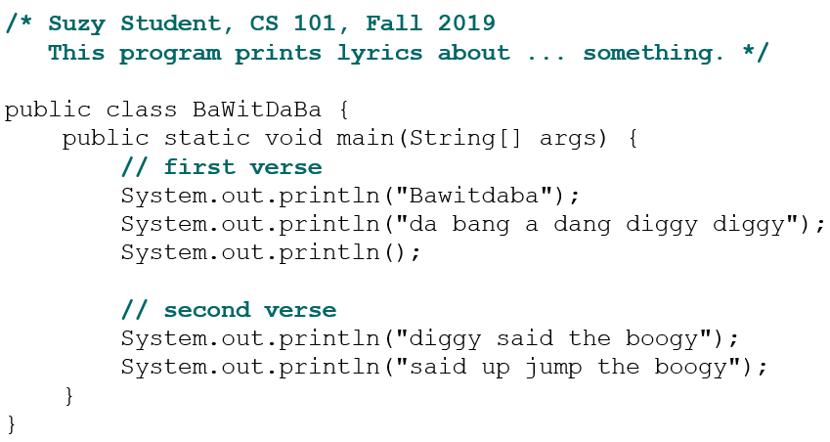
Comments Example

Slide 11
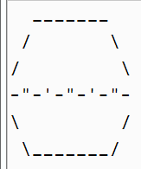
In-Class Assignment 1
Create a class in BlueJ named Egg.
Copy and past the contents of the CS21Comment Header at the beginning of you Java file and update the following:
Your first and last name after Author:
ICA1 after Assignment:
Egg after Name of Class:
Delete the rest
Write code that will create the following output:
Add single line comments that indicate where main ends, where the Egg class ends, and to any lines of code you feel need explaining.

Slide 12
Static methods

Slide 13
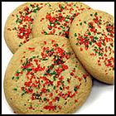
Algorithms
algorithm: A list of steps for solving a problem.
Example algorithm: “Bake sugar cookies”
Mix the dry ingredients.
Cream the butter and sugar.
Beat in the eggs.
Stir in the dry ingredients.
Set the oven temperature.
Set the timer.
Place the cookies into the oven.
Allow the cookies to bake.
Spread frosting and sprinkles onto the cookies.

Slide 14
Problems with Algorithms (1 of 2)
lack of structure: Many tiny steps; tough to remember.
redundancy: Consider making a double batch...
Mix the dry ingredients.
Cream the butter and sugar.
Beat in the eggs.
Stir in the dry ingredients.
Set the oven temperature.
Set the timer.
Place the first batch of cookies into the oven.
Allow the cookies to bake.

Slide 15
Problems with Algorithms (2 of 2)
Set the timer.
Place the second batch of cookies into the oven.
Allow the cookies to bake.
Mix ingredients for frosting.
...

Slide 16
Structured Algorithms (1 of 2)
structured algorithm: Split into coherent tasks.
1 Make the cookie batter.
Mix the dry ingredients.
Cream the butter and sugar.
Beat in the eggs.
Stir in the dry ingredients.
2 Bake the cookies.
Set the oven temperature.
Set the timer.

Slide 17
Structured Algorithms (2 of 2)
Place the cookies into the oven.
Allow the cookies to bake.
3 Add frosting and sprinkles.
Mix the ingredients for the frosting.
Spread frosting and sprinkles onto the cookies.
...

Slide 18
Removing Redundancy
A well-structured algorithm can describe repeated tasks with less redundancy.
1 Make the cookie batter.
Mix the dry ingredients.
...
2a Bake the cookies (first batch).
Set the oven temperature.
Set the timer.
...
2b Bake the cookies (second batch).
3 Decorate the cookies.
...

Slide 19
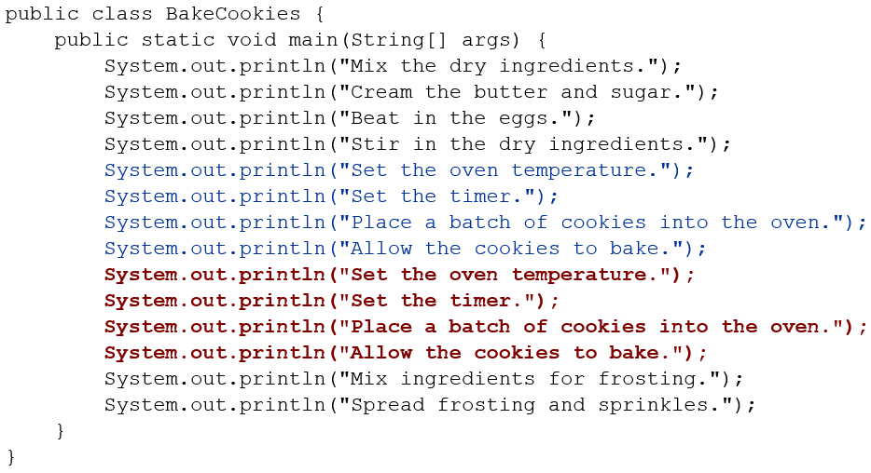
A program with Redundancy

Slide 20
Static Methods
static method: A named group of statements.
denotes the structure of a program
eliminates redundancy by code reuse
procedural decomposition: dividing a problem into methods
Writing a static method is like adding a new command to Java.
class
method A
statement
statement
statement
method B
statement
statement
method C
statement
statement
statement

Slide 21
Using Static Methods
1. Design the algorithm.
Look at the structure, and which commands are repeated.
Decide what are the important overall tasks.
2. Declare (write down) the methods.
Arrange statements into groups and give each group a name.
3. Call (run) the methods.
The program’s main method executes the other methods to perform the overall task.

Slide 22
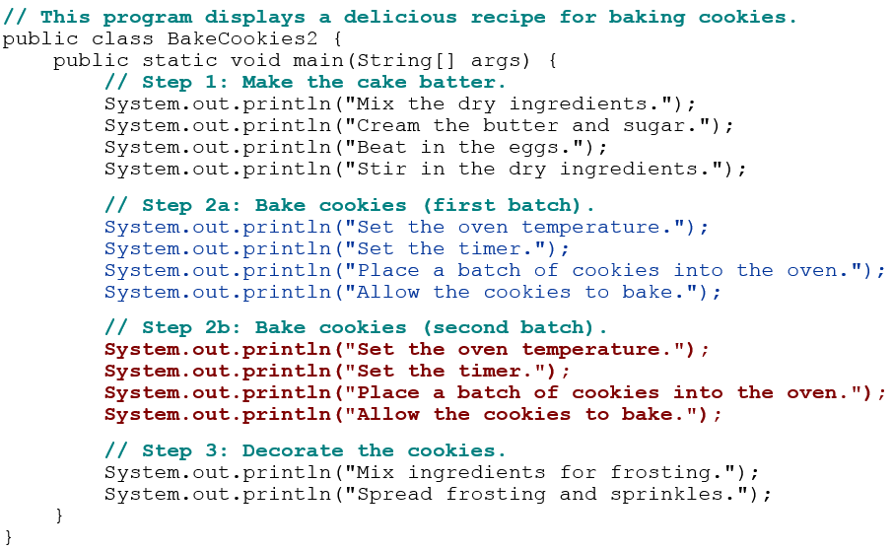
Design of an algorithm

Slide 23
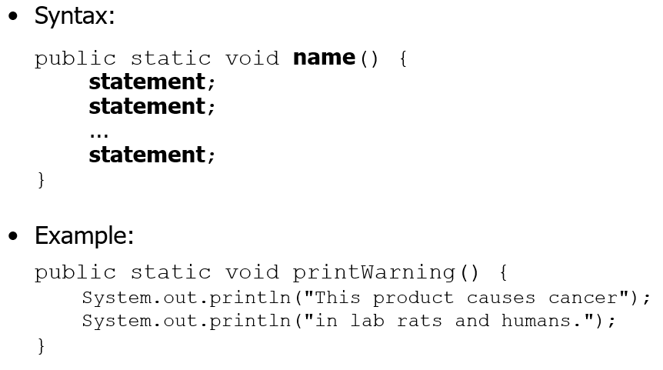
Declaring a Method
Gives your method a name so it can be executed

Slide 24
Calling a Method
Executes the method’s code
Syntax:
name();
You can call the same method many times if you like.
Example:
printWarning();
Output:
This product causes cancer
in lab rats and humans.

Slide 25
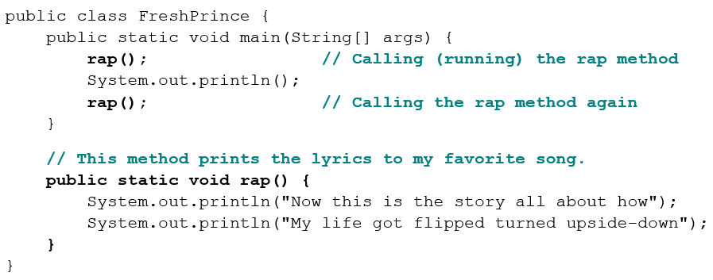
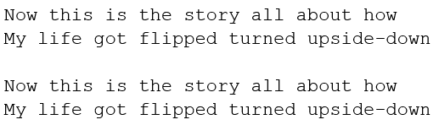
Program with Static Method
Output:

Slide 26
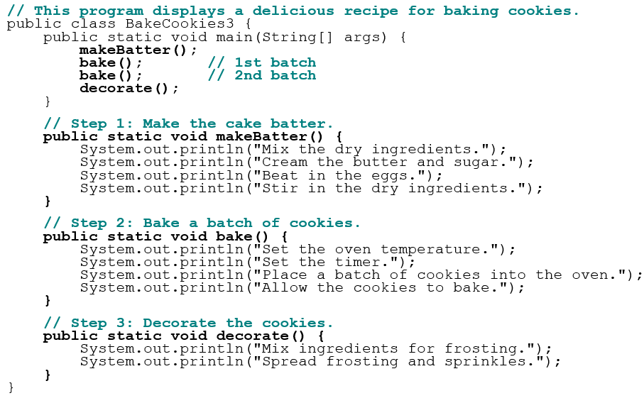
Final Cookie Program

Slide 27
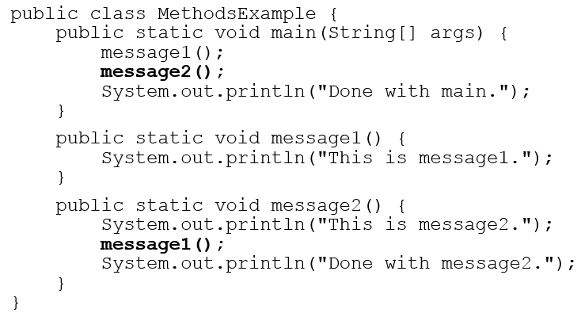
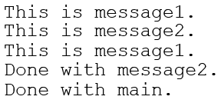
Methods Calling Methods
Output:

Slide 28
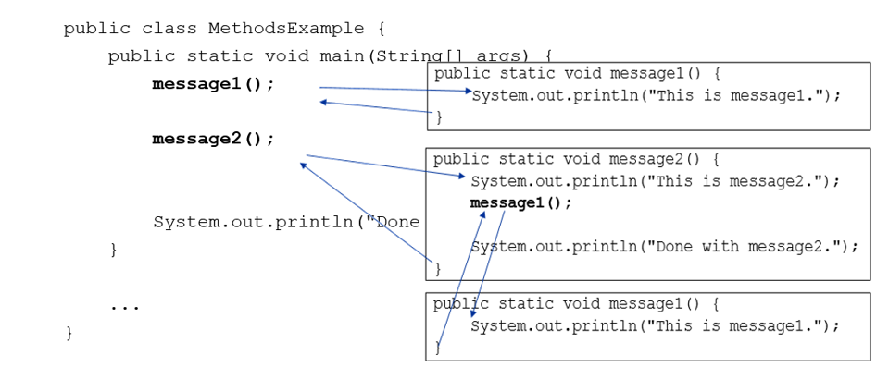
Control Flow
When a method is called, the program’s execution...
“jumps” into that method, executing its statements, then
“jumps” back to the point where the method was called.

Slide 29
When to use Methods
Place statements into a static method if:
The statements are related structurally, and/or
The statements are repeated.
You should not create static methods for:
An individual println statement.
Only blank lines. (Put blank printlns in main.)
Unrelated or weakly related statements. (Consider splitting them into two smaller methods.)

Slide 30
Drawing Complex Figures with Static Methods

Slide 31
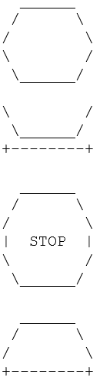
Static Methods Question
Write a program to print these figures using methods.

Slide 32
Development Strategy
First version (unstructured):
Create an empty program and main method.
Copy the expected output into it, surrounding each line with System.out.println syntax.
Run it to verify the output.

Slide 33
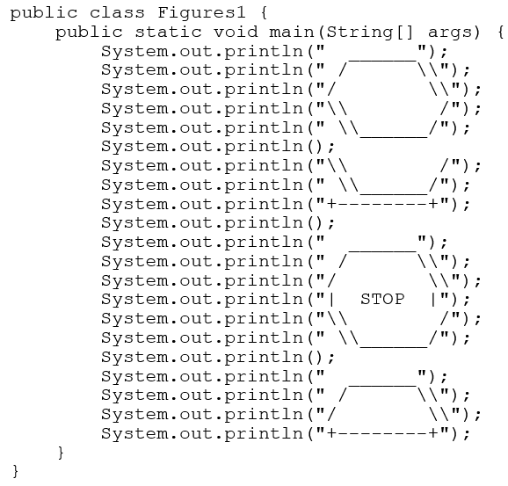
Program Version 1

Slide 34
Development Strategy 2
Second version (structured, with redundancy):
Identify the structure of the output.
Divide the main method into static methods based on this structure.

Slide 35
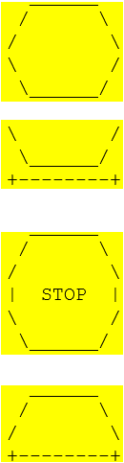
Output structure
The structure of the output:
initial “egg” figure
second “teacup” figure
third “stop sign” figure
fourth “hat” figure
This structure can be represented by methods:
egg
teaCup
stopSign
hat

Slide 36
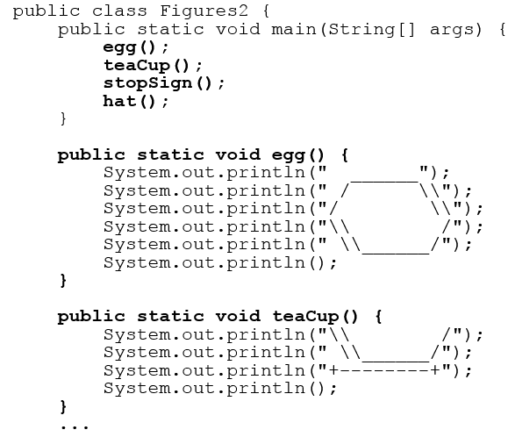
Program Version 2 (1 of 2)

Slide 37
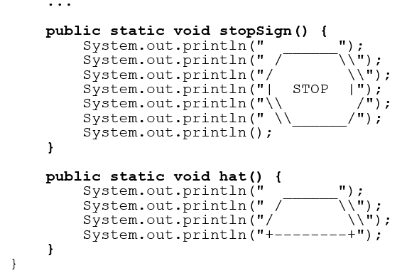
Program Version 2 (2 of 2)

Slide 38
Development Strategy 3
Third version (structured, without redundancy).
Identify redundancy in the output, and create methods to eliminate as much as possible.
Add comments to the program.

Slide 39
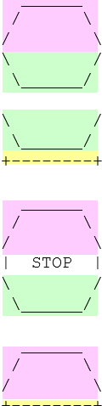
Output Redundancy
The redundancy in the output:
egg top: reused on stop sign, hat
egg bottom: reused on teacup, stop sign
divider line: used on teacup, hat
This redundancy can be fixed by methods:
eggTop
eggBottom
line

Slide 40
In-Class Assignment 2
Create a class in BluJ named EggStop.
Write code that draws the figures in the previous slide by doing the following:
In main(), call the following methods:
egg()
teaCup()
stopSign()
hat()
You will need to create methods named eggTop(), eggBottom(), and line() to do this.

Slide 41

Copyright

