Slide 1
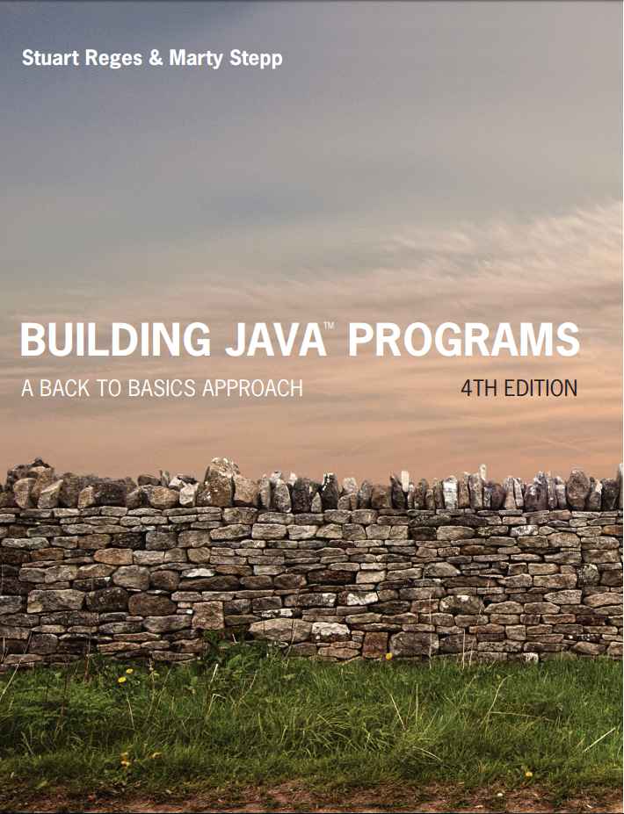
Building Java Programs
Fourth Edition
Chapter 2, Sections 3 and 4
Primitive Data and Definite Loops
Copyright © 2017, 2014, 2011 Pearson Education, Inc. All Rights Reserved
Notes:
If this PowerPoint presentation contains mathematical equations, you may need to check that your computer has the following installed:
1) MathType Plugin
2) Math Player (free versions available)
3) NVDA Reader (free versions available)

Slide 2
The for Loop

Slide 3
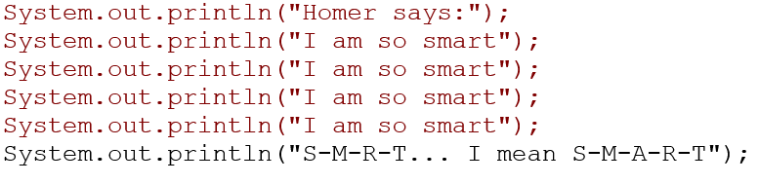
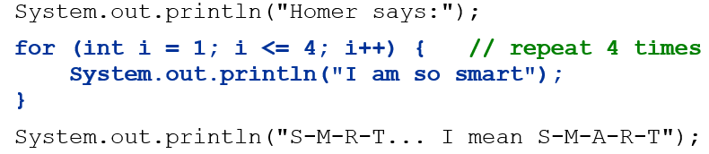
Repetition with for Loops
So far, repeating a statement is redundant:
Java’s for loop statement performs a task many times.
Notes:
also related to book exercise 1.10 about printing 1000 copies of "All work and no play makes Jack a dull boy"

Slide 4
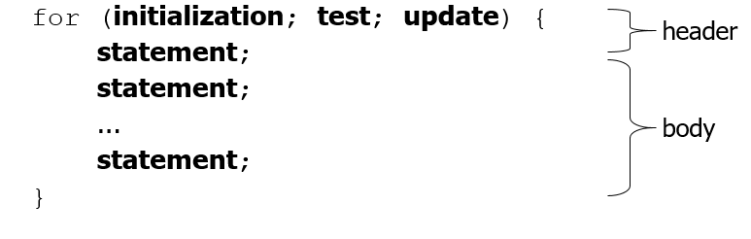
for Loop Syntax
Perform initialization once.
Repeat the following:
Check if the test is true. If not, stop.
Execute the statements.
Perform the update.

Slide 5
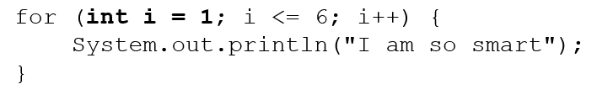
Initialization
Tells Java what variable to use in the loop
Performed once as the loop begins
The variable is called a loop counter
can use any name, not just i
can start at any value, not just 1

Slide 6
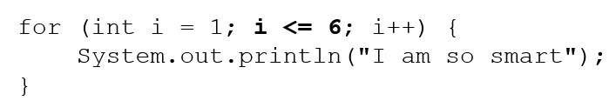
Test
Tests the loop counter variable against a limit
Uses comparison operators:
< less than
<= less than or equal to
> greater than
>= greater than or equal to

Slide 7
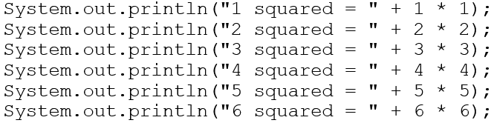
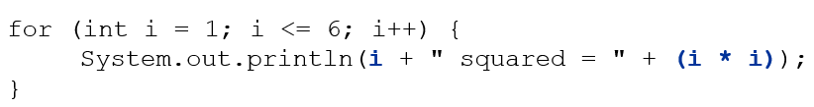
Repetition Over a Range
Intuition: “I want to print a line for each number from 1 to 6”
The for loop does exactly that!
“For each integer i from 1 through 6, print ...”

Slide 8
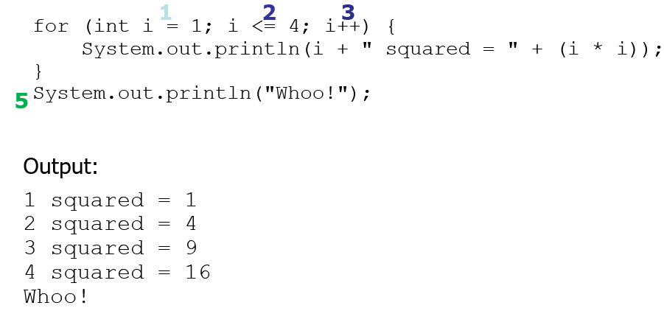
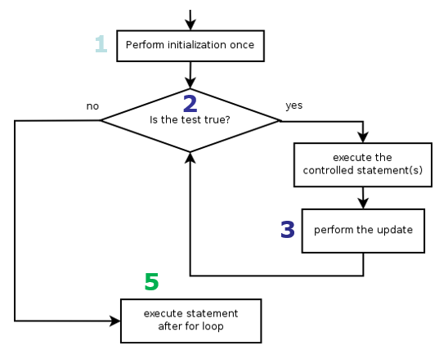
Loop Walkthrough

Slide 9
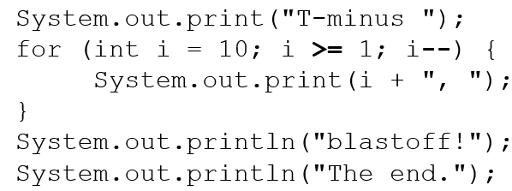
Counting Down
The update can use -- to make the loop count down.
The test must say > instead of <
Output:

Slide 10
In-Class Assignment 1, Part 1
Create the class Cubes in BlueJ
Use a for loop to output the cubes of each number from 1 to 7, one line at a time
After the loops end, add one more System.out.println to display your name, like this:
Author: Kyle Muldrow

Slide 11
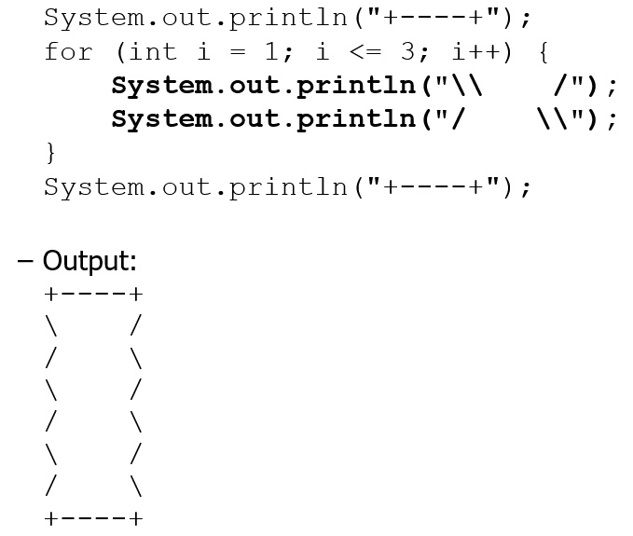
Multi-line Loop Body

Slide 12
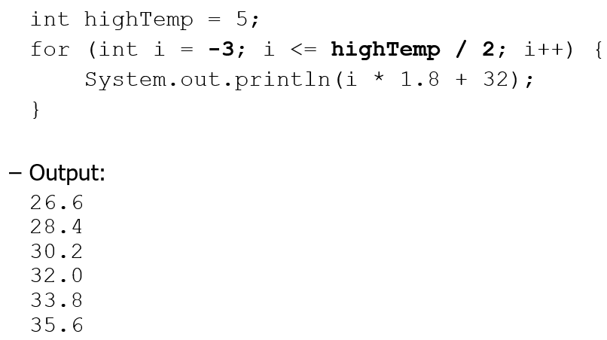
Expressions for Counter

Slide 13
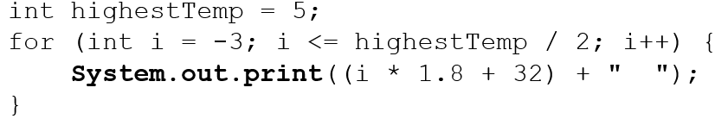
System.out.print
Prints without moving to a new line
allows you to print partial messages on the same line
Output:
Concatenate “” to separate the numbers

Slide 14
In-Class Assignment 1, Part 2
Use System.out.println to add a blank line of output after the math operations currently in class Cubes.
After the blank line and before the statement with your name, add a second loop to output the cubes of each number 7 to 1, all on the same line with one space between each value.

Slide 15
Nested for Loops

Slide 16
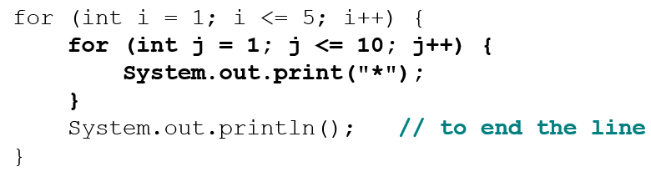

Nested Loops
nested loop: A loop placed inside another loop.
Output:
The outer loop repeats 5 times; the inner one 10 times.
“sets and reps” exercise analogy
Notes:
How would we print a multiplication table?
try printing each of the following inside the inner loop:
System.out.print(i + " ");
System.out.print(j + " ");
System.out.print((i * j) + " ");

Slide 17
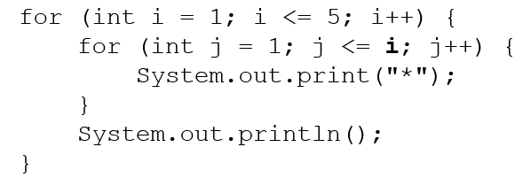
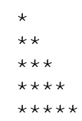
Nested for loop exercise 1
What is the output of the following nested for loops?
Output:

Slide 18
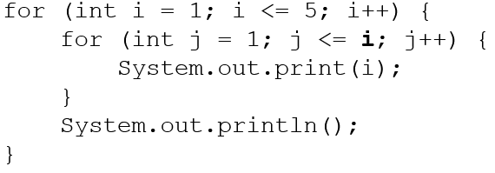

Nested for loop exercise 2
What is the output of the following nested for loops?
Output:

Slide 19
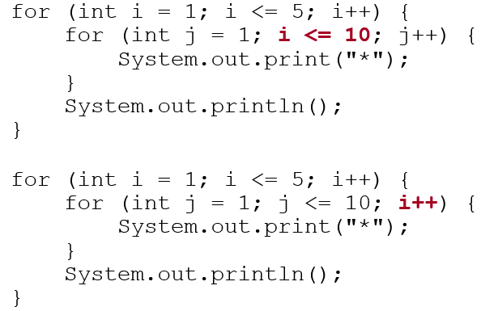
Common Errors
Both of the following sets of code produce infinite loops:
Notes:
Both cases produce infinite loops.

Slide 20
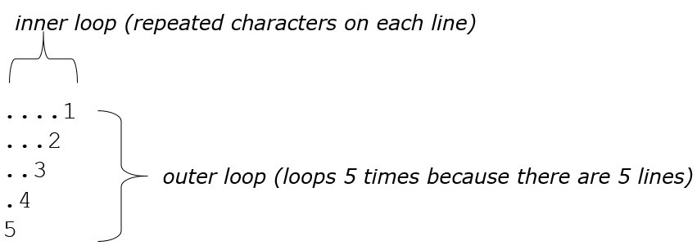
Complex Lines
What nested for loops produce the following output?
We must build multiple complex lines of output using:
an outer “vertical” loop for each of the lines
inner “horizontal” loop(s) for the patterns within each line

Slide 21
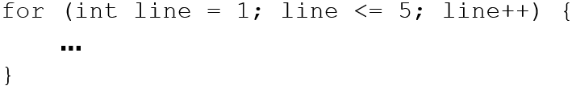
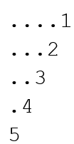
Outer and Inner Loop
First write the outer loop, from 1 to the number of lines.
Now look at the line contents. Each line has a pattern:
some dots (0 dots on the last line), then a number
Observation: the number of dots is related to the line number.

Slide 22
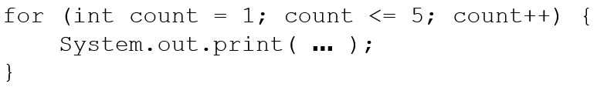
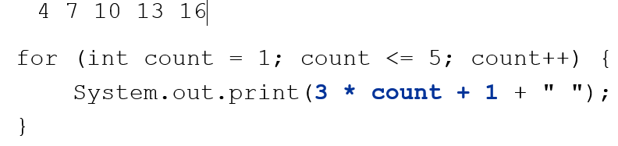
Mapping Loops to Numbers
What statement in the body would cause the loop to print:

Slide 23
Loop Tables
What statement in the body would cause the loop to print:
2 7 12 17 22
To see patterns, make a table of count and the numbers.
Each time count goes up by 1, the number should go up by 5.
But
is too great by 3, so we subtract 3.
Count | number to print
1 | 2 | 5 | 2
2 | 7 | 10 | 7
3 | 12 | 15 | 12
4 | 17 | 20 | 17
5 | 22 | 25 | 22

Slide 24
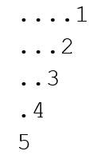
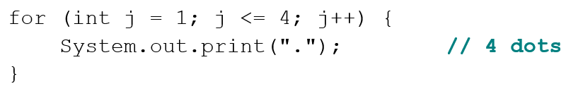
Nested for Loop Exercise
Make a table to represent any patterns on each line.
line | # of dots
1 | 4 | -1 | 4
2 | 3 | -2 | 3
3 | 2 | -3 | 2
4 | 1 | -4 | 1
5 | 0 | -5 | 0
To print a character multiple times, use a for loop.

Slide 25
In-Class Assignment 2, Part 1
In Blue J, create a class named NestedLoops to write the code for the program above.
You will need to determine how to set up the loop counters so that the output come out like this:

Slide 26
In-Class Assignment 2, Part 2
In the same NestedLoops class, output two blank lines after the previous output.
After the two blank lines, write code that gives the following output:
$$$1
$$22
$333
4444
You will need an outer loop for each line. Inside this outer loop, you will need to use two other loops. One of these loops will draw the dollar signs and the other will draw the numbers.

Slide 27

Copyright

