Slide 1
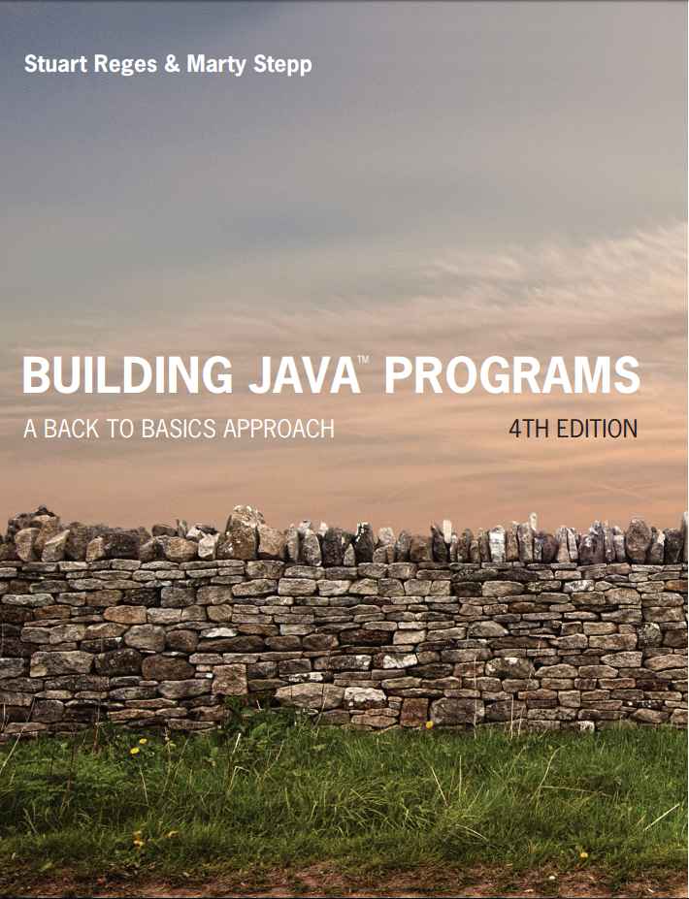
Building Java Programs
Fourth Edition
Chapter 2, Sections 3 and 4
Primitive Data and Definite Loops
Copyright © 2017, 2014, 2011 Pearson Education, Inc. All Rights Reserved
Notes:
If this PowerPoint presentation contains mathematical equations, you may need to check that your computer has the following installed:
1) MathType Plugin
2) Math Player (free versions available)
3) NVDA Reader (free versions available)

Slide 2
Managing Complexity

Slide 3
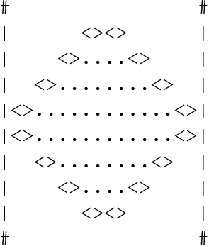
Drawing Complex Figures
Use nested for loops to produce the following output.
Why draw A S C I I art?
Real graphics require a lot of finesse
A S C I I art has complex patterns
Can focus on the algorithms

Slide 4
Development Strategy
Recommendations for managing complexity:
1. Design the program (think about steps or methods needed).
write an English description of steps required
use this description to decide the methods
2. Create a table of patterns of characters
use table to write your for loops

Slide 5
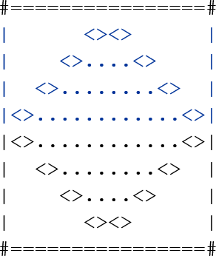
Pseudo-code Algorithm
1. Line
# , 16 =, #
2. Top half
|
spaces (decreasing)
<>
dots (increasing)
<>
spaces (same as above)
|
3. Bottom half (top half upside-down)
4. Line
# , 16 =, #

Slide 6
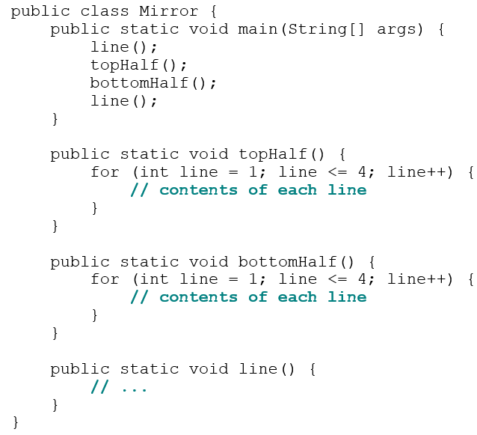
Methods from Pseudocode

Slide 7

2. Tables
A table for the top half:
Compute spaces and dots expressions from line number
line | spaces |  | dots
1 | 6 | 6 | 0 | 0
2 | 4 | 4 | 4 | 4
3 | 2 | 2 | 8 | 8
4 | 0 | 0 | 12 | 12

Slide 8
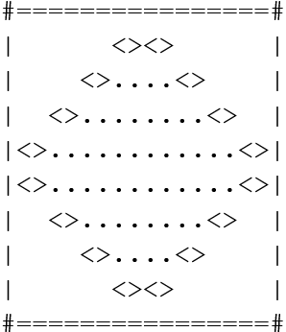
3. Writing the Code
Useful questions about the top half:
What methods? (think structure and redundancy)
Number of (nested) loops per line?

Slide 9
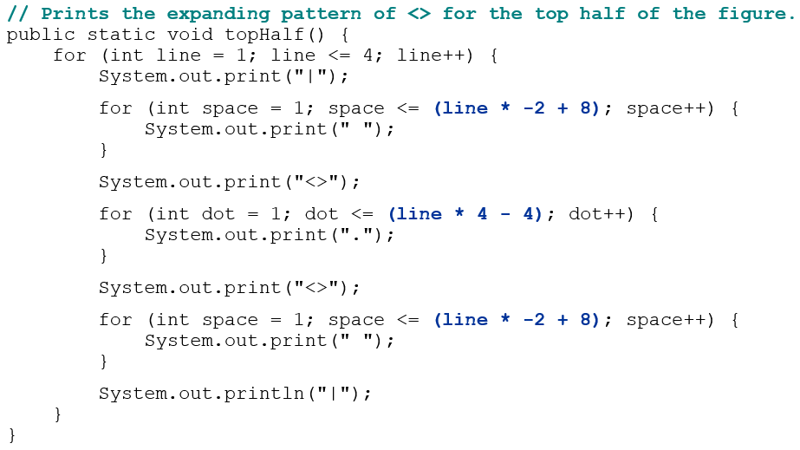
Partial Solution 1

Slide 10
In-Class Assignment 3, Part 1
In BlueJ, create a project named Mirror.
Type in the code in the previous slide for the topHalf() method.
Figure out what the code will look like for the bottomHalf() method, type it in, and run the program to get the correct output.

Slide 11
Class Constants and Scope

Slide 12
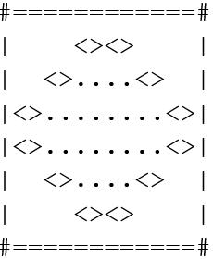
Scaling the Mirror
Let's modify our Mirror program so that it can scale.
The current mirror (left) is at size 4; the right is at size 3.
We’d like to structure the code so we can scale the figure by changing the code in just one place.

Slide 13
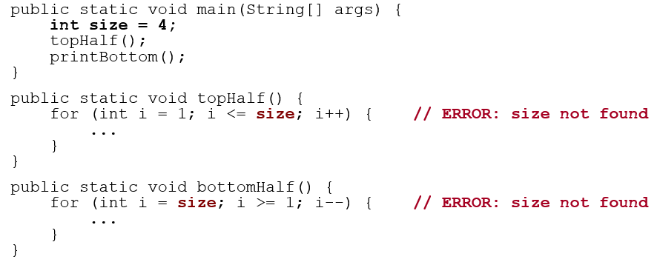
Limitations of Variables
Idea: Make a variable to represent the size.
Use the variable’s value in the methods.
Problem: A variable in one method can't be seen in others.

Slide 14
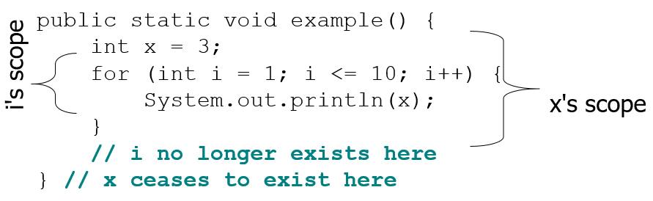
Scope
scope: The part of a program where a variable exists.
From its declaration to the end of the { } braces
A variable declared in a for loop exists only in that loop.
A variable declared in a method exists only in that method.

Slide 15
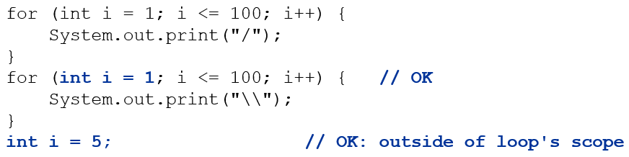
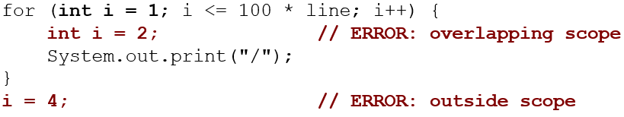
Scope Implications
Variables without overlapping scope can have same name.
A variable can’t be declared twice or used out of its scope.

Slide 16
Limitations of Variables
Idea: Make a variable to represent the size.
Use the variable’s value in the methods.
Problem: A variable in one method can't be seen in others.

Slide 17

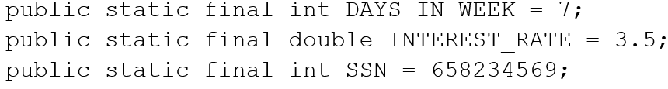
Class Constants
class constant: A fixed value visible to the whole program.
value can be set only at declaration; cannot be reassigned
Syntax:
Examples:

Slide 18
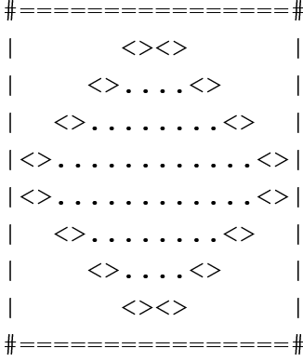
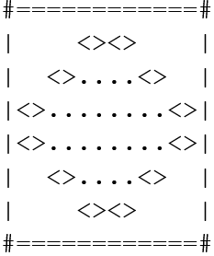
Complex Figure w/ Constant
Modify the Mirror code to be resizable using a constant.
A mirror of size 4:
A mirror of size 3:

Slide 19
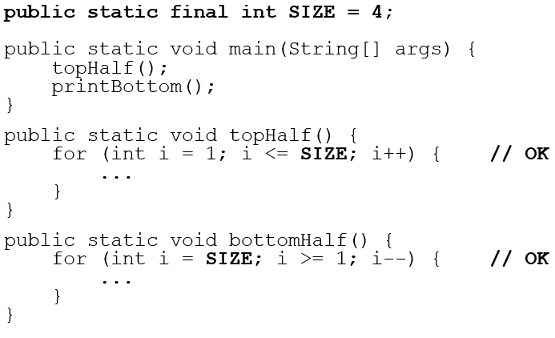
Using a Constant

Slide 20
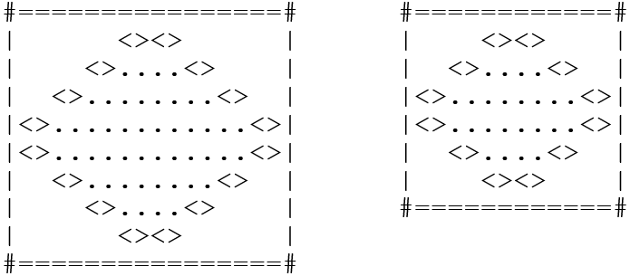
Loop Tables and Constant
Let’s modify our loop table to use SIZE
This can change the amount added in the loop expression
SIZE | line | spaces |  | dots
4 | 1,2,3,4 | 6,4,2,0 | -2 *line+8 | 0,4,8,12 | 4* line -4
3 | 1,2,3 | 4,2,0 | -2* line+6 | 0,4,8 | 4* line -4

Slide 21
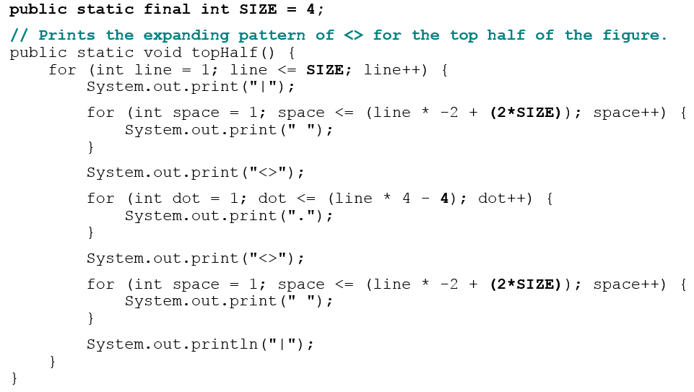
Partial Solution 2

Slide 22
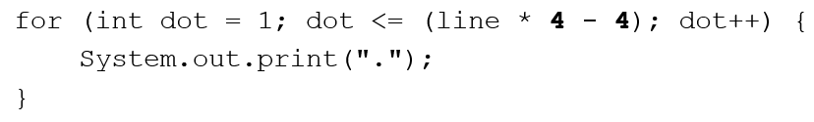
Loop Tables and Constant
Let’s modify our loop table to use SIZE
This can change the amount added in the loop expression
SIZE | line | spaces |  | dots
4 | 1,2,3,4 | 6,4,2,0 | -2 *line+8 | 0,4,8,12 | 4* line -4
3 | 1,2,3 | 4,2,0 | -2* line+6 | 0,4,8 | 4* line -4

Slide 23
Partial Solution 2

Slide 24
In-Class Assignment 3, Part 2
Update the bottomHalf() method to use the SIZE constant
Verify the code works when SIZE is 4.
Change the value of SIZE to 3 and verify that it works.
Submit the code and both outputs.

Slide 25
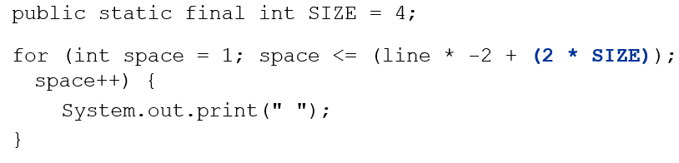
Observations About Constant
The constant can change the “intercept” in an expression.
Usually the “slope” is unchanged.
It doesn’t replace every occurrence of the original value.

Slide 26

Copyright

